Slide 1
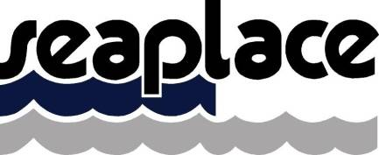
Reduced Draft Spar (RDS) Floating Offshore Wind Turbines A Market Opportunity
Pedro López
pvizcayno@seaplace.es
Offshore Engineering & Ship Design
www.seaplace.es
seaplace@seaplace.es

Slide 2
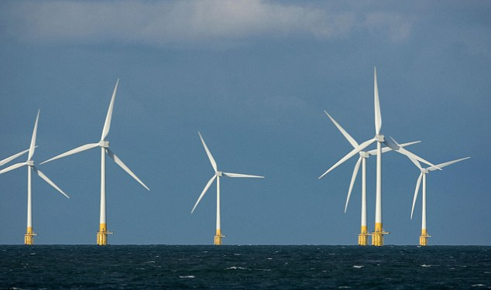
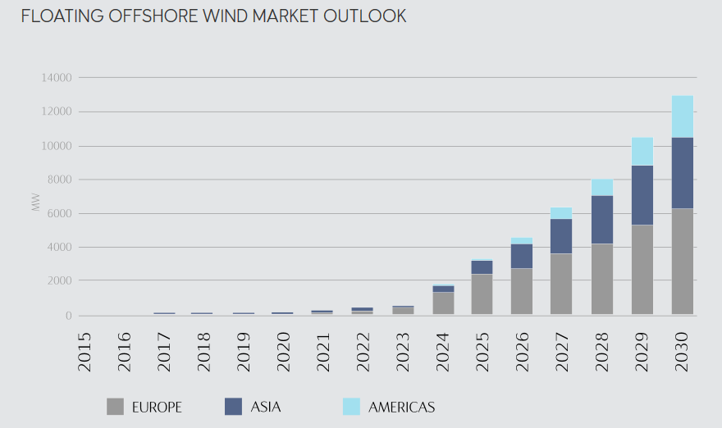
RDS Floating Offshore Wind Turbine
600.000 MW already installed onshore / offshore worldwide
20.000 MW installed fix offshore wind
30 MW installed floating offshore wind
14 GW in 2030
14.000 MW Floating in 2030 - 35.000 MM€

Slide 3
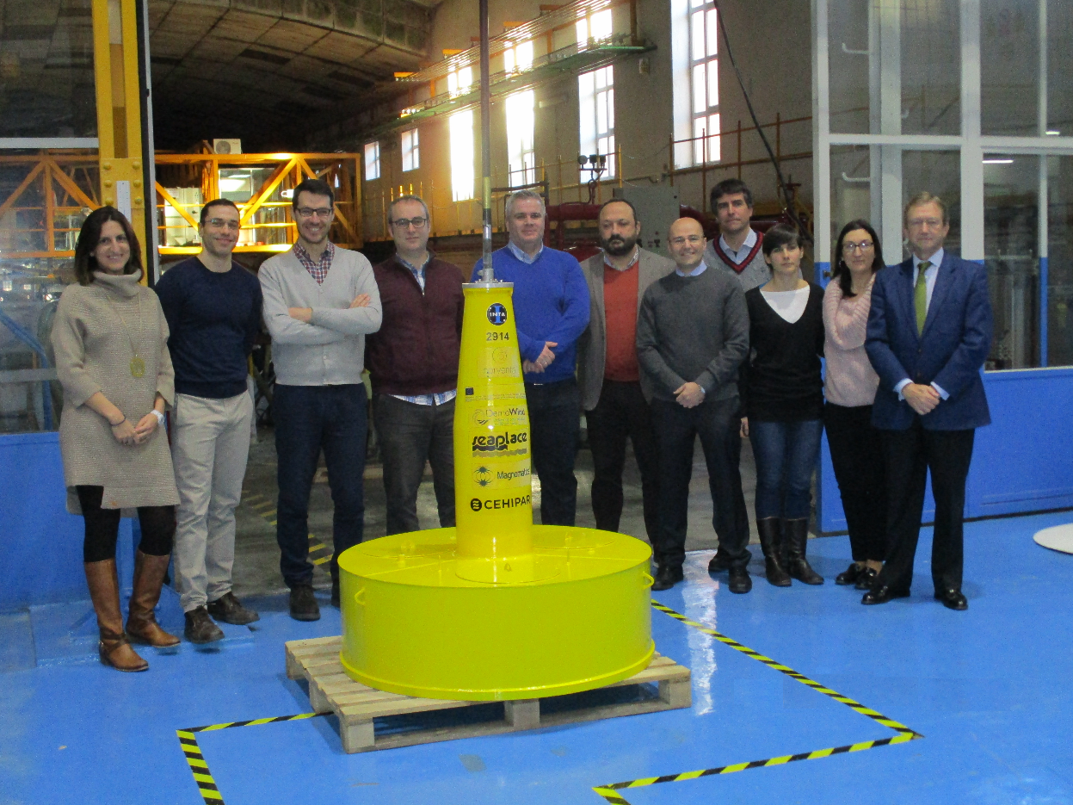
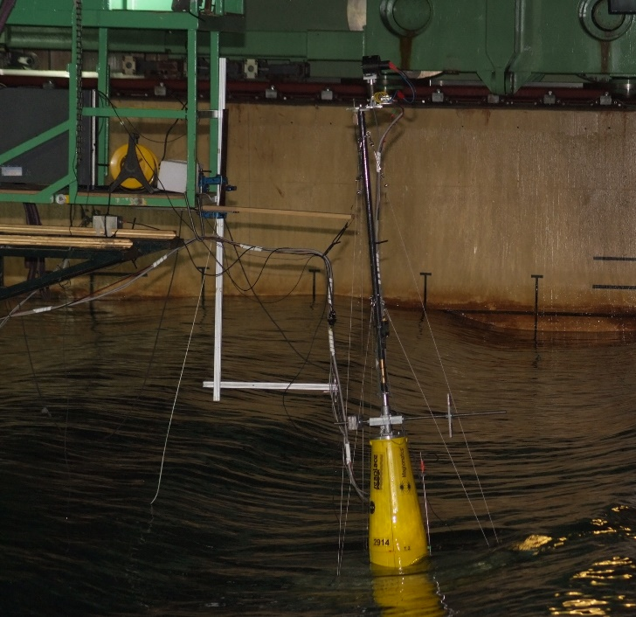
RDS Floating Offshore Wind Turbine

Slide 4
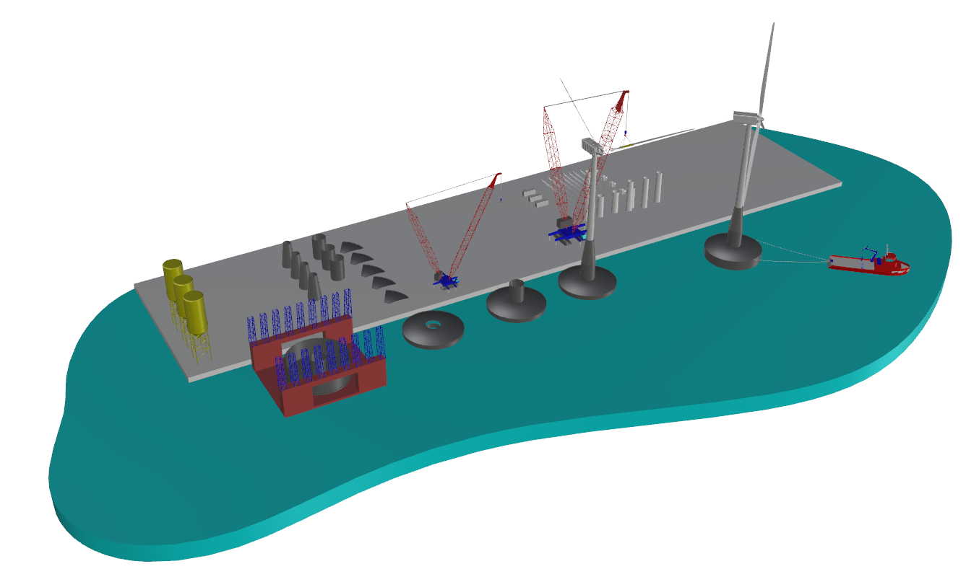
RDS Floating Offshore Wind Turbine
Fast-track construction
Serial construction
Scalable solution
Reduced installation cost & risk
Concrete price stable over time
 | Manufacture | Onshore turbine assembly | Major Repair | CAPEX savings 5 units | CAPEX savings 80 units
RDS
Spar |  |  |  | 21% | 28%
Semi |  |  |  | 8% | 15%

Slide 5
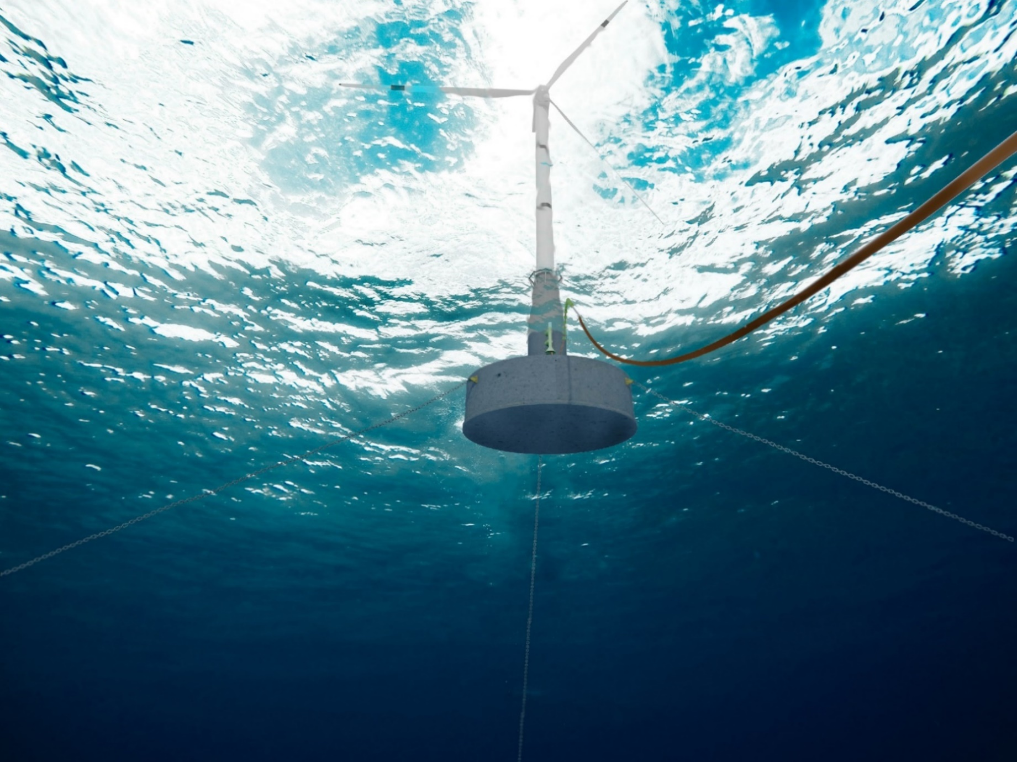
RDS Floating Offshore Wind Turbine
Short-Term Target:
10-12 MW Pre-commercial unit in 2 years
Investment of 2 MM€
On-going contacts with potential clients, shareholders and OEMs
Medium-Term Target:
7% of the European market valued in 700+ MM€
Contact:
Pedro Lopez
pvizcayno@seaplace.es
Santiago de Guzmán
sguzman@seaplace.es
Offshore Engineering & Ship Design

Slide 6
RDS Floating Offshore Wind Turbine
Contact:
Pedro Lopez
pvizcayno@seaplace.es
Santiago de Guzmán
sguzman@seaplace.es
Offshore Engineering & Ship Design

Slide 7
RDS Floating Offshore Wind Turbine
CAPEX savings
The CAPEX of the RDS concept has been compared with spars and semis made of steel
A significant reduction of CAPEX is found. The savings come from:
The use of concrete reduce manufacturing time and cost
The Transport & Installation is simplified to a tow & hook-up operation
 | CAPEX SAVINGS (WT excluded)
WIND FARM SIZE | Prototype (1 unit) | Pre-commercial (5 units) | Commercial (80 units)
RDS Vs SEMI | 3% | 8% / 6.5 MM€ | 15% / 210 MM€
RDS Vs SPAR | 18% | 21% / 20 MM€ | 28% / 470 MM€

Slide 8
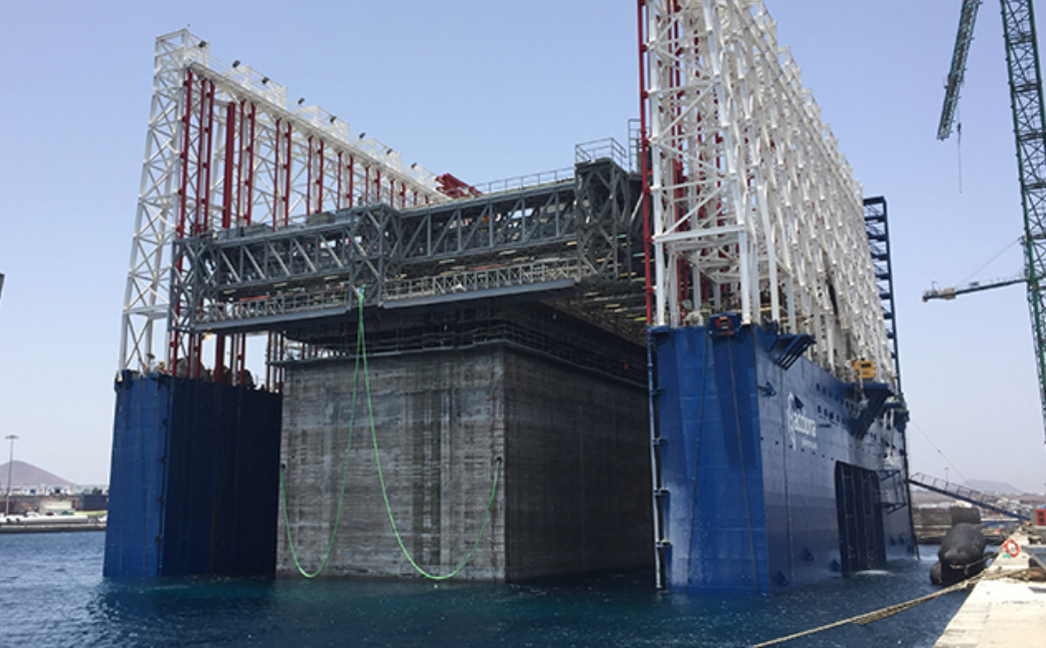
RDS Floating Offshore Wind Turbine
Construction savings

Slide 9
RDS Floating Offshore Wind Turbine
 | Structure Manufacture | Onshore turbine assembly | Seakeeping in high seas | Marine Operations | Major Repair | Draft requirement | CAPEX savings 5 units | CAPEX savings 80 units
RDS
Spar |  |  |  |  |  |  | 21% | 28%
Semi |  |  |  |  |  |  | 8% | 15%

