Slide 1
Pilot Blue Cloud Workshop
Michele Fichaut (SeaDataCloud coordinator)
Dick Schaap (SeaDataCloud technical coordinator)
and the SeaDataCloud consortium
presented by Gilbert Maudire (Ifremer – France)

Slide 2
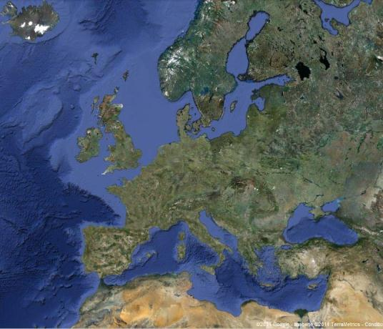
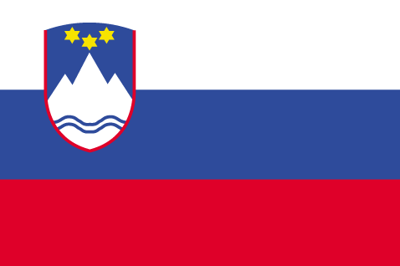
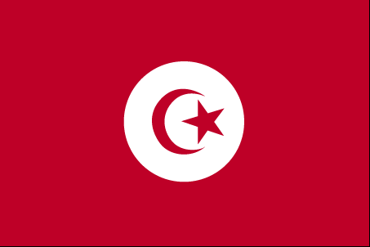
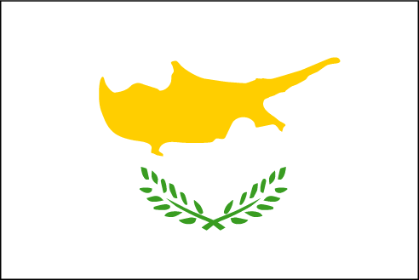

What is SeaDataNet?
A pan-European infrastructure set up and operated for managing marine and ocean data in cooperation with the NODCs and data focal points of 34 countries bordering the European seas
90s | Metadata directories Medar/MedAtlas
2002-2005 | Sea-Search (FP5)
2006-2011 | SeaDataNet (FP6)
2011-2015 | SeaDataNet II (FP7)
2016-2020 | SeaDataCloud (H2020)

Slide 3
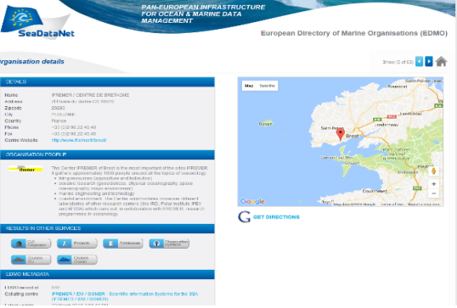
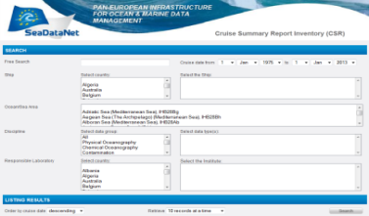
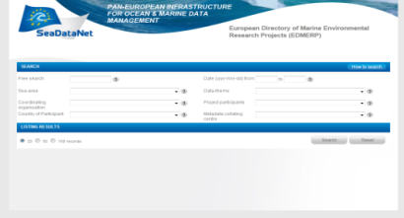
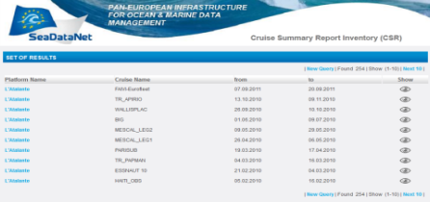
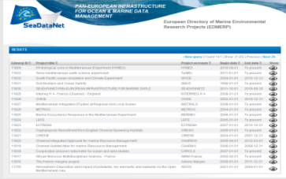
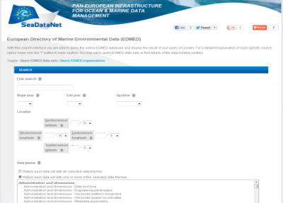
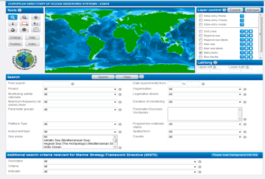
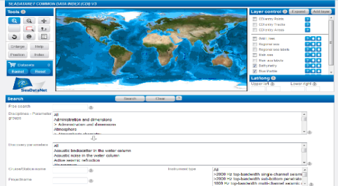
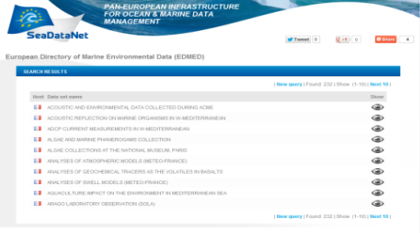
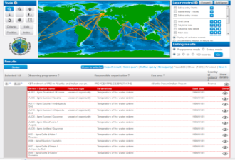
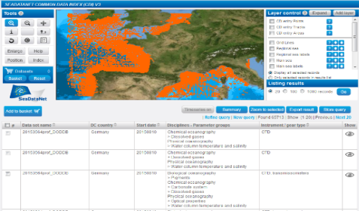
SeaDataNet metadata directories
EDMO
Organisations
CSR
EDMERP
Research cruises
Projects
EDIOS
EDMED
Observing programmes
CDI
Data index
Data sets
+ Common Vocabularies : parameters, instruments, platforms…
approx. 100 lists continuously maintained by groups of experts

Slide 4
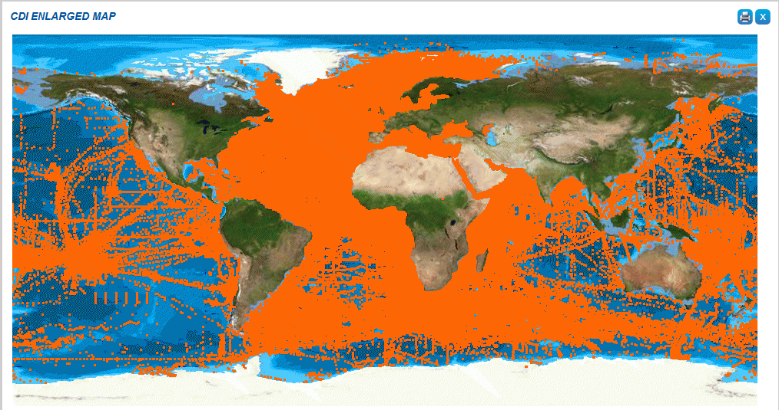
Discovery and unified data access
+1.95 million CDI entries from 34 countries, 102 data centres and 597 originators for physics, chemistry, geology, geophysics, bathymetry and biology; from 1805 to 2017; 86% unrestricted or under SDN License

Slide 5
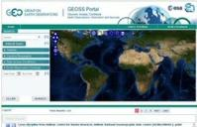
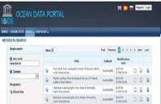
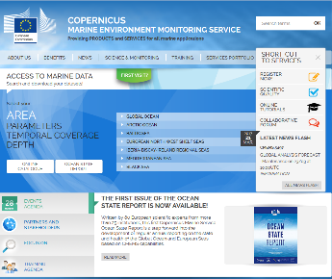


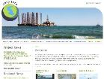
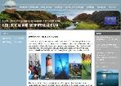



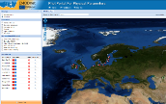
Total collection
GEOSS portal
IODE ODP portal
Copernicus MEMS
Aggregated collection
Data discovery
and access
Black Sea portal
Caspian portal
Geo-Seas portal
Regional subsets
> 100 data centres
Bathymetry
Thematic portals
NODCs; HOs; GEOs; BIOs; ICES
Physics
Chemistry
≈ 600 European data originators
General context
Geology
Biology

Slide 6
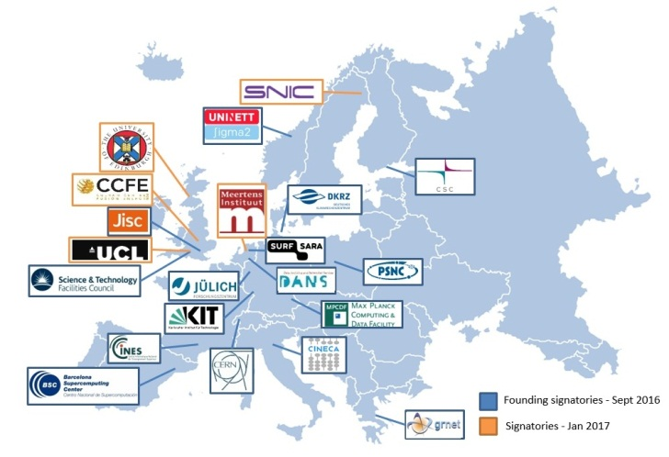
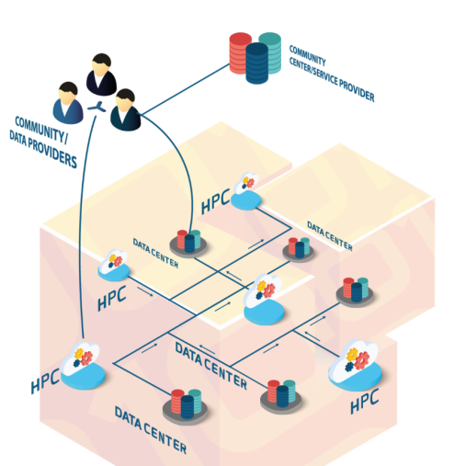
SeaDataCloud - Cooperation with EUDAT
A consortium of 20 High Performance Computing (HPC) centres offering also storage resources (5 EUDAT members are partners of SeaDataCloud)
With the objectives to:
- Set up a “centralized” copy of the distributed datasets (“technical cache”)
to improve the efficiency (response time…) of provided data services (data access, subsetting)
- Provide more advanced services within a “Virtual Research Environment”
online visualization, data processing (geostatistical analyses, …)

Slide 7
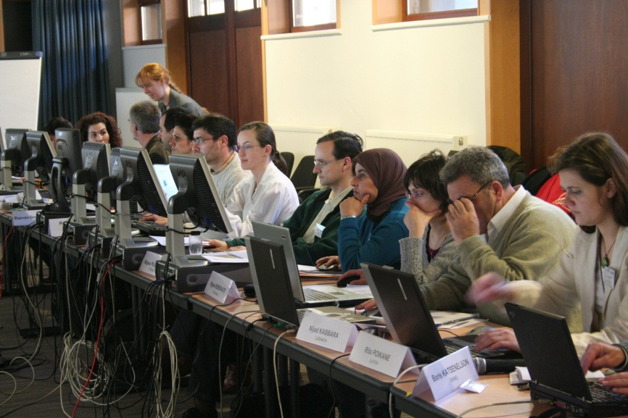
SeaDataCloud – Training sessions
IOC/IODE is a member of the SeaDataCloud consortium for the:
  Organisation and the hosting of the training sessions for data managers and technicians as well as for users of the SeaDataNet infrastructure
  Integration of the training material in the Ocean Teacher System
  Cooperation for the organisation of 2 IMDIS conferences that will be hold during the project in 2018 and 2020

