Slide 1
Project title
Tourism 4.0 for the Black Sea
Speaker’s name
Mamuka Berdzenishvili
Tourism Institute
Georgia
28 June 2023

Slide 2
Tourism in Georgia
National indicators | 2012 | 2019
International visitors | 4.8 million | 9.4 million
Tourism receipts | 1.4 bl. UDS | 3.3 bl. UDS
Growth | 95%

Slide 3
Catching up
with drastic development
Lack of:
Sustainable practices
Digital solutions
(Big) Data Analytics
(Destination) Management

Slide 4
About the project T4BS
Overview
Project is co-funded by the European Commission
Consortium of 6 partner organizations from Slovenia, Greece, Romania, Ukraine and Georgia
Duration: 2019 – 2021
General objective and aims
Demonstrate to regional stakeholders the benefits of Big Data Analytics
Foster the commercialization of HPDA tools in tourism
Test a set of concrete (Blue) Tourism 4.0 (HPDA) services in the Black Sea region
Stimulate (policy) dialogue on Tourism 4.0 potentials with regional and EU stakeholders

Slide 5
Key Results and Next Steps
Main results related to the thematic of the session
With innovative co-creation and technology bring into tourism data-driven strategic thinking.
Opportunities for future cooperation in the Black Sea, especially in the post-covid19 era
Providing competent and quick response of local governments with the use of big data.

Slide 6
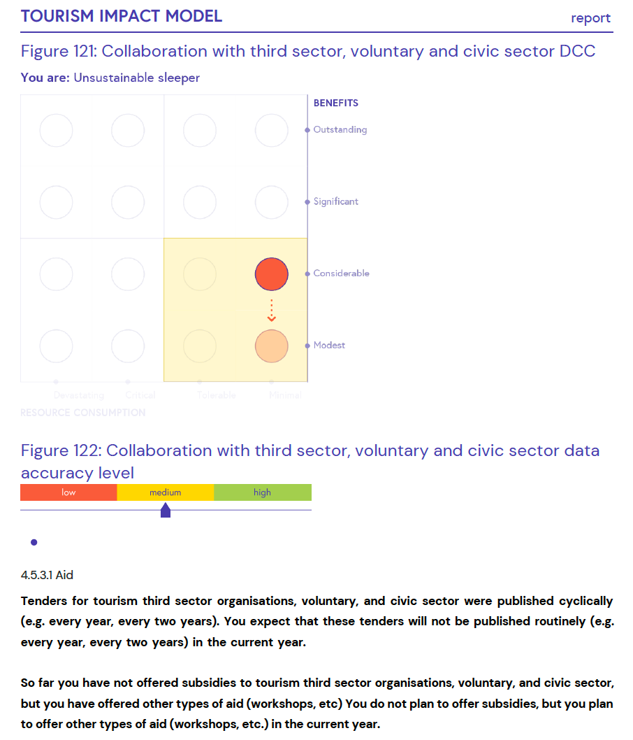
… in our local perspective
Lack of data on a city or municipality level.
Local governments rarely use the data for strategic planning and decision making.

Slide 7
Importance of
continuous fundings
for this kind of projects
Basis for development of a universal, digitally based approach for assessing the sustainable impact of tourism in the Black Sea
Use of our analysis in other projects (for ex. Maritime transportation, Aquaculture etc.)
#Tourism
#DataDrivenStrategicThinking
#GreenTransition
#Digitalisation
#Data

Slide 8
Thank you for your attention!
Mamuka Berdzenishvili
mamukabe@gmail.com
tourisminstitute.ge
www.t4bs.eu
www.facebook.com/tourism4bs
www.twitter.com/Tourism4BSea
www.linkedin.com/showcase/tourism4bs
We want you!
Become a member of
Tourism 4.0 Partnership
Sign up:
www.tourism4-0.org/en/join-us/

