Slide 1
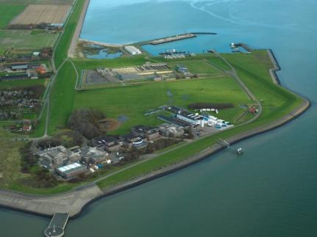
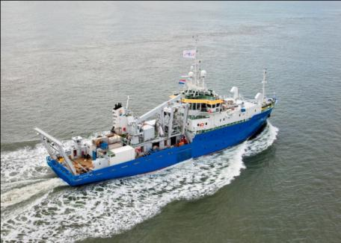
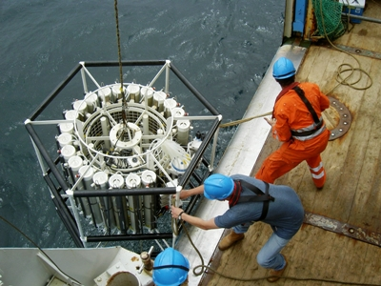
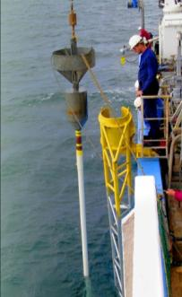
The National Oceanographic Institute of The Netherlands
Royal Netherlands Institute for Sea Research
An Institute of
supported by

Slide 2
NIOZ SCIENCE: 4 departments 2 locations
each with their specific missions
Coastal Systems (COS)
Marine Microbiology and Biogeochemistry (MMB)
Ocean Systems (OCS)

Slide 3
other NIOZ stakeholders
Other national academic partners
(RUG, VUA, UvA, TUD)
GEO
BETA
LAW
HUM
SOC
National applied research institutions
(TNO, Deltares, etc)
MMB
COS
EDS
OCS
International,
EU partners
(AWI, MARUM, NOC)
Ministries
Industry
NGOs
NIOZ-UU-NWO cooperation
DIRECTED TOWARDS LONG TERM DEVELOPMENT NL MARINE SCIENCES

Slide 4
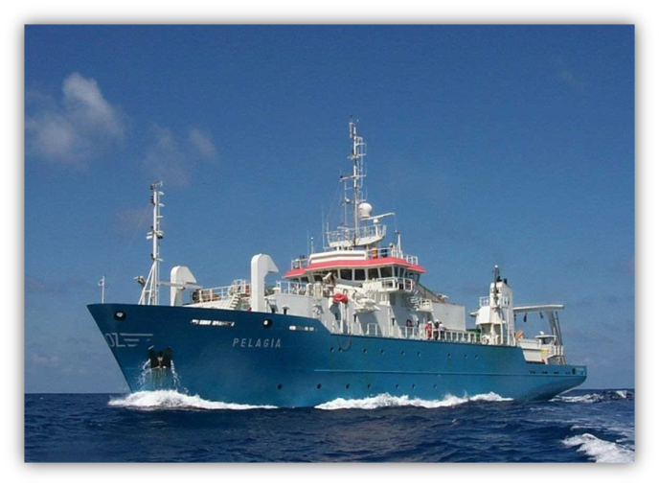
Mission Blue Planet
Oceans under pressure: the deadly trio: effects of climate change, overfishing and pollution
Oceans as source: sustainable exploitation food, energy, minerals and other resources
NIOZ: unique role in NL en EU marine research: Blue Growth
Knowledge, infrastructure (MRF) with support
Coordination of marine sciences and maritime research
National Maritime Scientific ‘Hub’
Advanced development of marine science for frontier-applications
excellent marine research for society

Slide 5
Mission Blue Planet
Global warming has far-reaching implications on the oceans. What science is needed first and foremost to help us manage our oceans and coasts in a way that helps mitigate the effects of climate change – or to cope with those effects?
Population growth and the rising expectations of developing and emerging economies mean that the demand for food, energy and other basic goods will continue to rise exponentially. How could future marine science contribute best to the challenge of feeding and sustaining a growing world population?
'blue economy' may have a higher potential for innovation and economic development than most other sectors of our economy. How could future science and innovation enable us to utilise our oceans' rich resources in a sustainable manner and yet achieve economic growth?
European Academy of Science's report on Sustainability in an age of changing seas and oceans. Do you agree with its recommendations?
excellent marine research for society

Slide 6
Mission Blue Planet
NIOZ: main research thrusts:
Fundamental, multidisciplinary process-oriented marine research
‘Building with Nature’ – fundamentals & delta technology
Dynamic sea level & spatial ecosystem-physical responses
Innovations in spatial ecological monitoring
High CO2 studies, calcification
Algal biomass (seaweed) fundamentals & culturing
Role of micro-organisms (microbiology, incl. viruses) (microplastics)
Deep sea resources and ecology
Blue energy, e.g., tidal energy
excellent marine research for society

Slide 7
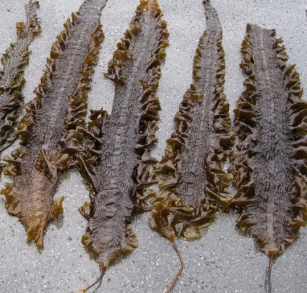
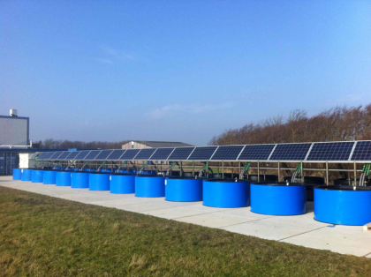
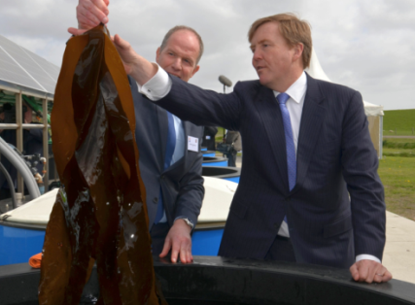
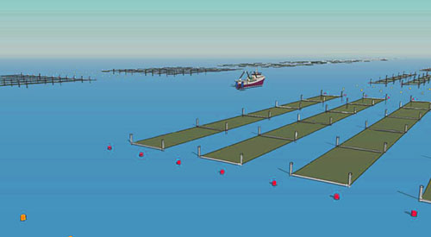
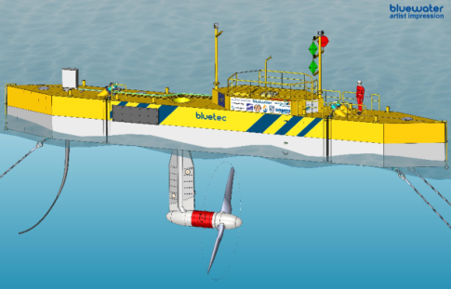
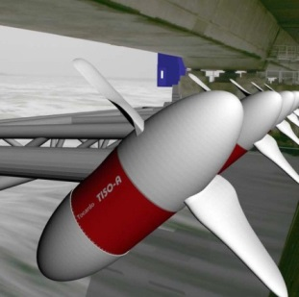
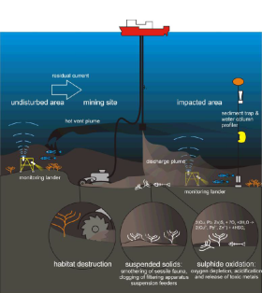
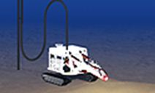
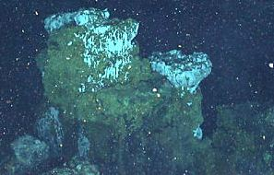
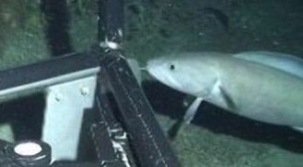
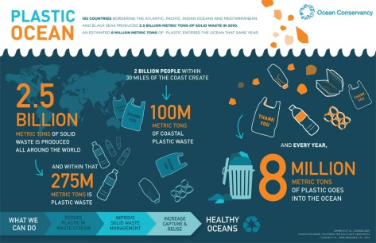
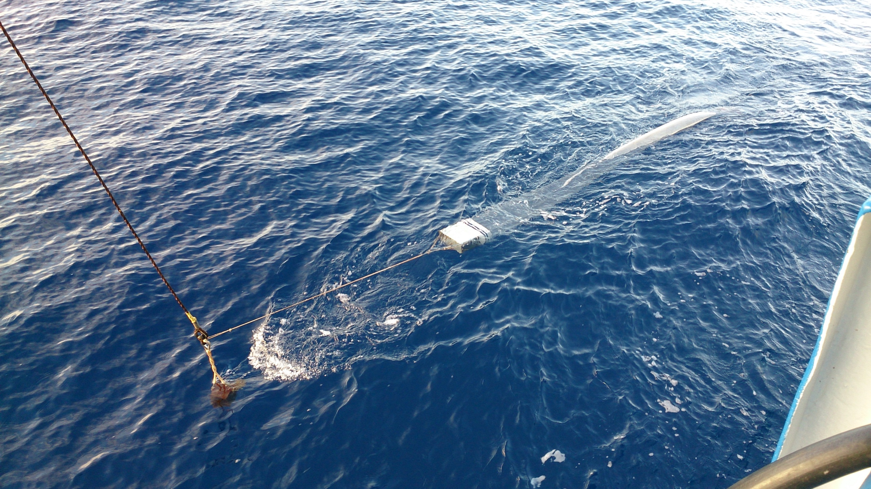
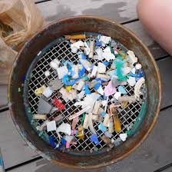
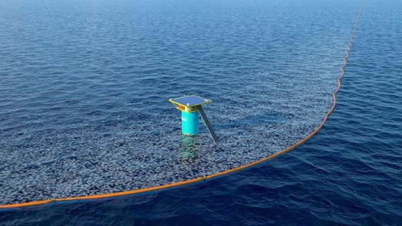
Blue Growth focal points NIOZ
Sea weed
Tidal energy
Deep Sea Mining
Ocean Plastics

Slide 8
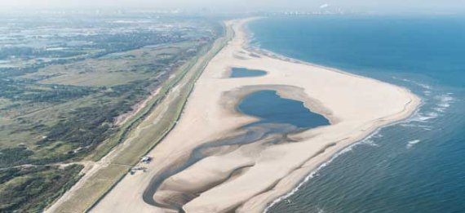

Slide 9
Mission Blue Planet
NIOZ: main research thrusts:
Fundamental, multidisciplinary process-oriented marine research
‘Building with Nature’ – fundamentals & delta technology
Dynamic sea level & spatial ecosystem-physical responses
Innovations in spatial ecological monitoring
High CO2 studies, calcification
Algal biomass (seaweed) fundamentals & culturing
Role of micro-organisms (microbiology, incl. viruses) (microplastics)
Deep sea resources and ecology
Blue energy, e.g., tidal energy
excellent marine research for society

