Slide 2
Introduction
The European framework
The "proof of concept" of EMODnet…
Objectives of DGMARE tender
EMODnet PP
the Methodology, the Parameters, the Pillars, the Sustainability
EMODnet PP and EuroGOOS
Geographical coverage (and acting communities)
Data already included in the project
Web Portal Architecture
EMODnet PP - NRT Data, Historical Data, Data Access
EMODnet PP - pilot portal
Enlarge the community
EUROGOOS reports

Slide 3
The EU framework
Marine Strategy Framework Directive (MSFD) - 2007
comprehensive monitoring of the marine environment beyond the geographical limits set in the Water Framework Directive.
European Environment Information and Observatory Network – EIONET
EEA tools for sharing coastal, transitional and marine waters observations at EU level.
Global Monitoring for Environment and Security (GMES)
GMES MARINE → informative system in the field of marine environment and security for forecasts, hindcasts, nowcasts
Water Information System for Europe (WISE)
WISE MARINE → for water related component of environmental data access and reporting
Shared Environmental Information System (SEIS) and INSPIRE

Slide 4
The "proof of concept" of EMODnet
Marine Knowledge 2020 (DG MARE 2010)
Unlock the potential of Europe’s marine knowledge
Preparatory Action to:
set up prototype European Marine Observation and Data Network (ur-EMODnet):
hydrography (water depth, coastlines ..
chemistry (concentrations in water, sediments, sea-life ..
biology (abundance and diversity ..,
geology (sediments, hazards, erosion ..
habitats (common classification for European waters ..
physics (temperature, currents waves ..
(52 organisations from 24 countries)
provide access to marine data of a standard format and known quality and identify gaps in coverage.
identify the main challenges in moving from an ur-EMODnet to an operational EMODnet.

Slide 5
Objectives of DGMARE tender
Provide access to archived and real-time data on physical conditions in Europe's seas and oceans and to determine how well the data meet the needs of users.
Make layers of physical data and their metadata available for use by industry, public authorities and scientists
Contribute towards the definition of an operational European Marine Observation and Data Network (EMODnet)
Contribute to developing the definition of the Global Monitoring for Environment and Security (GMES) marine core service.

Slide 6
EMODnet PP – the Methodology
Provide through a portal:
free and open access to marine data from measurement stations and ferryboxes.
metadata to these parameters using EMODnet/INSPIRE standards.
Monitoring and reporting on the effectiveness of the portal in meeting the needs of users in terms of ease of use, quality of information and fitness for purpose of the products delivered.

Slide 7
EMODnet PP – the Parameters
Parameters:
wave height and period;
temperature of the water column;
wind speed and direction;
salinity of the water column;
horizontal velocity of the water column;
light attenuation;
sea level.

Slide 8
EMODnet PP – the Pillars
EMODnet PP
EMODnet PP aims to bridge the communities behind EuroGOOS, MyOcean and SeaDataNet in order to meet their needs in term of use, the Commission agenda on IS and expand in future the participation to all partners
MyOcean
EuroGOOS
SeaDataNet

Slide 9
EMODnet PP – Sustainability
EMODnet PP aims also to attract data holders not yet participating and involve them in the existing infrastructures.
MyOcean
EuroGOOS
SeaDataNet
Middle term support:
MyOcean→MyOcean2
SeaDataNet→SeaDataNet2

Slide 10
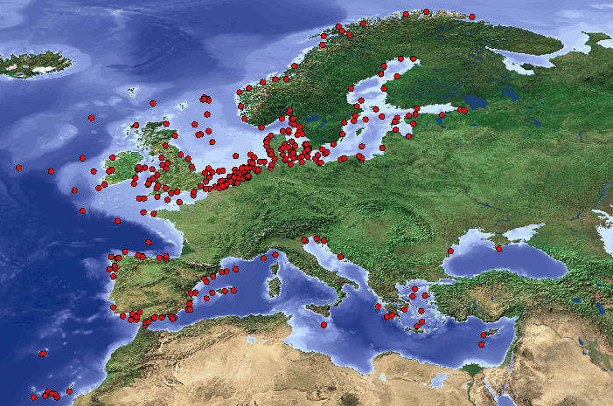
EMODnet PP and EuroGOOS
EuroGOOS is an Association of Agencies to further the goals of GOOS
Promote Operational Oceanography fostering a sustained production of services at a Regional scale (ROOS)
Real time data exchange
Specialised centre (ESEAS)
Global Centre
Global Centre
Global Centre
Regional centre
National dataprovider
National dataprovider
National dataprovider
Regional centre
European Centre
National dataprovider
National dataprovider
National dataprovider
National dataprovider
National dataprovider
Regional centre
National dataprovider
National dataprovider
National dataprovider
National dataprovider
National dataprovider
Regional centre
National dataprovider
National dataprovider
[source: Hans Dahlin, EuroGOOS ]

Slide 11
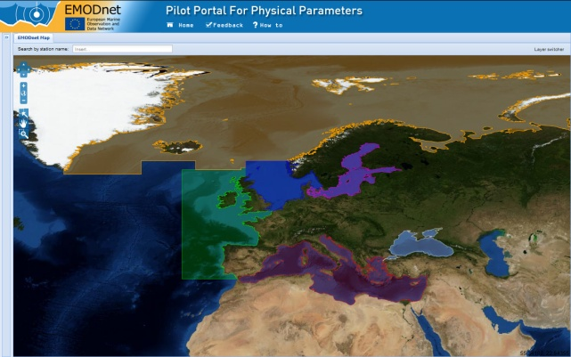
Geographical coverage (and acting communities)
Western Mediterranean Sea (ROOS Med and SeaDataNet);
Adriatic Sea (ROOS Med and SeaDataNet);
Ionian Sea and Central Mediterranean Sea (ROOS Med and SeaDataNet);
Aegean-Levantine Sea (ROOS Med and SeaDataNet);
Greater North Sea, including Kattegat, and English Channel (ROOS NWS [North West Shelf] and SeaDataNet);
Celtic Seas (ROOS IBI and SeaDataNet);
Bay of Biscay and the Iberian Coast (ROOS IBI and SeaDataNet);
In the Atlantic Ocean, the Macronesian bio-geographic region, being the waters surrounding the Azores, Madeira and the Canary Islands (Coriolis and SeaDataNet), and Cape Verde (E subtropical Atlantic)
North Atlantic (including Porcupine Abyssal Plain, Central Irminger Basin, Norvegian Sea)
Black Sea (BSGOOS)

Slide 12
Data already included in the project
EuroGOOS ROOS’s
SeaDataNet
MyOcean – In Situ
Jerico
Data Buoy Cooperation Panel
National initiatives
All contributors will be actors in the project:
documents will be agreed during ad hoc EuroGOOS meetings
EuroGOOS technical reports will contain results and names of contributors
EMODnet PP is being presented in IBI ROOS and MOON annual meetings, and several regional ROOS meetings

Slide 13
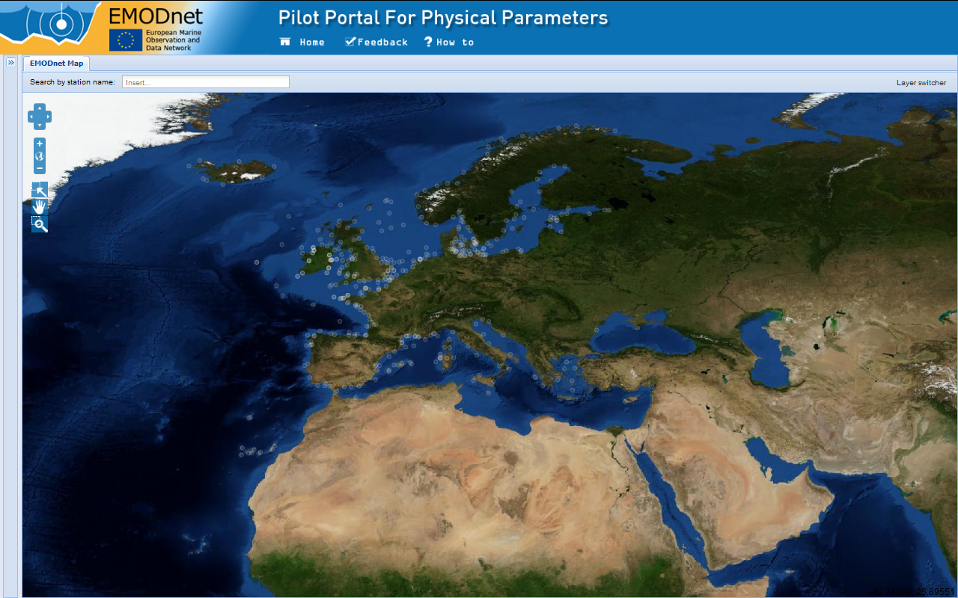
Geographical coverage – SEPRISE heredity

Slide 14
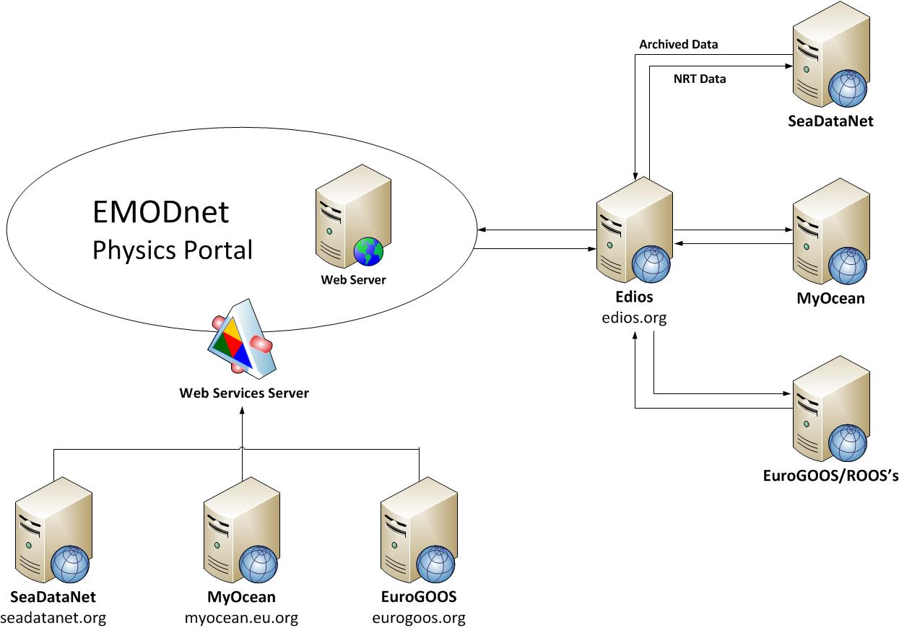
Web Portal Architecture

Slide 15
EMODnet PP - NRT Data
Access to NRT data is pretty much organized within ROOSs in collaboration with MyOcean
The existing network RT observing system is presenting spatial and temporal gaps.
A goal of EMODnet PP is to demonstrate that we are missing the observations needed for the operational and research applications in the area.

Slide 16
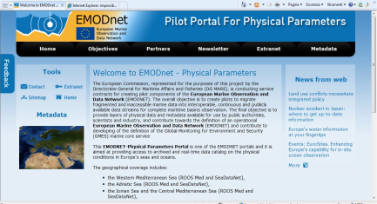
EMODnet PP – NRT Data
Feeding the system
EDIOS
EUROGOOSs share info according MyOcean std.
MyOcean index is published according EDIOS std.
EMODNet PP access metadata info by EDIOS

Slide 17
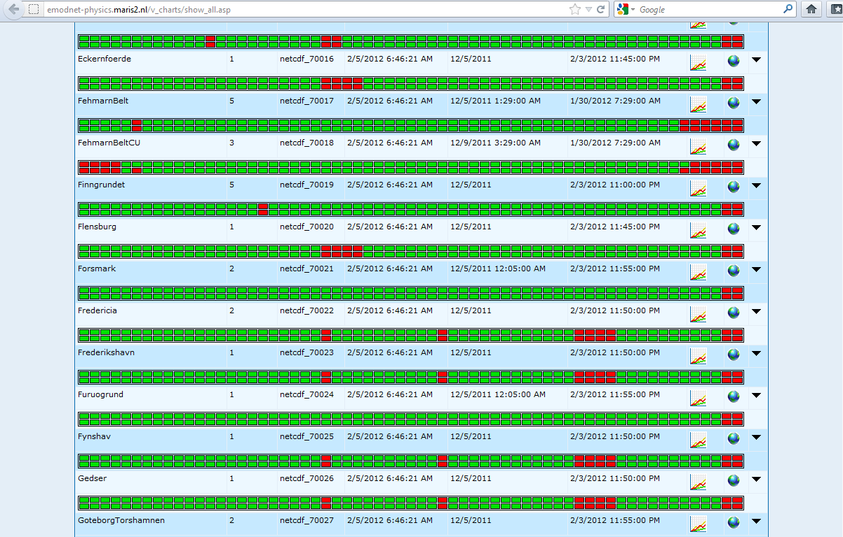
EMODnet PP – NRT Data
About 410 Station for NRT data
Station Name/id cross table to be completed

Slide 18
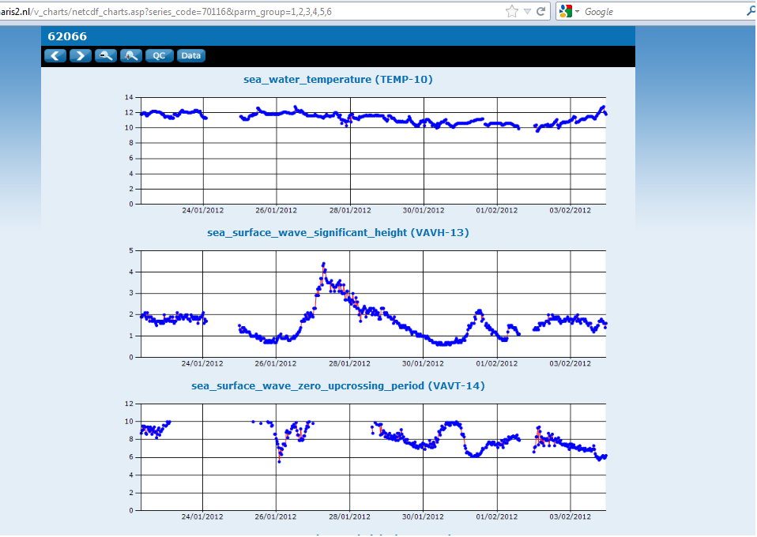
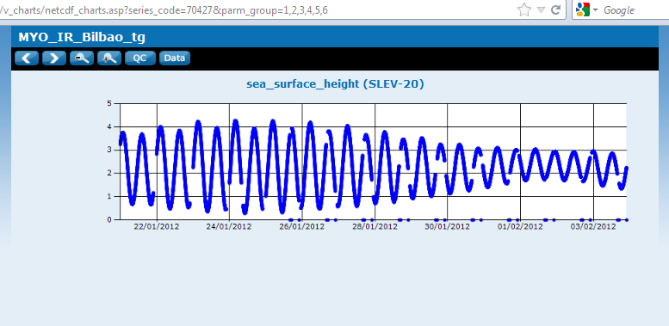
EMODnet PP – NRT Data

Slide 19
EMODnet PP - Historical Data
Access to historical data is organised through SeaDataNet, but there are still gaps (data not yet available)
EMODnet PP wants to demonstrate that NRT and historical data can be well organised in an unique Informative System (IS)
EMODnet PP wants to demonstrate that it is possible to benefit of such project for the reanalysis product that are required for (e.g.) climate and fisheries applications.

Slide 20
EMODnet PP – Historical Data
Feeding the system
EDIOS
ROOS
CDI
ROOS
ROOS
EUROGOOSs info published in SEADATANET
SEADATANET publishes according EDIOS std.
EMODNet PP access metadata info by EDIOS
EMODNet PP provides CDIs info by EDIOS

Slide 21
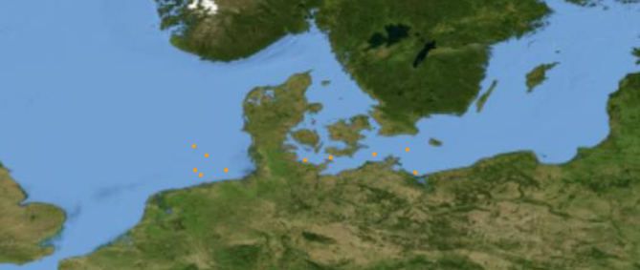
EMODnet PP – Historical Data
Germany:
10 - Series CDI
1 - Program CDI
(http://seadatanet.maris2.nl/v_edios_v2/result.asp)

Slide 22
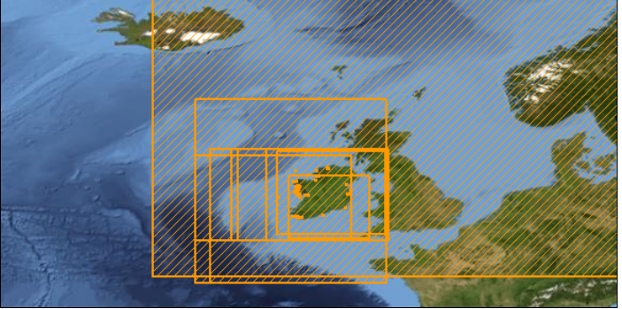
EMODnet PP – Historical Data
Ireland:
73 - Series CDI
12 - Programs CDI
(http://seadatanet.maris2.nl/v_edios_v2/result.asp)

Slide 23
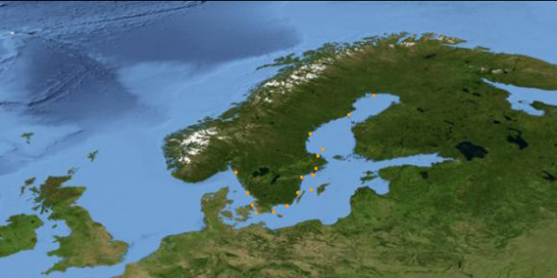
EMODnet PP – Historical Data
Sweden:
16 - Series CDI
2 - Programs CDI
(http://seadatanet.maris2.nl/v_edios_v2/result.asp)

Slide 24
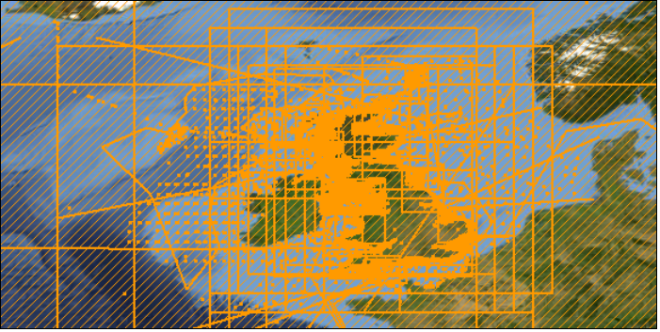
EMODnet PP – Historical Data
United Kingdom:
15103 - Series CDI
275 - Programs CDI
(http://seadatanet.maris2.nl/v_edios_v2/result.asp)

Slide 25
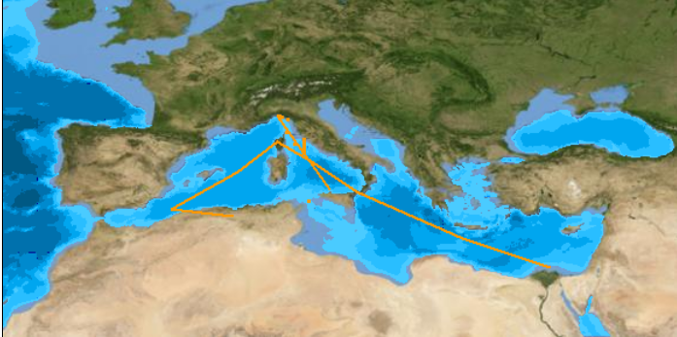
EMODnet PP – Historical Data
Italy:
28 - Series CDI
26 - Programs CDI
(http://edios-test.maris2.nl/v_edios_v2/result.asp) → to be validated

Slide 26
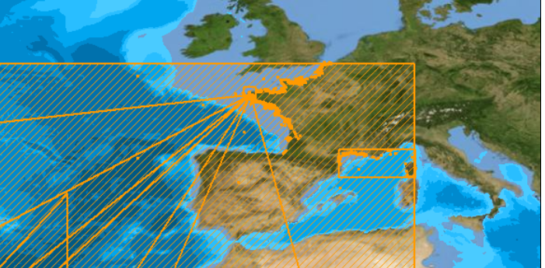
EMODnet PP – Historical Data
France:
990 - Series CDI
27 - Programs CDI
(http://edios-test.maris2.nl/v_edios_v2/result.asp) → to be validated

Slide 27
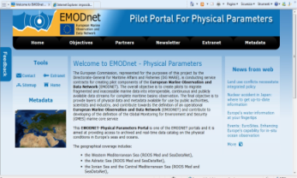
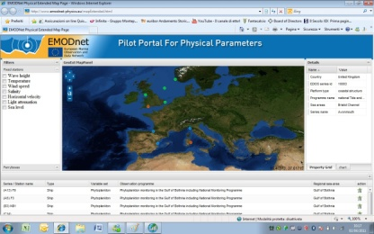
EMODnet PP – Data Access
Near Real Time
EDIOS
60 days data – direct access
CDIs
Archived Data
EDIOS
EDIOS
CDIs

Slide 28
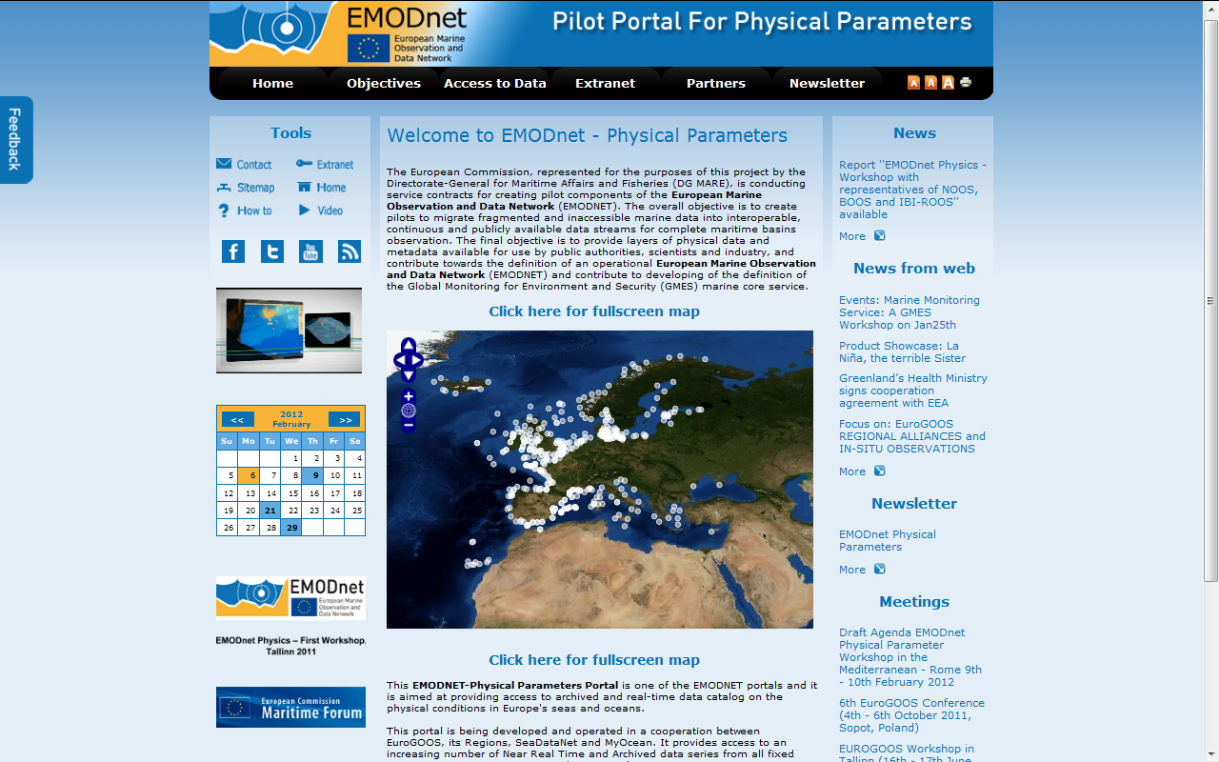
EMODnet PP - pilot portal
Domain name
www.emodnet-physics.eu
http://151.1.25.87/emodnet_test/prt_home.asp

Slide 29
EMODnet PP - pilot portal

Slide 30
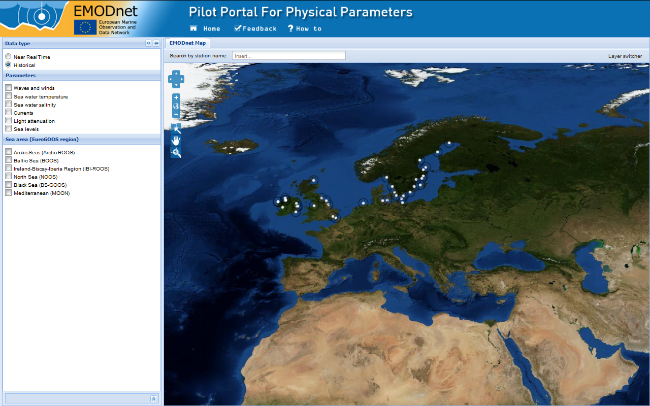
EMODnet PP - pilot portal
1
2
2

Slide 31
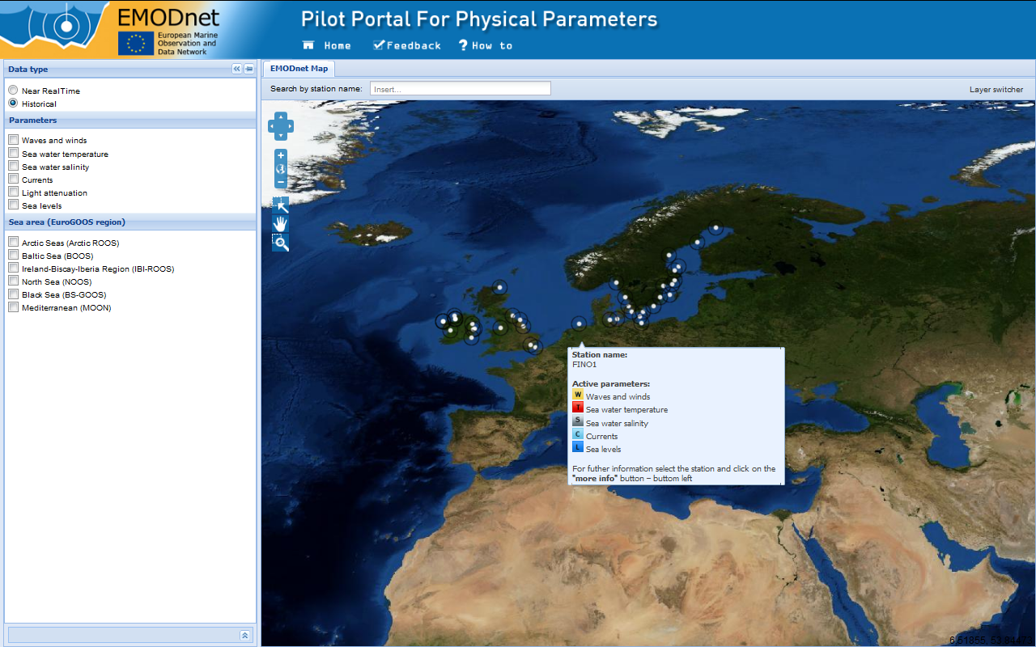
EMODnet PP - pilot portal
2

Slide 32
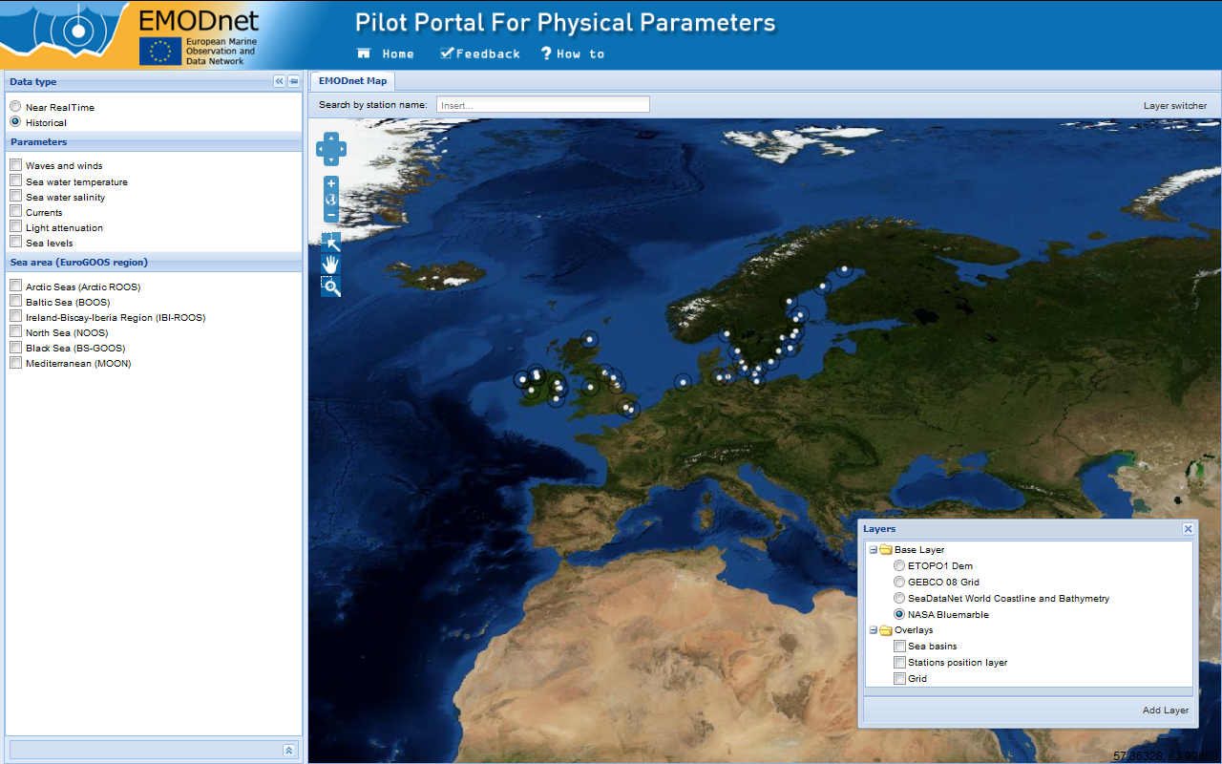
EMODnet PP - pilot portal
1
2
Maps and Overlays

Slide 33
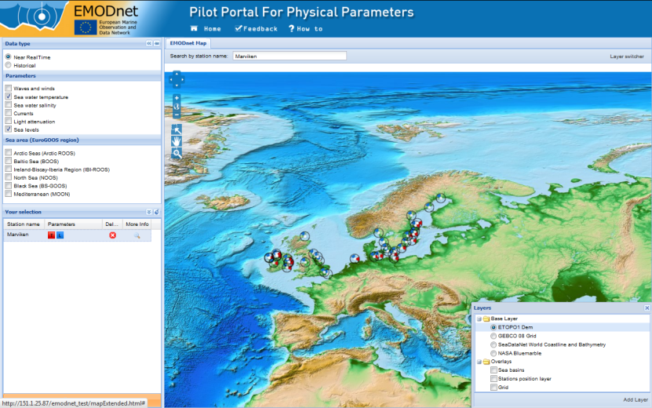
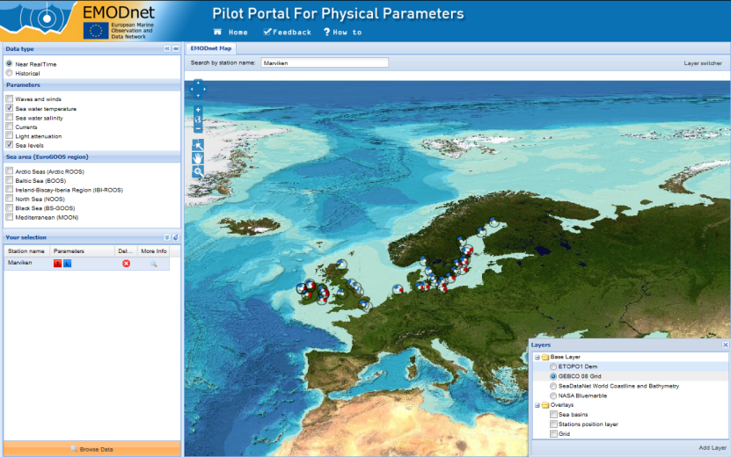
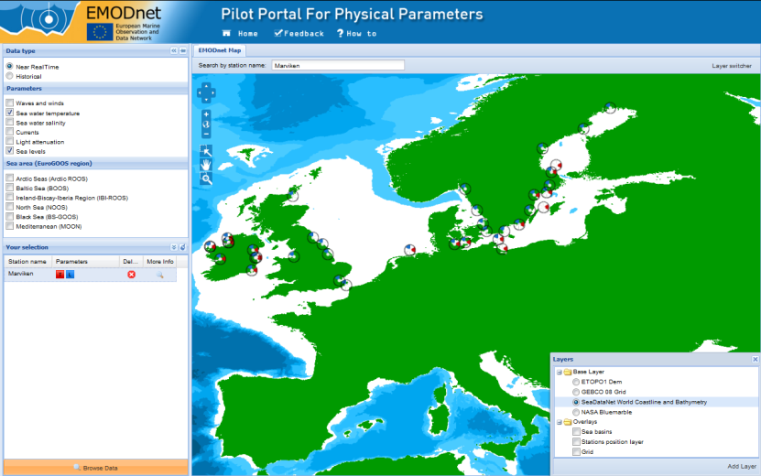
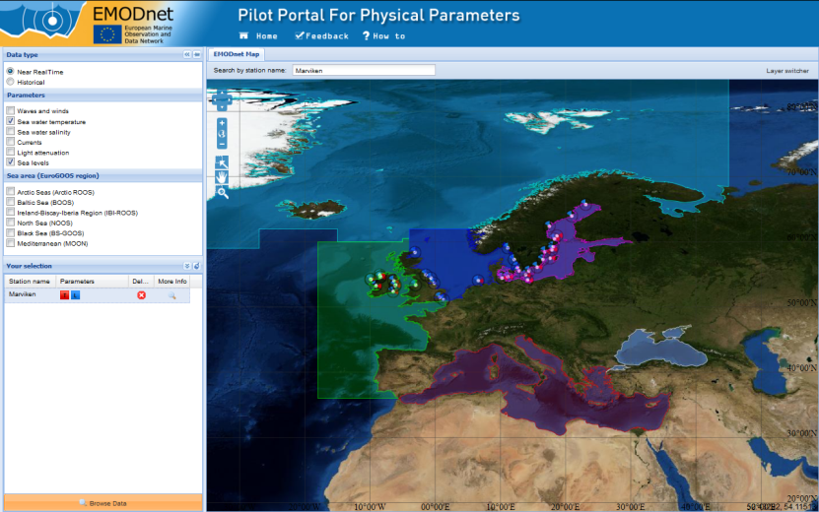
EMODnet PP - pilot portal
ETOP01
GEBCO
SeaDataNet
Sea Basins

Slide 34
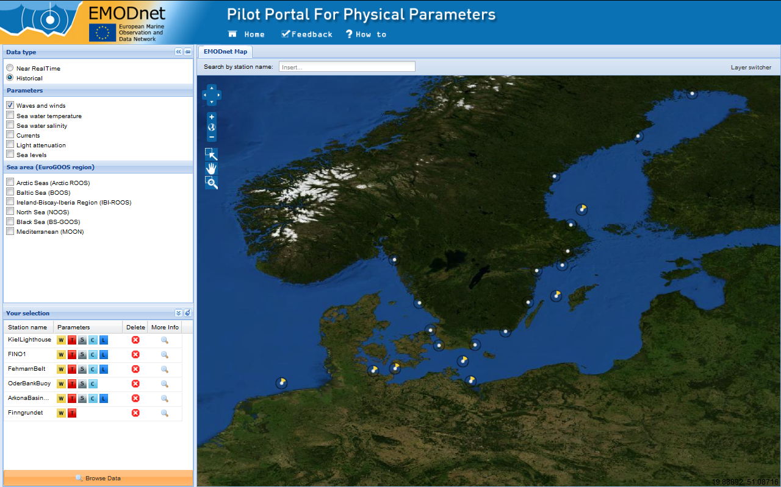
EMODnet PP - pilot portal
1
2
Appling filters

Slide 35
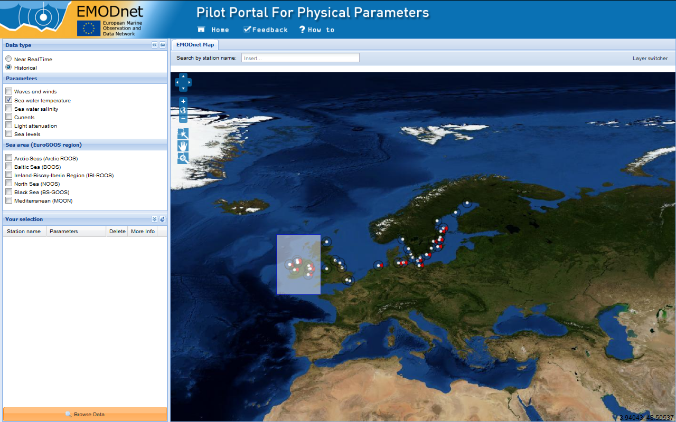
EMODnet PP - pilot portal
1
2
Box selection

Slide 36
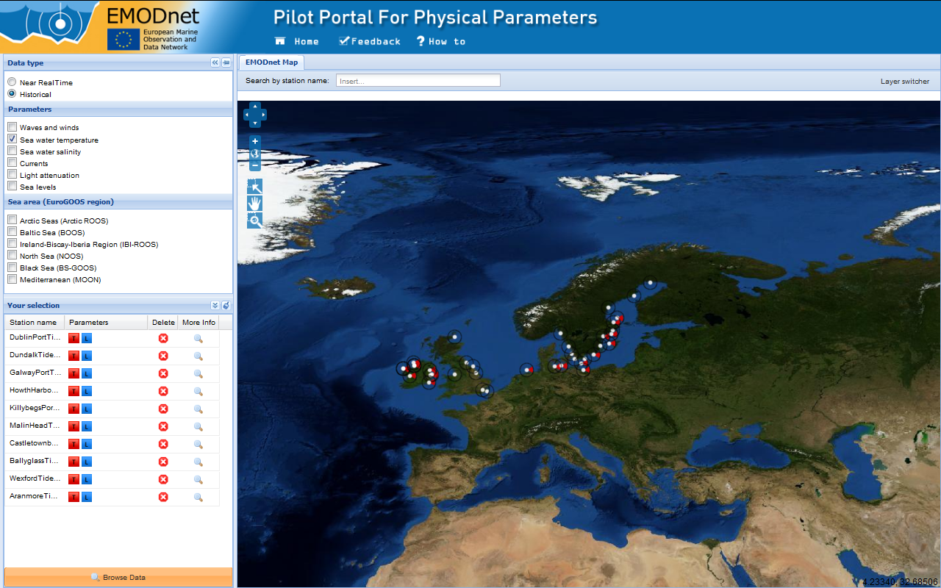
EMODnet PP - pilot portal
3
4
Historical data

Slide 37
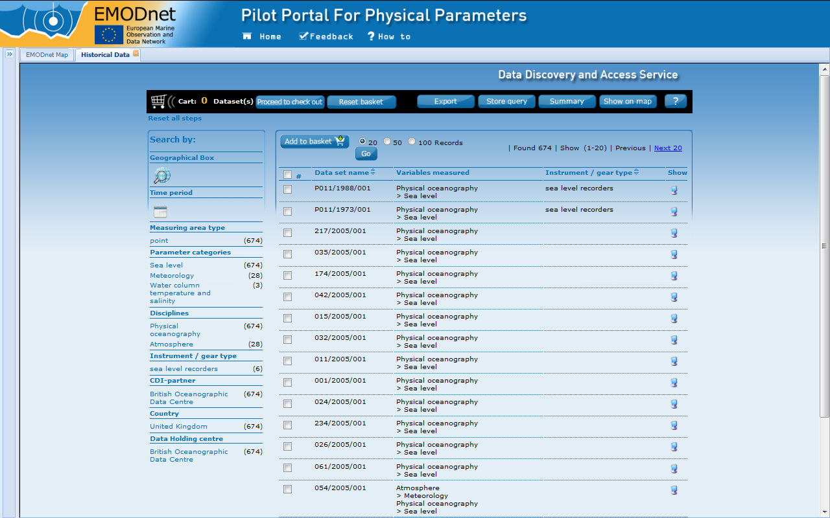
EMODnet PP - pilot portal
2
1
Historical data

Slide 38
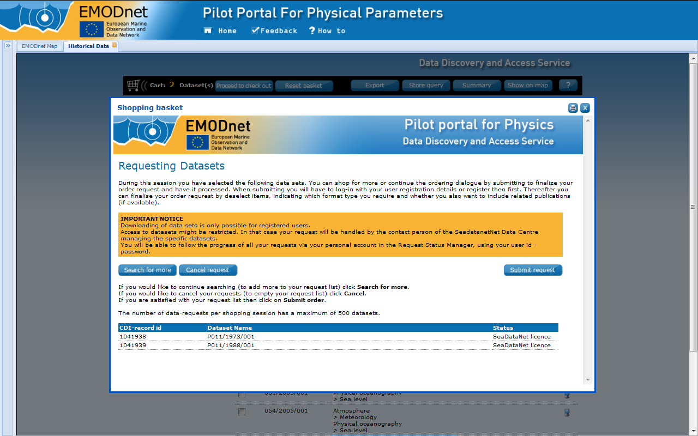
EMODnet PP - pilot portal
Historical data

Slide 39
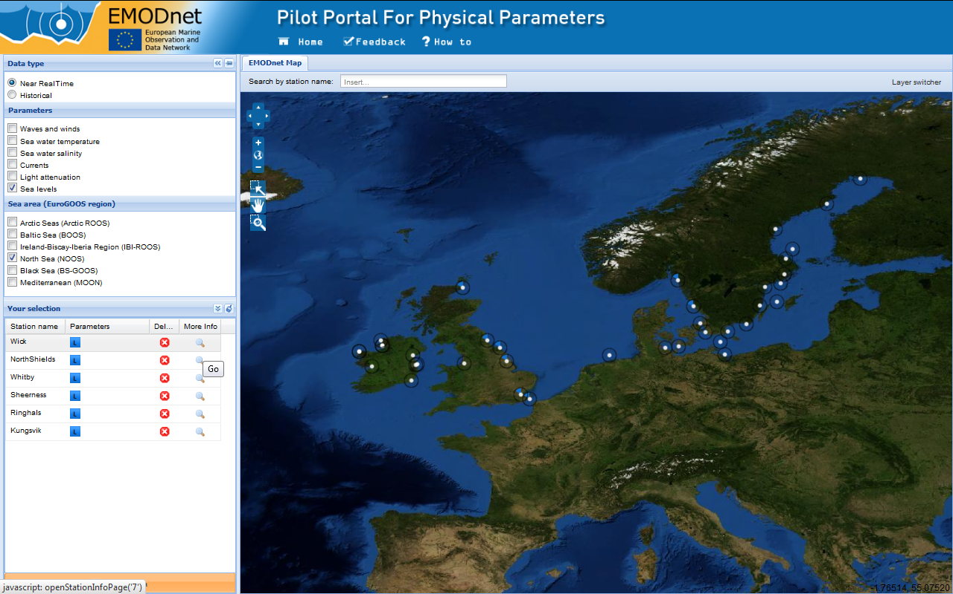
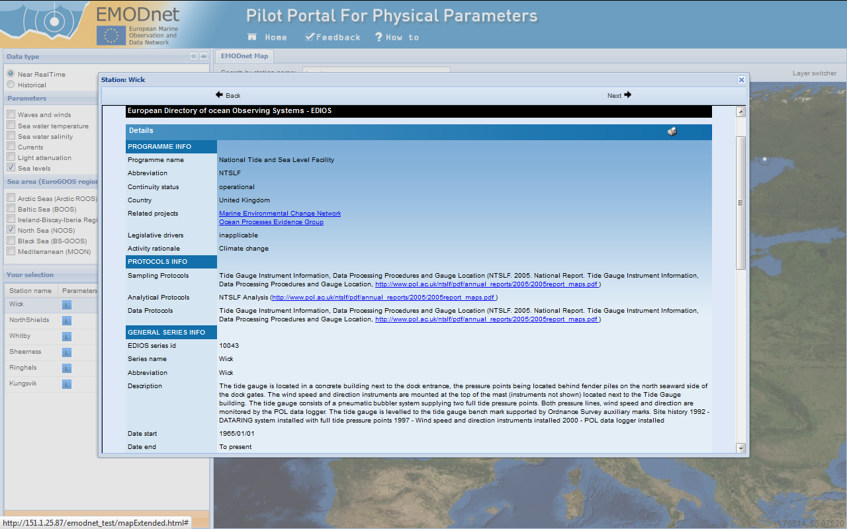
EMODnet PP - pilot portal
1
2
EDIOS info

Slide 40
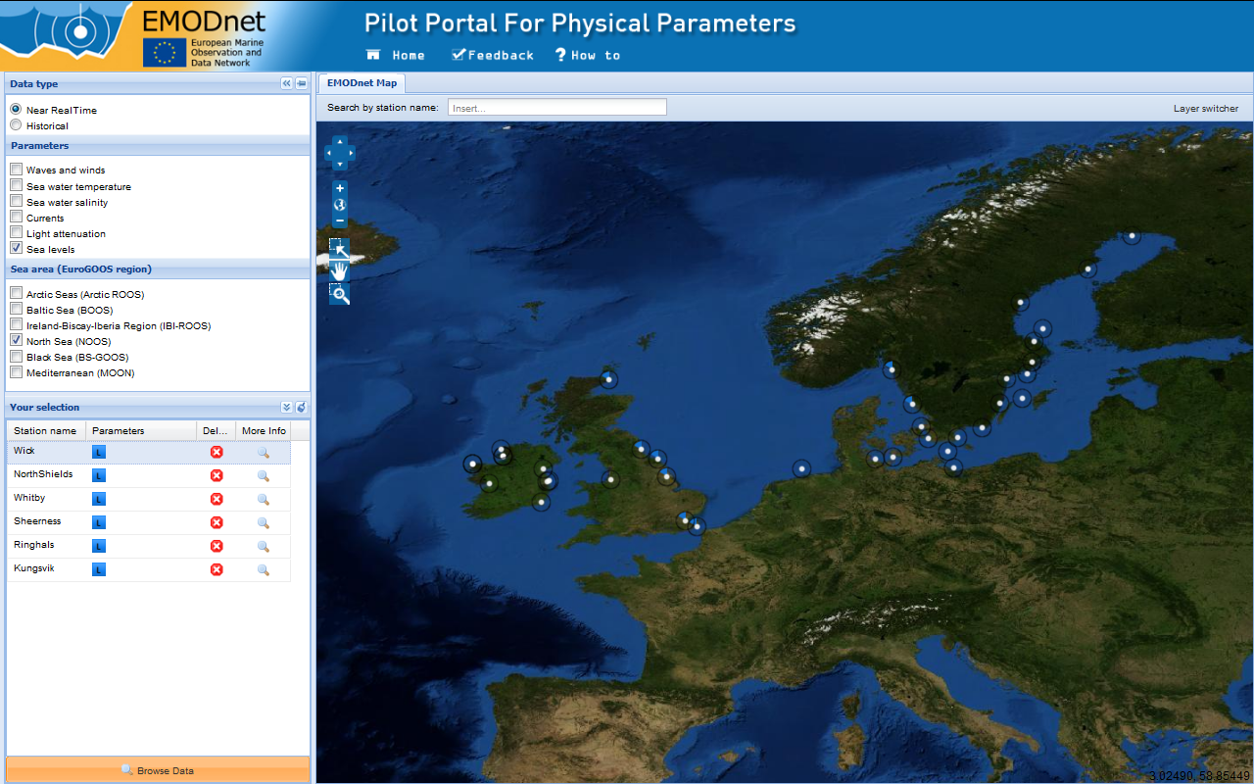
EMODnet PP - pilot portal
1
2
3
4
5
NRT data

Slide 41
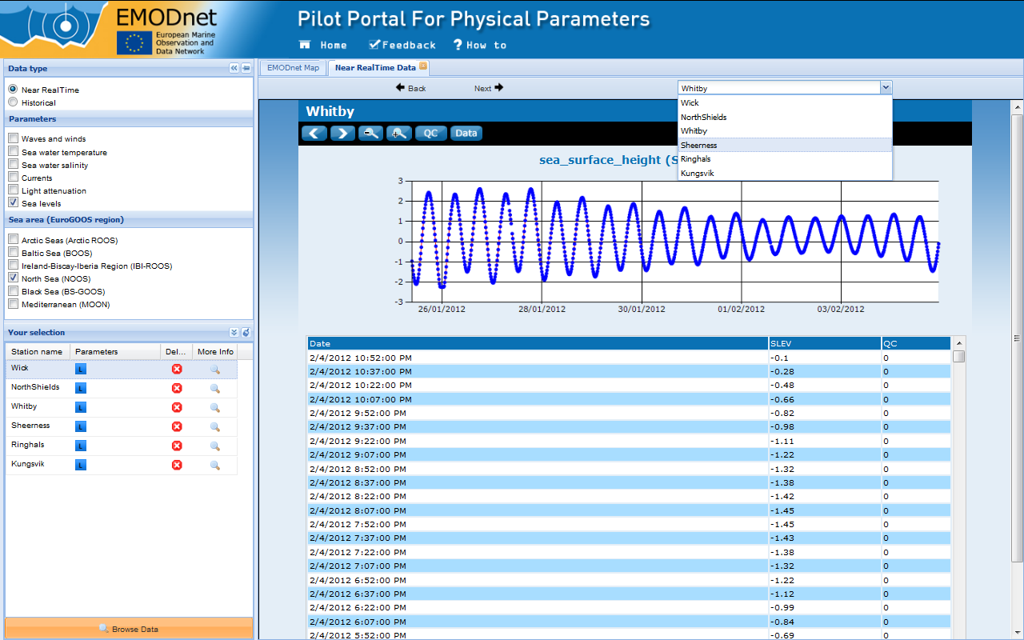
EMODnet PP - pilot portal
1
2
NRT data

Slide 42
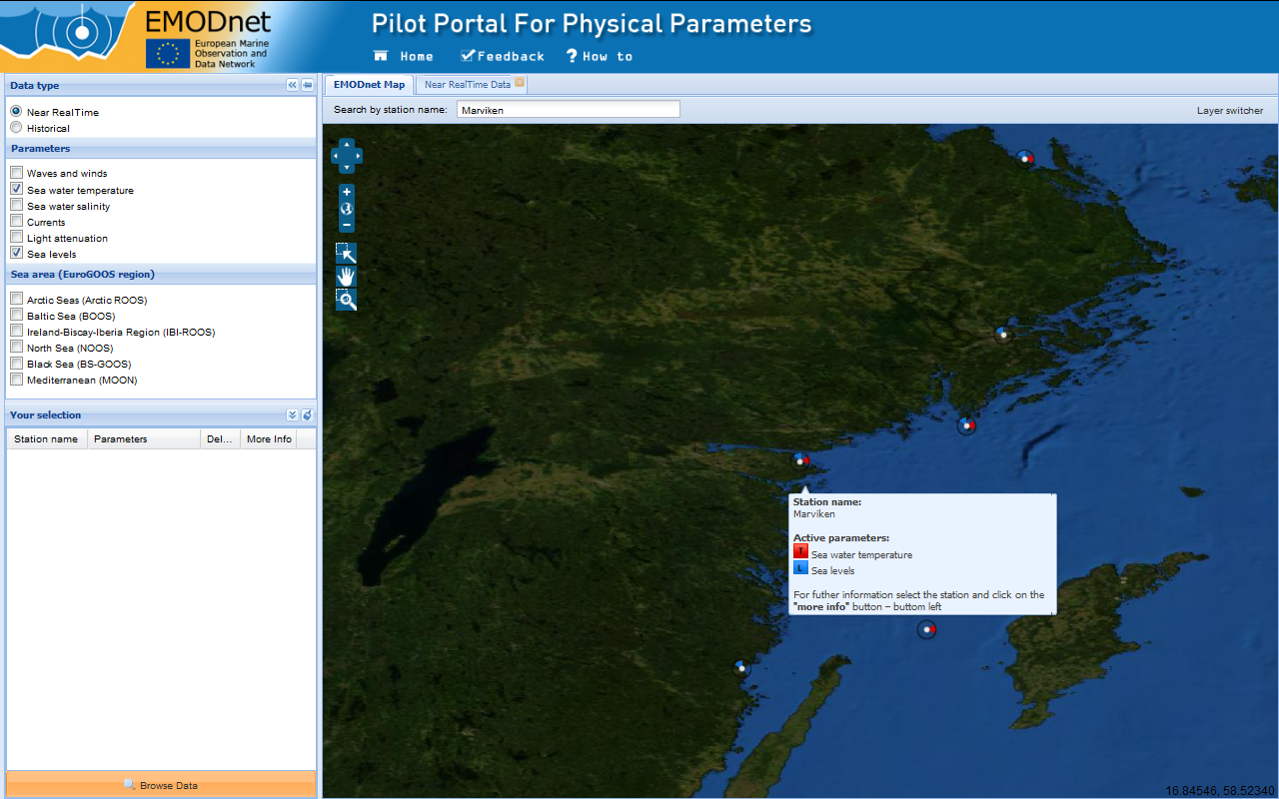
EMODnet PP - pilot portal
1
2
NRT data

Slide 43
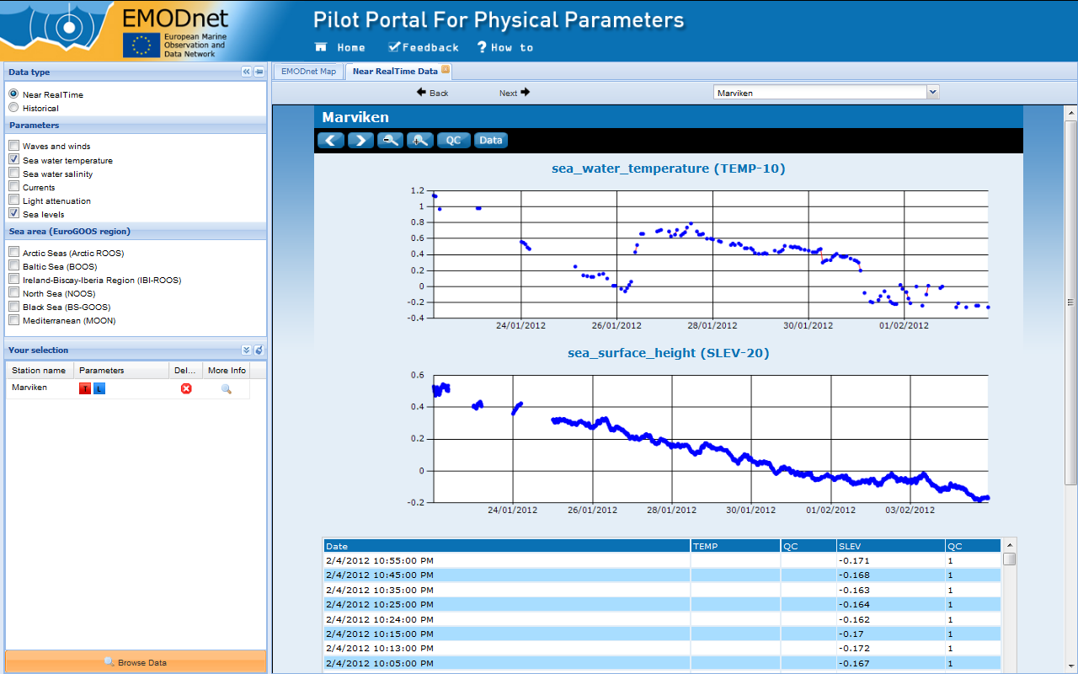
EMODnet PP - pilot portal
1
2
NRT data

Slide 44
EMODnet PP - pilot portal

Slide 45
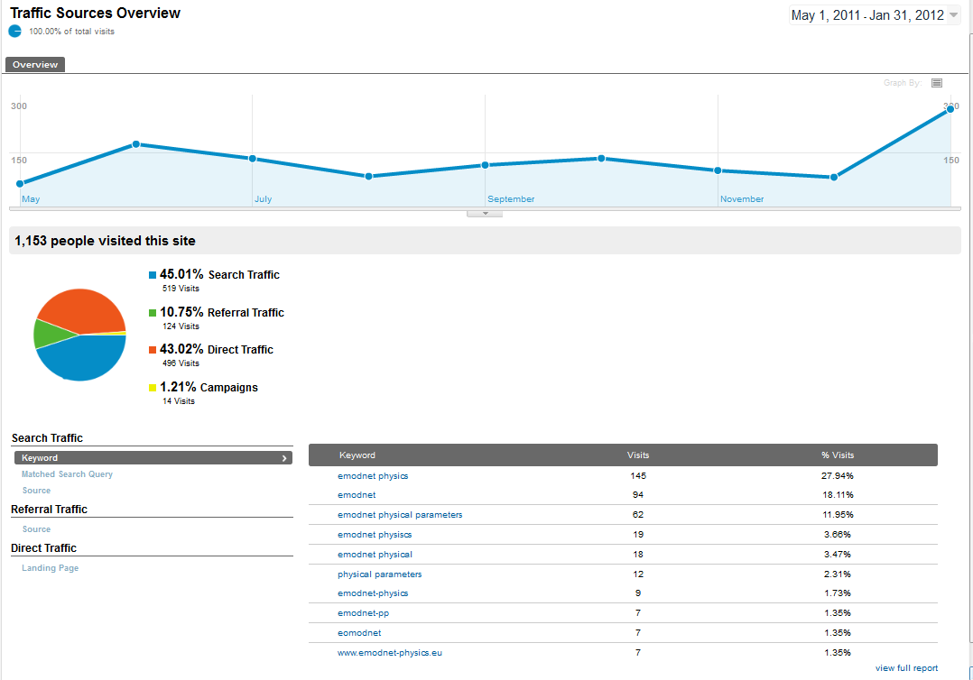
EMODnet PP - pilot portal

Slide 46
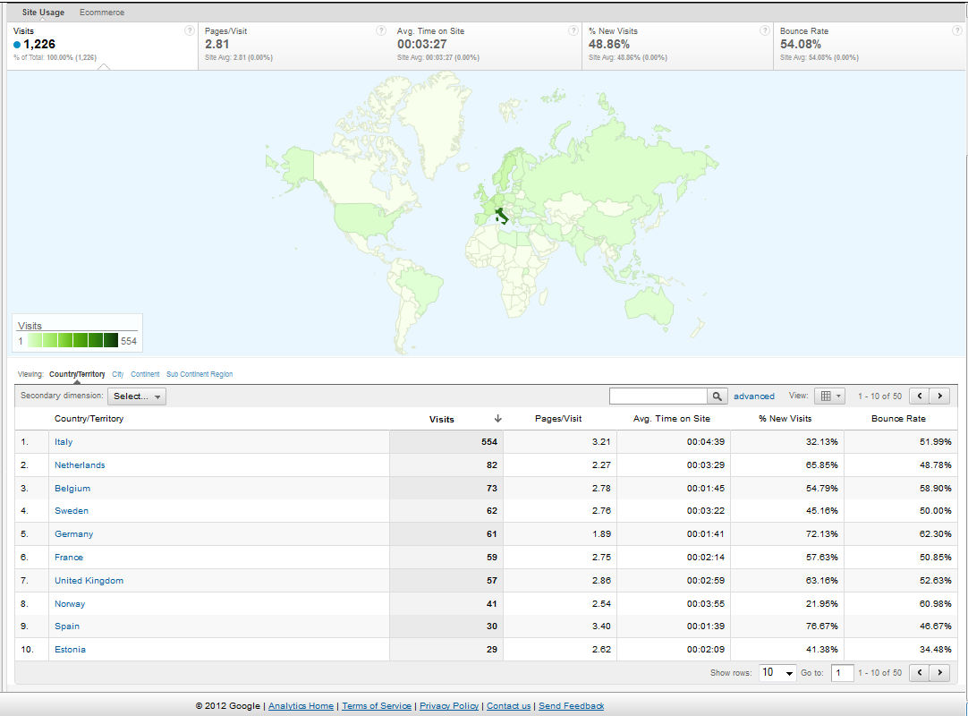
EMODnet PP - pilot portal

Slide 47
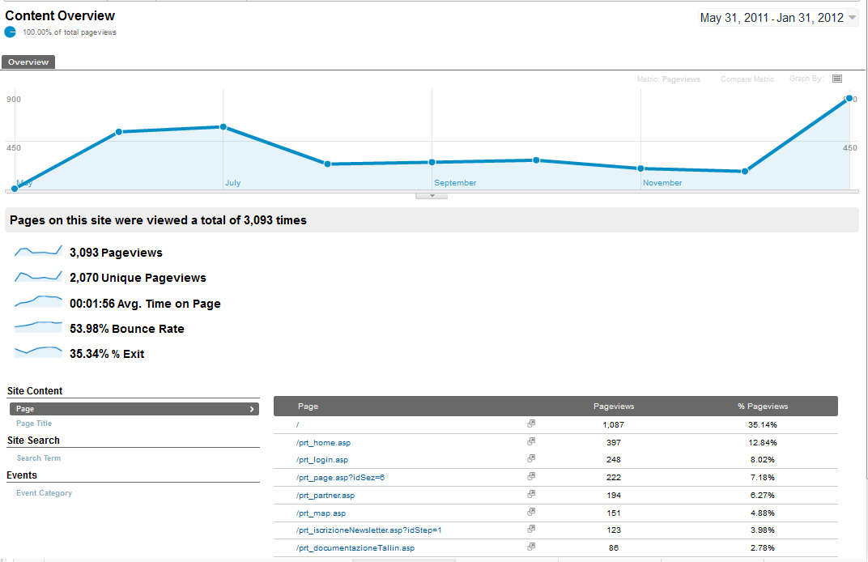
EMODnet PP - pilot portal
Picks are before and after EMODnet Workshops and one to one visit/meeting

Slide 48
Enlarge the community
EMODnet
ARTIC
BOOS
BSGOOS
IBIROOS
NOOS
MOON
SDN
SDN
SDN
SDN
SDN
SDN
MYO
MYO
MYO
MYO
MYO
MYO
Workshops
Tallinn (Estonia) → 6-17 June 2011
Rome (Italy) → 9-10 February 2012
Istanbul (Turkey ) → 21-23 February 2012

Slide 49
EMODnet PP pilot portal
Thank you

