Slide 1
Towards a German contribution to the Blue Cloud
Gauvain Wiemer Brussels Office

Slide 2
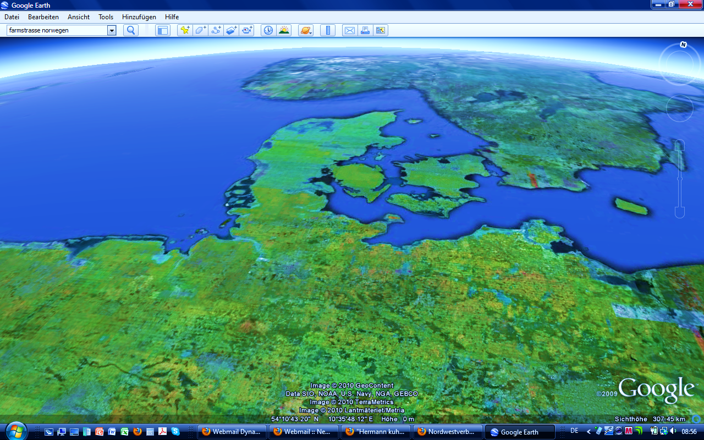
MaNIDA - Marine Network for Integrated Data Access
German Marine Science Consotium
Berlin
Brussels
Universities
Max Planck Institutes
Museums
Leibniz Institutes
Helmholtz Centres
Government Research Institutes
Notes:
Non-profit self-organisation of German marine science
Offices in Berlin and Brussels
Lean organisation (2 persons per office)
Expertise is located in the Member Institutes
At present 17 (soon 19) members, 1 member - 1 voice, membership dues according to institute size
Internal structure
Board of 5 persons incl. Chair and 2 Co-Chairs
Strategy and working groups
The Marine Network for Integrated Data Access aims to provide a networked approach to access and mining of federated e-infrastructures together with a management strategy targeting its long-term sustainability. With MaNIDA’s network, we will create a new paradigm in respect to integration, harmonization and aggregation of various types of quality-controlled data and related data products.
Primary focus will be given to data derived from nationally operated research and monitoring facilities (vessels, observatories, alert systems, etc).
Related contextual content and publications will also become an integral part of the aggregation effort.
For the community we will improve ingestion workflows, quality control and user support, thereby achieving substantial enhancements in the lifecycle management of marine scientific data.
The creation of a data curation and customer support centre is planned as well as various workshops.
Finally such procedures for data integration and aggregation will allow for novel combinations among data and data products.

Slide 3
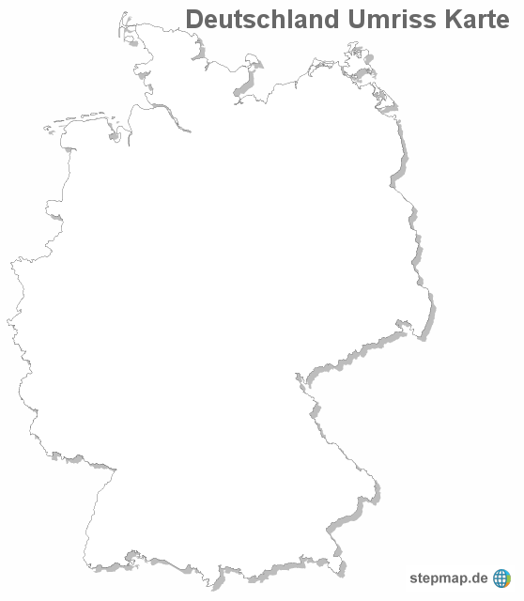
MaNIDA - Marine Network for Integrated Data Access
Publications
Reports
Underway data
Expeditions
Archived data
Near real time data
Notes:
The “Data Portal of German Marine Research" will enhance data mining in various disciplines as well as improve planning of future expeditions (via easy identification of data voids). It will also provide means for combining various data types (underway data, post cruise data, satellite gridded products, modelling data, etc) into enhanced data products. This global view on substantial data holdings available from distinct e-infrastructures will give stakeholders a novel support for “data centric science”

Slide 4
MaNIDA - Marine Network for Integrated Data Access
8 Providers:
PANGAEA, EPIC, OCEANREP, COSYNA, DOD
MARUM, DKRZ, AWI-BATHY,
Publications
Reports
Underway data
Expeditions
Archived data
Near real time data
Notes:
Extremely wide range of data sources
Ship-based instruments
Instruments in water column and at seafloor
Air- and space-borne instruments
Sensor networks
Individual data types and formats
Snapshot projects vs. long-term monitoring data

Slide 5
MaNIDA - Marine Network for Integrated Data Access
8 Providers:
PANGAEA, EPIC, OCEANREP, COSYNA, DOD
MARUM, DKRZ, AWI-BATHY,
Regions:
Atlantic Ocean, Pacific Ocean, Mainland Europe, European Mainland, Arctic Ocean, Indian Ocean ,Mainland North America, North America Mainland ,Southern Ocean, Baltic Sea, Mediterranean Region, Mainland Asia, Asian Mainland, South China And Eastern Archipelagic Seas
Publications
Reports
Underway data
Expeditions
Archived data
Near real time data

Slide 6
MaNIDA - Marine Network for Integrated Data Access
8 Providers:
PANGAEA, EPIC, OCEANREP, COSYNA, DOD
MARUM, DKRZ, AWI-BATHY,
Regions:
Atlantic Ocean, Pacific Ocean, Mainland Europe, European Mainland, Arctic Ocean, Indian Ocean ,Mainland North America, North America Mainland ,Southern Ocean, Baltic Sea, Mediterranean Region, Mainland Asia, Asian Mainland, South China And Eastern Archipelagic Seas
Parameters:
…
Publications
Reports
Underway data
Expeditions
Archived data
Near real time data
Notes:
Data covers the globe

Slide 7
AGE (23184)
ALTITUDE (23968)
Age (17179)
Air temperature at 2 m height(6266)
Algorithm (7591)
Alkalinity, total (5983)
Ammonium (6733)
Approximate age of pith (12847)
Bottle number (10928)
Calcium carbonate (6391)
Carbon, organic, total (6950)
Chlorophyll a (8430)
Code (6886)
Comment (19622)
Cond_FSI (mmho/cm) (6056)
Course (6003)
Current velocity, east-west(11086)
Current velocity, north-south(11083)
DATE/TIME (115746)
DEPTH, sediment/rock (92390)
DEPTH, water (94838)
Date/Time of event (8890)
Declination (5509)
Density, maximum (13004)
Density, minimum (13004)
Density, wet bulk (7888)
Depth, bathymetric, interpolated/gridded (9474)
Depth, bottom/max (18418)
Depth, composite (14822)
Depth, top/min (19801)
Dew/frost point (7451)
Diffuse radiation (9189)
Diffuse radiation, standard deviation (6164)
Direct radiation (9259)
Direct radiation, standard deviation (6256)
Distance (11923)
Earlywood density (8574)
Earlywood width (13004)
Elevation of event (9089)
Event label (21869)
FlowRate_Inlet (l/min) (6053)
Fluor_Turner (arb. units, de facto mg/m**3) (6053)
Fugacity of carbon dioxide (water) at sea surface temperature (wet air) (10600)
HEIGHT above ground (15554)
Humidity, relative (25257)
Identification (8154)
LATITUDE (56246)
LONGITUDE (56246)
Latewood density (8574)
Latewood width (13004)
Latitude of event (17816)
Latitude, error (5926)
Lithology/composition/facies(5551)
Long-wave downward radiation(10049)
Long-wave downward radiation, standard deviation (6606)
Longitude of event (17828)
Longitude, error (5924)
Nitrate (11043)
Nitrite (9037)
Oxygen (16284)
Phosphate (13253)
Present weather (6977)
Pressure at equilibration (6778)
Pressure, at given altitude(21002)
Pressure, atmospheric (12161)
Pressure, atmospheric, interpolated (9355)
Pressure, water (21825)
Quality flag (8366)
Ring width (17849)
Salinity (40147)
Salinity (PSU) (6074)
Salinity, interpolated (9343)
Sample ID (6212)
Sample code/label (77271)
Sea level (19494)
Short-wave downward (GLOBAL) radiation (10501)
Short-wave downward (GLOBAL) radiation, standard deviation (6558)
Silicate (13642)
Snow type (5521)
Station pressure (8288)
Strontium (5769)
Temperature at equilibration(8282)
Temperature, air (28943)
Temperature, water (69468)
Turb_Turner (arb. units) (6053)
Uniform resource locator/link to image (5646)
WaterTemp_Aanderaa (°C)(6056)
WaterTemp_FSI (°C) (6053)
WaterTemp_Turner (°C) (6056)
Wind direction (30304)
Wind direction description (5492)
Wind speed (30533)
chlorophyll_concentration_in_sea_water (mg/m**3) (6118)
fractional_saturation_of_oxygen_in_sea_water (%) (6531)
pH (6628)
sea_surface_salinity (PSU)(6444)
sea_surface_temperature (°C)(6949)
sea_water_turbidity (arb. units)(6053)
xCO2 (air), interpolated (6866)
xCO2 (water) at equilibrator temperature (dry air) (7557)
Metadata
Notes:
General Outline of Work
The overall concept is to build a federation of trusted content providers and offer ultimately a service platform including a portal for accessing aggregated content. The major challenge here is to find interoperable solutions, which lead beyond minimalistic discovery services. The major challenges here are to include steps for quality assessment/assurance and to make this work easier for scientists and less resource-intensive. An incremental approach to specify and implement technical and organizational improvements is made inevitable: there is already an enormous resource of major infrastructure components, ongoing project work and data available at the partners’ sites. MaNIDA and the individual partners need to track the evolutionary change of behaviour of scientists to share data and their acceptance of data publication and “data intensive science”.

Slide 8
Only three parameters from three providers!

Slide 9
Only three parameters from three providers!
Why?
Notes:
Access data

Slide 10
Challenges
Extremely wide range of data sources
Data are stored in different data centers (if at all !)
Metadata integration, harmonization and aggregation
Ingestion and workflow
Discovery, View, Download and Dissemination services
Notes:
Main challenges for research and implementation
Metadata integration, harmonization and aggregation Data from three national large-scale data e-infrastructures (PANGAEA, COSYNA, GDI-BSH) and at least three national publication e-infrastructures (ePIC, HZG_pubRep, OceanRep) will be aggregated into a central metadata catalogue. Dynamic procedures for harmonization and integration of content will be developed using common vocabulary, terms (ontology).
Ingestion and workflow We are planning to evaluate the current ingestion and workflow procedures at the distinct partner e-infrastructures; the goal is to be able to suggest new dissemination solutions as well as the establishment of data curation and customer support centres, both aiming at concrete improvements in the quality of the end data products. With a view to more automation we will improve the standardization of attaching sensor networks (e.g., OGC/SWE standards) as well as future versions of DSHIP (ship information system), a de-facto standard for research vessels, to repository and portal solutions.
Discovery, View, Download and Dissemination services We are planning to develop a series of content-specific services to enable coherent discovery and visualization (search/browse and mapping services) as well as dissemination of content at European and International levels. Intense exchange of ideas/wishes with scientists will take place.

Slide 11
Challenges are identical on the national and the European level.
Extremely wide range of data sources
Data are stored in different data centers (if at all !)
Metadata integration, harmonization and aggregation
Ingestion and workflow
Discovery, View, Download and Dissemination services
Notes:
Overcoming those challenges is of global interest.
Joint action should be taken in an inclusive manner

Slide 12
Key message
The Blue Cloud will be a great success
IF there is an incentive for all key players to contribute.
Notes:
How can Germany work complimentarily to the EU

