Slide 1
Research and challenges towards operational ecology and adaptive ecosystem management: Baltic Sea
Jun She, js@dmi.dk
Danish Meteorological Insitute

Slide 2
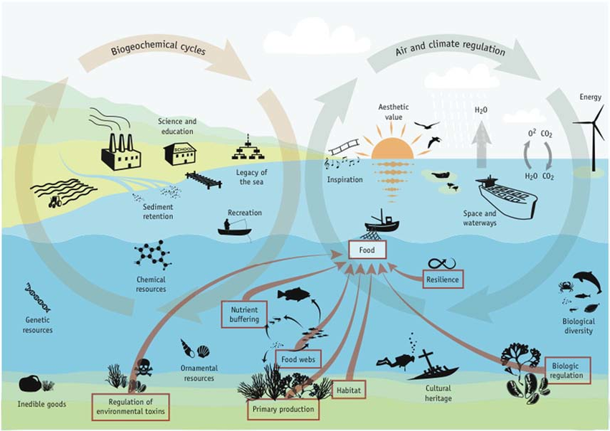
Baltic Sea situation analysis
Human activities
  Nutrient loading, fishery, shipping, tourism, aquaculture, wind farms
Natural variability and climate change
  Increased sea temperature
  Sea level rise
  Changes in precipitation and related river runoff and salinity
  Changes in winds and related vertical mixing and Baltic-North Sea transport
SwAM, 2013
Ecosystem change
Response of LTL to physical and human pressures
Eutrophication (Algae bloom, hypoxia)
Response of HTL to LTL and pressures

Slide 3
Instruments for solutions
Monitoring
Modelling
Assessment
Sustained, cost-effective
Knowledge generation
Unified, seamless, coupled
Rapid, operational, adaptive, integrated
Prediction
Management
Ecosystem-based, Knowledge & fact based
Fit-for-purpose, accurate
Policies for member states to implement:
  MSFD, WFD, MSP, HABITAT, CFP
BOOS and CMEMS (波罗的海业务海洋学系统和哥白尼海洋服务):
  operational monitoring, forecast and services
HELCOM (波罗的海环境保护委员会):
  offline monitoring, assessment, management
EMODnet (欧洲海洋数据网):
  data collection and integration
BSHC/IHO (波罗的海水文委员会):
  Bathymetry and maritime transport
VASAB(波罗的海远景战略委员会):
  Marine spatial planning

Slide 4
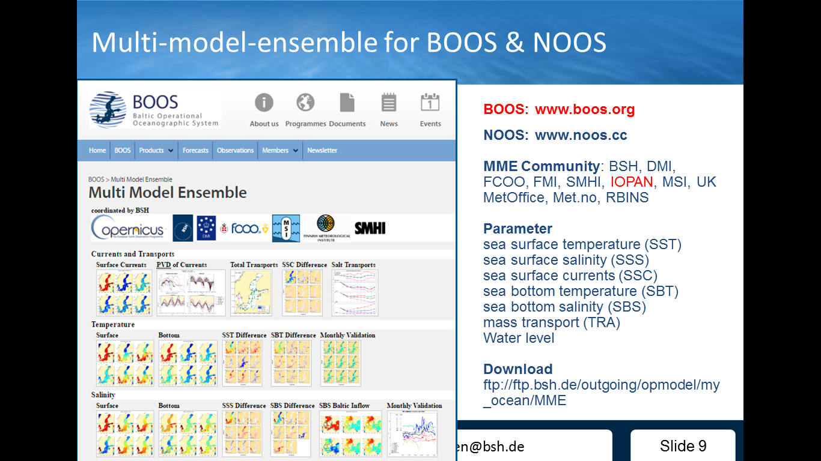
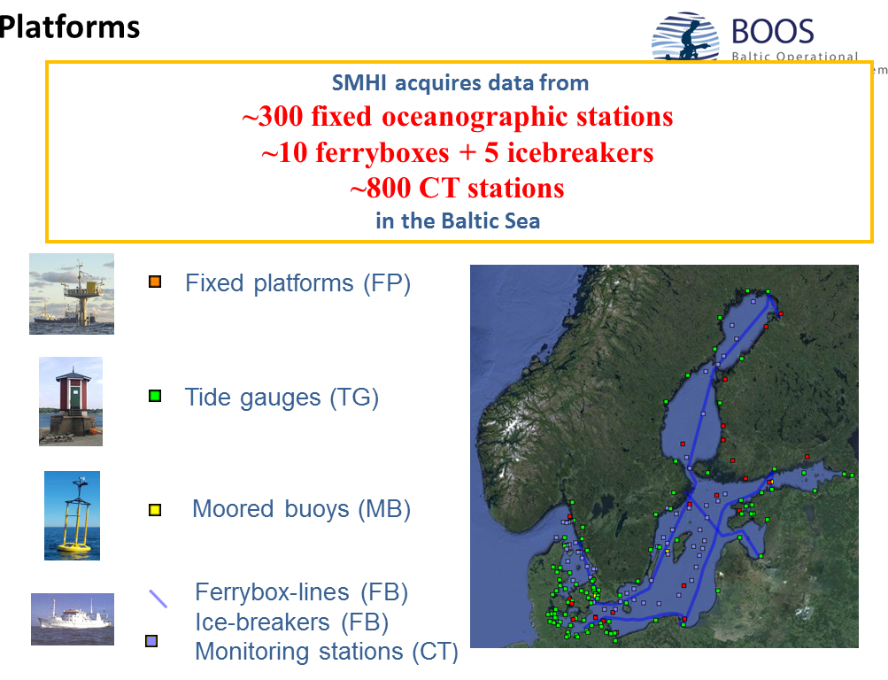
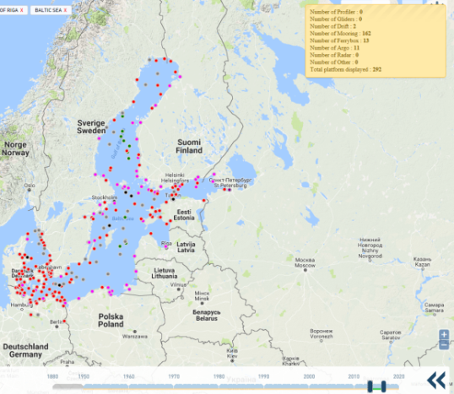
Operational services
PHY & BIO Forecasting systems : HBM-ERGOM, NEMO-SCOBI
Monitoring: BOOS, Argo, gliders, ferrybox, moorings etc
波罗的海-北海多模式集合预测系统
波罗的海业务观测系统

Slide 5
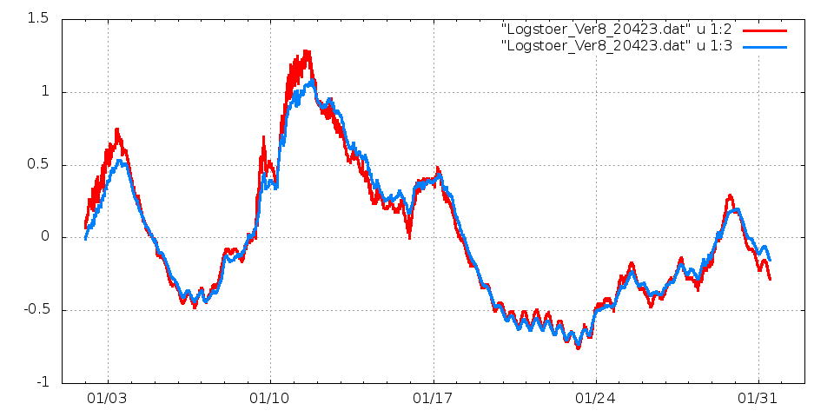
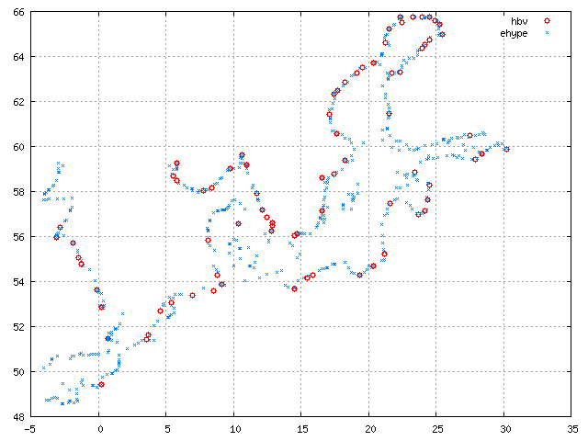
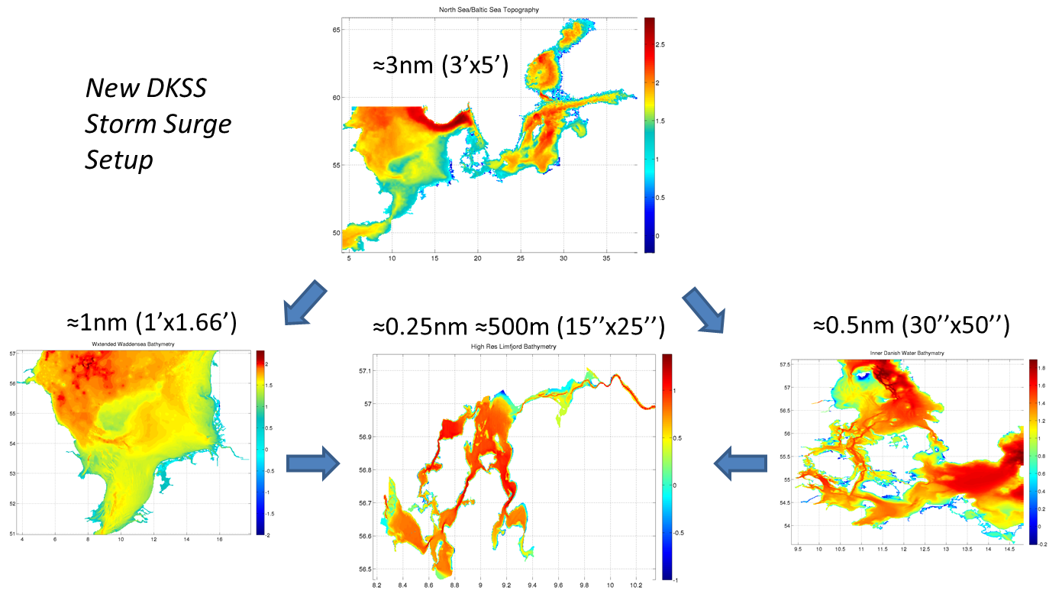
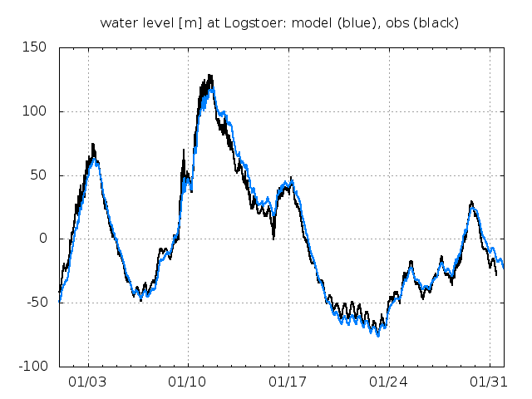
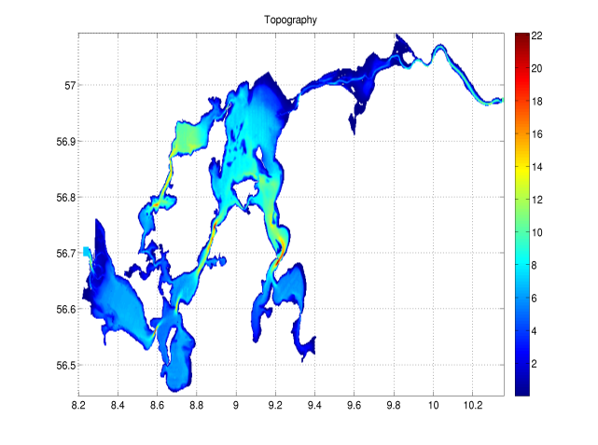
Seamless modelling: Danish ocean-ice forecasting system to resolve coastal-estuary continuum
Logstoer, 500m
resolution
径流输入
预报-观测对比
Logstoer, 185m
resolution
预报-观测对比
双向嵌套高分模式
185m resolution

Slide 6
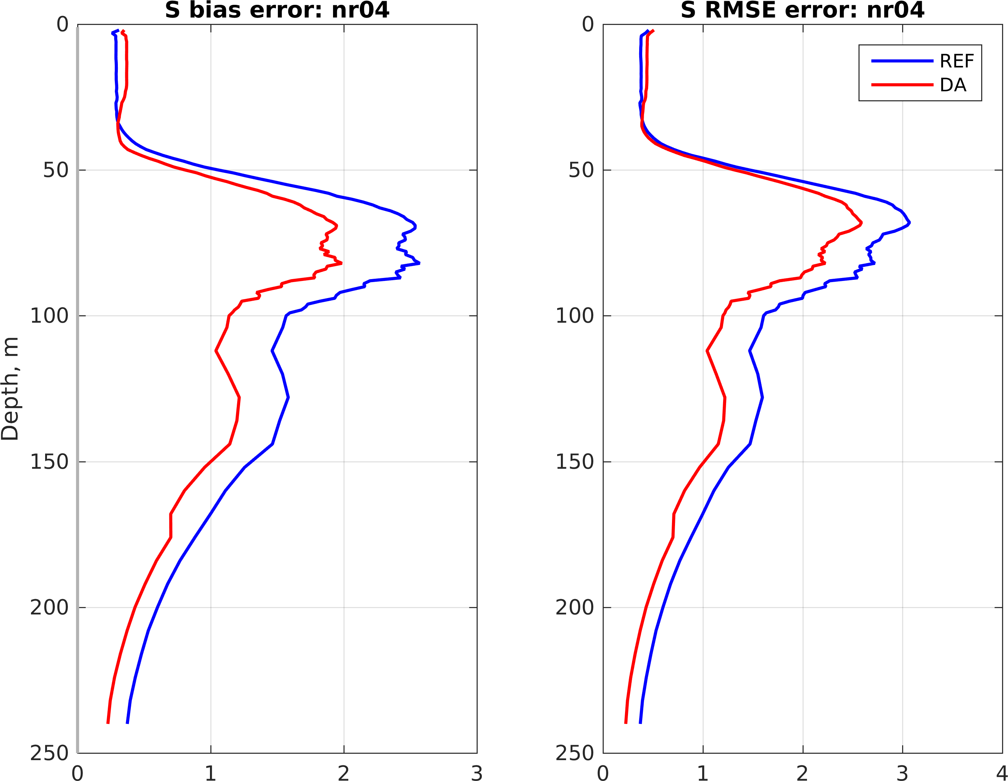
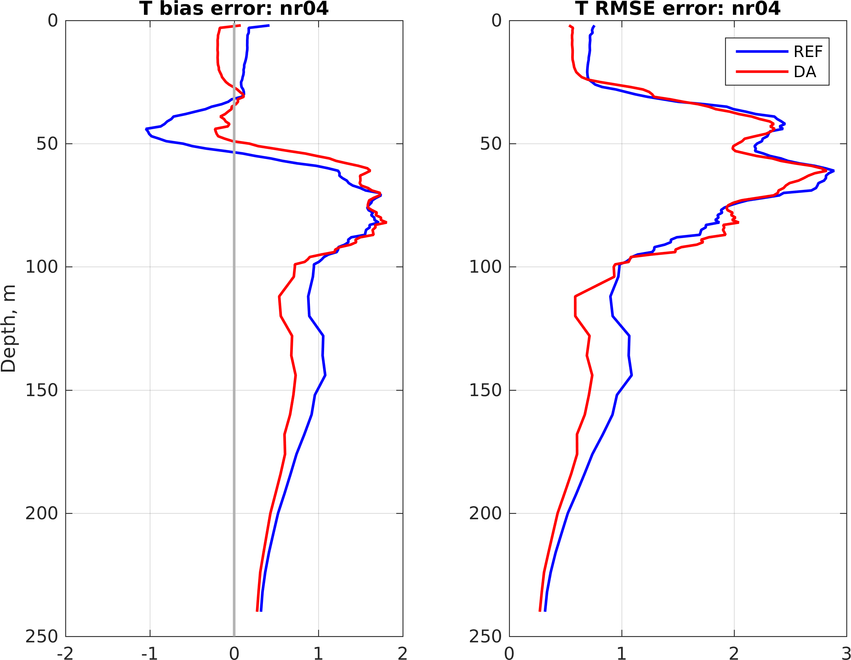
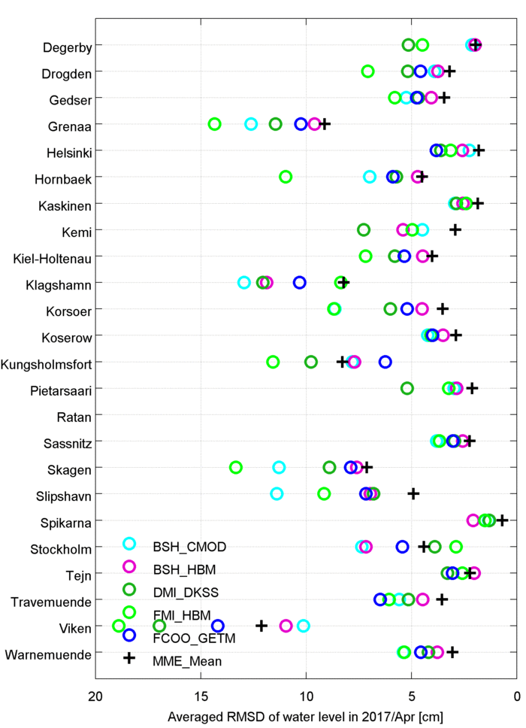
Product validation
波罗的海温度RMSE
波罗的海盐度RMSE
BALMFC 海浪预报, 有效波高检验, 1海里分辨率
波罗的海多模式水位集合预报:
站位-RMSD (2017年4月).

Slide 7
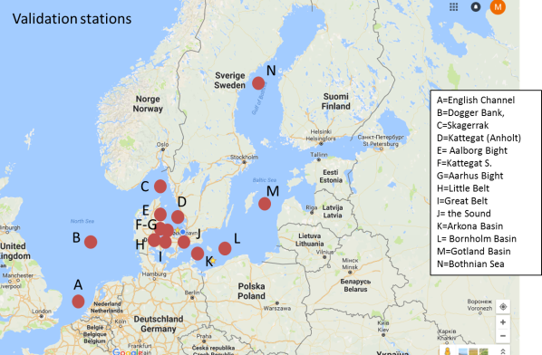
生态模式检验, Maar et al. (2016)

Slide 8
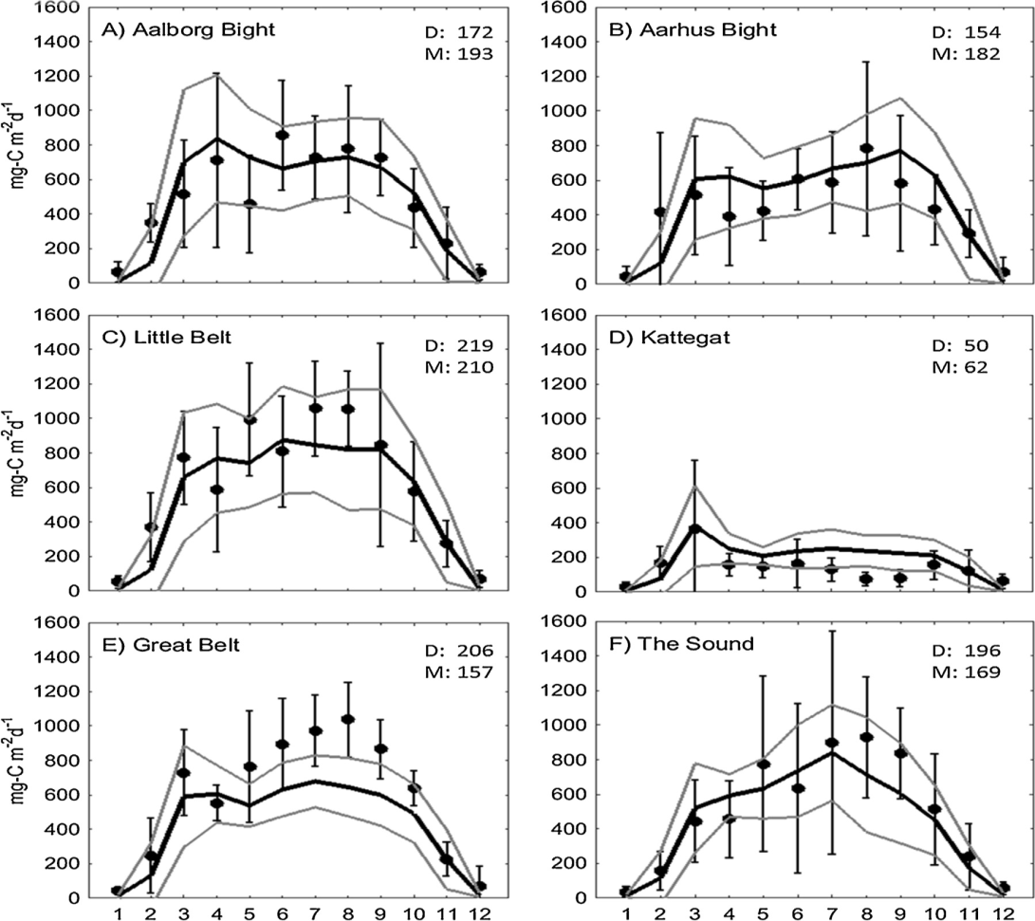
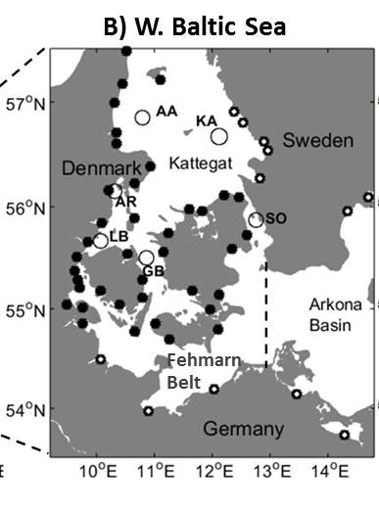
Primary production
(Maar et al, 2016; 基础生产力检验)
Monthly means 2001-2009
Data ± SD (•)
Model (black line)
Model mean ±SD (grey lines)
Only surface
All stations: R² = 0.59, PMB= 1%, nSD=0.83

Slide 9

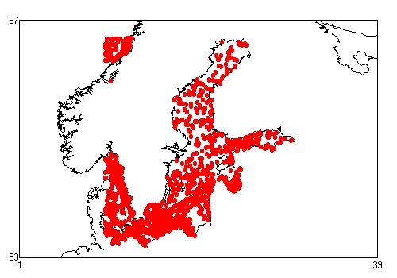
Integration of online and offline observations
线上线下集成
SST:
  More integration of satellite and BOOS (esp. Ferrybox) observations
T/S:
  More integration of BOOS (mainly coastal) and Helcom/ICES (mainly offshore) observations
  NRT delivery of R/V data
  Adding adaptive observations eg from gliders
Sea level:
  More integration of satellite and BOOS tidal gauge data
Offshore wind profile & currents:
  Not sufficiently monitored and shared
线上: BOOS
线下: ICES/HELCOM

Slide 10
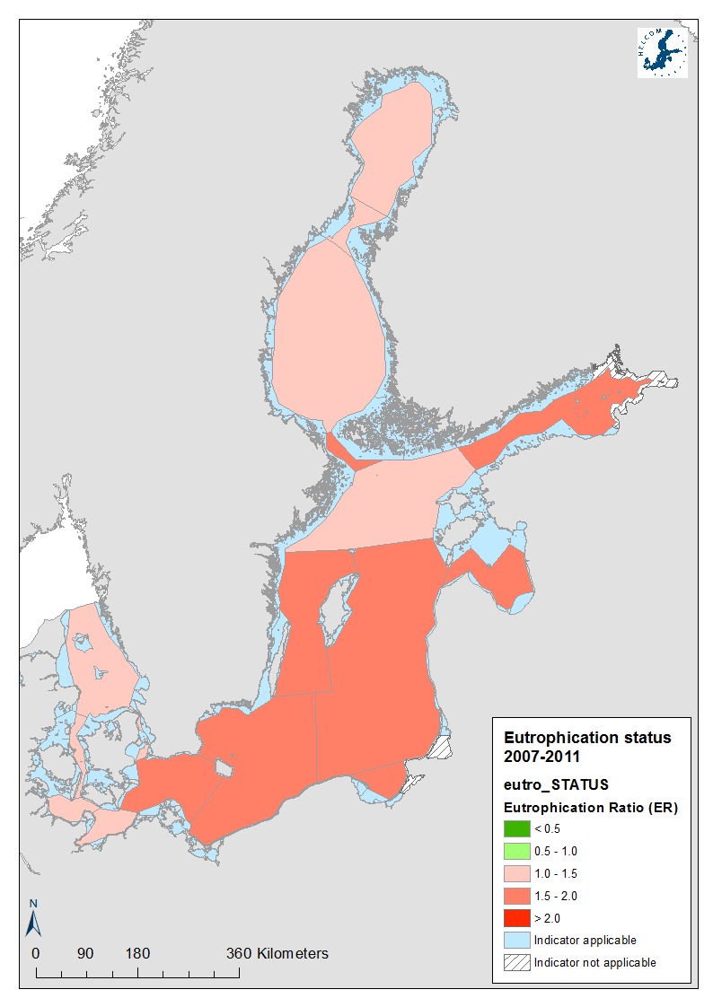
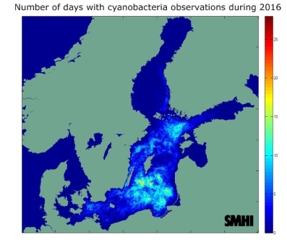
HELCOM eutrophication assessment
2016夏季藻华日数
5 year assessment (in-situ data only):
  2001-2006
  2007-2011
  2012-2016 (in preparation)
Yearly fact sheets (satellite data used)
  Öberg, J., 2016. Cyanobacteria blooms in the Baltic Sea. HELCOM Baltic Sea Environment Fact Sheets 2016. Online.
2007-2011 富营养状态

Slide 11
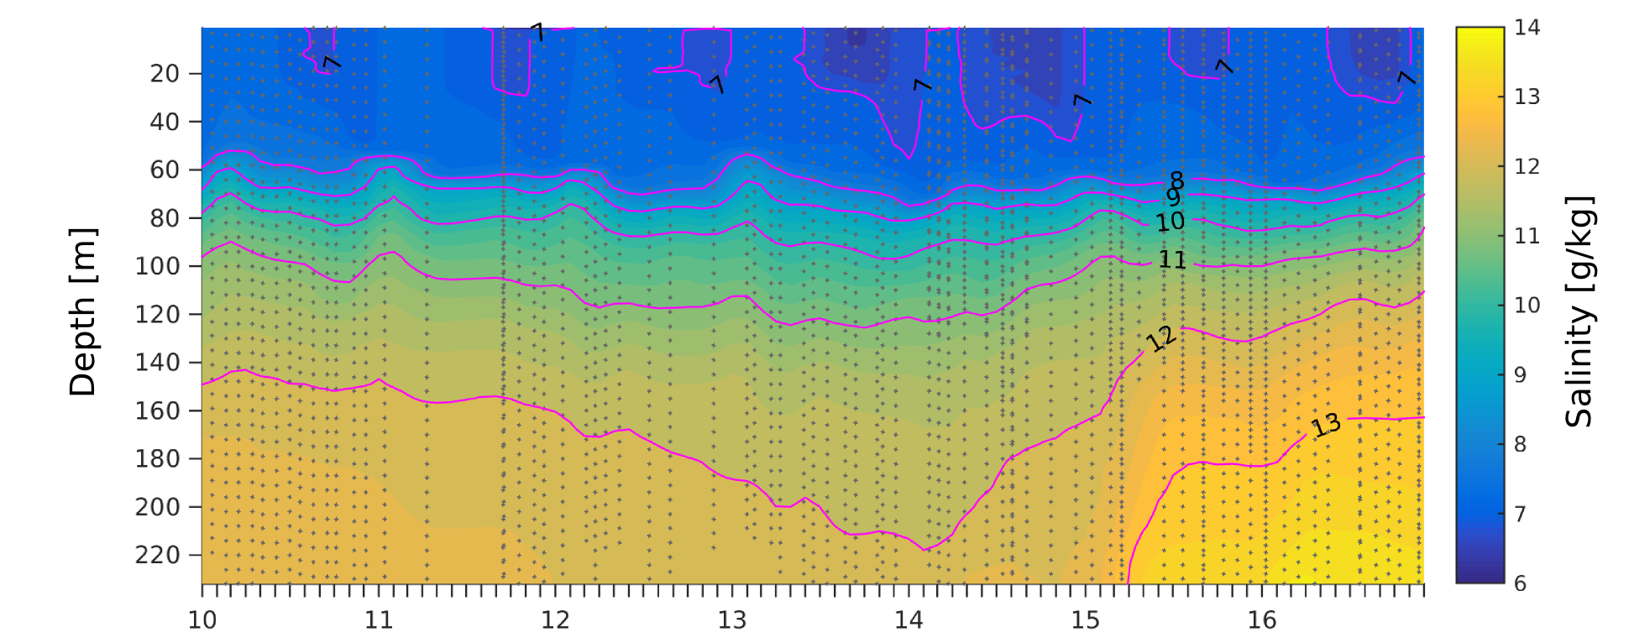
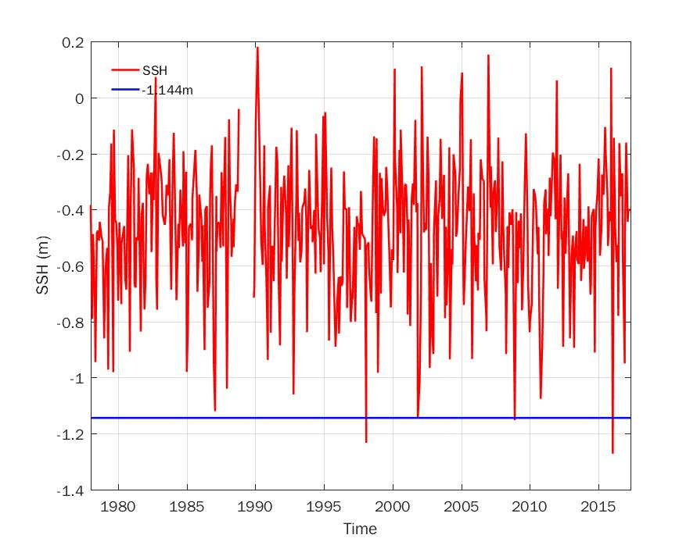
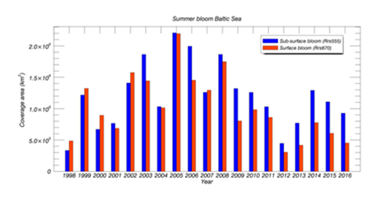
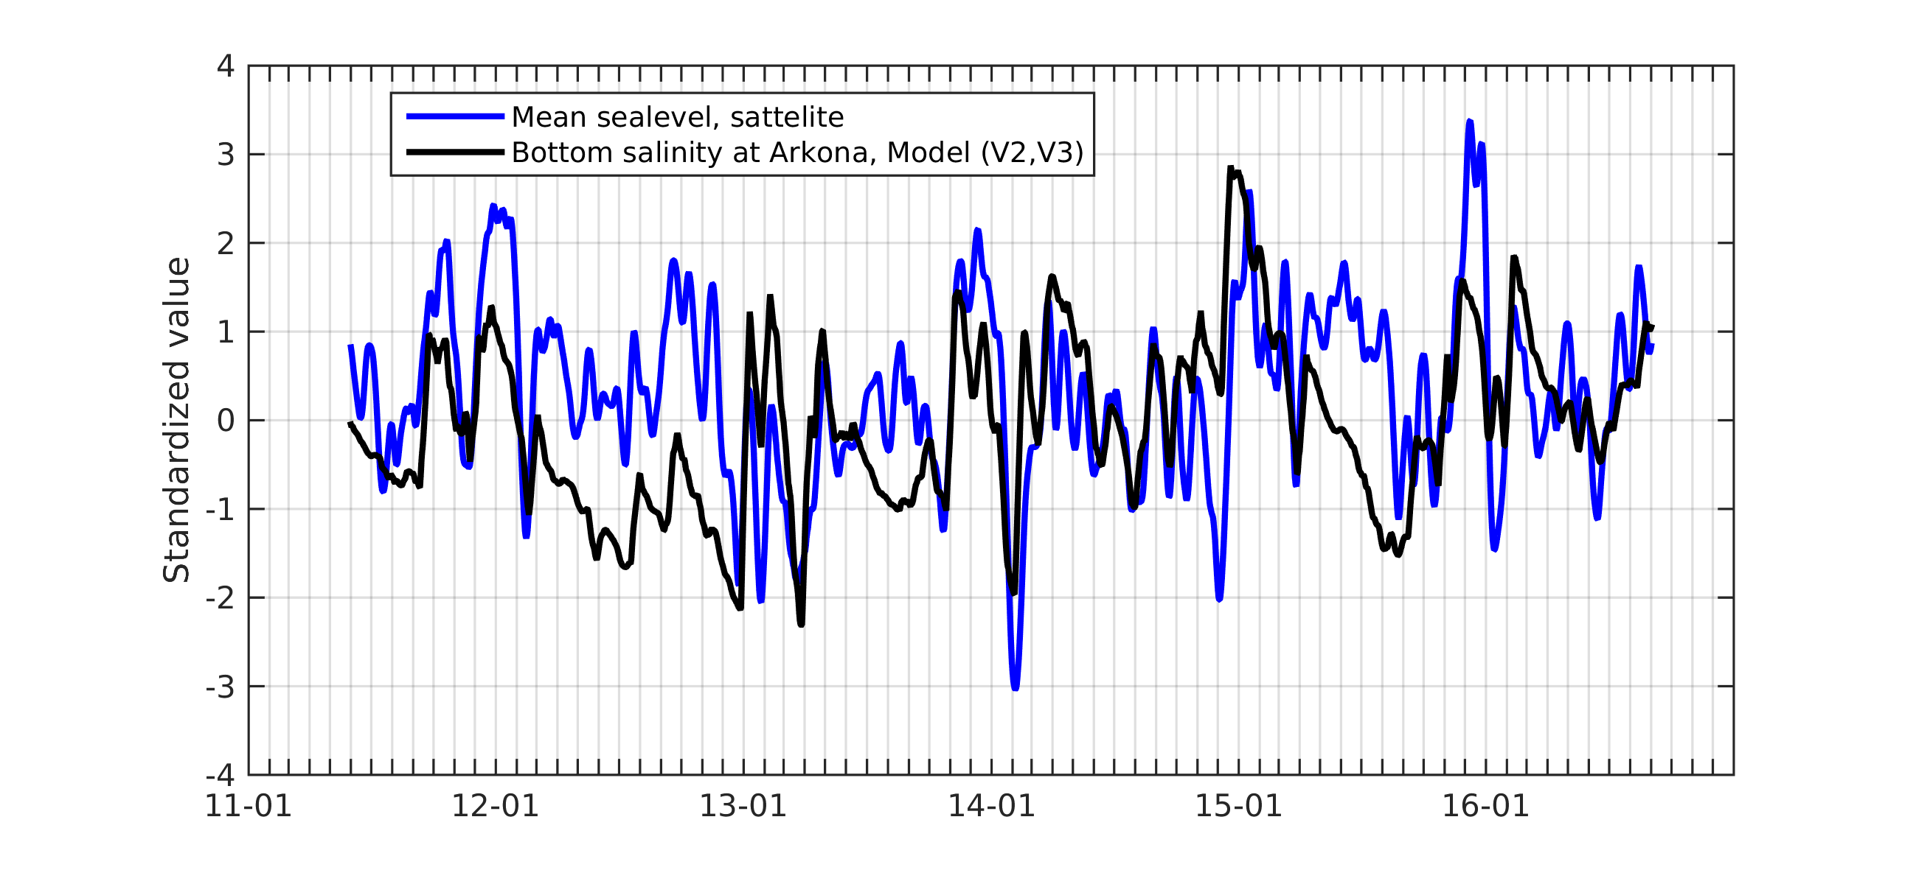
CMEMS Ocean State Report 2016: Baltic Sea inflow, Eutrophication, hypoxia, low sea level event (BAL MFC, CNR)
Salinity at Baltic Proper
Monthly min. Sea level at Kemi – N. Baltic
Summer bloom spatiotemporal coverage
Salinity & mean sea level

Slide 12
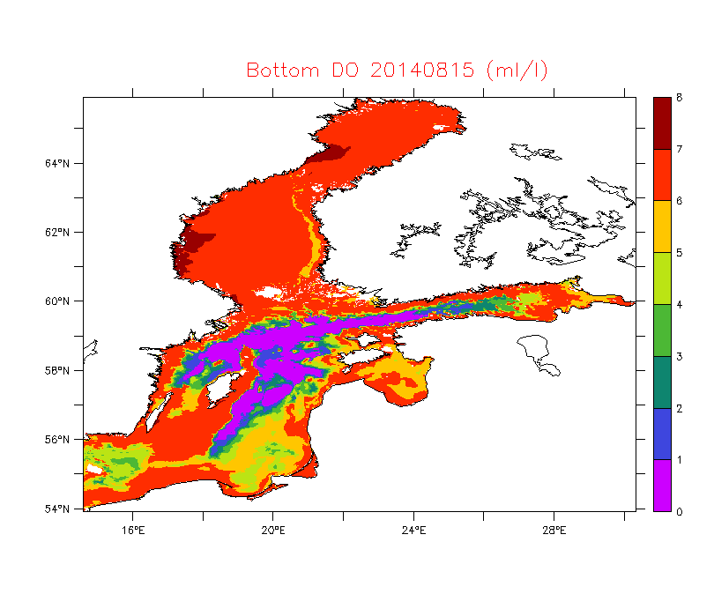
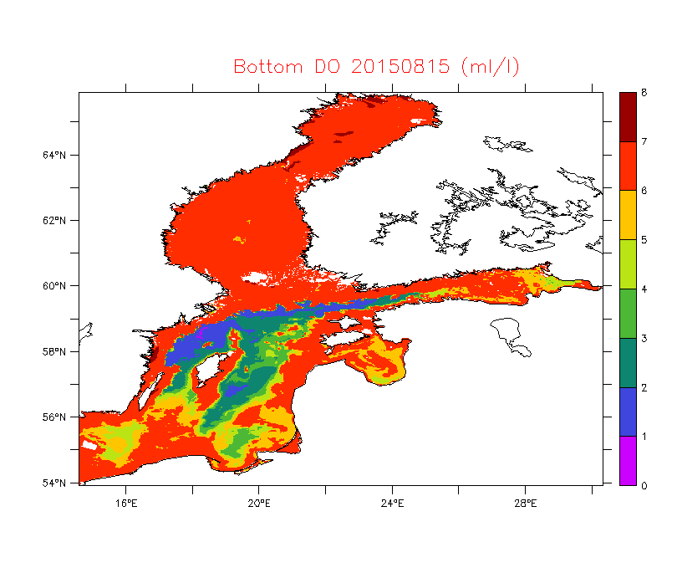
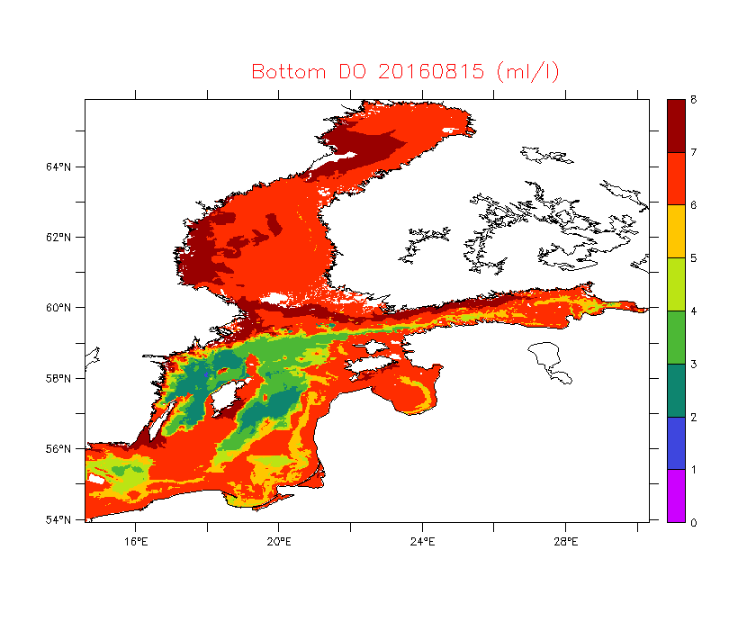
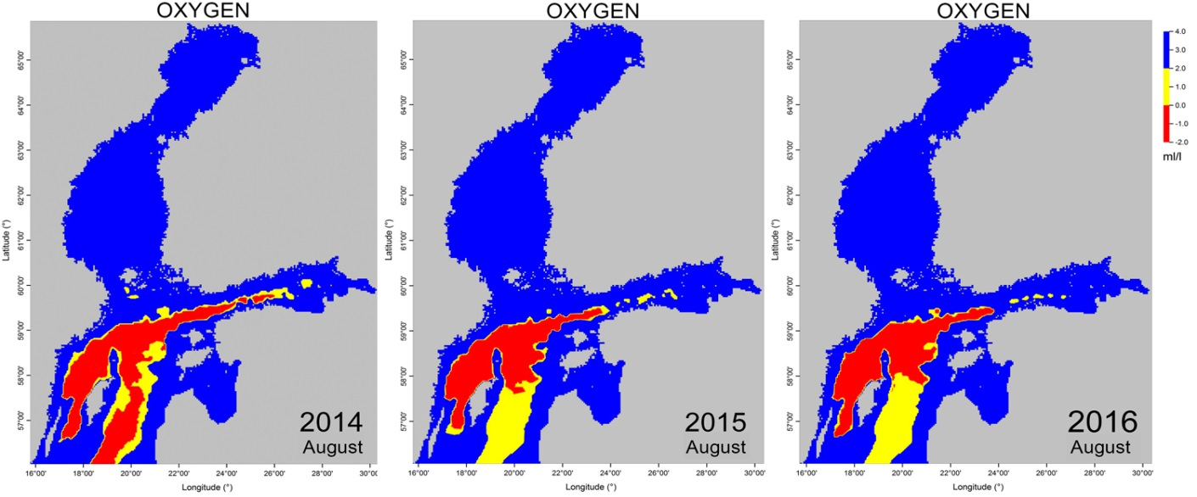
OSR Eutrophication 2016: bottom oxygen
Oxygen situation near the seabed in the Baltic Sea in 15 August 2014, 2015 and 2016, BAL MFC (ERGOM模式底层溶解氧, 2014-16 8.15)
Oxygen situation near the seabed in the Baltic Sea in August 2014, 2015 and 2016 © SYKE
(观测底层溶解氧, 2014/16 8.)

Slide 13
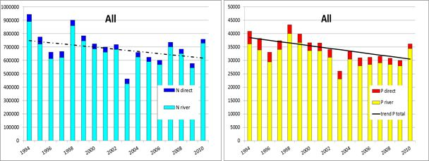
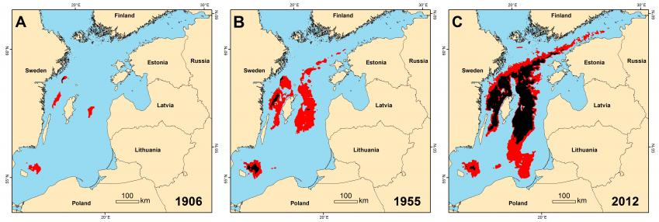
LTL response to human & natural pressure
低营养层对人类和自然压力的响应
水携营养盐入海载荷年际变化: nutrint load
Nutrient load has been reduced since 1990s
Eutrophication has not been improved as expected. Climate change (eg increase of temperature) makes the reversal of eutrophication more difficult.
Oxygen condition was 10 times worse in 2012 than a centuary ago
底层溶解氧: 1906, 1955, 2012; red: hypoxia; black: anoxia
MBI index
波罗的海主要入流事件指数 (1900-2014)

Slide 14

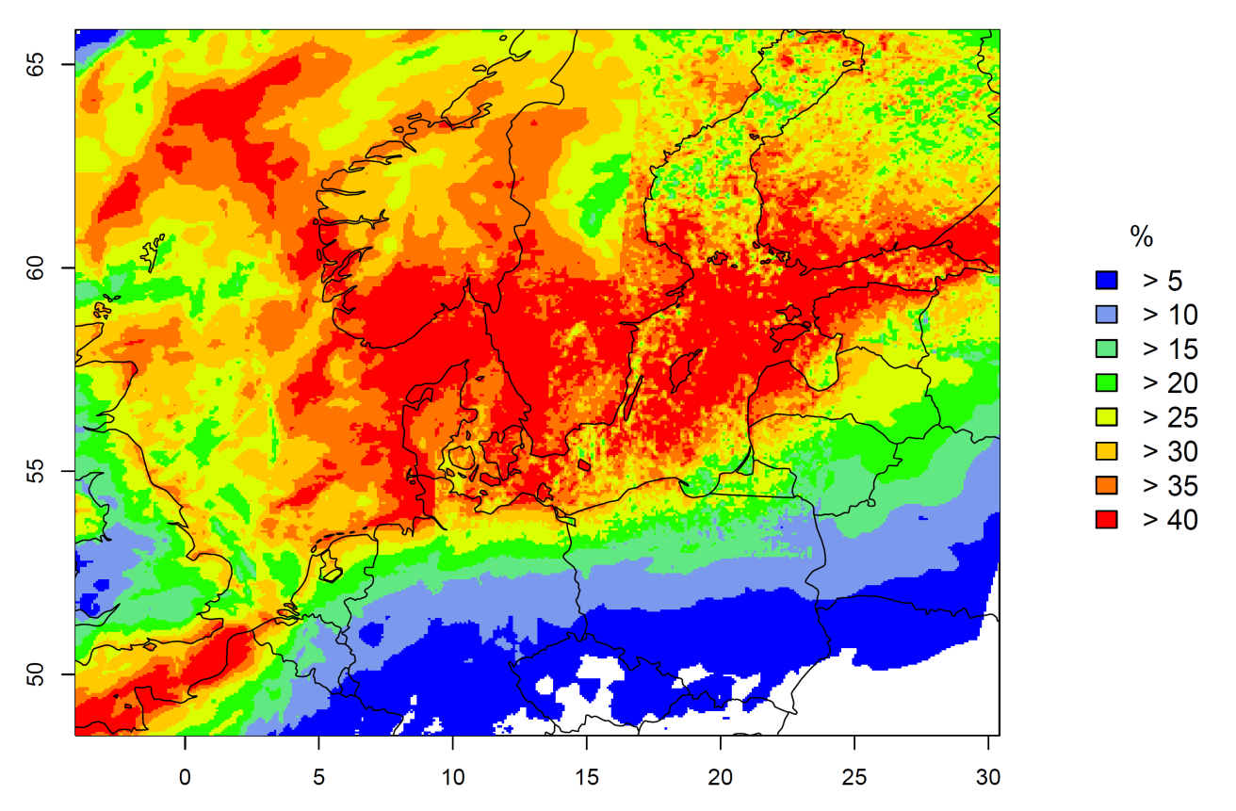
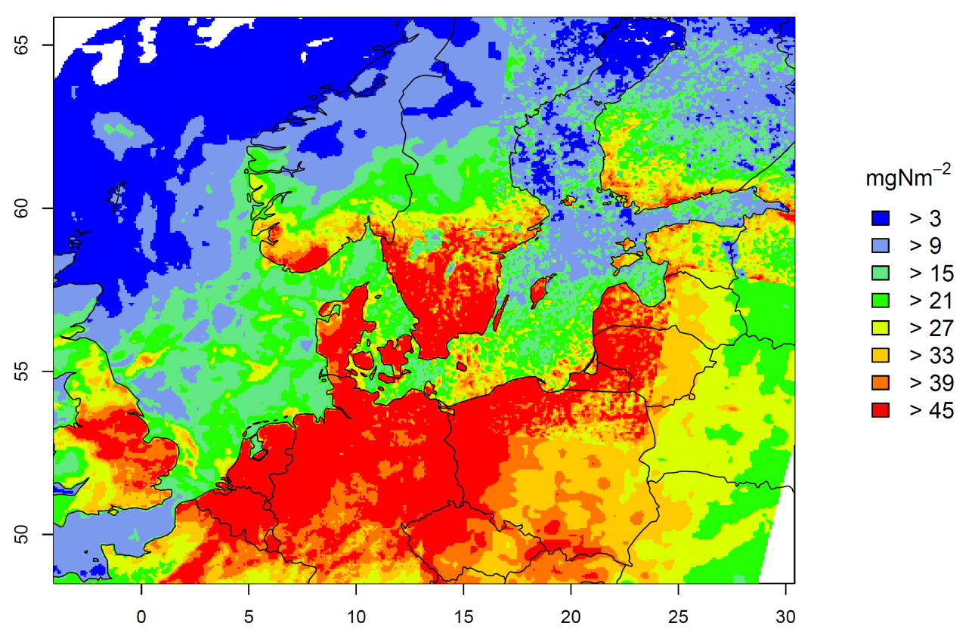
Nitrogen deposition from Shipping
total deposition of Nox July 2012
2012年7月大气沉降
contribution by shipping July 2012
2012年7月航运导致的大气沉降
volker.matthias@hzg.de

Slide 15

Nutrient tagging
Goal: estimate of contribution of anthropogenic nutrient input to
algea blooms and eutrophication (人类活动营养盐输入流动轨迹)
> Simulations with tagged nitrate input
Ship emissions
and other sources
Nitrate
River loads
Nitrate
Diatoms
Nitrats
Nitrogen compounds
Daniel.neumann@io-warnemuende.de

Slide 16
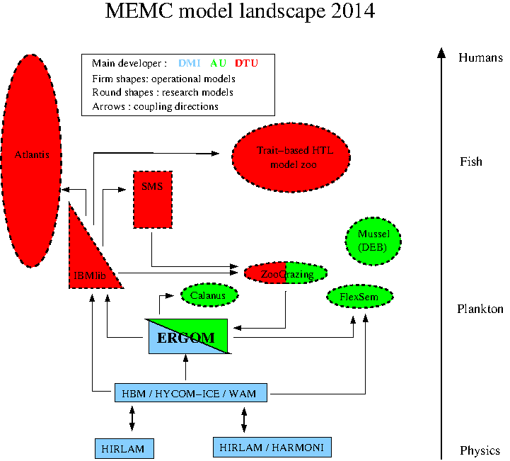
Beyond Eutrophication： end2end modelling (Danish system, 2006-)

Slide 17
Thank you for your attention!
谢谢！

