Slide 1
Study to Support a Sustainable Algae Industry
ROHELINE VIHMAVARI OÜ
CINEA/2023/OP/0006/SI2.906327
online
25th June 2024
Notes:
You (company/researcher/ association/NGO,…) can let us know, if you are interested in getting involved!
-> Chance to shape this study, which is
supposed to give advise to the algae industry but also
the authorities & policy makers!
CINEA (European Commission agency which manages decarbonisation and sustainable growth)​
& DG MARE (Directorate-General for Maritime Affairs and Fisheries)

Slide 2
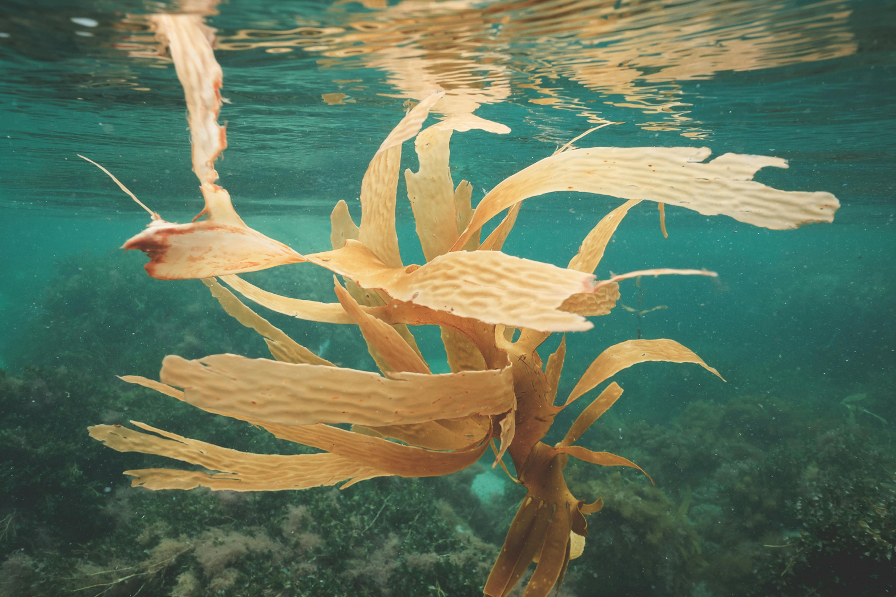
Study Objectives
Algae as key pathway to addressing: food security, climate change mitigation, employment and waste-related issues
Project: understand the potential, risks, challenges to the development of a sustainable EU algae sector
6 distinct topics (work packages) > comprehensive picture of whether/how algae can support the objectives of the EU Green Deal
Picture: Seaweed growing on bottom of sea

Slide 3
Work Plan
Year |  | 2024 |  |  |  |  |  |  |  |  |  |  | 2025
Calendar | 14.1. | 14.2. | 14.3. | 14.4. | 14.5 | 14.6. | 14.7 | 14.8. | 14.9 | 14.10. | 14.11 | 14.12. | 14.1. | 14.2. | 14.3. | 14.4. | 14.5. | 14.6.
Month | 1 | 2 | 3 | 4 | 5 | 6 | 7 | 8 | 9 | 10 | 11 | 12 | 13 | 14 | 15 | 16 | 17 | 18
Work Packages 1-6
literature research and data collection
stakeholder consultations (interviews, surveys)
analysis and synthesis of findings
validation (stakeholder workshops)
development of final reports
The final reports will seek to create new knowledge and concrete recommendations
on how to move forward towards a sustainable algae industry in the EU.

Slide 4
Work Package 2 Nutrients for organic microalgae/cyanobacteria production

Slide 5
EU Algae Initiative
Project Work Package 2 | EU Algae Communication Action from the European Commission
Nutrients for organic microalgae/cyanobacteria production | Action 8 - work with the algae industry and member States to: A. Identify valid and safe alternatives to the use of nutrients and CO2 from various sources for microalgae cultivation & organic certification (B. Promote the extraction of nutrients from algae biomass → WP3) C. Support the life cycle assessment of the environmental and climate impact of algae cultivation and production
Notes:
- EU Algae Initiative promised 23 actions regarding algae (will be completed 2030)
Many of the listed actions will be fulfilled by ALIS
- ALIS plays a core role in the EU Algae Initiative
C - by considering the development of monitoring methodologies and indicators to measure the environmental impact and sustainability of seaweed cultivation

Slide 6
Objectives
Assessment of the state of play of alternative sources of carbon & nutrients for organic microalgae cultivation for fertiliser markets, with emphasis on analysing legal framework & interpretation of EU laws by Member States
A set of validated recommendations of viable alternative sources of carbon & nutrients considering economic, legal and environmental dimensions

Slide 7
Methodology
Output | Planned Content
1. Landscaping of EU, national strategies, implementation plans, laws & industry standards | 1 - EU regulations relevant to using algae as ingredient in fertilizers for organic farming, including organic production scenarios with seaweeds 2 - Regulation 2021/1165 on using recycled carbon and nutrients in production of organic microalgae as fertiliser for organic farming
2. Hypothetical scenarios of microalgae cultivation settings for alternative sources for nutrients and CO2 for organic microalgae production | 1 - Alternative sources of nutrients and carbon aimed for production of organic algae-based fertilisers 2 - Hypothetical scenarios for North European cold climates and South European warm climates (economic, environmental, legal dimensions)

Slide 8
Stakeholder Involvement
Planned activities:
Surveys & interviews - to analyse the interpretation of law 2021/1165.
Workshop - with WG to investigate implications of using viable alternative sources for organic microalgae cultivation
If you want to get involved - let us know!
tms@sustainable-projects.eu

Slide 9
Thank you!
ROHELINE VIHMAVARI OÜ

