Slide 1
Update on the implementation of the European Fund for Strategic Investments (EFSI)
MEMBER STATES EXPERT GROUP ON MARITIME POLICY. Brussels, 09.12.2015
Juan Ronco, EU-Commission - DG Fisheries and Maritime Affairs

Slide 2
EU Investment Plan: 3 pillars
1. MOBILISING FINANCE FOR INVESTMENT
2. MAKING FINANCE REACH THE REAL ECONOMY
Boost investment in strategic projects and access to finance via the European Fund for Strategic Investments (EFSI) within EIB/EIF
Cooperation with National Promotional Banks and the EIB
European Investment Project Portal
European Investment Advisory Hub: technical assistance
3. IMPROVED INVESTMENT ENVIRONMENT
Predictability and quality of regulation
Removing non-financial, regulatory barriers in key sectors within EU Single Market
Structural reforms at national level

Slide 3
1. European Fund for Strategic Investments
EFSI risk-bearing capacity
€ 21bn
EU budget
guarantee
€ 16bn
€ 5bn
3x
EFSI
EIB / EIF financing
∼ € 61 bn
Infrastructure & Innovation window
SME window
5x
Investments
∼ € 240 bn
SMEs and mid-caps
∼ € 75 bn
Investment value
∼ € 315 bn
Total over 3 years:
∼ € 315 bn

Slide 4
EFSI: eligible sectors
Research, development and innovation
Energy (ref. Energy Union priorities)
Transport infrastructure
Information and Communication Technologies
Environment and resource efficiency
Human capital, culture and health
Support to SMEs and mid-cap companies

Slide 5
Key features of EFSI /1
Focus on investments in real economy
Results on growth and jobs
Market-driven, no political interference
No geographic or sector pre-allocation
Consistency with EU policies
Leverage / crowd-in private sector and third parties
Economic and technical viability
Additionality vs existing instruments
Market failures and sub-optimal investment
Higher risk-taking than EIB normal activity in EFSI timeframe

Slide 6
Key features of EFSI /2
Size of investments
EIB normally requires >€25m for individual loans
Smaller schemes can be grouped into framework loans
No size restriction for operations via Fin. Intermediaries (eg for SMEs)
Geographic scope
EU28
Projects involving an entity in a MS and extending to Enlargement, EU Neighbourhood, EEA, EFTA, OCTs countries.

Slide 7
EFSI in combination with other EU funds
ESIF (EU Structural and Investment Funds) programmes may contribute to the achievement of the objectives of the Investment Plan and be complementary to EFSI support.
ESIF may join EFSI supported projects where this would ensure a higher value added of EFSI support.
Further guidance will be provided by the Commission in the coming months.

Slide 8
EFSI Scoreboard
Ensure EU Guarantee is directed to projects with high V/A
Part of EIB due diligence -> Investment Committee
Scoring of each project
4 pillars
Contribution to EFSI policy objectives
Quality and soundness of the project
Technical and financial contribution
Complementary indicators
Additionality, Macro-economic indicators, Multiplier, Private finance, coop. with NPBs, cofinancing with EU, Energy efficiency, Climate action

Slide 9
EFSI Governance
EFSI Steering Board (EC/EIB)
Strategic orientation
Policy setting
EFSI Investment Committee (8 independent experts)
Decisions on use of EU guarantee for each operation based on Investment guidelines
EFSI Managing Director & deputy
Daily management

Slide 10
Opportunities for promoters/investors
Project level
Cofinancing with EIB/EIF
Investment Platforms
Pooling of projects with thematic or geographic focus
Flexible legal setup (e.g. contractual, Fund)
Can benefit from EU Guarantee via EIB
Cooperation with EU National Promotional Banks
High interest by institutional investors and SWFs

Slide 11
Status and next steps
Status
EFSI regulation approved by EU Institutions.
Projects already approved by EIB/EIF.
EFSI Steering Board Members appointed
EFSI Managing Director and Deputy appointed.
EFSI Investment Committee (members identified, operational from 01.01.2016)
European Iinvestment Advisory Hub operational.
Next steps
Strategic orientations, rules for Inv. Platforms/NPBs.
European Investment Project Portal operational by early 2016.

Slide 12
List of EIB approved operations/1 (Apr-Oct 2015)
Project | Country | Project cost | EIB financing (EFSI)
Bioscience R&D | Spain | € 240m | € 100m
Primary care PPP | Ireland | € 142m | € 70m
Industry modernisation | Italy | € 227m | € 100m
Renewable energy | Denmark | ≈ € 2,000m | ≈ € 75m
Energy efficiency in buildings | France | € 800m | € 400m
Gas transmission | Spain | € 326m | € 160m
Pulp production upgrade | Finland | € 1,225m | € 75m
Biotech/Chemical RDI | Spain | € 313m | € 50m
Health care |  | € 110m | € 60m
Smart meters | UK | ≈ € 1,378m | ≈ € 460m
Renewable energy equity fund | France | € 1,000m | € 50m
Renewable energy projects | Germany/France | € 300m | € 150m
Port upgrade | Netherlands | Not disclosed | Not disclosed
Offshore wind * | Belgium | € 653m | € 200m
Low-carbon projects * | France | Not disclosed | € 20m
Healthcare PPP * | UK | ≈ € 485m | ≈ € 166m

Slide 13
List of EIB approved operations/2 (Apr-Oct 2015)
Project | Country | Project cost | EIB financing (EFSI)
Financing for SMEs * | Netherlands | Not disclosed | € 24m
Financing for Midcaps * | Croatia | Not disclosed | € 50m
Renewable energy equity type* | Ireland | ≈ € 1,000m | Not disclosed
Offshore wind * | UK | Not disclosed | ≈ € 311m
Transport upgrade * | Italy | € 500m | Not disclosed
High-speed broadband * | France | € 600m | € 147m
High-speed broadband * | France | Not disclosed | Not disclosed
Transport upgrade * | Slovakia | € 1,300m | € 500m
Offshore wind * | UK | ≈ € 2,655m | ≈ € 300m
Energy efficiency * | UK | ≈ € 547m | ≈ € 137m
TOTAL |  | ≈ € 19,500m | ≈ € 4,000m
* Pending EC approval of the use of EU Guarantee

Slide 14
Example of EFSI project
Innovative renewable energy infrastructure fund in Denmark
EIB, backed by EFSI, provides equity-type financing of up to EUR 75m to Copenhagen Infrastructure Partners for an innovative infrastructure fund investing in large energy-related projects such as offshore wind, biomass and transmission schemes.
EIB's equity participation would contribute to the fund’s overall market credibility with institutional investors and help broaden its investor base to an international one.
The anticipated high share of offshore wind, biomass and transmission investments is expected to generate considerable employment in the construction phase (2500 - 4000 jobs). It is also estimated that some 1000 jobs may be created during the project’s operation, a significant number of which will be highly-skilled jobs.

Slide 15
SMEs and mid-cap window
SOURCES
OF FUNDING
TYPICAL PRODUCTS OFFERED
FINAL RECIPIENTS AND EXAMPLES
European Fund for Strategic Investments
The Fund serves as credit protection for new EIF activities
Venture Capital
Other investors join in on a project basis
SME
e.g. equity in a start-up
Guarantees
e.g. micro-loans to a SME
Securitisation
Mid-cap
company
e.g. loans for R&D project
Growth finance
e.g. venture capital for a prototype

Slide 16
EIF signatures Apr-Oct 2015
Project | # transactions | Investment triggered (est.) | EFSI financing commitment
EIF risk capital | 31 | € 10,598m | € 953m
EIF guarantees for SMEs portfolios | 23 | € 6,989m | € 292m
TOTAL | 54 | € 17,587m | € 1,245m
in 11 countries of EU-28: Belgium, Bulgaria, Czech Republic, France, Germany, Italy, Luxembourg, Netherlands, Poland, Portugal, UK.
Some 65 000 SMEs and Midcaps are expected to benefit from enhanced access to finance.

Slide 17
Example of EFSI-backed EIF operation
EIF and bpifrance sign first agreement for innovative French companies
The deal benefits from the support of the European Fund for Strategic Investments (EFSI) through which the Investment Plan for Europe is being deployed by the European Commission and the EIB Group.
Under the agreement, bpifrance will provide finance to innovative companies in France for a total of EUR 420 million over the next two years, allowing EIF to provide a new financing boost for highly innovative businesses under the Horizon 2020 initiative InnovFin, the EU's Finance for Innovators. Bpifrance has recently launched a product called "Prêt d'Amorçage investissement" ("PAi") to address the needs of start-up companies. It will combine this product with the EU guarantee at a 40% guarantee rate.

Slide 18
2. Making finance reach the real economy
Transparency on the investments in Europe
European Investment Project Portal – any public/private entity
Matching investment opportunities proposed by project sponsors with investors' interest
Strengthening advisory services
European Investment Advisory Hub (EIAH) – EC/EIB
Technical assistance
Pooling resources & expertise including from MS

Slide 19
European Investment Project Portal
Bridge between EU's investment opportunities and potential investors.
A web portal enables EU-based project promoters (public authorities, private, PPP) to share their investment proposals seeking external financing, in a transparent way.
Investors can search for opportunities across Europe (size, sector, geography).
Effective form of presenting new project ideas to the market (G20/ OECD experience).

Slide 20
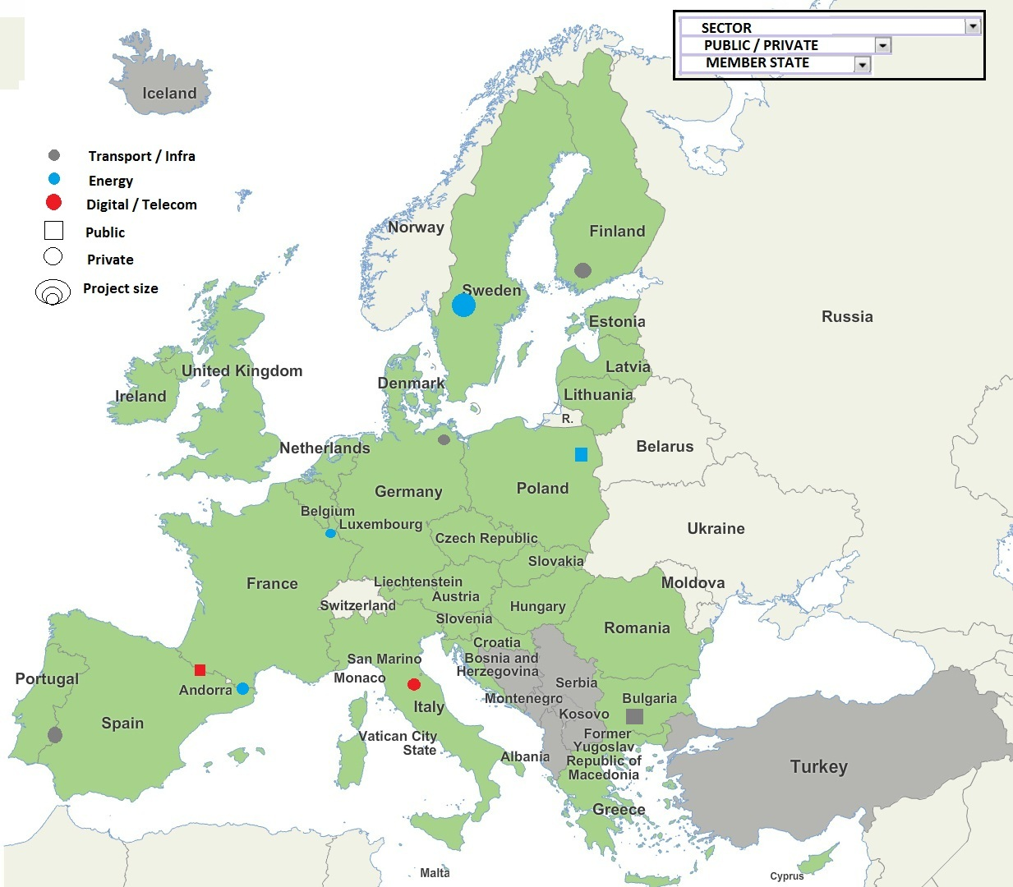
European Investment Project Portal
Prototype

Slide 21
What is the Advisory Hub (EIAH) ?
A joint initiative by the European Commission and the European Investment Bank
A tool to strengthen Europe's investment and business environment
A single access point to a 360 degree offer of advisory and technical assistance services
A cooperation platform to leverage, exchange and disseminate expertise
An instrument to assess and address new needs for advisory support

Slide 22
3. Improved investment environment
Better and more predictable regulation at all levels
Making most of the Single Market
Energy Union
Digital Single Market
Capital Markets Union: action plan
Services Market
Structural reforms in the Member States
Openness to international trade and investment

Slide 23
Thank you for your attention – more information available at:
http://ec.europa.eu/priorities/jobs-growth-investment/plan/index_en.htm
http://www.eib.org/about/invest-eu/index.htm
#investEU
#EFSI

