Slide 1
Results of the eSens workshop and its re-usability for CISE
Technical Advisory Group
18th November 2015

Slide 2
Context
The e-SENS project aims at facilitating the access of citizens and businesses to public services across borders.
The project will:
    Provide easy access to public administration online,
    Use the potential of ICT, to ensure interoperability across different national systems,
    Develop generic and re-usable architectural building blocks for electronic services in public administration.
Notes:
e-SENS covers four main solution patterns (another part called “Trust” was also briefly discussed during the workshop):
e-Delivery
e-Document
e-ID
e-Signature
Benefits of using eSens:
To reduce the risk and speed up the developments
To benefit from the experience from another large scale project
To show coherence between projects…
To benefit from the support
To benefit from the financing from the CEF program
…

Slide 3
EUCISE2020-eSENS Workshop
Held in the JRC premises (Ispra), 3 days in July 2015
Objectives
    To improve the level of general understanding of e-SENS
    To analyse the reuse of the e-SENS specifications for the EUCISE2020 project and CISE, in general
    To analyse the reuse of the e-SENS software for the EUCISE2020 project and CISE, in general
Two parallel sessions:
    e-SENS technical specifications
    Hands-on session on the e-SENS software implementations

Slide 4
EUCISE2020-eSENS Workshop
Participants:
    EUCISE2020 partners (7)
    e-SENS partners
        e-SENS(3)
        e-CODEX, DOMIBUS developers (2)
        CEF representatives (2)
    Observers/Facilitators:
        DIGIT (2)
        JRC (3)

Slide 5
What are the results of e-SENS?
Technical specifications of a set of architectural solution patterns:
    e-Delivery: transmission of information
    e-Signature: electronic signature of information
    e-ID: identification of participants
    e-Document: transmission of attached documents
    Trust: security measures for information exchange
Software components:
    DOMIBUS (for Message exchange and addressing)
    DOMIBUS back end plugins and eCodex connector (for backend integration)
    SMP/SML (for service location and capability lookup)

Slide 6
e-SENS context
Notes:
The specification of the architectural building blocks (and the software implementing them) resulting from e-SENS will be managed, maintained and promoted by the Connecting Europe Facility (CEF) programme (from DG CONNECT and DIGIT). At the same time, the building blocks identified by CEF will be piloted by e-SENS. As a result of this cooperation, CEF will provide a set of production-ready building blocks including out-of-the-box tools and services.
PEPPOL - Pan-European Public Procurement Online
SPOCS - Simple Procedures Online for Cross- Border Services
STORK - Secure idenTity acrOss boRders linKed
epSOS - European patient Smart Open Services
e-CODEX - e-Justice Communication via Online Data Exchange

Slide 7
e-Delivery
Defines a common information transport infrastructure based on the following architectural building blocks and standards:
      Message Exchange → ebMS3/AS4
      Addressing of end entities → ebCore ID
      Service Location and Capability Lookup → SML/SMP (Service Metadata Locator/ Service Metadata Publisher)
      Back-end integration → Connector (specific to e-Codex)
Notes:
connector: this building block was not discussed in detail as the e-SENS team agreed that the connector is specific to the needs and context of e-CODEX and the reusability is thus low. It is therefore questionable if a single connector building block can cater for all the business specific needs of any possible context

Slide 8
e-Delivery – Findings
Message protocol: AS4 profile
    The AS4 profile can be useful for EUCISE 2020 as exchange protocol
    Additional CISE requirements must be fulfilled
Addressing of end entities: ebCore ID
    EUCISE 2020 should study the ISO6523 standard for the codification of the participants’ IDs
    If CISE decides to create its own identifiers, the ebCore specification becomes irrelevant
Notes:
Findings Message Protocol:
The e-SENS choices for supporting part of the AS4 profile are deemed appropriate and useful for the needs of EUCISE 2020 in terms of exchange protocol. The additional CISE requirements should be implemented on top of this messaging protocol.
The security specification of the e-SENS messaging protocol should be further analysed, to make sure that e-Delivery specifications are adequate for use in the range EU-UNCLASSIFIED up to EU-RESTRICTED.
The group identified additional components to be included in the CISE gateway to deal with attachments and streams (not defined by the e-SENS messaging protocol).

Slide 9
e-Delivery – Findings
Service Location and Capability Lookup: SML/SMP
    This mechanism allows the discovery of service access points
    It does not support the advanced service discovery features foreseen in CISE
    CISE should specify a specific service registry component
    The role of SML/SMP standards could be used, but will not fulfil all the requirements
Back-end Integration: e-CODEX Connector
    The reusability of this building block is very limited for CISE
    The modular approach and the multi-protocol support of the connector should be considered for the CISE gateway and node.

Slide 10
E-Signature
Defines a set of interoperable components for a secure cross-border cross-sector authentication infrastructure
    handles the creation, management and verification of signatures
    specifies the format and content of these signatures
Findings:
    e-Signature could be considered for end-to-end verification of messages in CISE
    eSignature is transparent to the CISE infrastructure
    Participating authorities should choose whether to use it or not in their legacy systems
Notes:
The e-Signature solution pattern aims to establish cross-border interoperable components for a secure authentication infrastructure in different domains. e-Signature handles the creation, management and verification of signatures. It also specifies the format and content of these signatures.
e-Signature is not used in e-Delivery, which uses the WS-Security standard instead.
e-Signature could be interesting for CISE for the signature of the messages from the legacy system. In doing so it provides end-to-end support for nonrepudiation, thus ensuring that messages are received in the way they are sent. As signing the business messages (CISE messages) is considered of importance for CISE this components is of high interest to it.

Slide 11
E-ID
Building block for cross-border recognition among partners and e-identification validation
Findings:
    e-ID could be used as the “identification manager” in the CISE context
Further investigation should be performed on this building block
Notes:
The objective of the e-ID solution pattern is to establish cross-border recognition among partners and e-identification validation.
In CISE, the participating authorities cannot identify individual end-users, who are already identified and managed in the existing systems of the Member States. The impact would be important for the Member States systems.
However, the e-SENS experts pointed out that e-ID could be also used to the identities impersonated by a CISE gateway/node. The study on Access Rights and Security (JRC) identified the need for an “identification manager” component, which could be deployed at European level or at National level. The EUCISE2020 project could reuse the specifications of e-ID, in particular the metadata linked to the participants’ identities and the protocol of communication between the identity manager and the CISE gateway.

Slide 12
e-Document
This building block defines a container component to wrap up business content or documents for e-Delivery
    Document supported: structured, unstructured, images or binary sequences, among others
Findings:
    There is no specific need to adopt e-Document in CISE since the CISE business messages have already been defined.
Notes:
The e-Document solution pattern defines a container component used to wrap up business content or documents for e-Delivery. It supports different types of e-documents: structured, unstructured, images or binary sequences, among others.
e-Document reuses the SBDH standard, i.e., a document wrapper defined by UN/CEFACT.
Findings:
e-Document could be used to check the metadata managed in the CISE data model and in the CISE service model.
There is no specific need to adopt e-Document in CISE since the CISE business messages have already been defined.

Slide 13
Trust
This building block defines models for certificate management
Findings:
    The Trust building block could be used as a guide of best practices on certificate management
Notes:
The Trust building block defines models for certificate management. It proposes some standard certificate fields, aligned to some attributes of the AS4 protocol, and introduces different processes and best practices for certificate management. For instance, EUCISE2020, or CISE in general, could choose either:
to choose certificates recognised by agreed certification authorities
to set up a central (secured) server to manage and distribute the certificates of the different CISE participants
Findings:
The Trust building block could be used as a guide of best practices on the certificate management.
The EUCISE2020 Security Board should advise on the security requirements and security architecture for information exchange in EU-UNCLASSIFIED and EU-RESTRICTED.

Slide 14
e-SENS Software Implementations
e-SENS Solution Pattern | e-SENS Architectural Building Block | Software components
e-Delivery | Message Exchange Addressing of End Entities | DOMIBUS v3
 | Backend Integration | DOMIBUS back-end plugins e-CODEX connector (not tested)
 | Service Location Capability Lookup | SMP/SML (not tested)

Slide 15
DOMIBUS v3
Architecture tested during the workshop:
Notes:
The following systems and interfaces (Blue/Red) are identified:
DOMIBUS: AS4 gateway
AS4 interface
Backend plugin (BP): Connection with an ActiveMQ through JMS (shipped as part of DOMIBUS)
Admin: Administrative interface (web)
ActiveMQ: Message queue system interfacing DOMIBUS and the e-CODEX connector.
e-CODEX connector: implements the required business logic for e-CODEX
WS: Web service interface.
Message DB: message database deployed in a MySQL database

Slide 16
DOMIBUS v3
Findings:
    DOMIBUS has several limitations in regards to the CISE requirements:
      only Push
      no delivery to the final legacy system
      limited access right management
      no multicast patterns
      no service discovery, etc.
    All the business logic missing in DOMIBUS should be implemented by EUCISE2020 in a connector
    Beta version. Final release: End of 2015
    Lack of documentation
Notes:
Findings:
DOMIBUS implements the e-SENS AS4 profile for the communication between corners 2 and 3. It only implements the transport of the messages from one gateway to another. Business rules in the context of CISE should be implemented in a separate component (the connector).
It is a beta version. Final release: End of 2015.
It provides a basic admin web interface.
Admin interface still needs to be improved for final release.
Message Exchange:
It implements the one-way push mechanism, corresponding to the CISE Push Pattern.
DOMIBUS does not ensure that the messages are delivered to corners 1 and 4.
AS4 establishes a point-to-point communication. Multicast patterns are not supported.
The other CISE patterns can be implemented using DOMIBUS and a connector, which should manage how DOMIBUS exchanges the messages.
It implements retry mechanisms and non-repudiation receipts.
It implements message compression.
It implements security measures based on the WS-Security standard. (The security features were not tested)
The management of the access rights is based on certificates, i.e., only the participant with the right certificate can read the messages.
The messages can indicate under which agreement the data exchange is regulated.
It is possible to define the CISE services in DOMIBUS. However, the orchestration of the services, service operations and the messages (e.g., request/response) should be managed from a connector.
Addressing of end entities:
DOMIBUS is focused on the communication between corners 2 and 3. According to AS4, each DOMIBUS gateway is a party associated to an endpoint (physical IP address).
DOMIBUS cannot address a specific message to a backend plugin. All the backend plugins might be asked about a message. Any backend plugin can retrieve a message even without notification or having rejected the notification.
It is possible to create logic parties for corners 1 and 4, but DOMIBUS cannot ensure the delivery.
The DOMIBUS configuration file contains all the possible parties in the network (trusted gateways). The list of parties must be shared among all the participants.
Messages are only sent to (or accepted from) parties in the configuration file (access rights management).
There is no established procedure for the distribution of configuration files.
Dynamic discovery of participants (e.g., by country, function or sea basin) is not supported and it is not a requirement for DOMIBUS. However, it is possible to group the participants by categories (logic parties) and address them all at the same time.
The integration with SMP/SML is not tested by the DOMIBUS developers.

Slide 17
Back-end plugin / Connector
These components integrate DOMIBUS with other legacy systems
Findings:
    The eCodex connector is too specific and cannot be reused
    The backend plugins provide a basic and flexible way to integrate DOMIBUS with other systems
    A new connector should be developed for EUCISE2020 implementing all the specific EUCISE2020 requirements

Slide 18
Conclusions of the Workshop
The e-SENS specifications and implementations will be included in the EUCISE2020 ToR as a “SHOULD”:
    Transferring the risk to the industry
    The candidates would get more points during the evaluation of the offer if they fulfill this requirement
e-SENS offers a set of solutions that could be reused in CISE
    The degree of maturity of these solutions should be further improved
    Some governance issues of their solutions should be addressed and clarified

Slide 19
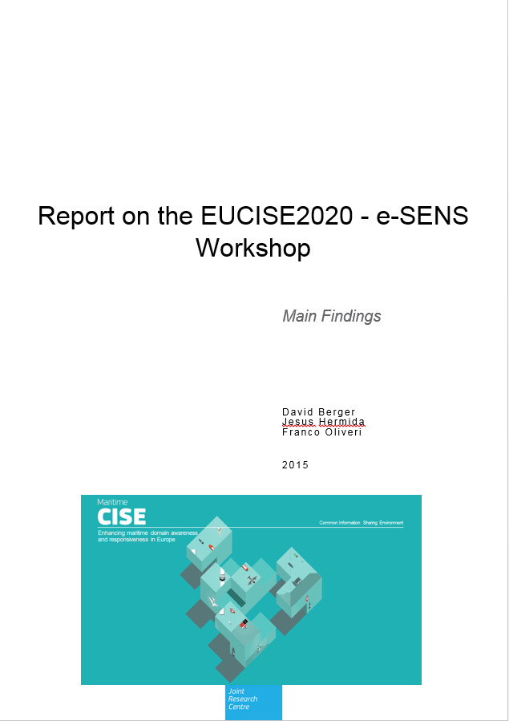
Thank you
The complete report is available
upon request
  franco.oliveri@jrc.ec.europa.eu

Slide 20
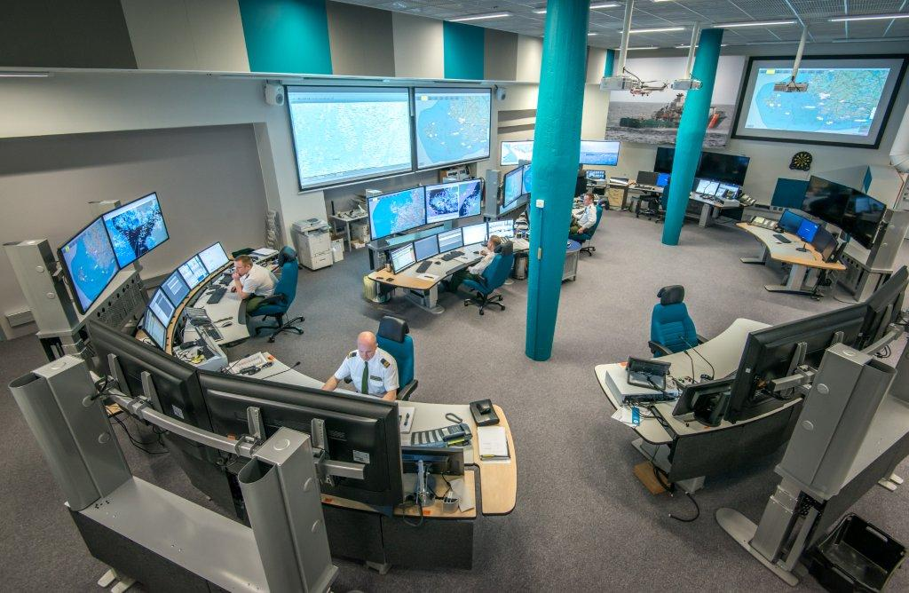
Thank You
https://webgate.ec.europa.eu/maritimeforum/en/cise

Slide 21
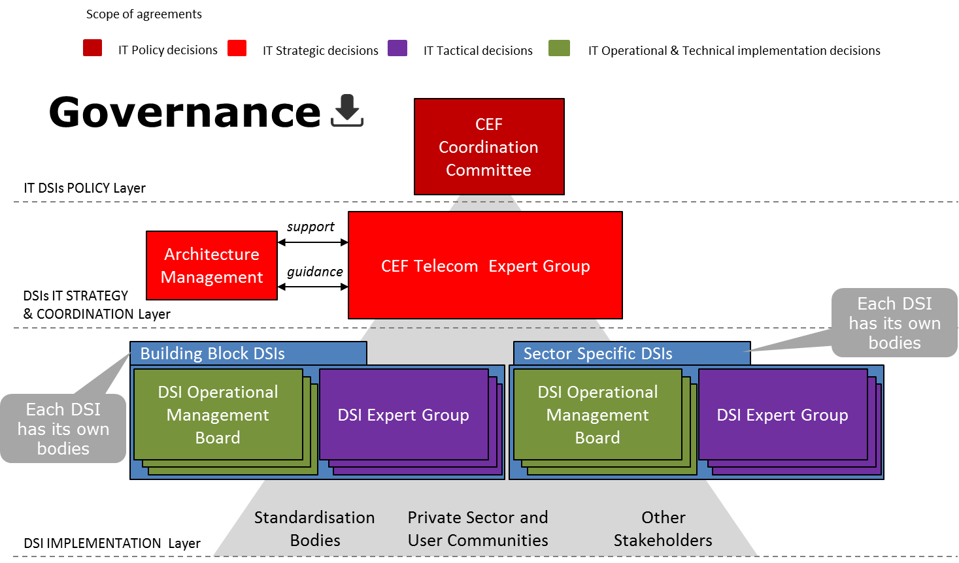
CEF governance
Notes:
At present, the specifications of the solution patterns and the architectural building blocks are maintained by the e-SENS project and the CEF programme (DIGIT, European Commission). The CEF programme and DG Connect (European Commission) will become the full owners of the results of e-SENS from mid-2016.
The CEF programme has established a governance process for the CEF specifications and the CEF software implementations (including DOMIBUS).
A member of the CEF team confirmed that if CISE decides to use the e-SENS specifications or the e-SENS implementations (at present only DOMIBUS is available), CEF will ensure the maintenance. It means that any bug discovered will be fixed in one of the quarterly releases planned. Important problems could be also fixed in nightly releases.
Requests for new features from CISE will be addressed to the management board defined by the CEF governance (see Figure 7: The CEF governance).
Findings:
The CEF components could fit the EUCISE2020 needs.
The CISE project should directly contact DG CONNECT to confirm the support provided on the building blocks specifications and implementations.

