Slide 1
ODIP: an international effort promoting the development a global framework for marine data management to support large-scale ocean research
Helen Glaves

Slide 2
Ocean Data Interoperability Platform (ODIP II)
Promoting development of a common global framework for marine data management
Creating a European - USA - Australia-Canada co-ordination platform to promote dialogue between regional marine data infrastructures
Developing a series of prototype interoperability solutions demonstrating a coordinated approach to marine data management on a global scale

Slide 3
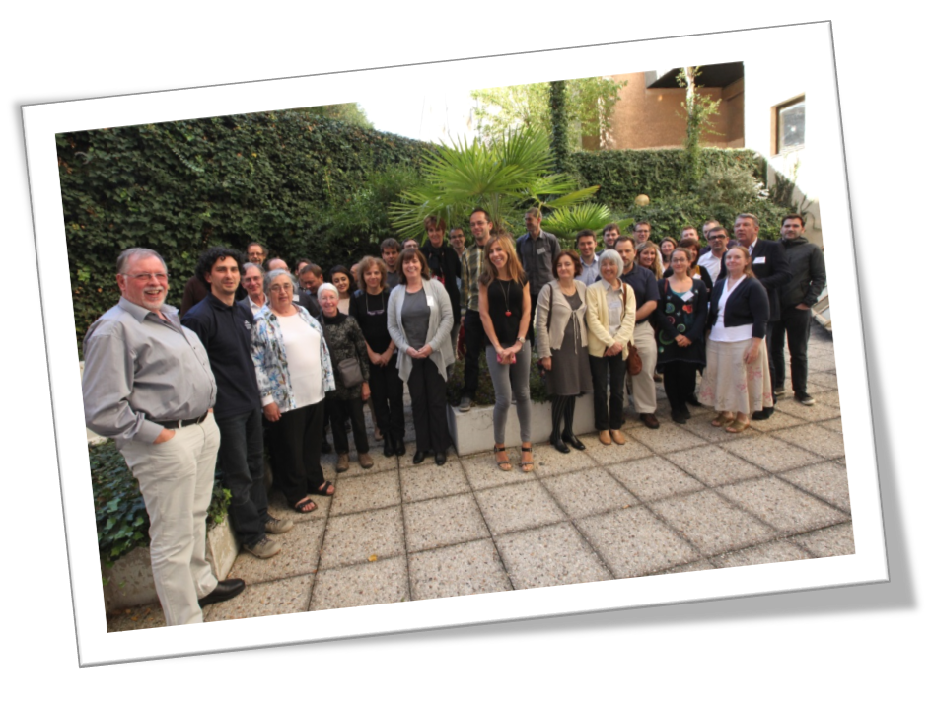
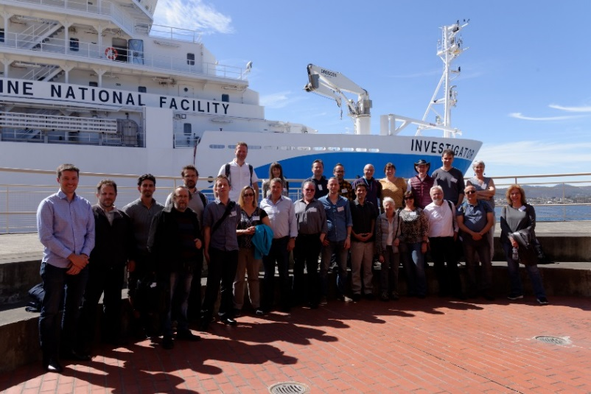
ODIP II: core activities
Workshops
representatives from selected regional marine data systems, related global data infrastructures and other relevant technical/domain experts
evaluation of existing marine data infrastructures, standards and best practices
development of interoperability solutions and common standards to overcome incompatibilities

Slide 4
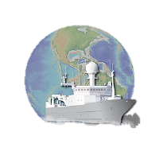
Global Data Infrastructures
ODIP I+ prototype
Marine data discovery and access
ODIP 2+ prototype
Cruise summary reporting
ODIP 3+ prototype
Sensor web enablement (SWE)
ODIP 4 prototype
Testing standardised technologies
Ocean Data Interoperability Platform
Regional Data Infrastructures
ODIP II: core activities

Slide 5
ODIP II and the EOSC
Enabling large-scale, multidisciplinary marine research by:
creating a common global framework for marine data management
improving findability and access to marine data (adoption of FAIR data principles)
encouraging use of common standards, services and open protocols to support interoperability

