Slide 1


Expert group on the skills and career development in the Blue economy
10 April 2019
Maritime Alliance for fostering the European Blue economy through a Marine Technology Skilling Strategy
Lucía Fraga Lago, CETMAR
Lefteris Sdoukopoulos, CERTH-HIT
Co-funded by the
Erasmus+ Programme
of the European Union
The European Commission support for the production of this publication does not constitute an endorsement of the contents which reflects the views only of the authors, and the Commission cannot be held responsi­ble for any use which may be made of the information contained therein.
Notes:
MATES’ objective is to develop a skills strategy for the maritime industry, in particular shipbuilding and offshore renewable energy
Sector Skills Alliances are an instrument to contribute to the New Skills Agenda for Europe , and in particular to improve the quality and relevance of Europe’s Vocational Education and Training. The Blue Print for sectoral cooperation on skills is one of the 10 actions of the New Skills Agenda for Europe and the call KA2, above referred

Slide 2
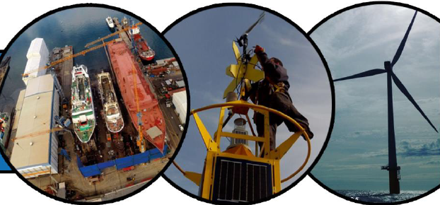
Skills intelligence: Baseline report on current skills gaps
Input sources:
Methodology (steps):
Description of current status in both sectors
Value chain approach: Phases and components
Mapping of relevant occupational profiles (primary and secondary) and identification of associated essential skills and competences based on ESCO
Mapping of relevant E&T programs across Europe (all EQF levels)
Identification of gaps in E&T programs and skills shortages
Bibliographic revision of the repository of relevant information on maritime technologies and sectors: 220 publications and 147 projects reviewed.
State of the Art compilation
Feedback from 2 rounds of regional stakeholder workshops

Slide 3
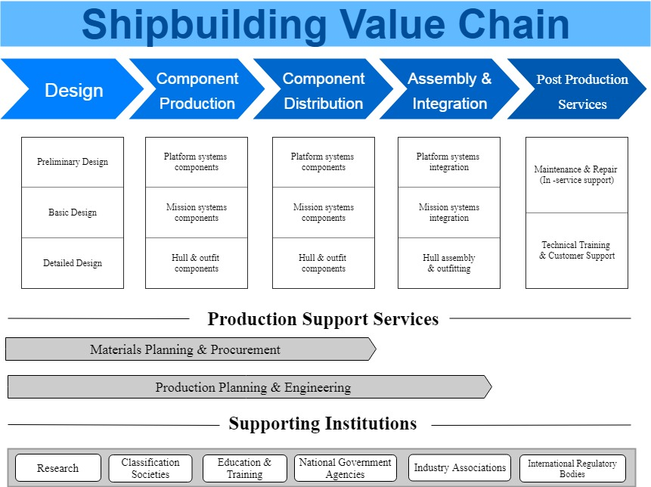
Current status & value chain
Shipbuilding
300 facilities in Europe involved in vessel construction, repair and retrofitting
More than 200.000 people directly employed
Marine equipment
22.000 manufacturers and suppliers of different sizes and sales volume
52% of the global market, with an annual turnover of nearly € 60 billion, generating over 350.000 jobs
Notes:
In red, the key phases of the shipbuilding value chain

Slide 4
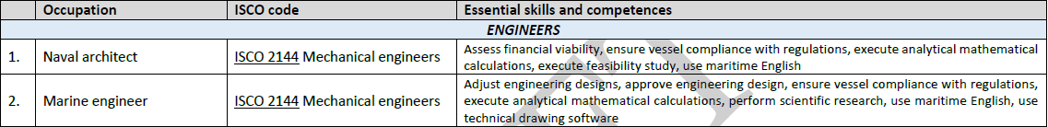
Mapping of occupational profiles
Primary occupational profiles categories - Shipbuilding
35 primary
25 supporting
Example
Notes:
Primary occupational profiles were selected based on their relative impact / effect in the shipbuilding value chain

Slide 5
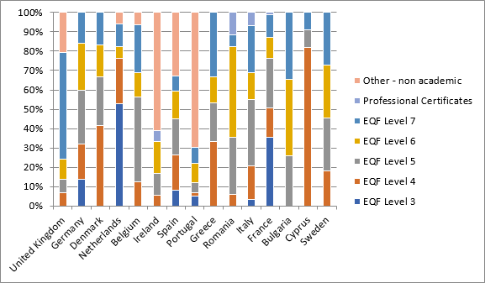
Relevant E&T programs across Europe
450 E&T programs currently available (2018-2019) were identified (all EQF levels)
15 EU countries addressed: France ,Portugal, Germany, Spain, Italy, United Kingdom, Bulgaria, Ireland, Romania, the Netherlands, Greece, Belgium, Denmark, Sweden, and Cyprus
Notes:
France (20.4%) ,Portugal (13%), Germany (10%, ranks 3rd in terms of productivity),Spain, Italy, United Kingdom, Bulgaria, Ireland, Romania, the Netherlands, Greece, Belgium, Denmark, Sweden, and Cyprus
The majority (47.8%) of the currently available offers are VET: 3^{d} to 5th EQF covering a wide range of occupational profiles, mainly in metalworking activities.
15.8% of the total number are under graduate programs or equivalent vocational diplomas of the 6th EQF level, mainly addressing engineers and engineering technician professionals.
The post graduate education offers are accounting for the 18% providing a specialization path for the engineering professionals employed across the shipbuilding value chain.
16.7% are other types of non academic training courses covering a wide variety of subjects from communication and team working skills to specific technical training. These types of courses don’t correspond to the EQF levels.
Finally, the 1.3% of these offers are professional certificates addressing to specific professions who want to acquire a specialization in a particular field. These certificates also, don’t correspond to the EQF levels.
The primary occupational profiles of the shipbuilding value chain are covered by the 93% of the identified E&T offers while the supporting occupations like industrial engineer, mechatronics engineer, project manager, etc. are covered by the 20%.
The most well-addressed groups of occupations are metalworkers and engineers with 30% and 29% coverage respectively followed by the engineering technicians with 21%.
In many European countries the currently available training programs specifically designed and applied to the shipbuilding trades are very few, and in most cases the vocational system doesn’t provide technical workers directly ready to work but only at an initial specialization level.
Regarding the occupations related to welding activities, work at heights, work in confined spaces and with lack of light, which characterize the shipbuilding and ship repair industries, are covered only by a fraction of the training offers, mainly those that combine apprenticeship in a company. As a result, people employed in such activities, need to be trained on the job, to acquire these skills and become familiar with the production activities of a shipyard.

Slide 6
Current gaps in education and training
Few programs directly target the shipbuilding industry (i.e. more general programs with applicability to various sectors)
In some countries, programs are limited to / concentrated in certain regions
SECTOR
Metalworkers, engineers and engineering technicians are the occ profiles mostly addressed by available programs.
42% of identified occupational profiles are targeted by a single/couple of programs
OCCUPATIONS
The majority are VET programs addressing first phases of specialization only (mainly in metalworking), and do not provide technical workers with qualifications that will enable them to enter the market
Welding capabilities as well as the ability to work at heights, in confined spaces and with no light are only provided by very few training schemes, usually combined with apprenticeships in specific companies.
ESPECIALISATION
Only 17% of the E&T programs are being offered in English (or are bilingual) and mainly consist of programs of higher education. VET programs are only provided in the respective national language
LANG

Slide 7
Skills shortages – preliminary results
Challenges:
Aging workforce (in most EU countries the average age exceeds 45 years) and inefficient exploitation of knowledge and experiences of older workers
Young people not interested in the industrial maritime sectors: lack of knowledge, association with a negative image…
Women are under-represented, and there are few gender statistical data.
Source: CESA 2008- Demographic Change & Skills Requirements in the European Shipbuilding & Ship Repair Industry

Slide 8
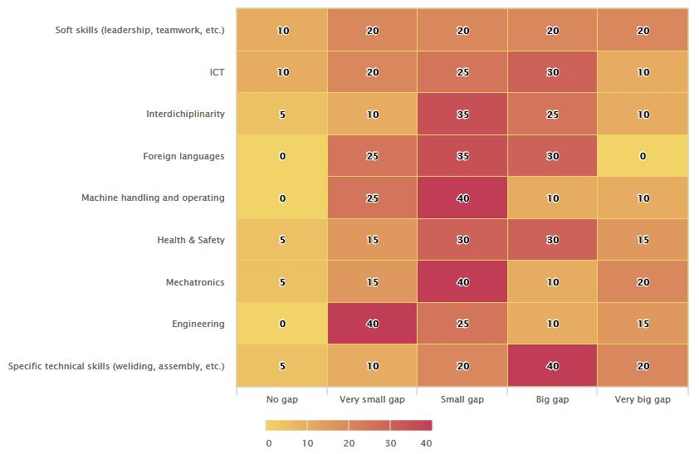
Skills shortages – preliminary results
Specific technical skills (e.g. welding, assembly, etc.)
Skills on Information and Communication Technologies
Skills addressing Health & Safety issues
Foreign languages
Mechatronics
Machine handling and operating

Slide 9
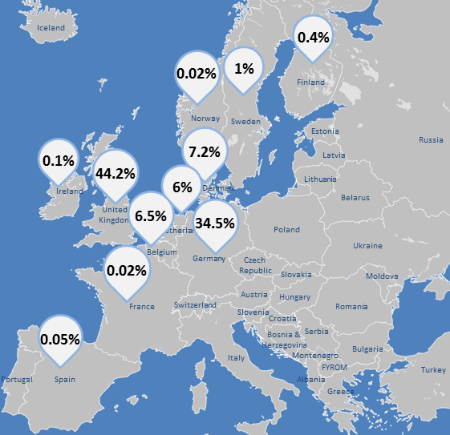
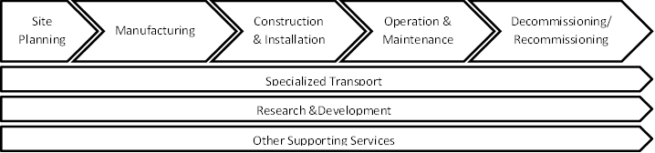
Current status & value chain
Offshore wind
18,7GW of produced capacity in 2017 – 80% located in North Sea
Most advanced sector of offshore renewables
Offshore solar
Still under investigation / development – 1st pilot project implemented in 2017
Ocean energy: wave, tidal, hydropower
241 MW of produced capacity in 2017
91% produced in France
Notes:
ORE value chain approach – applicable / covering all different sub-sectors

Slide 10
Mapping of occupational profiles
23 primary
43 supporting

Slide 11
Relevant E&T programs across Europe
486 E&T programs currently available (2018-2019) were identified (all EQF levels)
11 EU countries addressed: Germany, United Kingdom, Portugal, Cyprus, Denmark, Greece, Spain, Belgium, Ireland, Norway, the Netherlands
Notes:
Majority of the offer identified in Germany (28.9%) and UK (28.3%) where the largest capacity for offshore wind energy, for example, is located. The rest of the countries where relevant programs were identified include Portugal, Cyprus, Denmark, Greece, Spain, Belgium, Ireland, Norway and the Netherlands,

Slide 12
Relevant E&T programs across Europe
*Other refers to E&T programs that correspond to supporting occupational profiles related to energy, mechatronics, mechanical engineering, etc.

Slide 13
Current gaps in education and training
Very few VET programs providing technical skills.
44% are Master Degree programs : Relevant qualifications are only provided as a specialization
SECTOR
ESPECIALISAT.
Only 5% programs directly address offshore renewable energies – In most cases, these are being tackled within the broader framework of renewable E.
OCCUPATIONS
Only 35% of the primary occ. profiles are being targeted to a satisfactory extent by available programs.
Gaps identified for occ. profiles in the groups of electro-mechanics, assembling, metalworking, diving and health & safety.
Gaps vary across Europe; some countries share additional common ones, mainly related to: (a) cable installation, (b) ocean energy technologies, (c) maintenance of energy systems, and (d) energy distribution.
LANG
Approximately 50% of available programs are offered in English or are bilingual

Slide 14
Skills shortages – preliminary results
Challenges:
Increased subcontracting of certain activities – lack of collective experience and cumulation of skills / competences on-the-job
Temporary employment – deprives employees of the opportunity to closely follow and monitor sector developments
Unwillingness to move to more distant locations where new ORE projects are planned – constrains the collection of diverse knowledge and experiences taking into account different local characteristics

Slide 15
Skills shortages – preliminary results
Shortages in skills qualities rather than specific skills required for performing specific tasks / activities
Hard skills (technical and offshore-specific)
Diversification and transferability of technical skills – timely adaptation to new needs
Multidisciplinary knowledge and better and more integrated understanding of the ORE value chain
Specialization of managerial positions (e.g. project managers, offshore financial officers, etc.)
Upcoming demand for undertaking decommissioning / recommissioning processes since some offshore wind farms are entering the end phase of their lifecycle
Soft skills
Teamwork and communication: most important and desirable (considering also the multi-cultural business environment)
Analytical skills acknowledged as essential for overcoming technical challenges
More for white-collar occupations: leadership, critical thinking, time management and prioritization

Slide 16
Conclusions and identified barriers
Maritime Industry needs
New capabilities and skills
Specialized training offer directly adapted to the sector
Lack of educational offer addressing specifically offshore renewable energies
Need for mechanisms to facilitate the completion of training pathways:
Modular trainings, Access to other sector trainings
Ad hoc training offer
collection of information related to VET education levels
Language barriers for the analysis of T&E offer
The industrial maritime sectors need to attract talent
Raising the level of ocean literacy could contribute to reverse this trend
Skills needs are constantly evolving, and the rhythm accelerates
Skills ecosystems: meeting points for the most relevant stakeholders from industry, academia and research will contribute to get 'fresh' and sustainable data
Notes:
There is a need to strengthen the existing education in the marine fields, developing new capacities and specialized training offer addressing the particularities of the maritime industry. Shipbuilding sector is demanding educational and training programs in the digital domain, green technologies and soft skills, adapted to the sector and developed in collaboration with it. Marine Offshore renewable energies sector could be boosted through the improvement of training offer specialized to its particularities, and especially on the VET qualification levels (EQF 3-5).
The industrial maritime sector needs to attract talent and implement generational replacement systems. The growing demand for specialized jobs may constitute an opportunity for this. Raising the level of Ocean Literacy would also give visibility for the professional opportunities of the maritime industry to entice more youngster, women, but also specialists from other sectors.
Skills ecosystems, functioning as meeting points for the most relevant stakeholders from industry, academia and research will be able to make a significant contribution towards obtaining 'fresh' and reliable data when skills needs are constantly evolving. The UvA partner identified at the Digitalisation workshop of WP2 held in Ghent, that maritime industry requires also a special Digital literacy and Data Literacy training for white collar workers and managers in particular.
Challenges:
One of the main challenges we have faced is the collection of information related to VET education levels, particularly in the countries were we do not have partners, but in the countries that we do have partners as well. Language barriers are one of the main problems for the analysis of this information. Also, the way in which data on the skills requirements are collected is a challenge. There are several disparate sources and no systematic way of mapping the current skills in the industry and the new skills required.

Slide 17

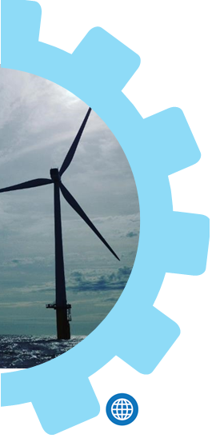


Thank You
SAVE THE DATE
Next meeting: 28 May, Brussels.
Workshop for the MATES strategy validation.
Skills intelligence to boost maritime technologies.
Contact Details:
Lucía Fraga Lago, CETMAR, mates@cetmar.org
Lefteris Sdoukopoulos, CERTH-HIT, sdouk@certh.gr
www.projectmates.eu
info@projectmates.eu
@ErasmusMATES
Co-funded by the
Erasmus+ Programme
of the European Union
The European Commission support for the production of this publication does not constitute an endorsement of the contents which reflects the views only of the authors, and the Commission cannot be held responsi­ble for any use which may be made of the information contained therein.

Slide 18
Some points for the debate
Any major issue / aspect / gap in the baseline report?
There is a need for highly specialised capabilities, together with the need for multidisciplinarity and the ability to adapt to a continuous changing demand of skills. How can the competing priorities of hyper-specialisation versus multidisciplinarity be best addressed?
The existing shipbuilding curricula should be adapted, and also for new programs addressing ocean energy technologies (wave, tidal and hydropower). How to foster a better match between training on offer and industry needs without the continuous creation of new trainings?
In the Offshore Renewable Energies sector, short term contracts lead to temporary employment. The shipbuilding value chain also has an important turnover of its workforce. How best promote a higher level of experience and specialization in this context?
MATES considers the possibility to increase attractiveness of maritime careers for graduates and early-career skilled workers, through the promotion of Ocean Literacy. What instruments do you consider more adequate for this purposes? Who are the actors and stakeholders that you consider more relevant to address this issue?

