Slide 1
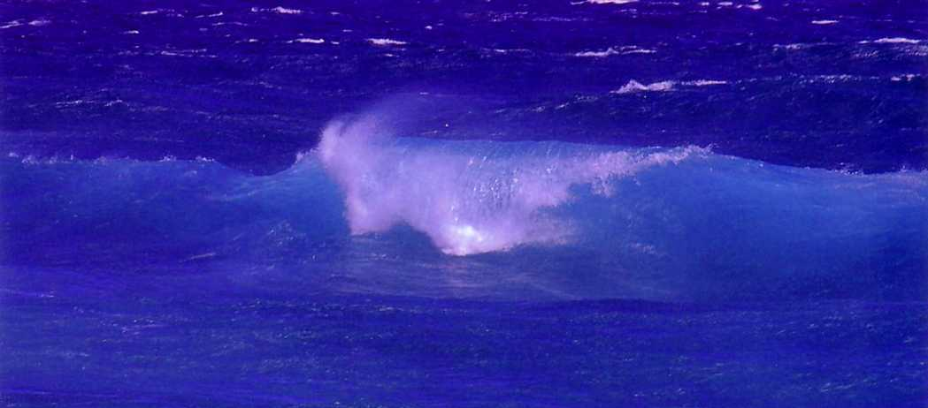
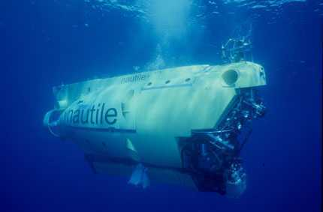
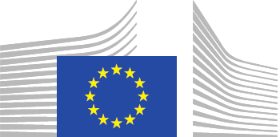
Institut Français de Recherche pour l'Exploitation de la Mer
French Research Institute for Exploitation of the Sea
Meeting with Commissioner K. Vella
March 1st, 2016

Slide 2
Ifremer : a leading institute in marine sciences
An integrated research institute covering all marine sciences and technology disciplines: living and mineral resources, environment, geosciences, oceanography, marine economy, observation technologies
A large scope of activities : research, engineering, monitoring, infrastructures
Missions
Develop marine research in order to better understand (preserve and exploit) marine ecosystems
Technological development and transfer
Perform environmental assessment and monitoring missions, support to public policies
Conceive and operate large-scale Research Infrastructures (French Oceanographic Fleet)

Slide 3
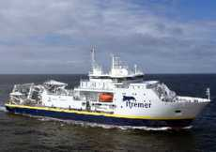
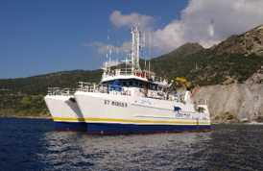
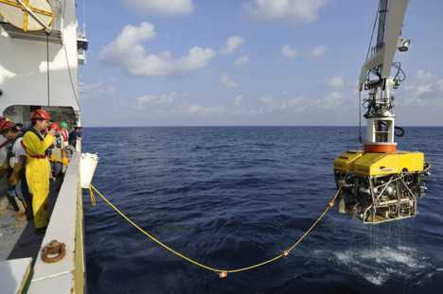
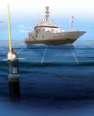
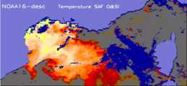
Facilities and infrastructures
• 3 research Vessels
• 3 Coastal Vessels
Underwater vehicles
Data centers
Pourquoi pas?
L’Europe
Victor 6000
Cersat
Coriolis

Slide 4
Research activities
Ocean dynamics
Marine biodiversity
Biotechnologies and bio-prospection
Sustainable aquaculture and fisheries
Eco-systemic approach of coastal zones
Deep-sea exploration
Mineral and energy resources

Slide 5
Ifremer in Europe
60% of Ifremer projects have a European component
Ifremer is leader of more than 10 EU projects (H2020, Interreg and calls of DG MARE)
Ifremer is active in European Marine Board and Technical groups of DG MARE among others
Ifremer is one of the main French actors in the IMP and the implementation of the Marine Strategy Framework Directive (5 DCF campaigns launched since Oct. 14), the Water Framework Directive (coastal waters), the Common Fisheries Policy (DCF)
Ifremer is part of EMODNET, coordinates SeaDataNet
Ifremer participated to the Aora-CSA Workshop (onset of the Galway Statement) for the Atlantic Basin and is also part of the BlueMed initiative

Slide 6
What possible improvement ?
Better complementarity/synergy between DGs:
DG MARE (Atlantic Action Plan) and DG RESEARCH (AORA H2020 project)
common reporting process to DG MARE and DG ENV for EMODNET and implementation of directives
DG GROW, DG MARE and DG RESEARCH for funding in the field of observation
Better coordination of environmental and European policies, for instance research policy
Enhance cross-cutting approaches, for instance monitoring / research
Funding for observation
ERIC Euro-ARGO (2017-2020); Deep ARGO; Bio-ARGO
An integrated « Ocean » approach in European calls

Slide 7
Major research challenges
An integrated observation network
Long-term data collection
Observation technologies (integration, miniaturization, cost lowering)
Ocean and climate
Strong interaction observation / modelling, improved predictability (seasonal,…)
Ocean atmosphere interface
Sustainable use of resources
Ecosystemic approach of fisheries
Aquaculture : seek for some real breakthroughs towards sustainable, spatial planning of infrastructures
Environmental monitoring
Ecological functioning of coastal areas
Marine litters : dissemination mechanisms and impacts
Marine geosciences (natural hazards)
Understanding biodiversity and deep-sea ecosystems

