Slide 1
Pilot Blue Cloud
Gauvain Wiemer Brussels Office
Notes:
Replace business with technologies
We want all communities to work together – business, education, research and, of course, government.

Slide 2
Gaps and Obstacles
Variety
Velocity
Blue Cloud
Heterogeneity
Volume
Sustainability
Infrastructure
Increasing Data Production
Free flow of data
Notes:
3 Vs:
The volume of the data as covered by most definitions today (see Loukides, 2010 and MGI, 2011, which are cited above; but also McGuire et al., 2012);
The variety of the data, which refers to mostly unstructured data sets from sources as diverse as web logs, social media, mobile communications, sensors and financial transactions. Variety also goes hand in hand with the capability to link these diverse data sets; and
The velocity or the speed at which data is generated, accessed, processed and analysed. Real-time monitoring and real-time “nowcasting” are often listed here as benefits that go along the velocity of “big data”.
Heterogeneity of data with respect
to content (semantics) and structuring - To applications & components for ingest, dissemination, & analysis of data
-> Use of common ontology
Infrastructure
IT infrastructure providers offering data management tools and critical computing resources including, but not limited to, data storage servers, database management software, and cloud computing resources,
Increasing data production
Volume is not steady but increasing and with blue growth
Free flow of data
provision of high-quality data can require significant up-front investments before data can be shared
applicability of “ownership” is being challenged
Lack of data portability and interoperability are among the most challenging barriers to data reuse
Status of Marine Science in Germany
Challenge
a deluge of marine environmental data from many different sources
Extremely wide range of data sources
Ship-based instruments
Instruments in water column and at seafloor
Air- and space-borne instruments
Sensor networks
Individual data types and formats
Snapshot projects vs. long-term monitoring data
Data are stored in different data centers (if at all !) (PANGAEA/AWI/MARUM, DOD/BSH, COSYNA/HZG, Kieler Daten Management/GEOMAR)
Many obstacles still overshadow the cloud

Slide 3
The most pressing need…
Open & reliable platform for
Dissemination
S
T
O
R
A
G
E
Ingestion
Notes:
set up of an open & reliable platform for ingest, storage, and dissemination of data
Data-intensive marine science needs a coherent data protal with common access strategy:
aggregation, integration, free access

Slide 4
What should the cloud do?
Common Standards & Guidelines for deployment of application
Open & reliable platform
Dissemination
S
T
O
R
A
G
E
Common Standards & Guidelines for upload
Ingestion
Remain dynamic & adaptable
for the development and deployment of applications
for the ingestion, storage and dissemination of data
Notes:
- upload of data sets following common standards & guidelines - deployment of applications following common standards & guidelines
„Die Blue Science Cloud als Plattform sollte zwar nach gemeinsamen Richtlinien und Standards funktionieren aber dennoch dynamisch bleiben, was die Entwicklung und das Deployment von Applikationen für Ingest, Storage und Dissemination betrifft.“

Slide 5
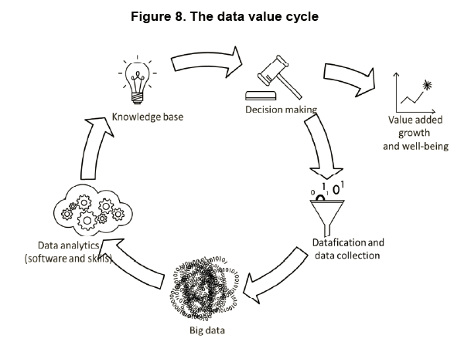
What could the cloud look like?
Notes:
This system would adress the gaps and Obstacles
Take Home message
die Blue Cloud braucht einen Business plan für eine nachhaltige Selbstfinanzierung. Daraus ergibt sich die Frage nach, Marktanalyse, Kosten-Nutzen, Angebot-Nachfrage usw.. Also auch wem soll es nutzen - wie du unten schon sagst.
Sie muss die Vielfalt wissenschaftlicher Daten abbilden
Eine Balance zwischen Regelwerk und Freiheitsgrad
das Umsetzungsverfahren muss inklusive sein. Also auch da: Vielfalt statt Einfalt und möglichst alle Hauptakteure an Bord statt einen Gewinner zu ermitteln der 'Business and mistakes as usual' macht
Deutschland könnte sich organisieren (Bezug zum Workshop auf nationaler Ebene) um komplementär mitzuwirken
Die OECD kommt in ihrem Bericht «Data- driven Innovation for Growth and Well- being» zum Schluss, dass Daten eine wichtige Ressource darstellen, die zu neuem Wissen, neuen Produkten, Prozessen und Märkten führen können, und bezeichnet diesen Trend als datenbasierte Innovation.
Explore all issues raised by the data economy, e.g. localisation of data, liability, standardisation, to identify where regulatory action is needed
• Data precious for research, innovation and new business opportunities
• Support promising technologies, such as cloud computing and the Internet of Things
Basically: Have a business plan in the back that allows sustainability of the cloud to avoid another data cimetary.
The Data Value Cycle applied to the Blue Cloud!
Copernicus
Satellite Systems
EU PROJECTS
EuroGOOS
IBIROOS
Argo
MONGOOS
NOOS
BOOS
Artic GOOS
Black Sea GOOS
Ocean Sites
MS in-situ networks
SeaDataNet
EMODnet
WISE marine
GO-SHIP
ICES fishery services
Acronyms:
Copernicus = aka Global Monitoring for Environment and Security is the European Programme for the establishment of a European capacity for Earth Observation, EuroGOOS = European Global Ocean Observing System, IBIROOS = Iberian-Biscay-Irish Regional Operational Oceanographic System, Argo = Array for Realtime Geostrophic Oceanography, MONGOOS = Mediterranean Operational Network for the Global Ocean Observing System; NOOS = North West Shelf Operational Oceanographic System; BOOS = Baltic Operational Oceanographic System; GOOS = Global Ocean Observing System; OCEAN Sites = worldwide system of long-term, deep water reference stations measuring dozens of variables and monitoring the full depth of the ocean, from air-sea interactions down to 5,000 meters, MS = Member States; SeaDatanet = pan-European infrastructure for Ocean and Marine data management (DG Research & Innovation), EMODnet = European Marine Observation and Data network (DG Mare), WISE marine = Water information System for Europe (DG Environment, European Environment Agency, GO-SHIP = The Global Ocean Ship-based Hydrographic Investigations Program, Joint Research Centre and Eurostat), ICES fisheries services = International Council for the Exploration of the Sea, CMEMS = Copernicus Marine Environmental Monitoring Service (DG Growth), MCS = Marine Core Service.

