Slide 1
SMART-HATCHERY:
Smart Feeding Systems for Hatcheries
Ph.D. Javier A. Osuna
28 June 2023

Slide 2
Context
The production of high-quality fish and shrimp juveniles in aquaculture is still hindered by sub-optimal production conditions occurring during the larval stage of many farmed animals.
One of the major farming bottlenecks occurring during these early-life stages is the lack of systems that maximize the feeding efficiency, which includes minimizing fish feed loss.
There are no solutions for automated live feed supplying and there are no adequate solutions for monitoring, controlling and optimizing dry feeding of small particle pellets (100-800 μm) during the larval and weaning stages, as opposed to later growth stages, for which fully automated feeding systems are commercially available.
It is necessary a new kind of microdiets that improve not only the Feed Conversion Rate (FCR) and a superior juvenile quality of fish and shrimp, but also in a strong reduction of production costs, allowing hatcheries to increase the number of production cycles per year.

Slide 3
Consortium
Name | Country
FEEDING SYSTEMS | SPAIN
SPAROS LTD | PORTUGAL
ACUINOVA | PORTUGAL

Slide 4
Overall objetives
SMART-HATCHERY main goal is to innovate and make a change in the current feeding processes in aquaculture hatcheries of marine fish and shrimp species, by demonstrating the benefits of using:
smartFEEsh: centralized smart feeders based in innovative digital technologies, such as Cloud technologies, Internet of Things (IoT) and Artificial Intelligence which radically increase the co-feeding efficiency, reduce the wastes while increasing the quality of the water, reduce the stress level and susceptibility to disease and thus improve the welfare of the species.
winFEEDs: A new generation of dry microdiets resulting from nutritional knowledge (premium quality ingredients that fulfil larvae nutritional requirements) and cutting–edge technologies (cold-extrusion and encapsulation – using pharmaceutical expertise), while have low leaching and high water stability, leading to maximal larval performance and welfare.

Slide 5
Overall objetives
SMART-HATCHERY intends to increase the profitability of fish farmer by reducing the costs of feeding processes in weaning stages while improving the quality of the feed and rearing water and offering a high-quality and safe seafood, with the best organoleptic and nutritional values.

Slide 6
Ambition: Progress beyond the status quo
1
Increasing larvae survival between 5-15%,
Reducing deformities and fish discarding between 1-5%
3
Reduction of pathological outbreaks up to 20%
4
2
Reducing feed consumption between 5-10%,
5
Reducing operational costs up to 5%
6
Reducing feed purchasing costs up to 5-10%
7
Reducing to <0.1% of traceability non-conformities

Slide 7
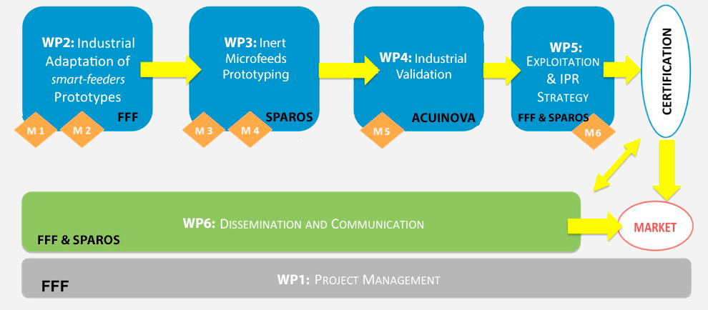
Workplan

Slide 8
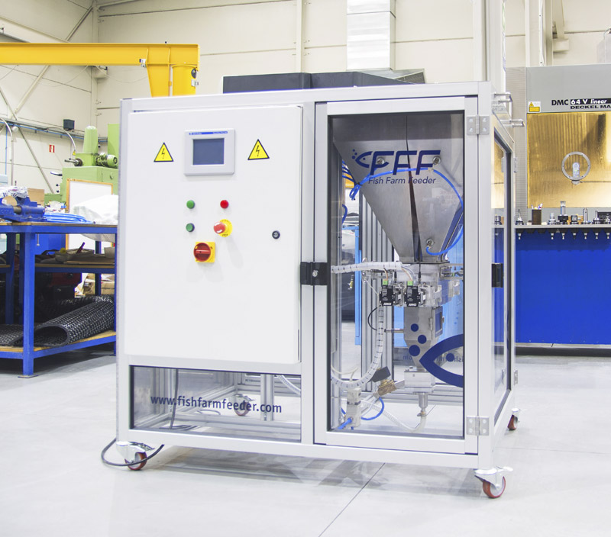
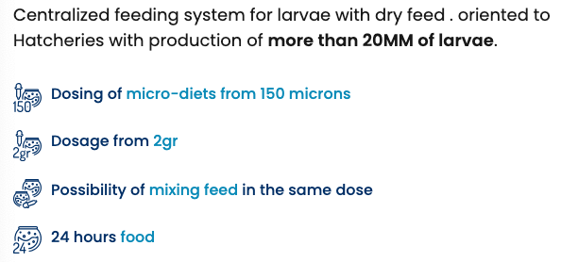
Results: Dry Feed

Slide 9
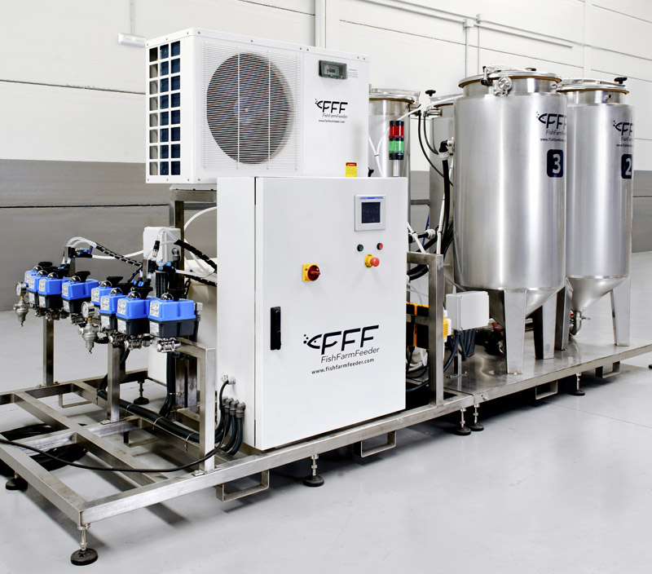
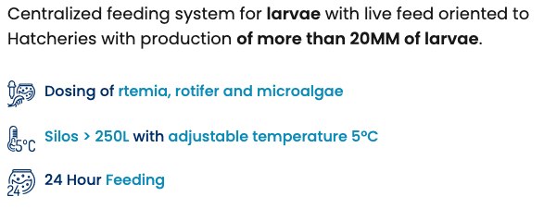
Results: Live Feed

Slide 10
Results: App

Slide 11
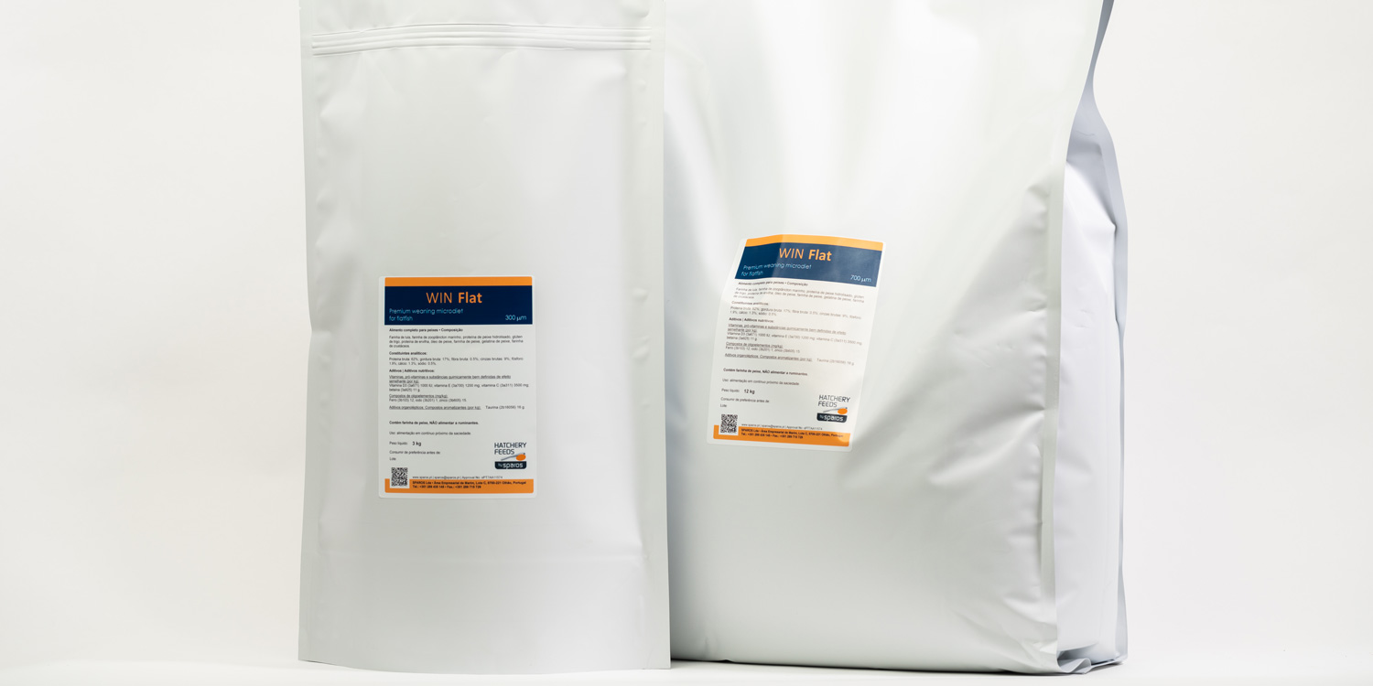
Results: Hatchery Feeds
Premium weaning microdiet for flatfish larvae, produced with high quality ingredients by low-shear extrusion. Includes microencapsulation of heat-sensitive nutrients.
Species › Atlantic halibut | Senegalese sole | Turbot

Slide 12
SMART-HATCHERY:
Smart Feeding Systems for Hatcheries
Thanks for your attention
28 June 2023

