Slide 1
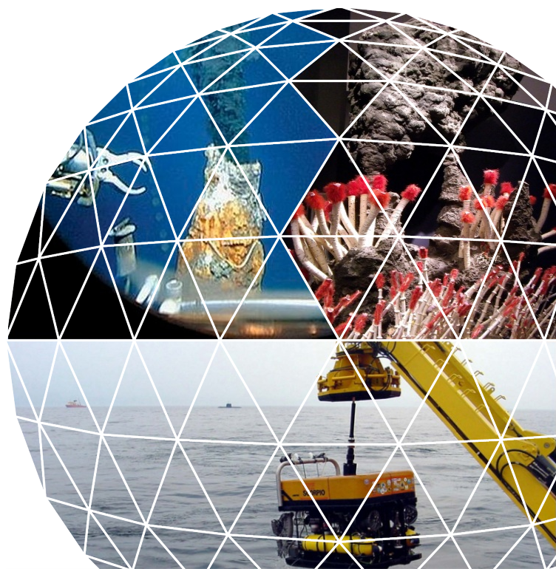
Study to investigate the state of knowledge of Deep Sea Mining
Inception meeting
Brussels, 27 January 2014

Slide 2
Agenda for the meeting
Tour de table
Presentation of the study team
Purpose and scope
Presentations per task
Comments on the inception report
AOB

Slide 3






I. The study team
Combining Blue Growth & wider environmental & economic policy expertise with specialist knowledge on deep sea mining technologies, impacts and legislation:
Ecorys (NL/BE)
MRAG (UK)
GRID Arendal (NO)
GEOMAR (GE)
NOC Southampton / Seascape (UK)
TU Delft (NL)

Slide 4
Study team involvement in tasks
Combined teams per task
Exchange through liaisons in each task team
Regular exchanges between the partners to ensure overall coherence and feedback across tasks
 | 1. Techno-logy | 2. Economic | 3. Legal | 4. Geological | 5. Projects | 6. Environ-ment | 7. Public consulta-tion
Ecorys | √ | √ | √ | √ | √ | √ | √
MRAG |  |  | √
GRID |  |  |  | √ |  | √
Geomar |  |  |  | √
Seascape | √ | √ |  |  |  | √
TU Delft | √ | √

Slide 5
Scope of the assignment
To gain understanding of the state of play (technology, economics, individual projects) and of the role for EU stakeholders
To understand and assess environmental impacts associated to potential development
Types of deep sea mining:
  Polymetallic nodules
  Polymetallic sulphides
  Cobalt-rich crusts
  REE included as product in above categories
  Working definition: as of 500m water depth
In consultation (task 7) shallow water mining (aggregates, phosphates etc.) is included in other tasks not.

Slide 6
Structure of the assignment: 7 tasks

Slide 7
Task 1 Technology analysis: value chain ‘toolbox’
Framework conditions
Research, Land reclamation, Licensing, Decommissioning, regulatory framework, control of environmental impacts, financing, conditions of demand (strategic and/or commercial), employment
Exploration
Demonstration and extraction
Pre-processing and storage
Transportation, handling and storage
Processing
Distribution and sales
Value chain
Upstream and downstream services
Locating (Echo’s, AUV’s))
Sampling (ROV’s, nets)
Drilling
Resource definition & quantification
Supporting services
ROV’s/RCM
Fragmentation
Ore transport
Operations vessel/platform
Power supply
Spare parts
Supply services
Separation
Dewatering
Waste water returning
Temporary storage
Shipbuilding
Storage facilities
Spare parts
Bunkering
Manning services
Loading and unloading equipment
Plants
Storage facilities
Commodity prices
Societal demand
Strategic imperative
Mineral Type
Depth
Volumes
Distance to shore
Commodity prices
Mineral Type
Location: seabed, on ship or onshore
Volumes
Rate of production
Mineral Type
Oil Price
Volumes & capacity
Rate of Production
Mineral Type
Volumes & capacity
Location: seabed, onboard ship or onshore
Critical factors

Slide 8
Task 1 Technology analysis: decision tree structure to analyse value chain components
Methodology:
  desk-based research;
  interviews;
  international workshop for stakeholders

Slide 9
Task 1 Technology analysis: factors to be Included in ranking for current state of the art
Objective is to define the state of the art, identify gaps and assess requirements for maturation of mining & processing technologies to enable exploitation of deep sea resources.
Level of Technology Maturity
  Concept
  Active Research
  Pilot/Demonstration activity – laboratory
  Prototype in Deep Sea environment
  Production System
Likelihood of progressing to practical implementation
  Understanding the scenario specific requirements
  Urgency – strategic and/or economic imperative
  Magnitude of progress needed to fill perceived gap

Slide 10
Task 2 Economic analysis
Aim: to present an overview on the economic viability – including associated costs and benefits- of possible deep sea mining projects (where this task will make use of the information collected under task 5).
Approach:
  Assessment of relevant commodity markets (revenue; availability/accessibility (scarcity/geopol); competitiveness)
  Identify criteria to determine economic viability
  Develop a simple economic model to assess the profitability of deep sea mining operations;
  Use this model to conduct three case studies
  Indicate scenarios where seabed mining could become strategically important for Europe
  Contrast the costs vis-à-vis alternatives (land-based mining and recycling

Slide 11
Task 2 Economic analysis
Main elements to determine the economic viability of deep sea mining

Slide 12
Task 2 Economic analysis
Overview of the main components of the preliminary Ecorys DSM- economic model

Slide 13
Task 3 Legal analysis
Aim: a description of the legal framework governing deep-sea minerals exploration and extraction and exploitation, including environmental impact assessments, at three separate levels: international law, European Union law and national law.
Scope: Four different, yet inter-linked, spatial and jurisdictional contexts:
  Member State EEZ & continental shelf: BE, FR, DE, GR, ES, PT, IT & UK
  EEZ & continental shelf of OCT: DK, FR, NL & UK
  3rd country EEZ & continental shelf: Canada, China, Fiji, Japan, Papua New Guinea & USA
  the Area Beyond National Jurisdiction

Slide 14
Task 3 Legal analysis
Methodology: Analytical review of legal instruments (eg UNCLOS, Part XI Agreement, Mining Code), case law (ITLOS), EU legislation & case law, national legislation, literature, selected interviews.
Steps:
  Preliminary analysis
  Prepare & circulate questionnaire to national correspondents
  Interviews
  Completion of analysis
Outputs:
  Preliminary assessment in interim report
  Complete assessment in final report

Slide 15
Task 4 Geological analysis
Overall aim:
Help identify areas that might see marine mining in the near future or are unlikely to be affected
based on geological criteria such as:
  metal content
  size of deposits
  other geological criteria (water depth, age of the crust, etc.)
other criteria such as EEZ vs. ABNJ, MPA‘s will be handled by other tasks

Slide 16
Task 4 Geological analysis
assess site specific data and geological information
identify regions with enrichment of metals of interest (Cu, Ni, Co, REE, Zn, Au, Ag, ...)
address differences in commodities
compile methodology used for prospection
based on geological criteria
  identify known sulfide sites high resource potential
  identify areas with high Mn-nodule and Co-rich crust potential

Slide 17
Task 4 Geological analysis
identify and compile known exploration areas and mining sites and transfer into GIS and kml-formats (for easy visibility; → GRID Arendal)
query maps showing impacts on resource potential (geology, exploration status, Marine Protected Areas)

Slide 18
Task 5 Project analysis
Aim: identify all relevant licensed projects with their characteristics related to seabed mining currently going on or in the planning phase
Inventory of projects
Catalogue style / project fiches
Both in EEZ and ABNJ areas

Slide 19
Task 5 Project analysis
Catalogue style presenting factsheets at project level:
Location (EEZ or ABNJ) and mapping (in coordination with task 4)
Consortium members
Type of contract (exploration, extraction, scientific or industry driven)
Status (license pending, license given but no action, project started, closed, cancelled, etc.)
Time scale
Type of deposit
Estimated amount of minerals
Possible obstacles
Technologies used (for the value chain components relevant)
Source of financing (public, private, origin)
Government involvement
Some of the information might be confidential! It is expected that not all information can be made available.

Slide 20
Task 5 Project analysis
Sources:
Projects in ABNJ through ISA (International Seabed Authority)
Project in EEZ through various inputs:
  Other tasks (task 1, task 3, task 4, task 6)
  literature review
  interviews with identified stakeholders (e.g. Nautilus Minerals of Canada, Bluewater Minerals Australia, the Korea Institute of Ocean Science and Technology, governments/EU, IHC Merwede, Greenpeace, Ocean foundation, deep sea mining campaign, save the sea, Neptune, Odyssey, etc.)
Aim to distinguish between rumours and reality (validation)

Slide 21
Task 6 Environmental analysis
Aim:
  to provide the European Commission with a detailed assessment of the possible environmental implications of deep-sea mining activities. These environmental impacts are analysed in the context of relevant legislative frameworks and thereby provide an overall assessment on possible barriers and further development.
Methodology:
  desk-based research;
  interviews;
  international workshop for stakeholders; and
  analysis of questionnaire results.

Slide 22
Task 6 Environmental impacts
Template for the inventory of impacts

Slide 23
Task 6 Environmental analysis
Outputs:
  Preliminary analysis report (end of March)
  A roadmap on compiling operational targets for Good Environmental Status
  A workshop on environmental impacts

Slide 24
Task 7: Public consultation and website
Task 7 focuses on supporting the European Commission`s public consultation process on deep-sea mining.
The public consultation will be carried out by the Commission using the IPM tool and the “Your voice in Europe” website.
To do:
Preparation of a questionnaire for public consultation;
Preparation of a draft consultation paper;
Mapping all relevant stakeholders;
Informing stakeholders;
Mobilising stakeholders; and
Setting up website using the maritime forum, supporting the dissemination of information about the project and inviting feedback.

Slide 25
Where we are
Draft questionnaire and consultation paper prepared based on initial suggestions from the kick-off meeting such as:
    Max 20 questions
    Address a variety of stakeholders (public and private)
    Address aggregates mining as well
    Open and closed questions
Mapping of stakeholders underway, criteria:
    Include stakeholders from all MS
    Include relevant MS authorities (ministries)
    Inputs needed from Steering Committee
Website preparation yet to begin:
    Website set-up to be clarified with DG MARE
    Links to “Your voice in Europe”

Slide 26
Further steps
Finalise questionnaire and consultation paper
Finalise stakeholder list
Website set-up
Following the launch of the public consultation process of the EC, we will mobilise stakeholders by email using the stakeholder database.
Questions to the Commission:
- Feedback on questionnaire
- How to set-up the website using the Maritime Forum?
Should we include stakeholders with no EU affiliation in the stakeholder database?
Commission inputs to the stakeholder database?

Slide 27
Workshops on Technology and Environment
(Tasks 1 and 6)
Two international workshops are to be organised within the study focusing on the technological and environmental challenges of deep-sea mining.
Each are to be organised following the submission of the interim report and seek to invite around 30 experts.
To do:
Agree on the agenda
Agree on date and venue
Select invitees
Organise

Slide 28
Where we are
We suggest to organise the two workshops on consecutive days in Brussels.
This would allow stakeholders from the technology as well as the environment side to attend joint events (networking dinner) as well as to participate in both workshops.
Preliminary date: 29-30 April (Tuesday, Wednesday)
Venue: to be confirmed (in Brussels)
Selection of attendees:
Invitation will be sent to experts selected from the stakeholder database.
Selection will be based on prioritisation criteria such as profession/link to deep-sea mining, geographical spread etc.

Slide 29
Further steps
Finalise agendas for the workshops
Finalise list of invitees
Selection of venue
Organisational details
The organisation of the events will be carried out jointly with Ecorys and project partners.
Questions to the Commission:
Particular topics that should not be missed?
Suggestions for prioritisation criteria for attendees?

Slide 30
Project planning

Slide 31
Project planning & main milestones
Website & stakeholder consultation to be launched – soon.
Interim report due end of March
  Presenting preliminary results on technology, legal & environmental analysis
Technology & environmental analysis workshop end of April
Preliminary results on all tasks end of May
  Incl. map layers
  Upto three presentations on these results in April-May
Draft final report end of June
Feedback from SC and finalisation before end August

Slide 32
Any other business?
...

Slide 33

THANK YOU!

