Slide 1
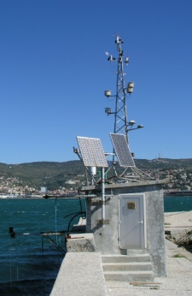
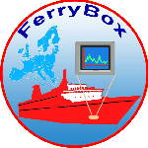
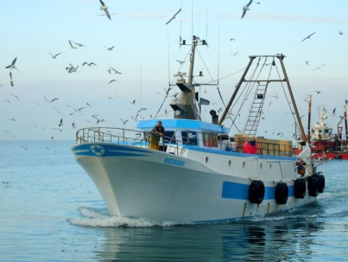
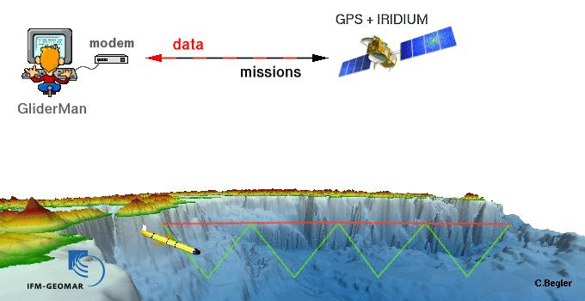
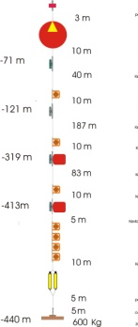
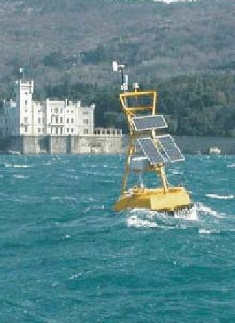
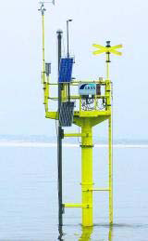
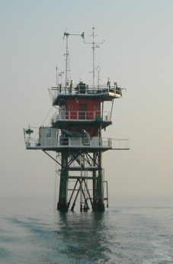
Joint
European
Research
Infrastructure network
for Coastal
Observatories
JERICO
A
Glenn Nolan, Henning Wehde, Patrick Farcy, Stefania Sparnocchia and George Petihakis
(on behalf of JERICO consortium)

Slide 2
The JERICO consortium
27 top-level marine research Institutes, Universities and SMEs from 17 European countries
coordinated by
IFREMER, France
    Start: May 1st, 2011 End: April 30th, 2015

Slide 3
  Towards a long-term and sustained European network
  of coastal observatories
EC umbrella (directives, policies, communications)
Marine Core Services (DG ENT / GMES)
Oceanic modelling
Coastal modelling
Coastal and shelf seas continuous in situ measurements
MY OCEAN
National/regional activities/projects
JERICO (I3)
Rivers discharges
EURO ARGO (ESFRI)
Fisheries data
Social/commercial activities
EMSO (ESFRI)
EUROFLEETS (I3)
MY OCEAN
Marine data thematic centers
SEADATANET (I3) standards and web portal
WISE-Marine (DG ENV)
EMODNET (DG MARE)

Slide 4
JERICO objectives
  To set up an European Research Infrastructure for
  coastal observations based on existing systems in
  European coastal and shelf seas.

Slide 5
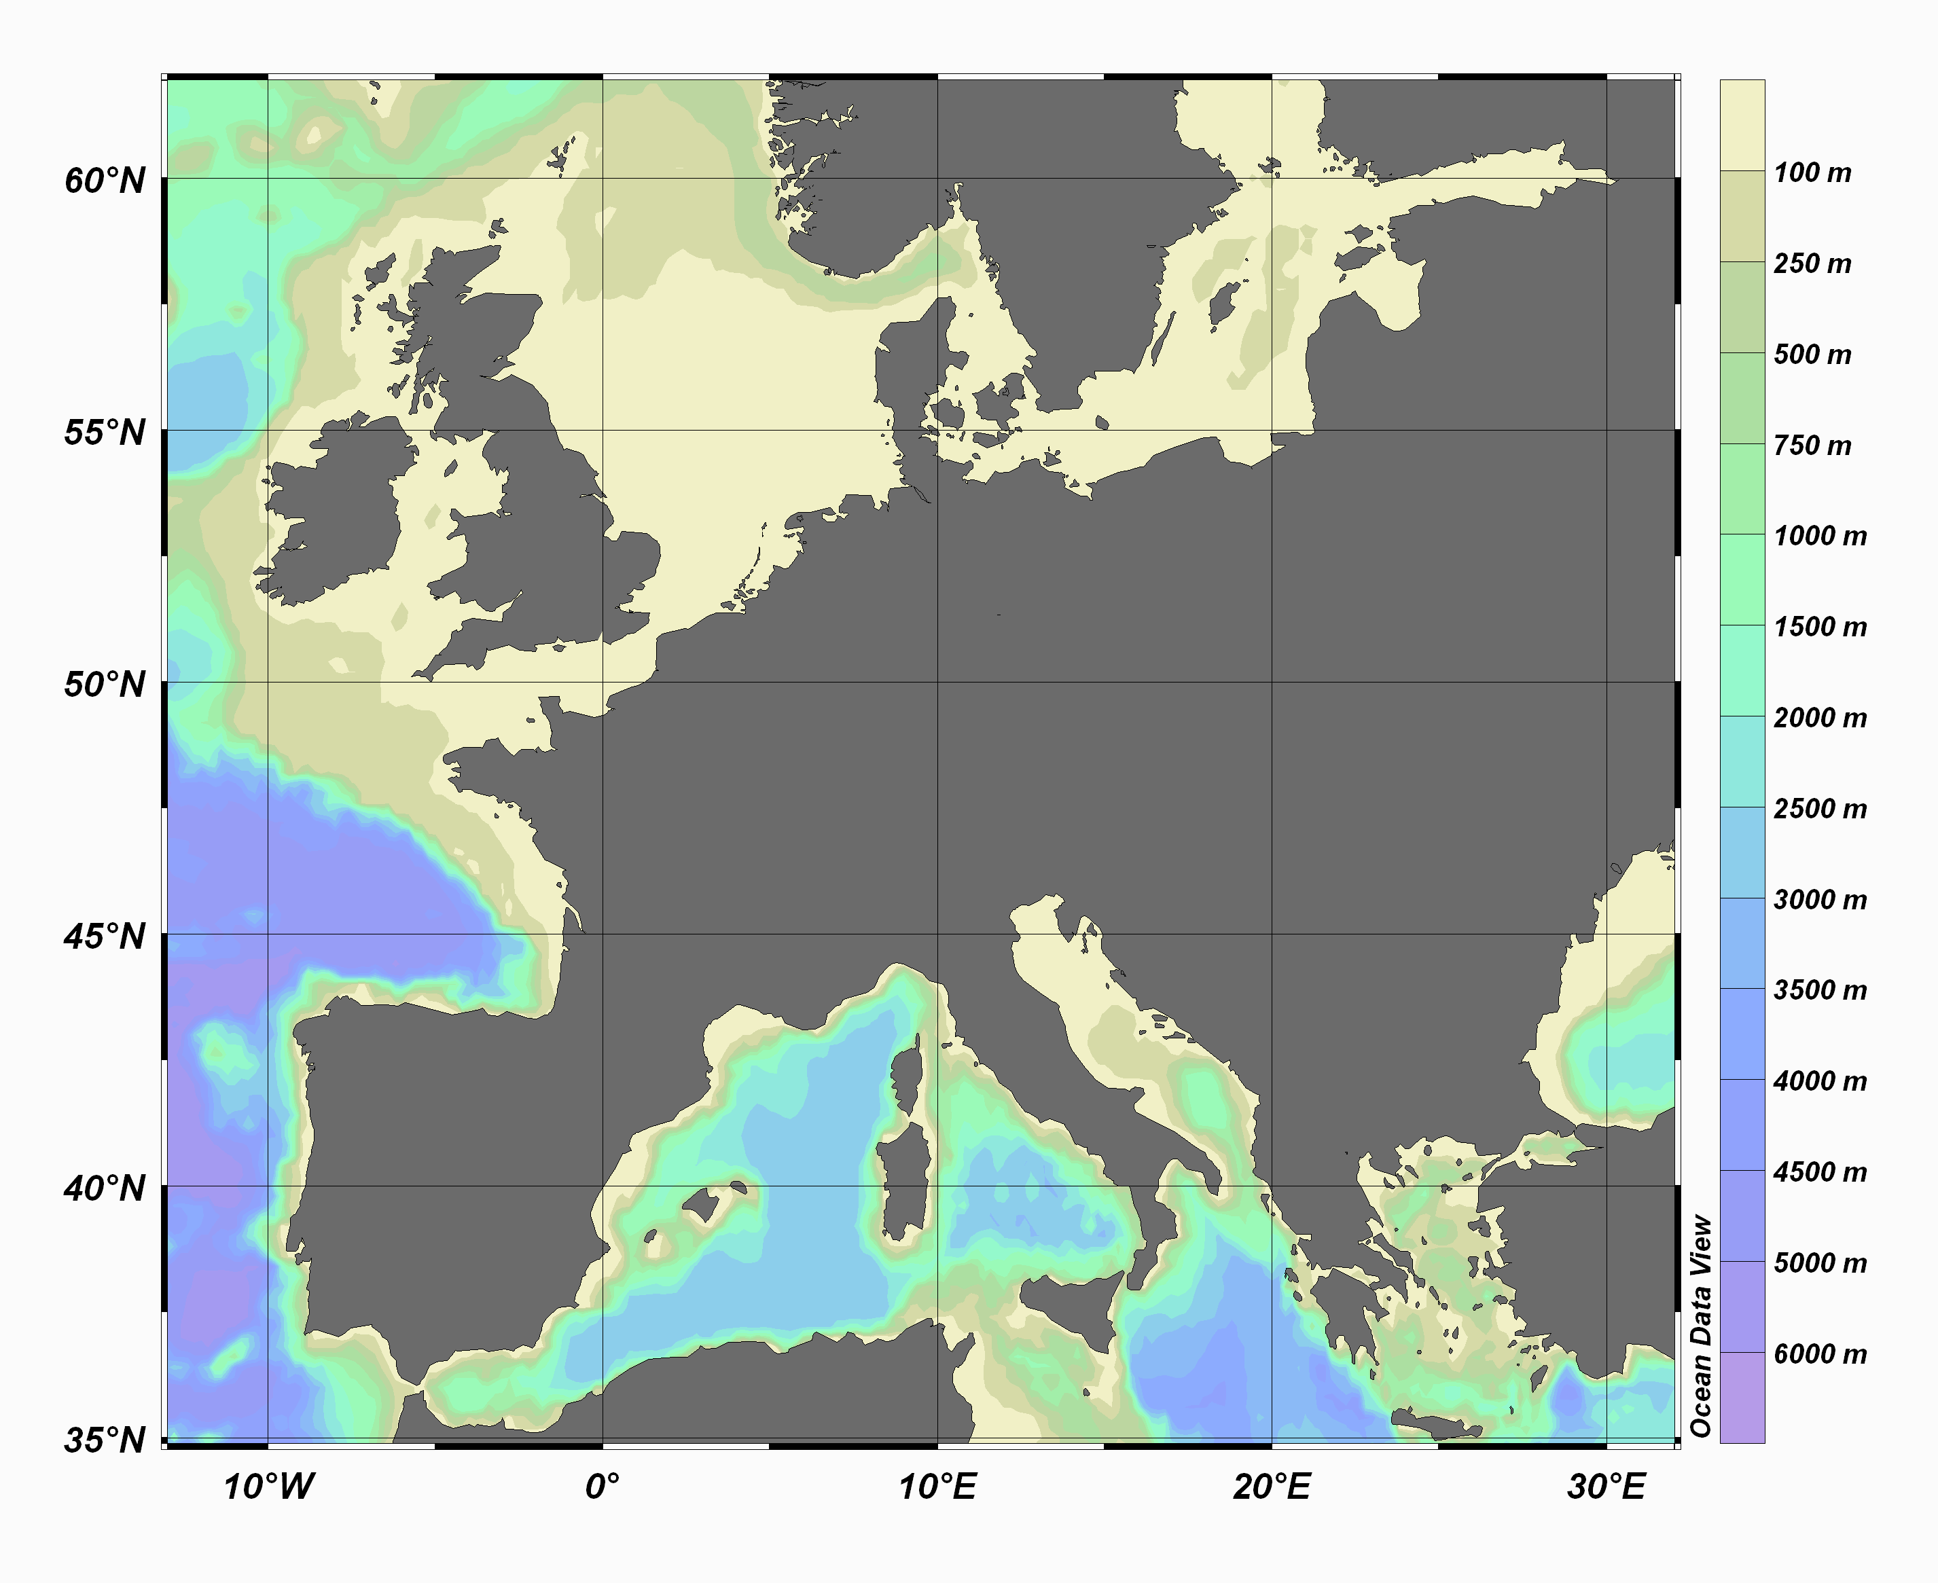
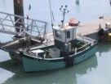




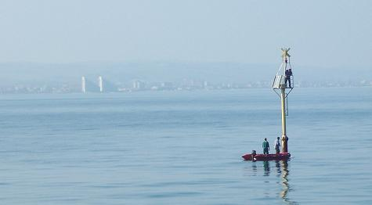
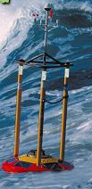

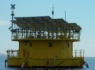
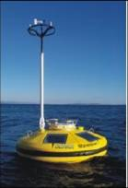

European coastal and shelf seas
Fixed platforms
Ferrybox
Fishing vessels
Gliders

Slide 6
JERICO objectives
  To set up an European Research Infrastructure for
  coastal observations based on existing systems in
  European coastal and shelf seas.
  2. To support standardization of operations and activities for
  the benefit of data quality and availability.
  - Harmonizing technological aspects
  assure compatibility and promote interoperability wherever
  possible
  - Harmonizing operation and maintenance methods
  sensor calibration, antifouling measures, quality control,
  maintenance and costs
  - Definition of a JERICO label (brand, standard)
  set of parameters, frequency, sampling scheme, data quality, data delivery…

Slide 7
JERICO objectives
  To set up an European Research Infrastructure for
  coastal observations based on existing systems in
  European coastal and shelf seas.
  2. To support standardization of operations and activities for
  the benefit of data quality and availability.
  3. To promote the cost-effective use of the facilities.
  provide access to external users for their own experiments and testing (TNA) and access to data and services (SA)

Slide 8
JERICO objectives
  To set up an European Research Infrastructure for
  coastal observations based on existing systems in
  European coastal and shelf seas.
  2. To support standardization of operations and activities for
  the benefit of data quality and availability.
  3. To promote the cost-effective use of the facilities.
  4. To stimulate the development of new automated systems
  for the operational monitoring of the coastal marine
  environment, with the focus on the biochemical
  compartment.
  (JRA + Forum for Coastal Technology)

Slide 9
JERICO WP SCHEME
WP0
Management
Steering Committee
Science Advisor Committee (SAC)
WP1
Common Strategy
Forum for Coastal technology (FCT)
WP2
Regional Activities
WP6
Public Outreach & Education
WP3
Technological Aspects
WP4
Harmonizing Operation
WP5
Data Distribution
WP9 – JRA/ Observing System Design
WP7 – SA/ Targeted Operational Phase
WP8 – TNA/ Access to The Infrastructure
WP10 – JRA/ Improve System Components
- Management
- NA
- TNA
- JRA

Slide 10
How is the project structured?
Scientific Advisory Committee
General Assembly
Forum
for Coastal Technology
Steering Committee
JERICO Coordinator
Project Management Team (WP0)
Networking Activity
Transnational Access Activity
Joint Research Activity
NA (WP1 to WP6)
JERICO
Cost efficient long term coordination of European coastal observatories
TNA (WP7 to WP8)
JRA (WP9 to WP10)
Advanced management of costs, resources, planning , knowledge, communications, quality indicators.

Slide 11
Prepare for the future European Network of operational coastal observatories (OCO) through:
  Better pan-European coordination
  Increased harmonisation of existing infrastructures
  Exchange of know-how and definition of Best Practices
  Promote European OCO through TNA
  Agreed deployment strategy

Slide 12
JERICO Networking activities (NA)
WP1 : A common strategy, including definition and implementation aspects
WP2 : Strengthening regional aspects
  EuroGOOS ROOSs aspects and inter regional interfaces
WP3 : Harmonizing technological aspects
  Observing systems : fixed station, ferrybox, gliders
WP4 : Harmonization operation and maintenance methods
  Fouling, calibration, quality control, maintenance and costs
WP5 : Data distribution (Seadatanet, MyOcean and EModNet)
WP6 : Public outreach and education

Slide 13
Coordination of NAs
Science Advisory
Committee.
Forum Coastal Tech.
WP2: Overview
of Regional
components
WP3: Overview
of Technologies
& Harmonization
WP4: Operation
& Maintenance
Harmonization
Gaps
Best practices
JERICO LABEL

Slide 14
JERICO TNA & JRA
WP7 : Service Access (SA) to the data
WP8 : Trans National Access
WP9 : OBSERVING SYSTEM DESIGN
  How to optimize the network : OSE, OSSE
WP10 : IMPROVE THE SYSTEM COMPONENTS
    monitoring of key biological compartments and processes .
    Developments and implementation on new platforms of physico-chemical sensors
    Emerging technology : profiler, ship of opportunity

Slide 15
Coordination of DATA WPs
Science Advisory
Committee.
Coordination Team WP1.
WP7: Service
Access
WP6: Outreach
and web portal
WP5: Data
distribution
Data
Data Manage-
-ment rules
JERICO DATA
OPEN ACCESS

Slide 16
JERICO WP SCHEME
WP0
Management
Steering Committee
Science Advisor Committee (SAC)
WP1
Common Strategy
Forum for Coastal technology (FCT)
WP2
Regional Activities
WP6
Public Outreach & Education
WP3
Technological Aspects
WP4
Harmonizing Operation
WP5
Data Distribution
WP9 – JRA/ Observing System Design
WP7 – SA/ Targeted Operational Phase
WP8 – TNA/ Access to The Infrastructure
WP10 – JRA/ Improve System Components
- Management
- NA
- TNA
- JRA

Slide 17
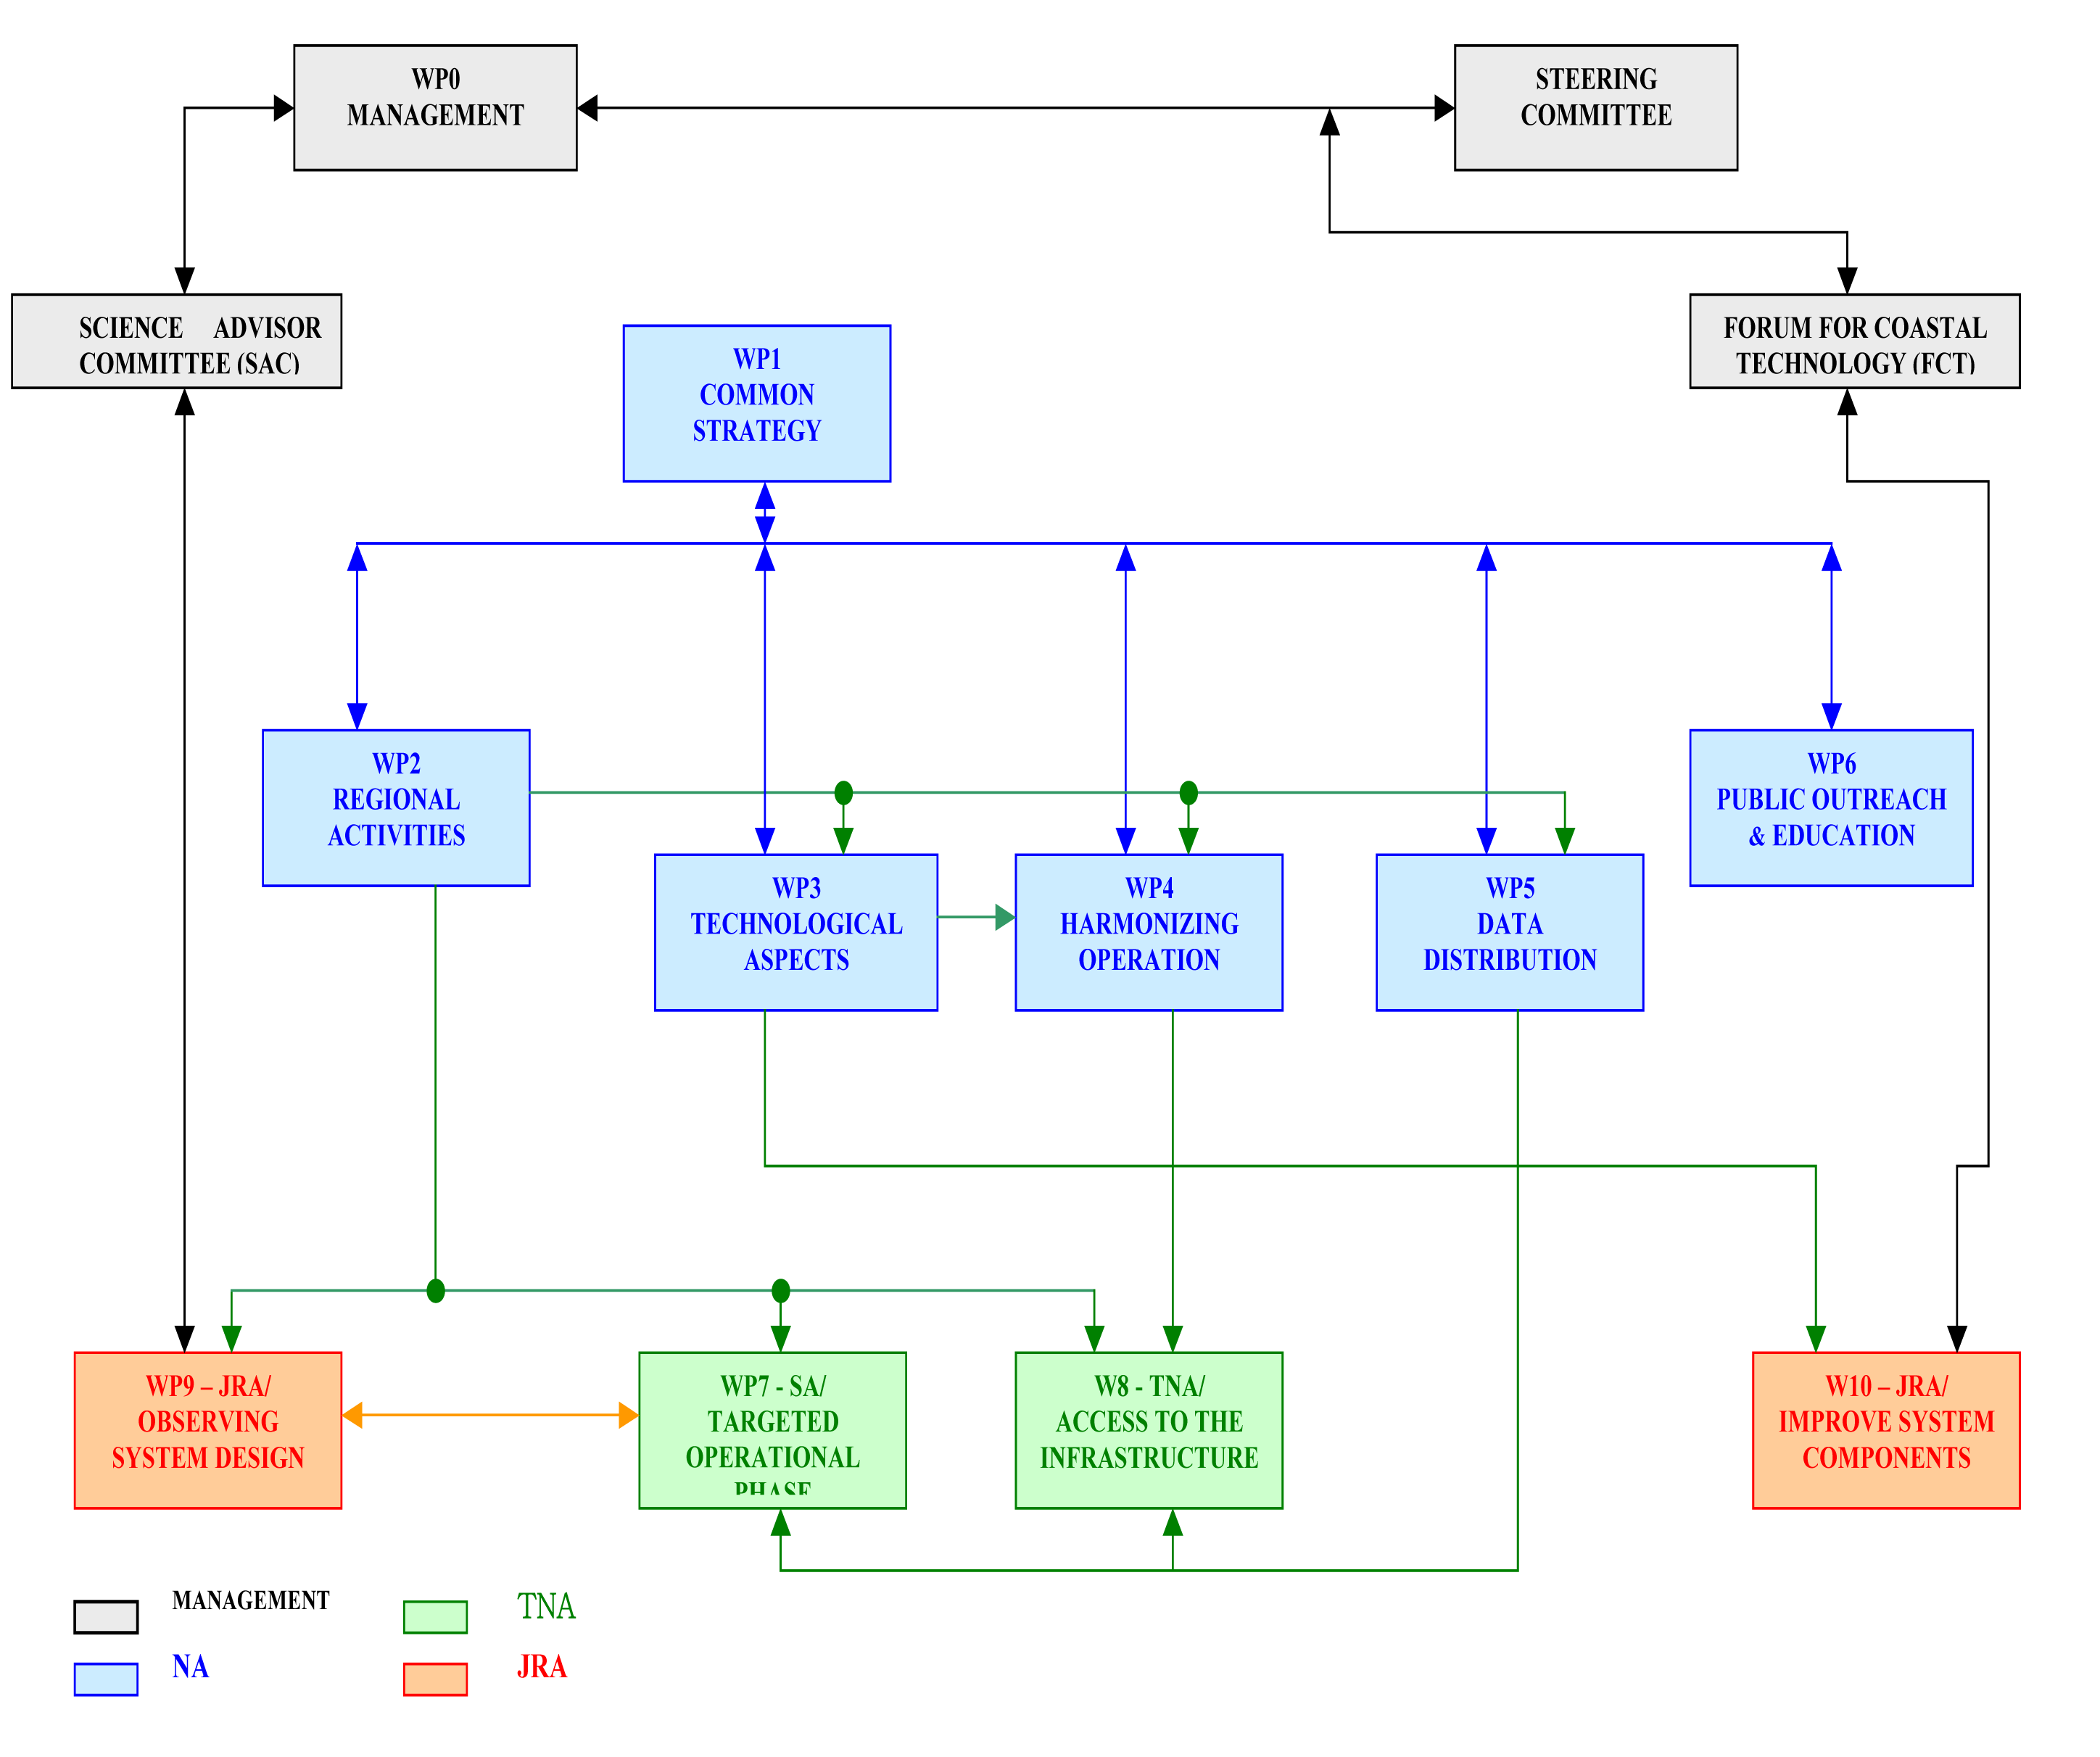
Jerico WP2 Strengthening regional and trans-regional activities

Slide 18
WP 2 Regional activities Objectives
  Make an inventory of existing coastal observing systems
  To identify data to be used for demonstration, for inter-calibration and data collection in servers
  To identify main gaps between accessible observations and data needs and address how to fill these gaps at the regional level.
  To demonstrate the feasibility of joint trans-regional products

Slide 19

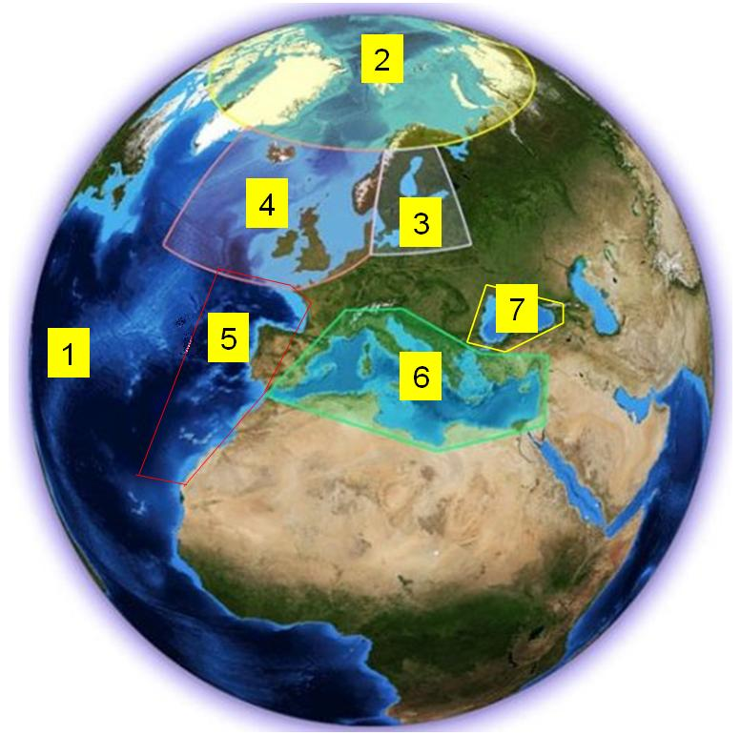
WP 2 Regional activities
Partners in WP2
Arctic ROOS IMR
BOOS SMHI
NOOS Deltares and IMR
IBI ROOS IH and AZTI
MOON INGV
Black Sea IO-BAS

Slide 20
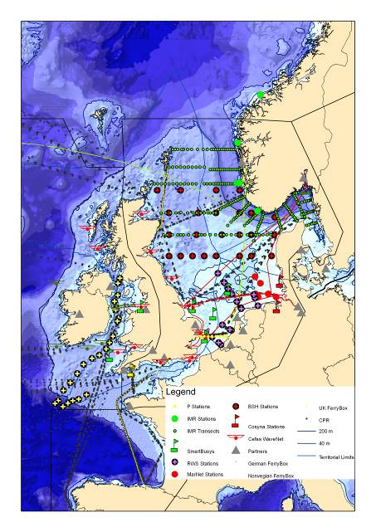

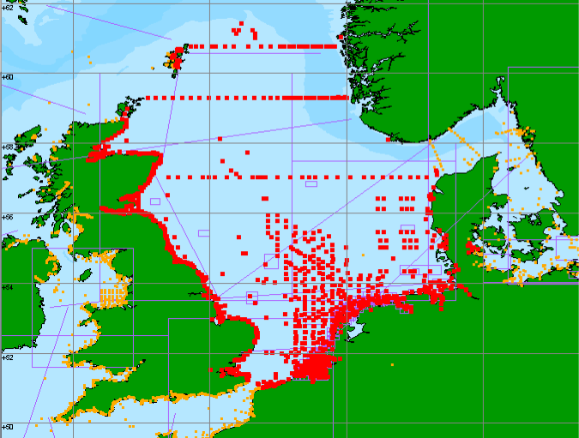
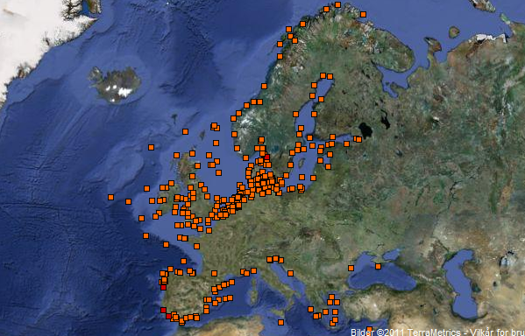
Coastal observing systems
EMECO
Review of ongoing and planned programmes and projects collecting in situ data and identification of Gaps
Establishment of an inventory of existing observing systems, with special focus on biogeochemical parameters, terms for data accessibility, administrative and legal barriers
Seprise
EDIOS

Slide 21
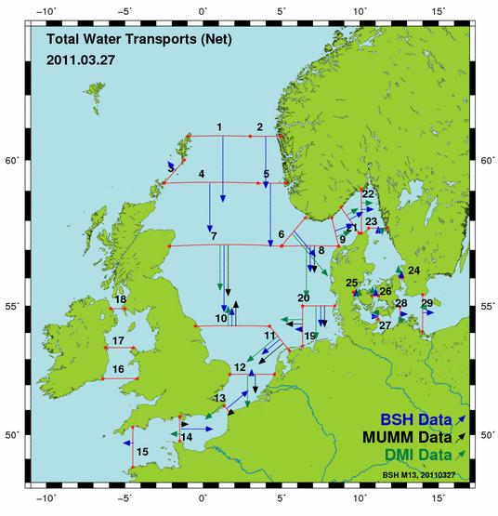
Cross regional integration and demonstration
Transport
  Model products existing (i.e.NOOS)
  Exploring observations for an observational based Pan-European product
  Example NOOS fluxes model product

Slide 22
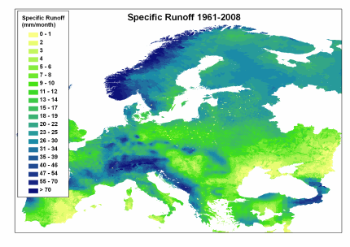
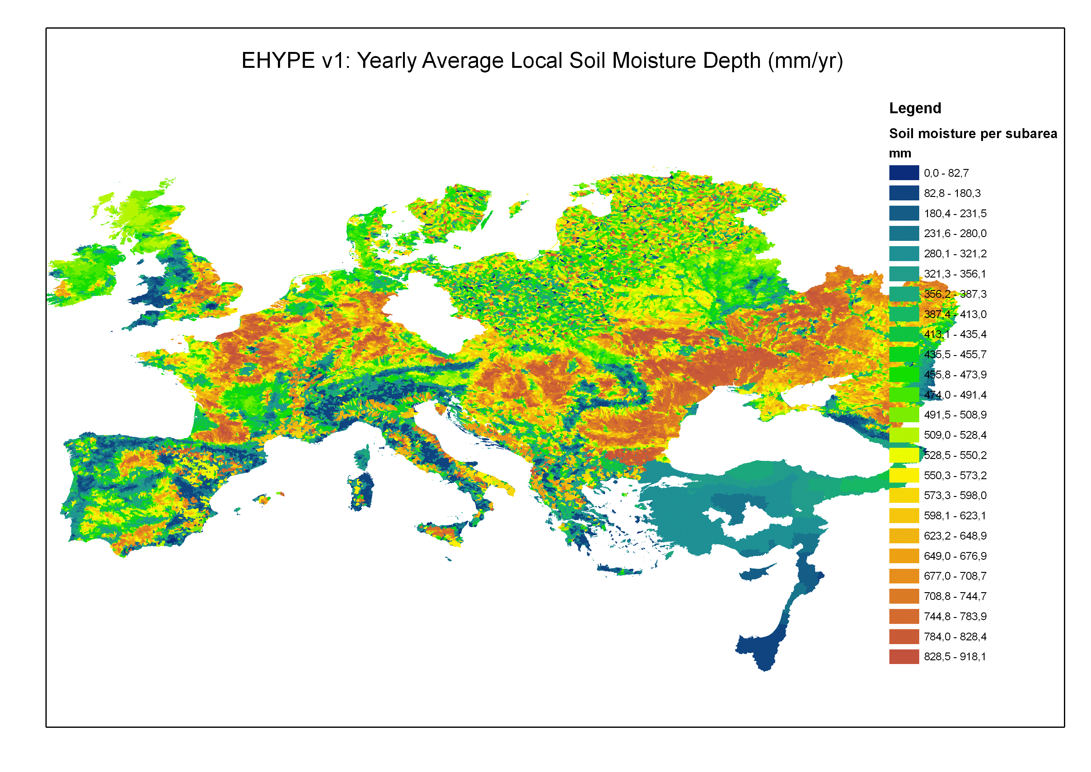
Cross regional integration and demonstration
River Runoff
E-HYPE
Validation / New data
Impact

Slide 23
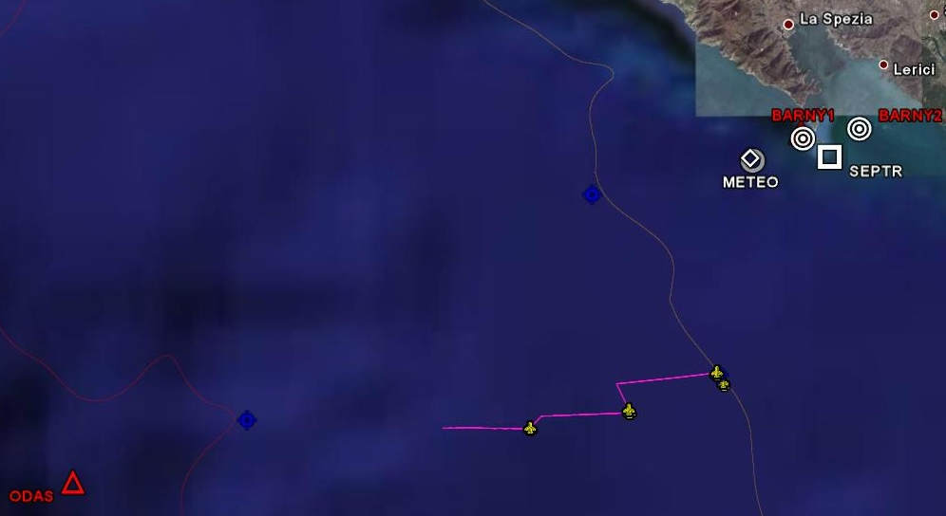
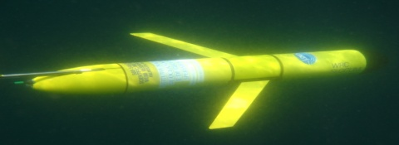
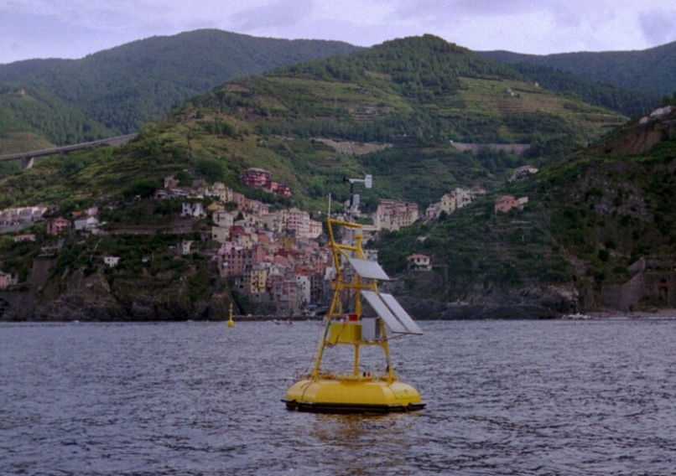
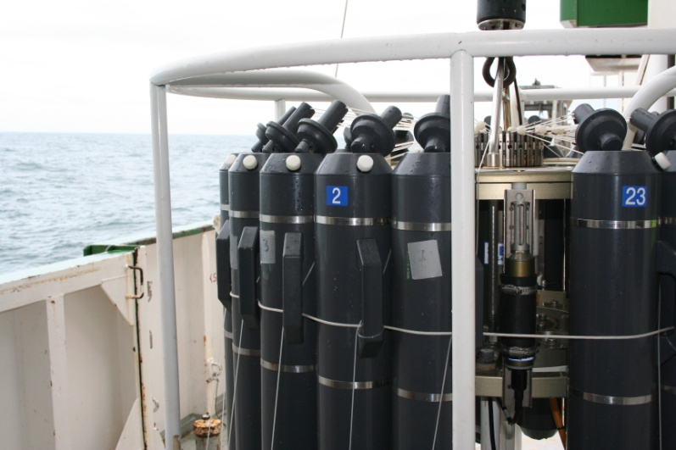
7 km
Start
6.3 km
End
7.25 km
WP4
Based on the experience of infrastructure operators and relevant regional activities, this WP will:
gather elements of best practice in conducting operations and maintaining coastal observatories,
identify the successes in terms of systems autonomy and reliability,
propose common procedures to be followed by all operators

Slide 24
WP5 (“Data Management & Distribution”) Activities

Slide 25
WP6 – Education and outreach
Cefas lead: partners UOM, Deltares, NERC, Syke, CISC
Objectives
To develop a Jerico Community Hub and Jerico Datatool for engagement of diverse end users
To provide information resources for identified user groups
To provide training in topics related to Jerico
Deliverables
Web site, hosting Community Hub and link to tools
Formation of Ocean Board – Jerico-Prof, Jerico-Pub
Tools for Data integration & promoting uptake of Jerico information
2 summer schools; observing technologies & linking Jerico coastal research to management needs
New methods for displaying FerryBox information to the public

Slide 26
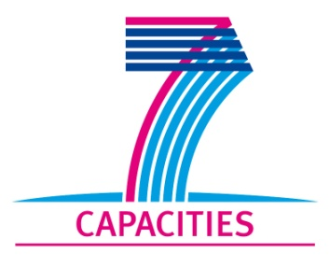
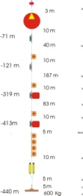
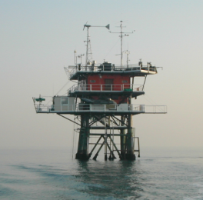
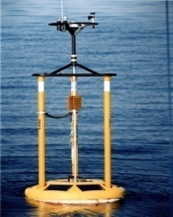
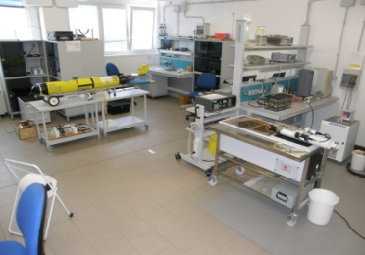
WP8 - Trans National Access to Coastal Observatories
OBJECTIVE To enable Transnational and free-of-charge access to original coastal
infrastructures among those operated by the JERICO Consortium
ACTIVITIES
    Two call openings ( Dec 2011 and Dec 2012 )
    Selection of proposals by a Selection Panel composed of international
    experts in the field
    Implementation of projects by user groups supported by a local team
    Reporting of information and results of the access activity on the
    TNA Web page
    http://www.jerico-fp7.eu/content/trans-national-access
MAIN RULES AND PRIORITIES
  The user group leader and the majority of the group must work in a Member
  State or Associated State other than the country of the facility operator
  Priority should be given to user groups composed of users who:
    have not previously used the infrastructure
    - are working in countries where no such research infrastructures exist

Slide 27
CONCLUSION :
JERICO Ultimate goal
Roadmap for future implementation and deployment of OCOs in Europe
Through
  Harmonisation of strategies, technologies and methodologies
  Identification of gaps and plan for filling in gaps
  Accounting for new environmental, research and service requirements
  Accounting for new technologies

Slide 28
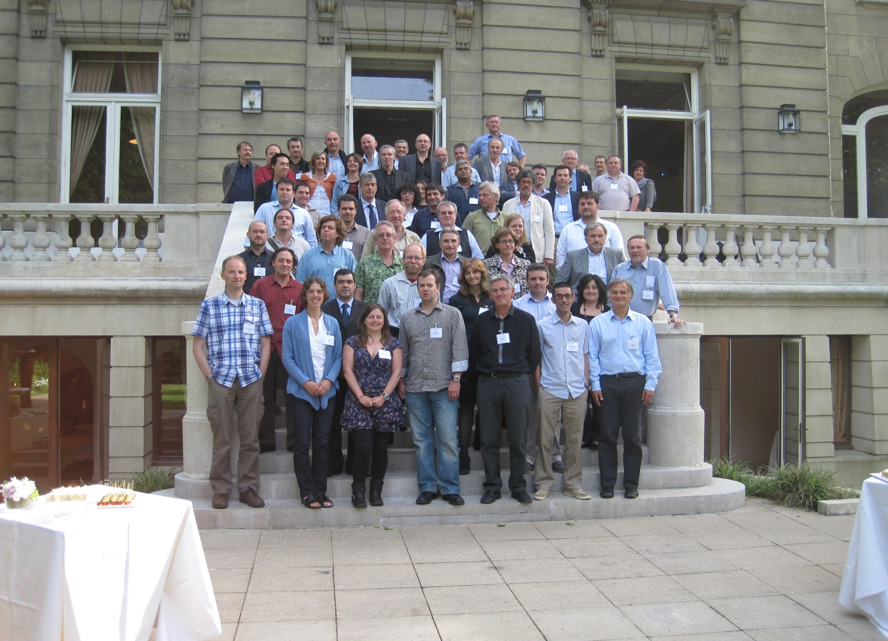
The JERICO Consortium

