Slide 1
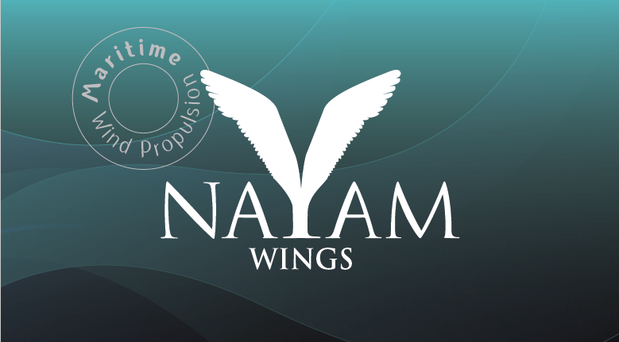
Blue Invest in the Mediterranean - Malta 2019

Slide 2
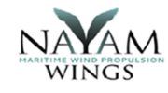
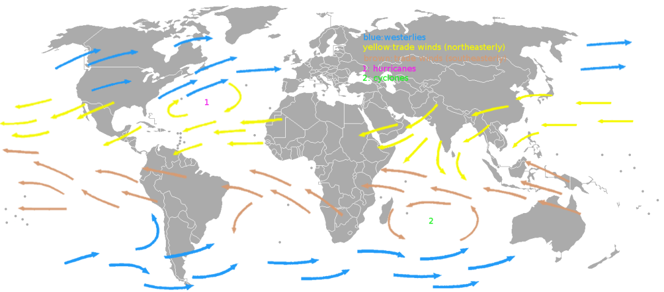
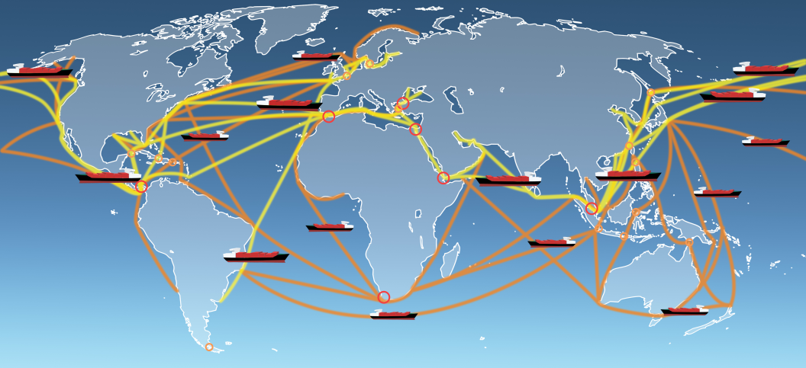
Background
90% of all global goods are delivered by sea.
Global maritime ships count 90,000 - 100,000
.
Global winds
Ship routes

Slide 3
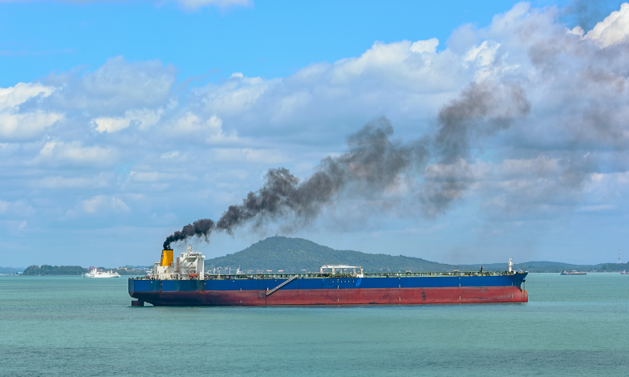
The problem
Fuel consumption
Pollution
New IMO restrictions on CO2 and SOx emissions will come into force by 1/1/2020

Slide 4
problem
New IMO restrictions on CO2 and SOx emissions will come into force by 1-1-2020
Ships will have to: ① use higher grade fuel, or ②install giant filters or ③convert engines to LNG ④replace engines
Enormous cost for shipping companies

Slide 5
The Solution
WIND PROPULSION
By NAYAM`S wing sail technology
Our solution will reduce fuel consumption and emissions by 30%

Slide 6
Market
Market analysis predicts installation of up to 10,700 wind propulsion systems by 2030.
Potential market for NAYAM WINGS:
Billions of dollars

Slide 7
NAYAM WINGS product
Better performances than other wing sail technologies:
Highest propulsive performances
Unique 3D wing maneuverability
Minimizes stability problems
Automatic control of wing
positioning and heeling angle

Slide 8
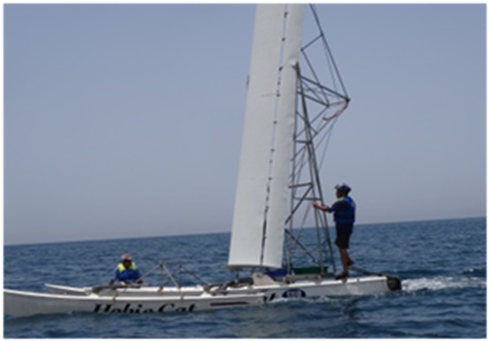
Achievements and status to date
POC model with 8 meters wing conducted very successful open sea trials
The technology is patented in the US and Europe
The company was awarded a grant from the Chief Scientist Innovation Office of the Energy Ministry of the State of Israel

Slide 9
Business Plan
Next milestone: Completing R&D stage with designing and building the 3rd POC model with full capabilities
Partnering with a strategic partner to bring our product to real size manufacturing and installation
Business model: Agreements with the above partners for upfront payments and royalties

Slide 10
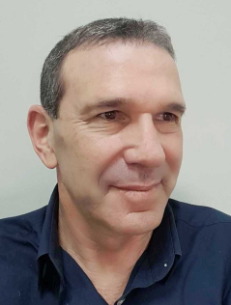
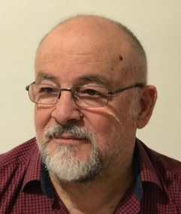
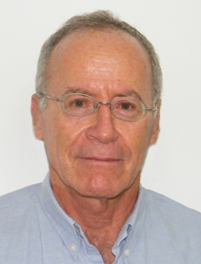
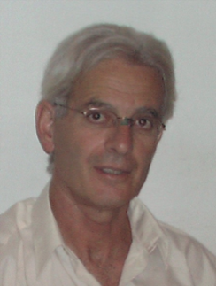
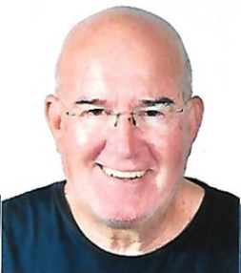
The TEAM
Amnon Kariv – CTO.
Expert aeronautical engineer, aircraft and wing sail design
Ido Haklai – CFO. MBA, manager in entrepreneurships
Amnon Asscher Founder, CEO.
Aeronautical engineer
Dov Ginsburg – COO. Experienced CEO at Nestle and Kimberly Clark.
Dr. Menashe Rajuan
Advisory Board Managing / Consulting start ups

Slide 11
Open sea trial of POC model #1
Open sea trial of POC model #4

