Slide 1
NeXOS development and end-to-end integration of compact, low-power, multifunctional ocean sensors
Eric Delory, Dr.-Ing.
Oceanic Platform of the Canary Islands (PLOCAN) PLOCAN Observatory NeXOS Project coordinator eric.delory@plocan.eu

Slide 2
NeXOS
Ocean of Tomorrow Project
Project number : 614102 (FP7-OCEAN-2013.2)
Starting date : 1st of October 2013 (48 months)
21 partners from 6 European countries
Coordinator : Eric Delory (PLOCAN, Spain)

Slide 3
NeXOS innovations
Transversal:
Smart sensor interface
Antifouling (optics)
End-to end Interoperability via OGC standards
Application-specific:
Multifunctional optics
Preprocessed passive acoustics
Ecosystem sensors for EAF (fisheries)

Slide 4
NeXOS Objectives
Lower capital and operating expenses for sensor systems and in-situ ocean observations
Multifunctional sensor packages for multiple cost-effective platforms
Standard web interfaces (Sensor Web)
Extend the deployment duration of sensors

Slide 5
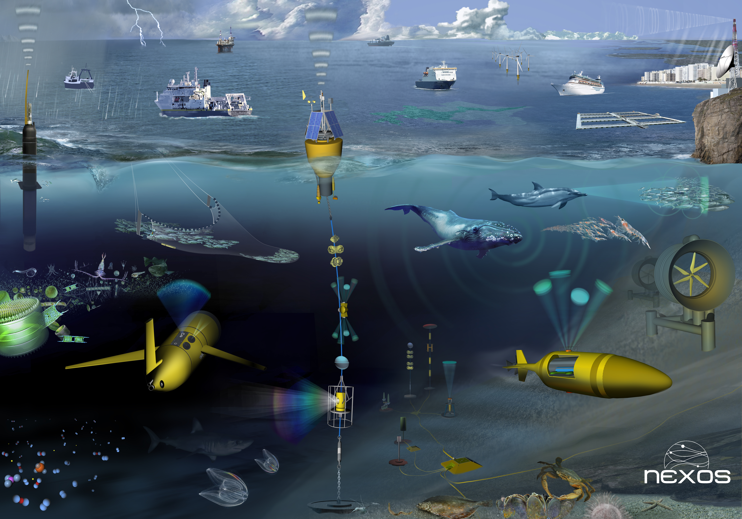
Sensors, Platforms and Oceanscape

Slide 6
NeXOS & MSFD GES

Slide 7
Sensor Technology |  |  | Sensor type
Optical |  |  | O1 Matrix-fluorescence
 |  |  | O2 Hyperspectral
 |  |  | O3 Carbon
Passive Acoustics |  |  | A1 Preprocessed
 |  |  | A2 Real-time
RECOPESCA/EAF |  |  | EAF/ Chlorophyll
 |  |  | EAF/Oxygen
Cross-cutting Technologies
Smart Sensor Interface – OGC PUCK + SWE |  |  | Bio-fouling prevention
Target Platforms
Gliders | Drifters/profilers | Cable Observatories |  | Ferries
Trawlers | Nets & Lines | Other leisure |  | Stand alone

Slide 8
From basic principles to operational systems
Technology Readiness Levels

Slide 9
Research to Prove Feasibility (TRL 2&3)
System commissioning (TRL 7&8)

Slide 12
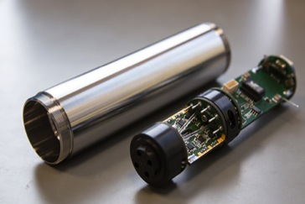
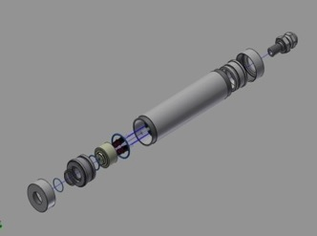
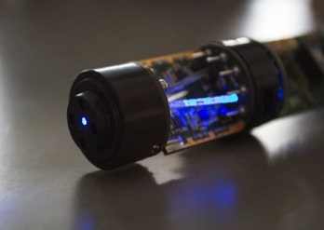
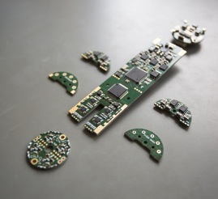
NeXOS O1 – Fluorescence matrix TRL 5 to 7
UV-Version:
PAH monitoring CDOM classification
 | Em
Ex | 280 | 360 | 450 | 850
254 | PAH(a) | PAH(b) | CDOM(A)
280 | scat 280 | PAH(c) | CDOM(B)
320 |  |  | CDOM(C)
850 |  |  |  | Turbidity
VIS-Version: algae, CDOM, turbidity monitoring
 | Em
Ex | 460 | 655 | 682 | 850
375 | CDOM | CDOM backgnd | CDOM backgnd
470 | scat 460 |  | chl-a
625 |  | cyanobac pig. | PC via chl-a
850 |  |  |  | Turbidity

Slide 13
NeXOS O1 – Fluorescence matrix TRL 5 to 7

Slide 14
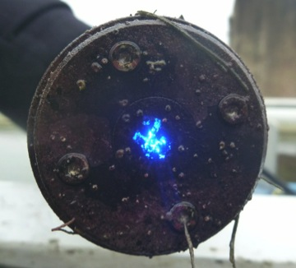
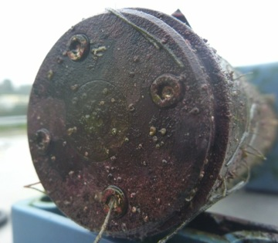
NeXOS Biofouling protection by electro-chlorination
TRL 4 to 7
Copper
Conductive SnO2 electrode
Window
Protected
Electrochlorination by SURFACE thin film working electrode on window
Image and information courtesy of Laurent Delauney, IFREMER
Unprotected

Slide 15
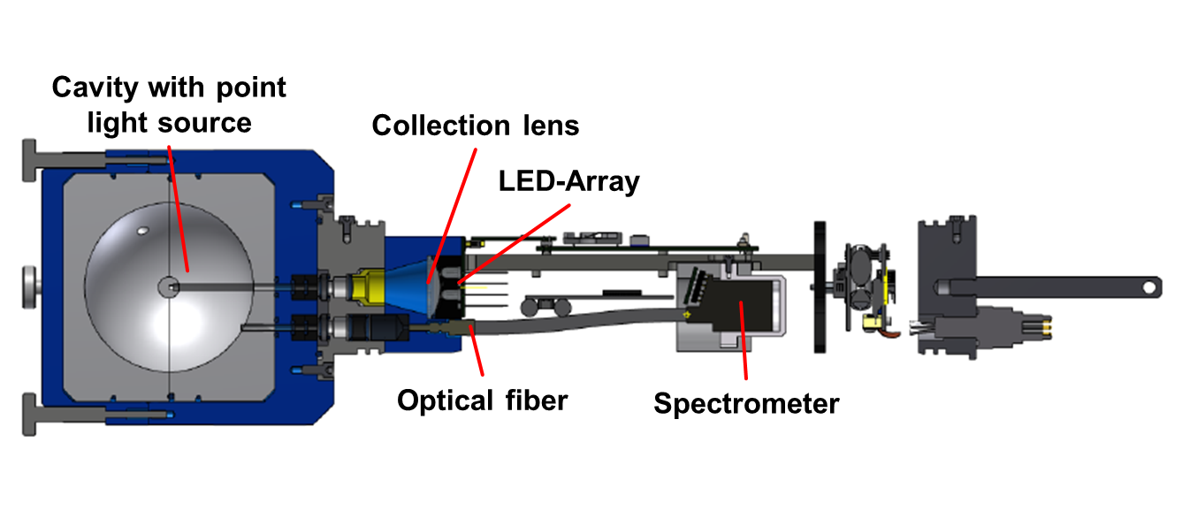
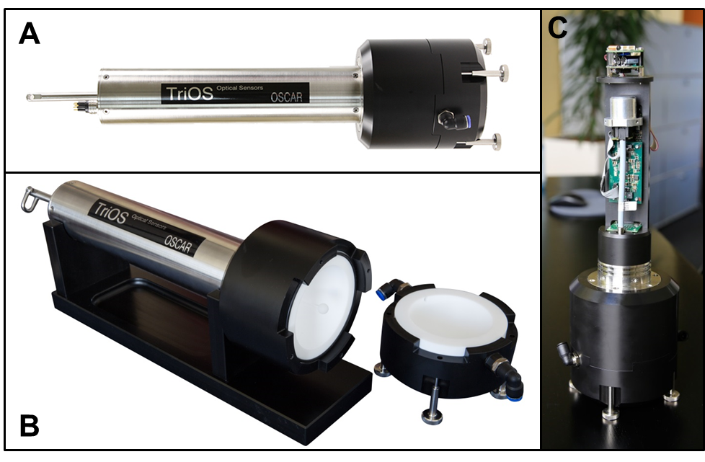
NeXOS O2 – Hyperspectral Cavity Absorption sensor TRL 4 to 5

Slide 16
Phytoplankton Identification with NeXOS O2
Currently, reliable identification of at least 7 groups possible (in lab experiments)
Chlorophytes
Chrysophytes
Cryptophytes
Bluegreen cyanobacteria
Brown cyanobacteria
Prochlorococcus
Browngreen algae (Diatoms, Dinophytes, Haptophytes)
Differences also visible in field data (further validation necessary)
Improvement of the algorithm by inclusion of field spectra in the reference database

Slide 17
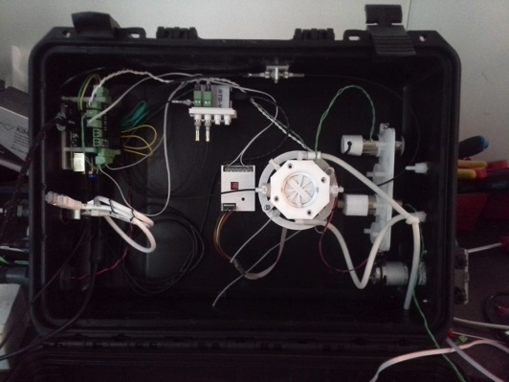
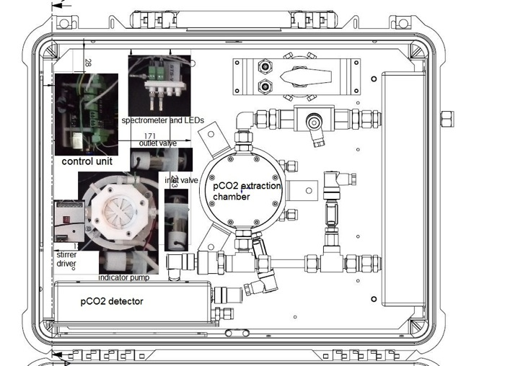
NeXOS O3 – Carbon Sensor System TRL 4 to 7
Spectrophotometric pH detection,
with embedded system
(Raspberry pi 2,linux ARM7 arch.)
8 ADC channels.
Embedded PUCK friendly.
Different Array Setups:
Cbon2-fb pH and pCO2 in the same box aside the ferrybox system on a ship
Cbon2-sv pH and low power NDIR pCO2 in the same surface vessel (sailbuoy)
Cbon3-fb: pH + pCO2 + AT

Slide 18
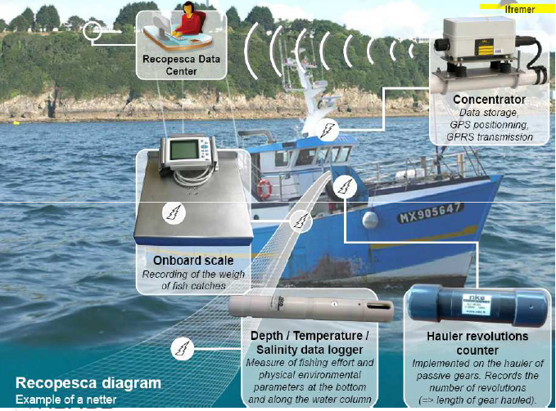
Recopesca

Slide 19
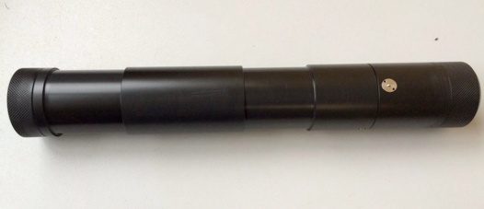
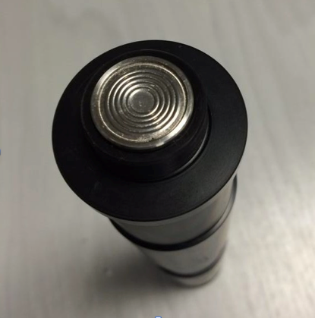
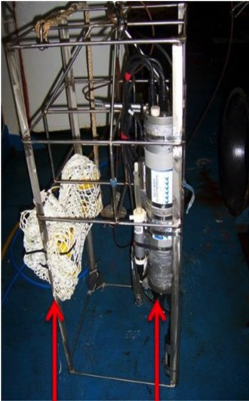
NeXOS new Recopesca sensors TRL 3 to 7 (status: 5)
Oxygen Sensor
CTD (ref)
Fluorometer Sensor (chl-a)
Sensors to test

Slide 20
NeXOS Acoustic Sensors TRL 2 to 8 (current:6)
NeXOS A1: Compact low-power multifunctional passive acoustics sensor system, enabling on-platform measurement and characterisation of underwater noise for platforms with limited communication.
NeXOS A2: Compact multifunctional sensor system for real-time waveform streaming aimed for platforms with unlimited autonomy and/or communication capability.

Slide 21
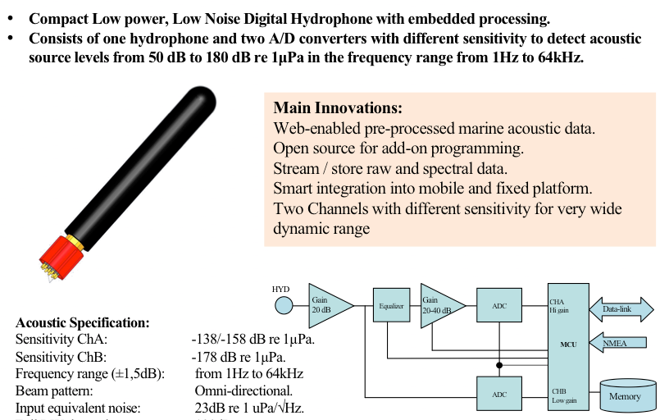
Passive Acoustic Sensors

Slide 22
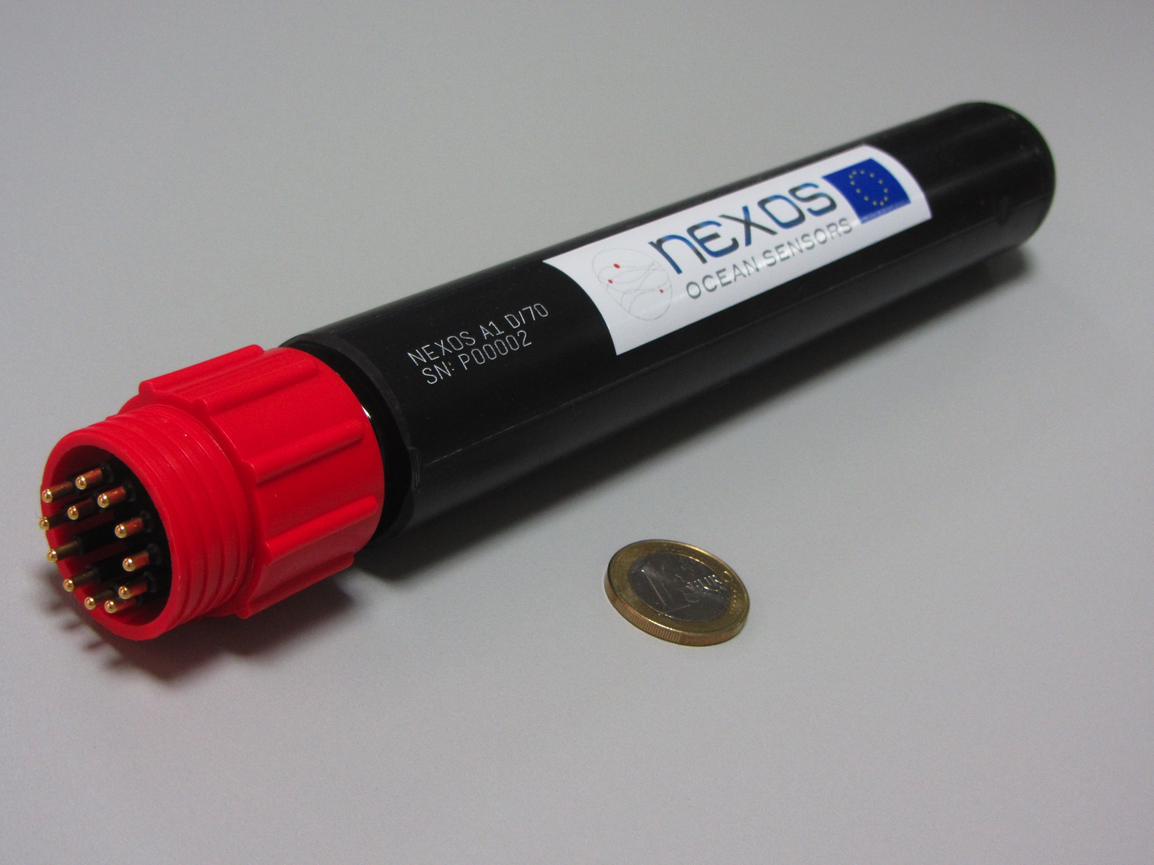
NeXOS Acoustic Sensors TRL 2 to 8 (current:6)
Compact, low power <1W in active mode (low power) for autonomous mobile platforms
OGC-PUCK and SWE enabled

Slide 23
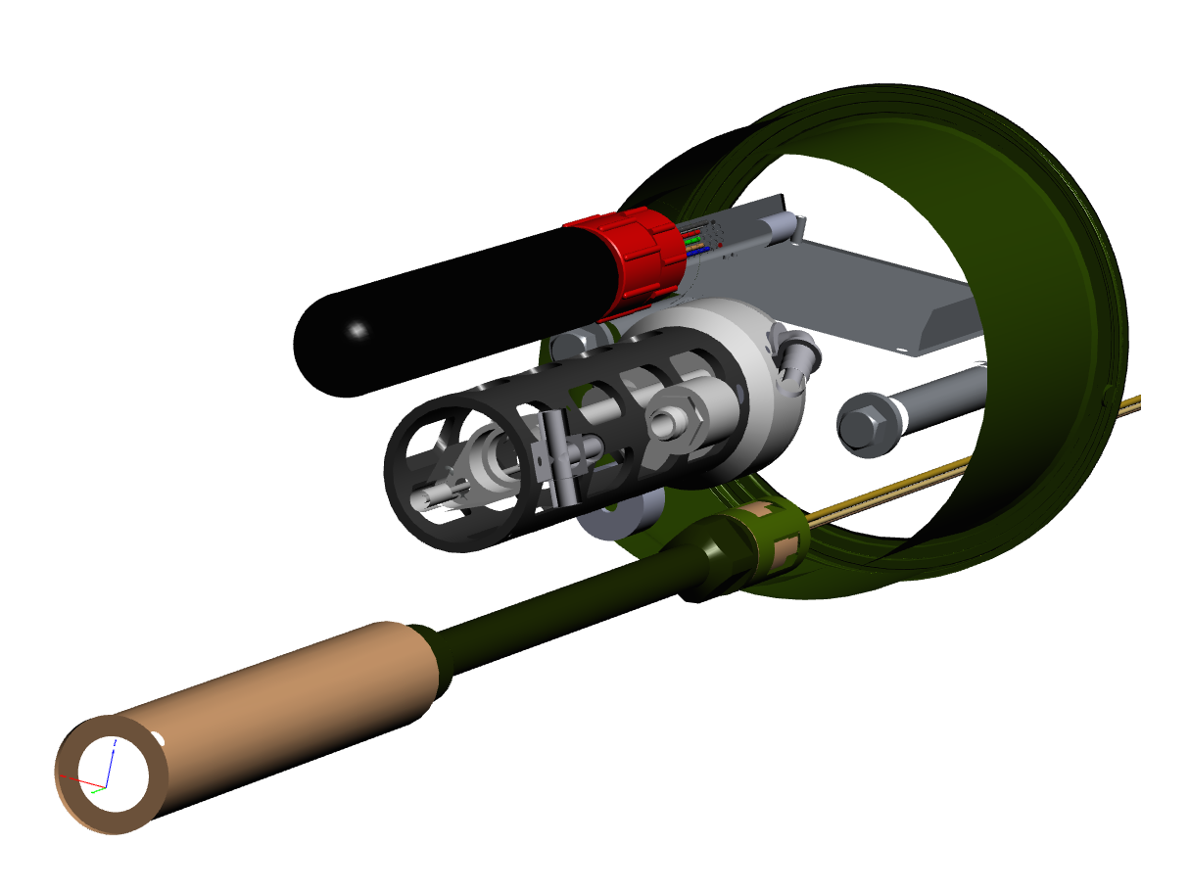
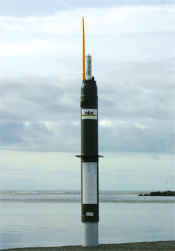

Slide 24
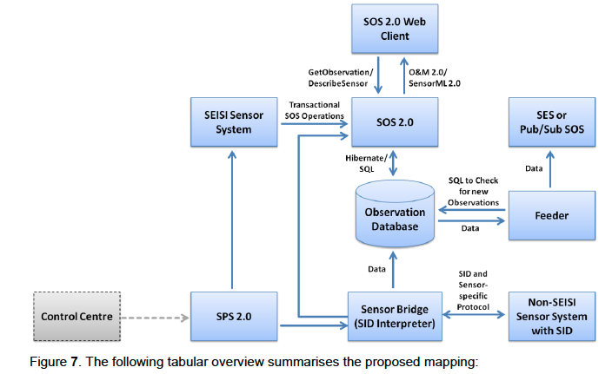
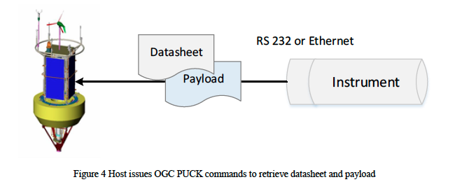
Web of Things OGC SWE and OGC PUCK open standards TRL 4 to 7

Slide 25
Web of Things Smart Sensor Interface TRL 3 to 8
Smart Sensor Interface and Web Components Hardware and software interface with miniaturized low power modular design
Implementation of OGC PUCK protocol for instrument discovery and identification
Precision Time Protocol (IEEE Std. 1588) for time synchronization
Open Source software development tools
Open Data access based on Sensor Web Enablement framework.
Notes:
SPS is sensor planning service; SOS sensor observation service; SAS sensor alert service; Sensor Interface Descriptor (SID) schema that enables the declarative description of sensor interfaces, ... a profile and extension of SensorML. Based on this schema, SID interpreters can be implemented, independently of particular sensor ..

Slide 26
SM(i)LE

Slide 27
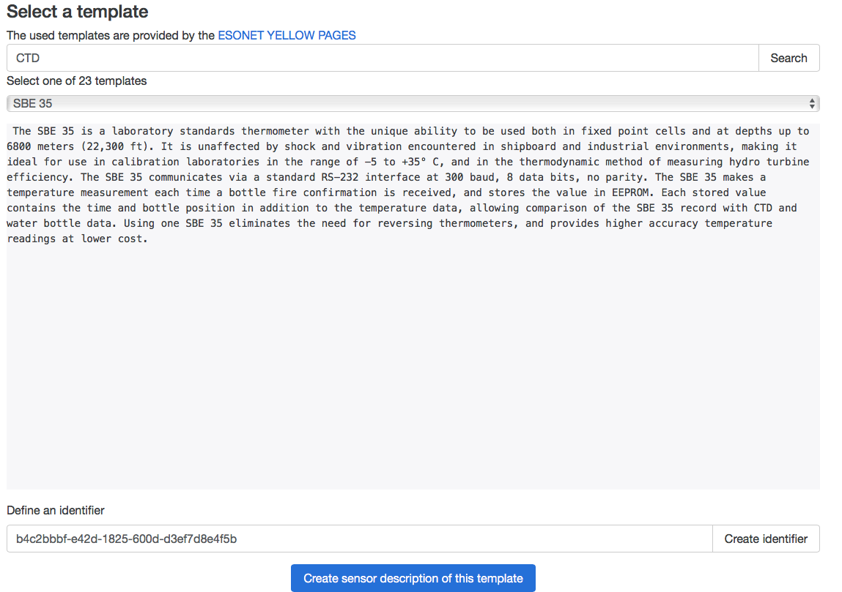

Slide 28
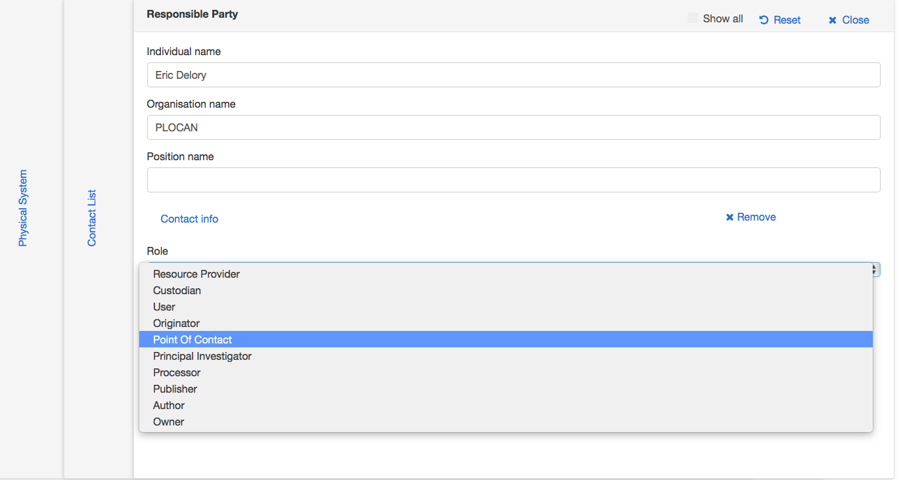

Slide 29
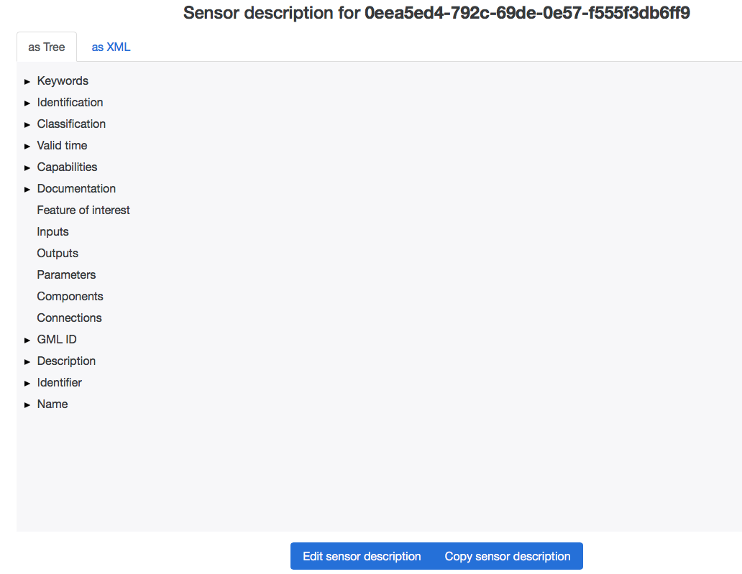

Slide 31
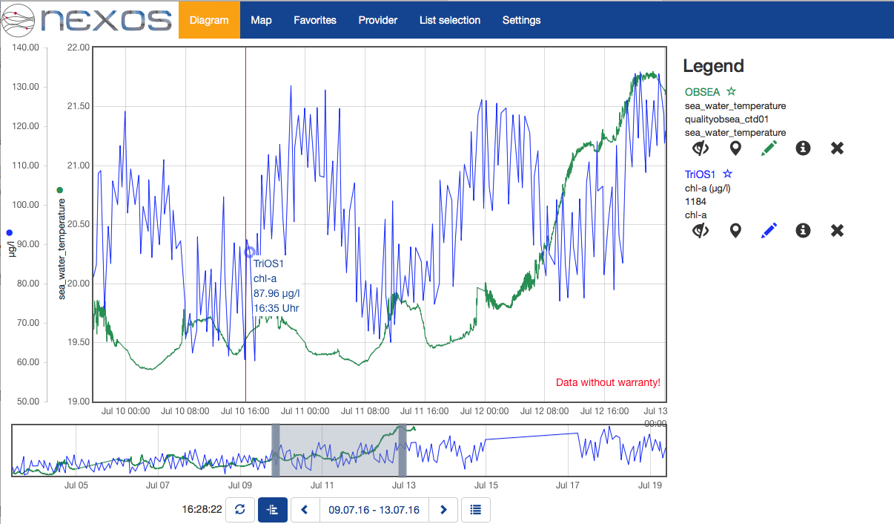
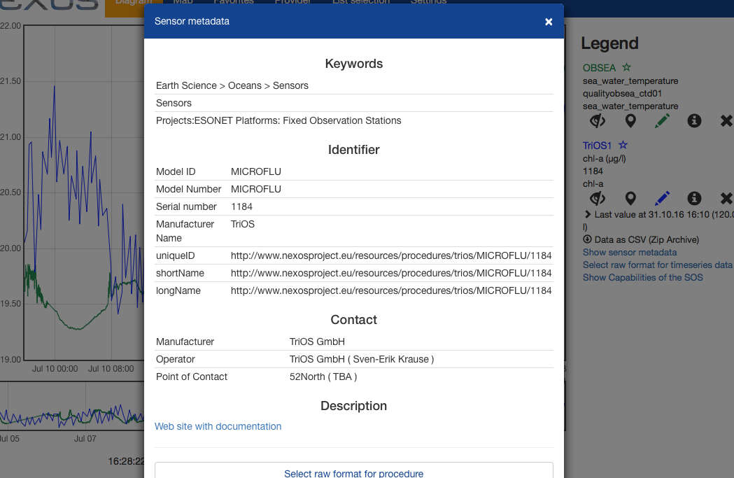
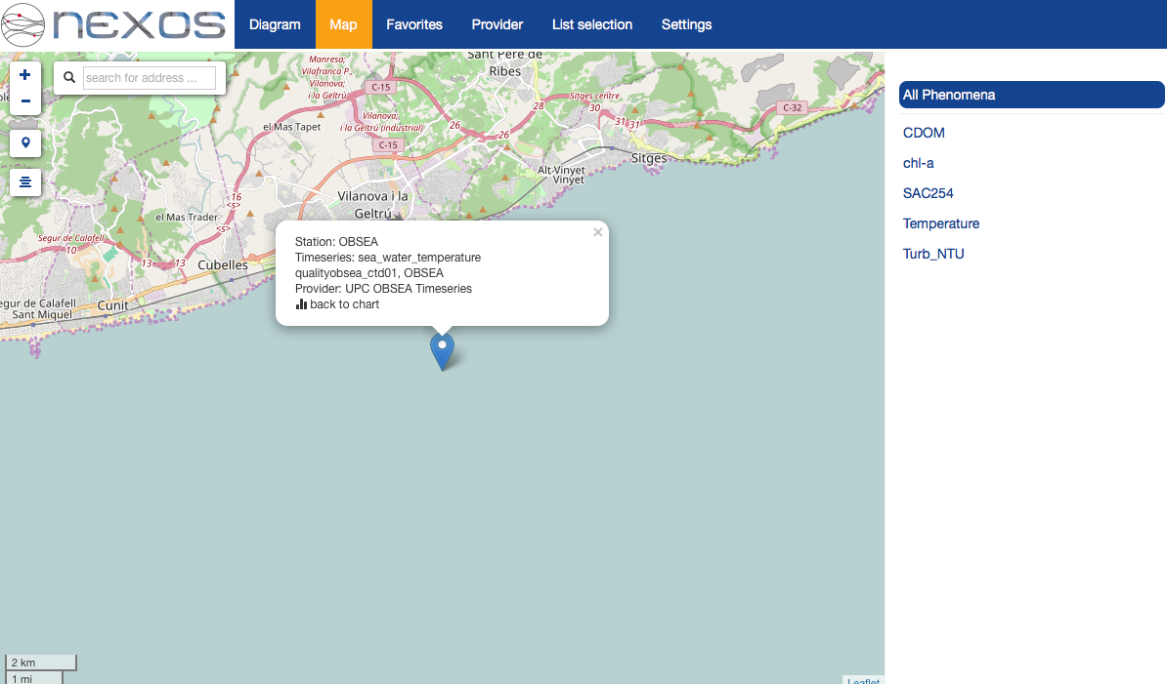
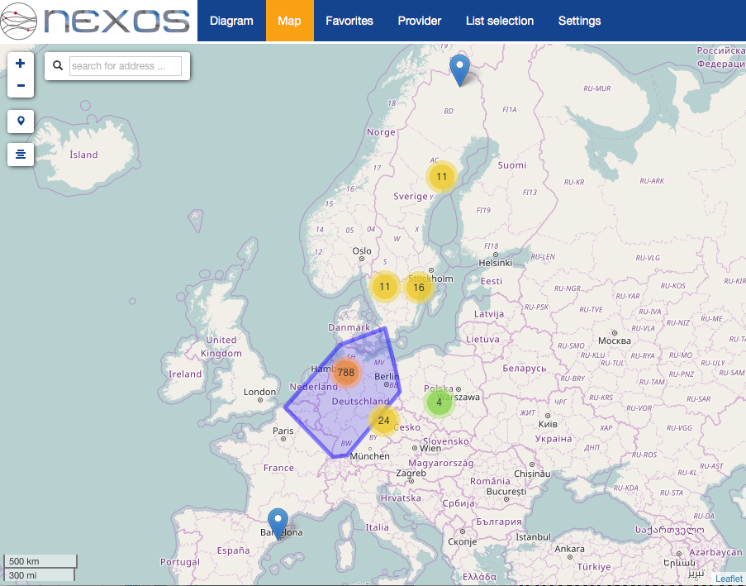
NeXOS SWE User front end

Slide 32
NeXOS Test and Demo Scenarios
Scenario 1: Hydrocarbon observations with gliders; detection and quantification of leakage
Scenario 2: Carbon cycle and carbon sequestration monitoring with ferry-boxes including pH, inorganic carbon, carbonate ions, partial pressure CO2.
Scenario 3: Passive acoustic monitoring and characterization of underwater sounds from floats and gliders
Scenario 4: Observations for sustainable fisheries observing ocean variables
Scenario 5 : Detection and characterization of phytoplankton blooms and groups

Slide 33
Status & Next Steps
Tests, validation and demonstrations on PLOCAN testbed and observatory, Norwegian Sea, Mediterranean Sea
Continuum with EMSO (EMSODev), FixO3 (R&D and harmonisation), AtlantOS (WP6)

Slide 34
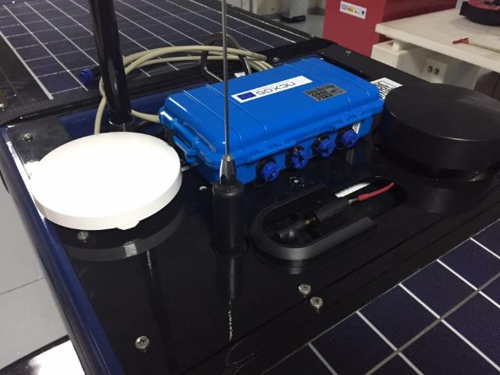
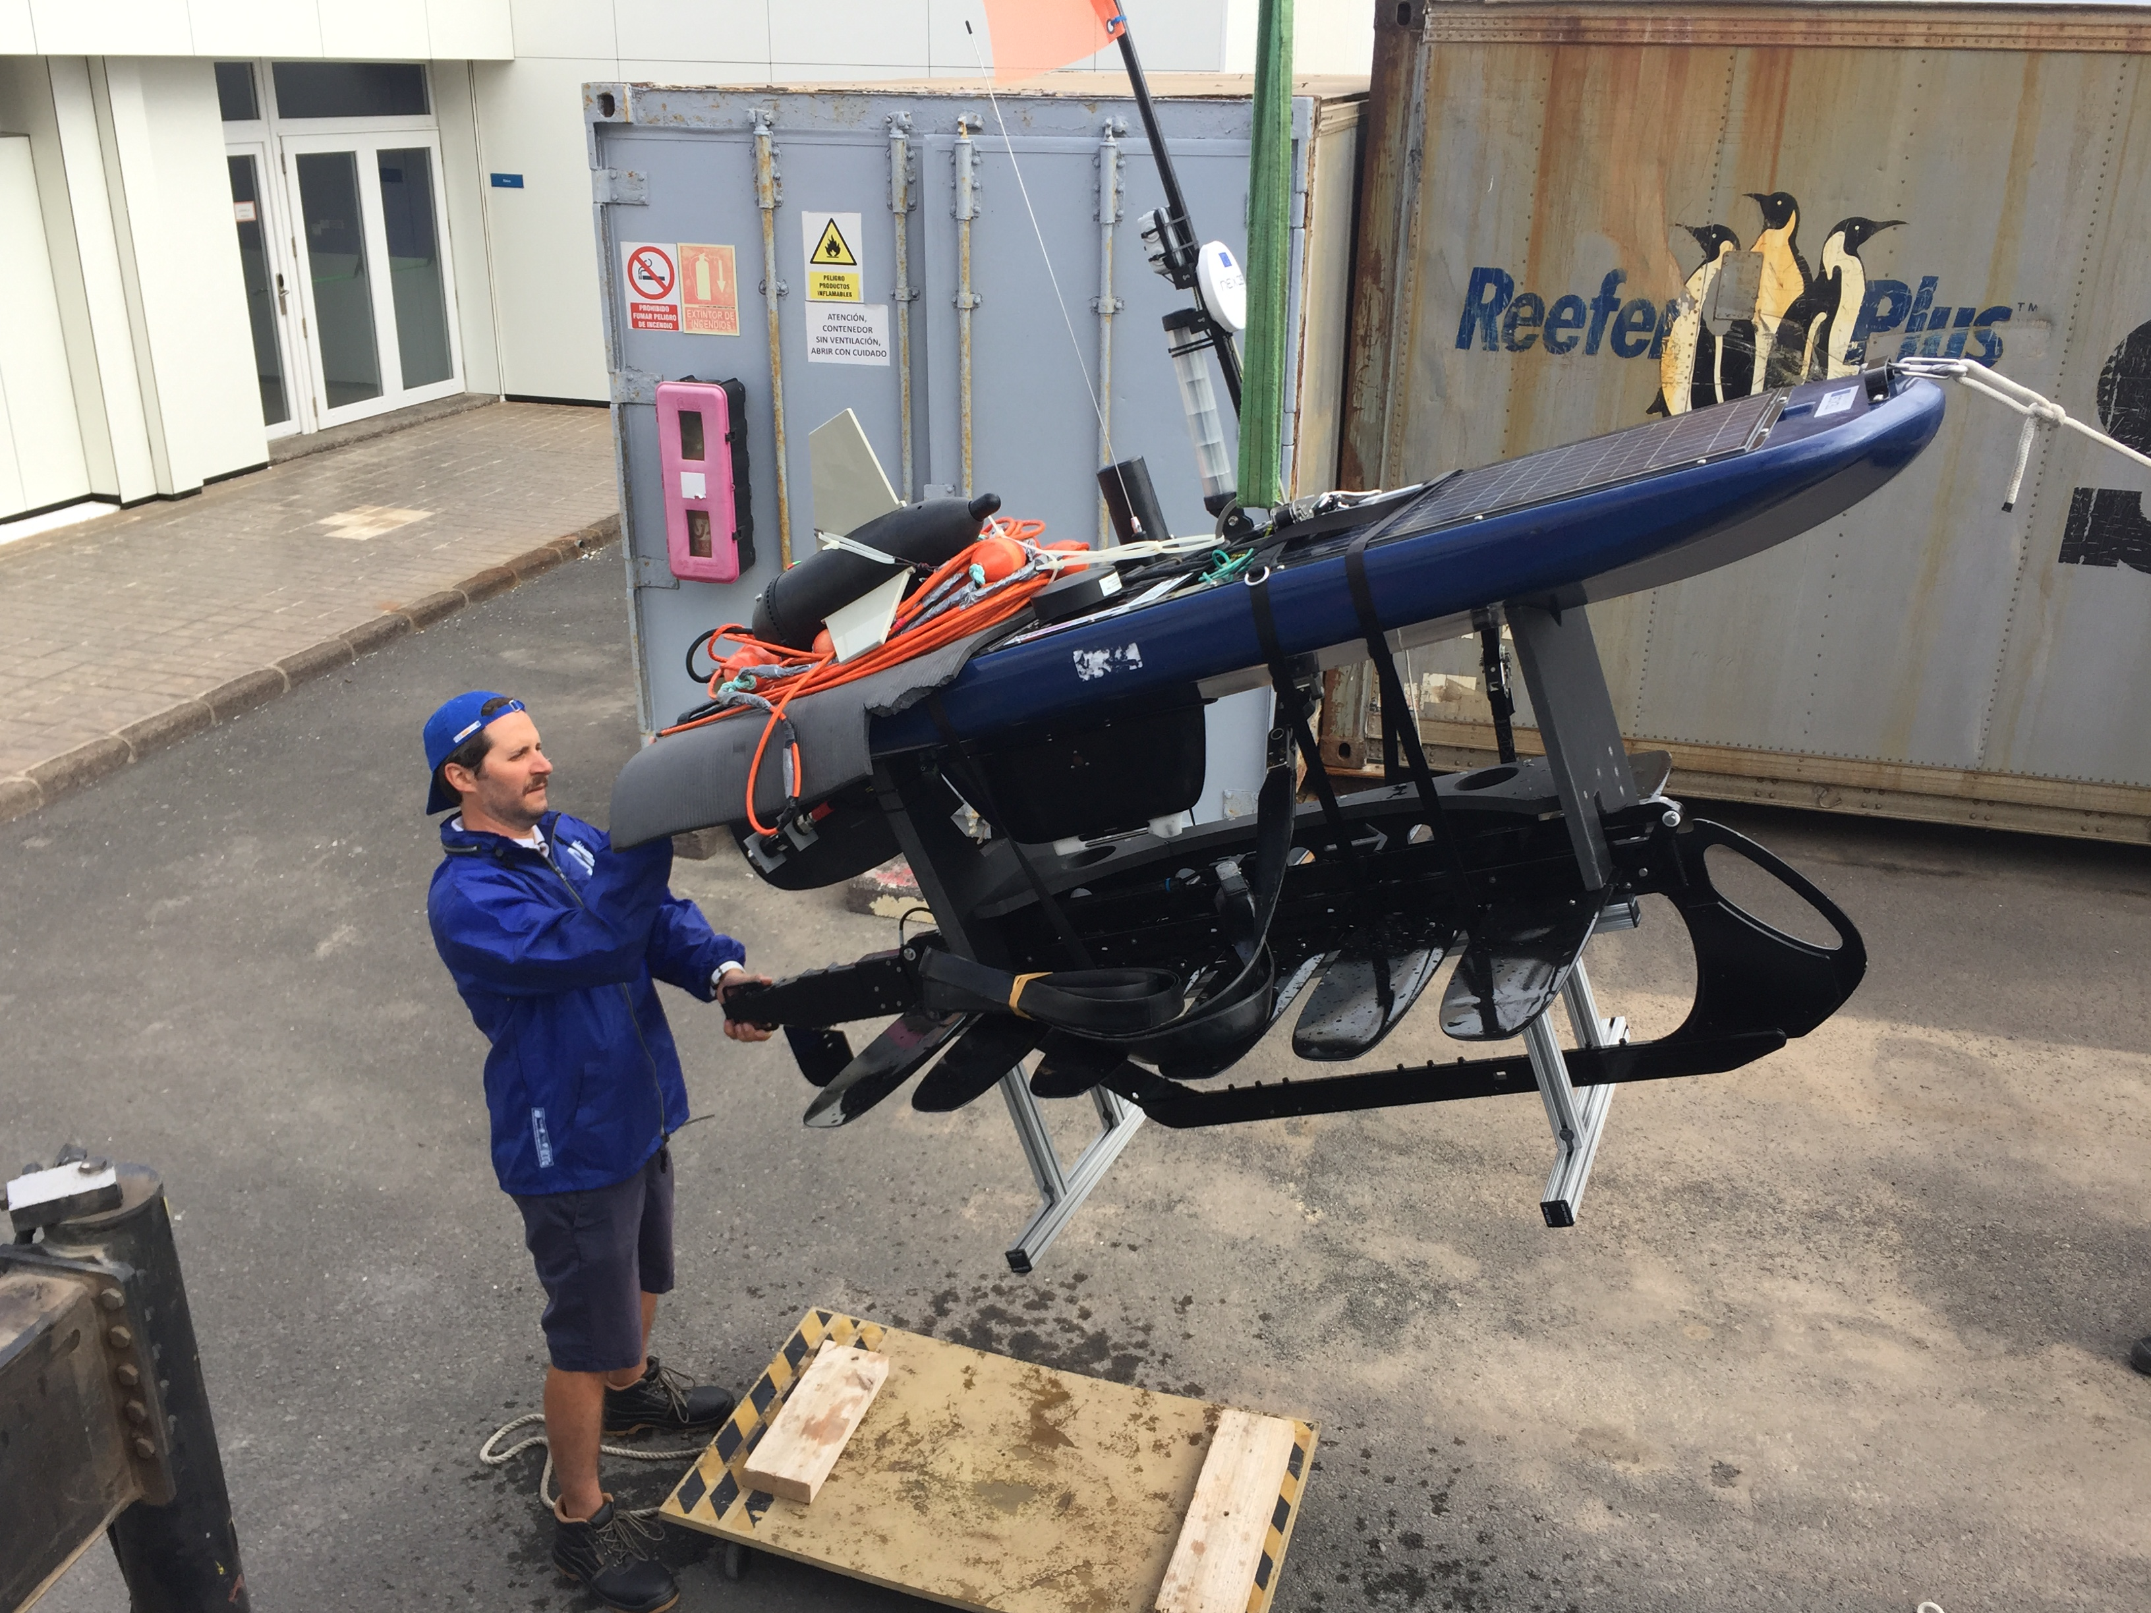
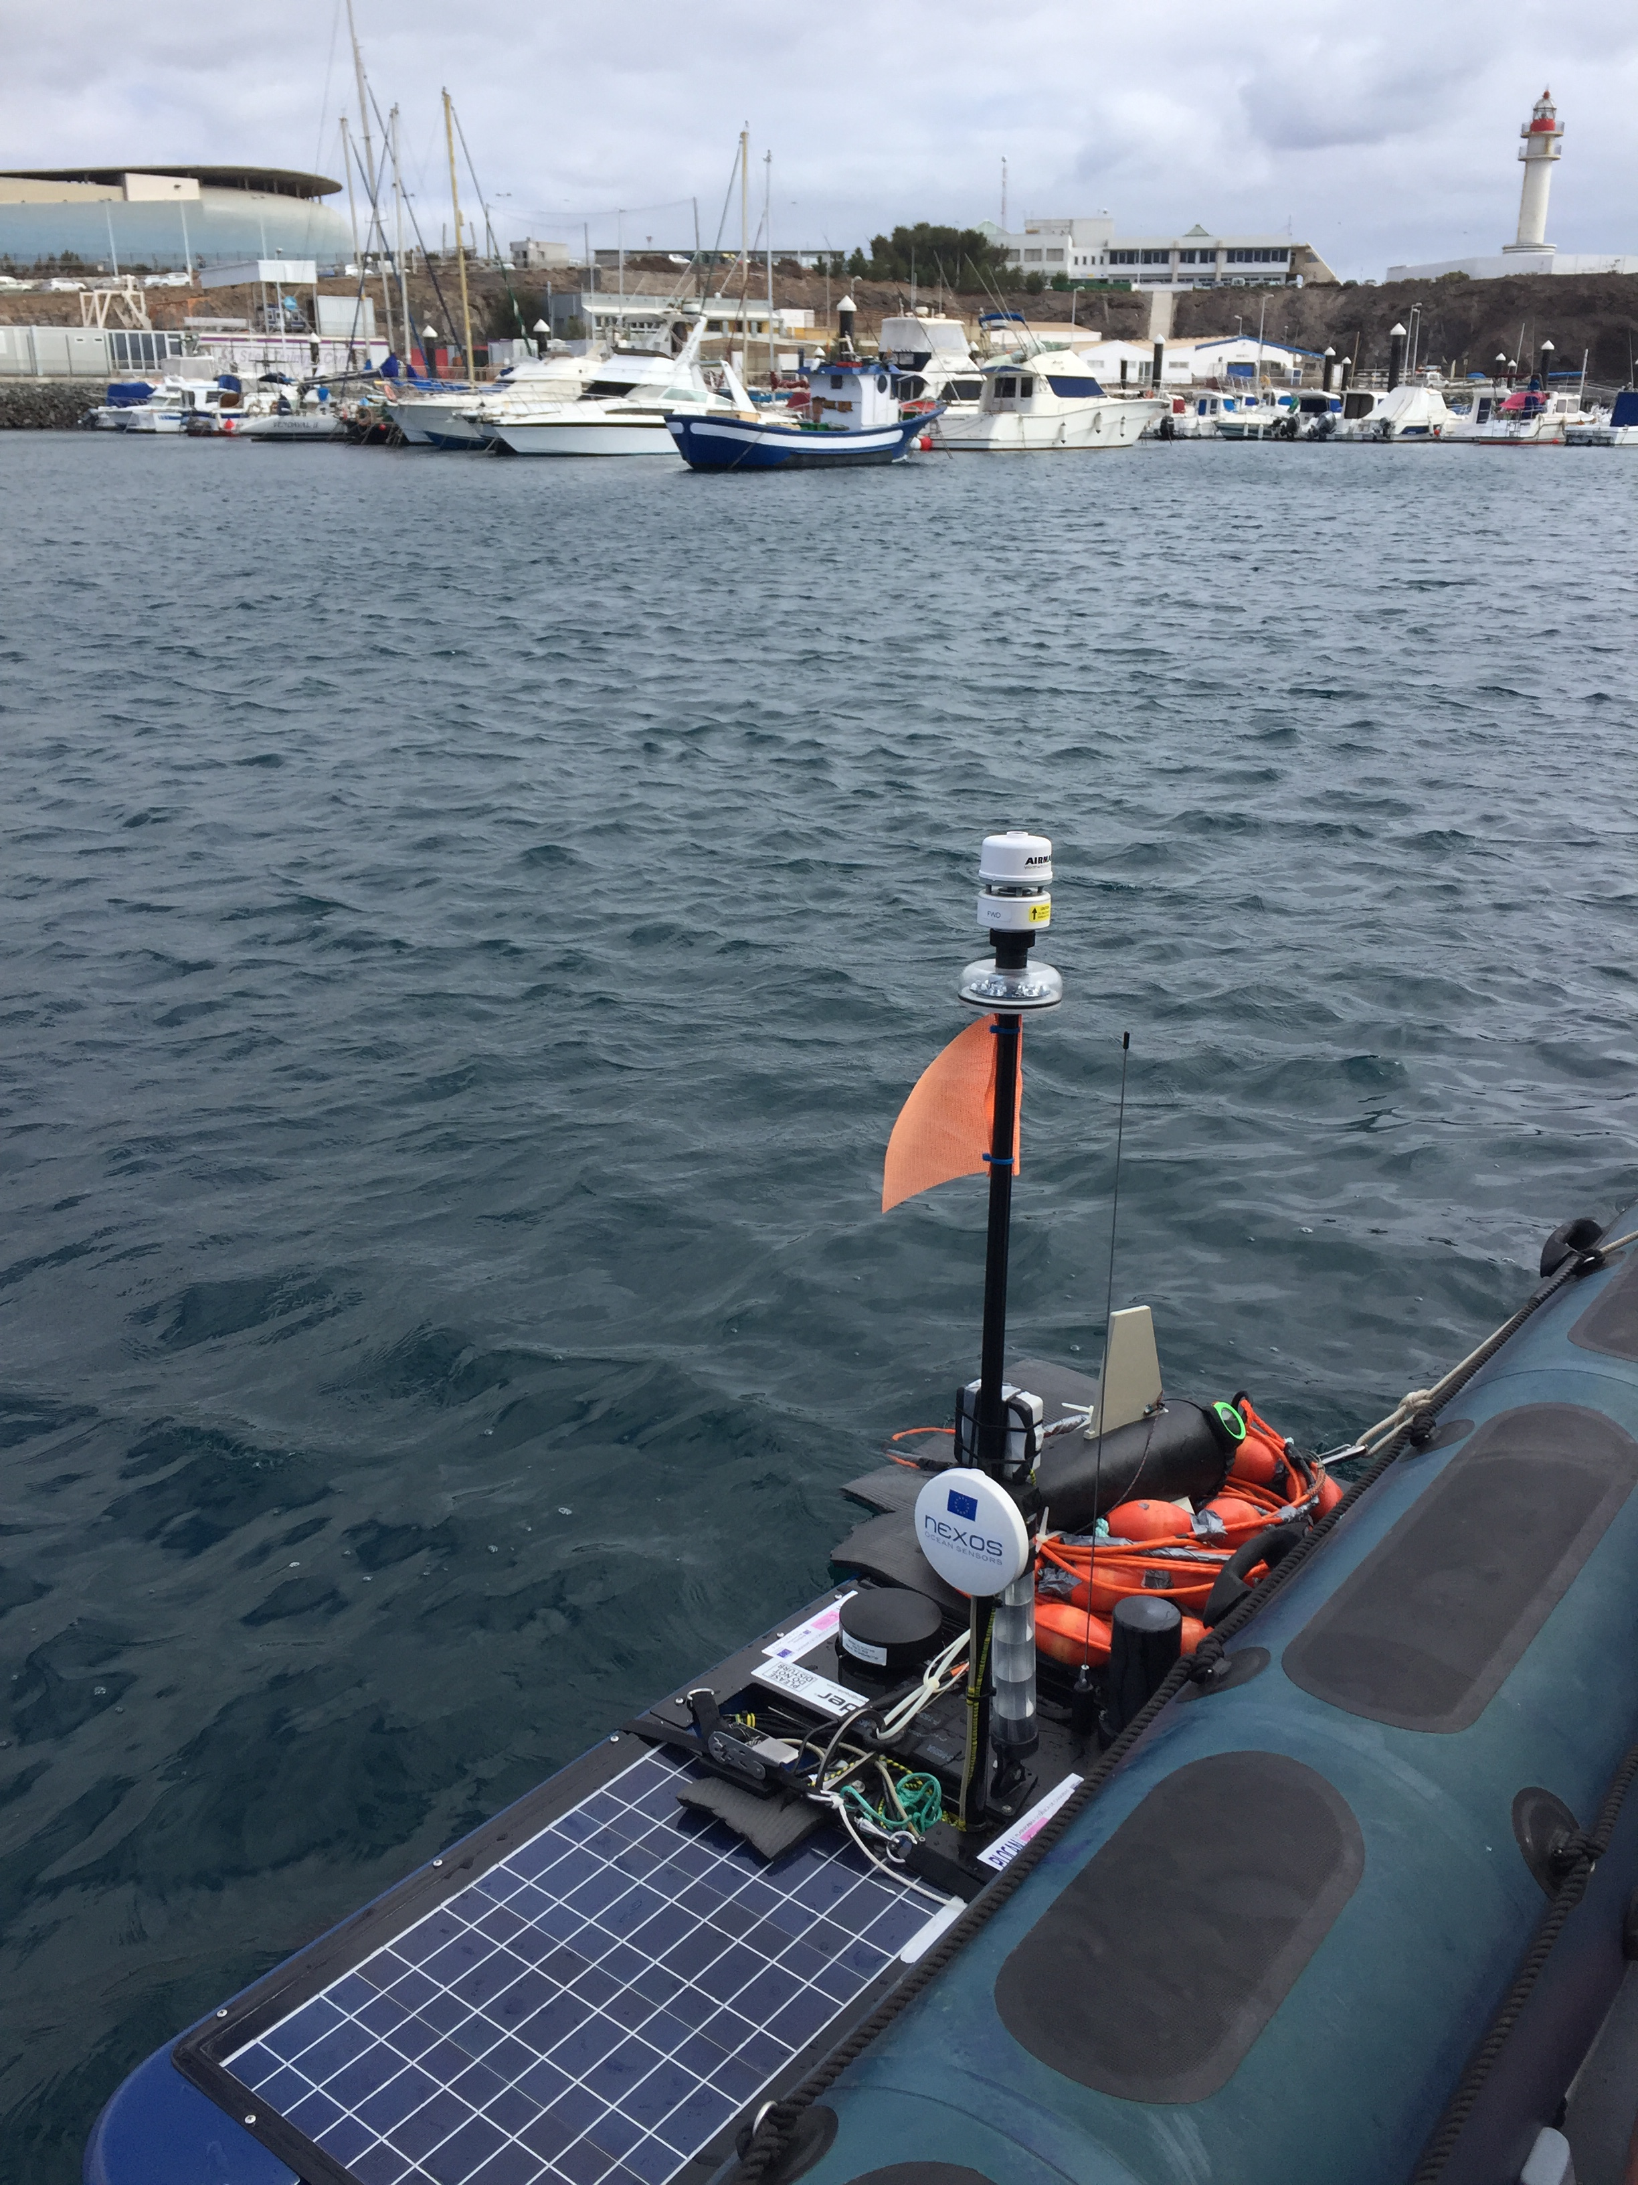
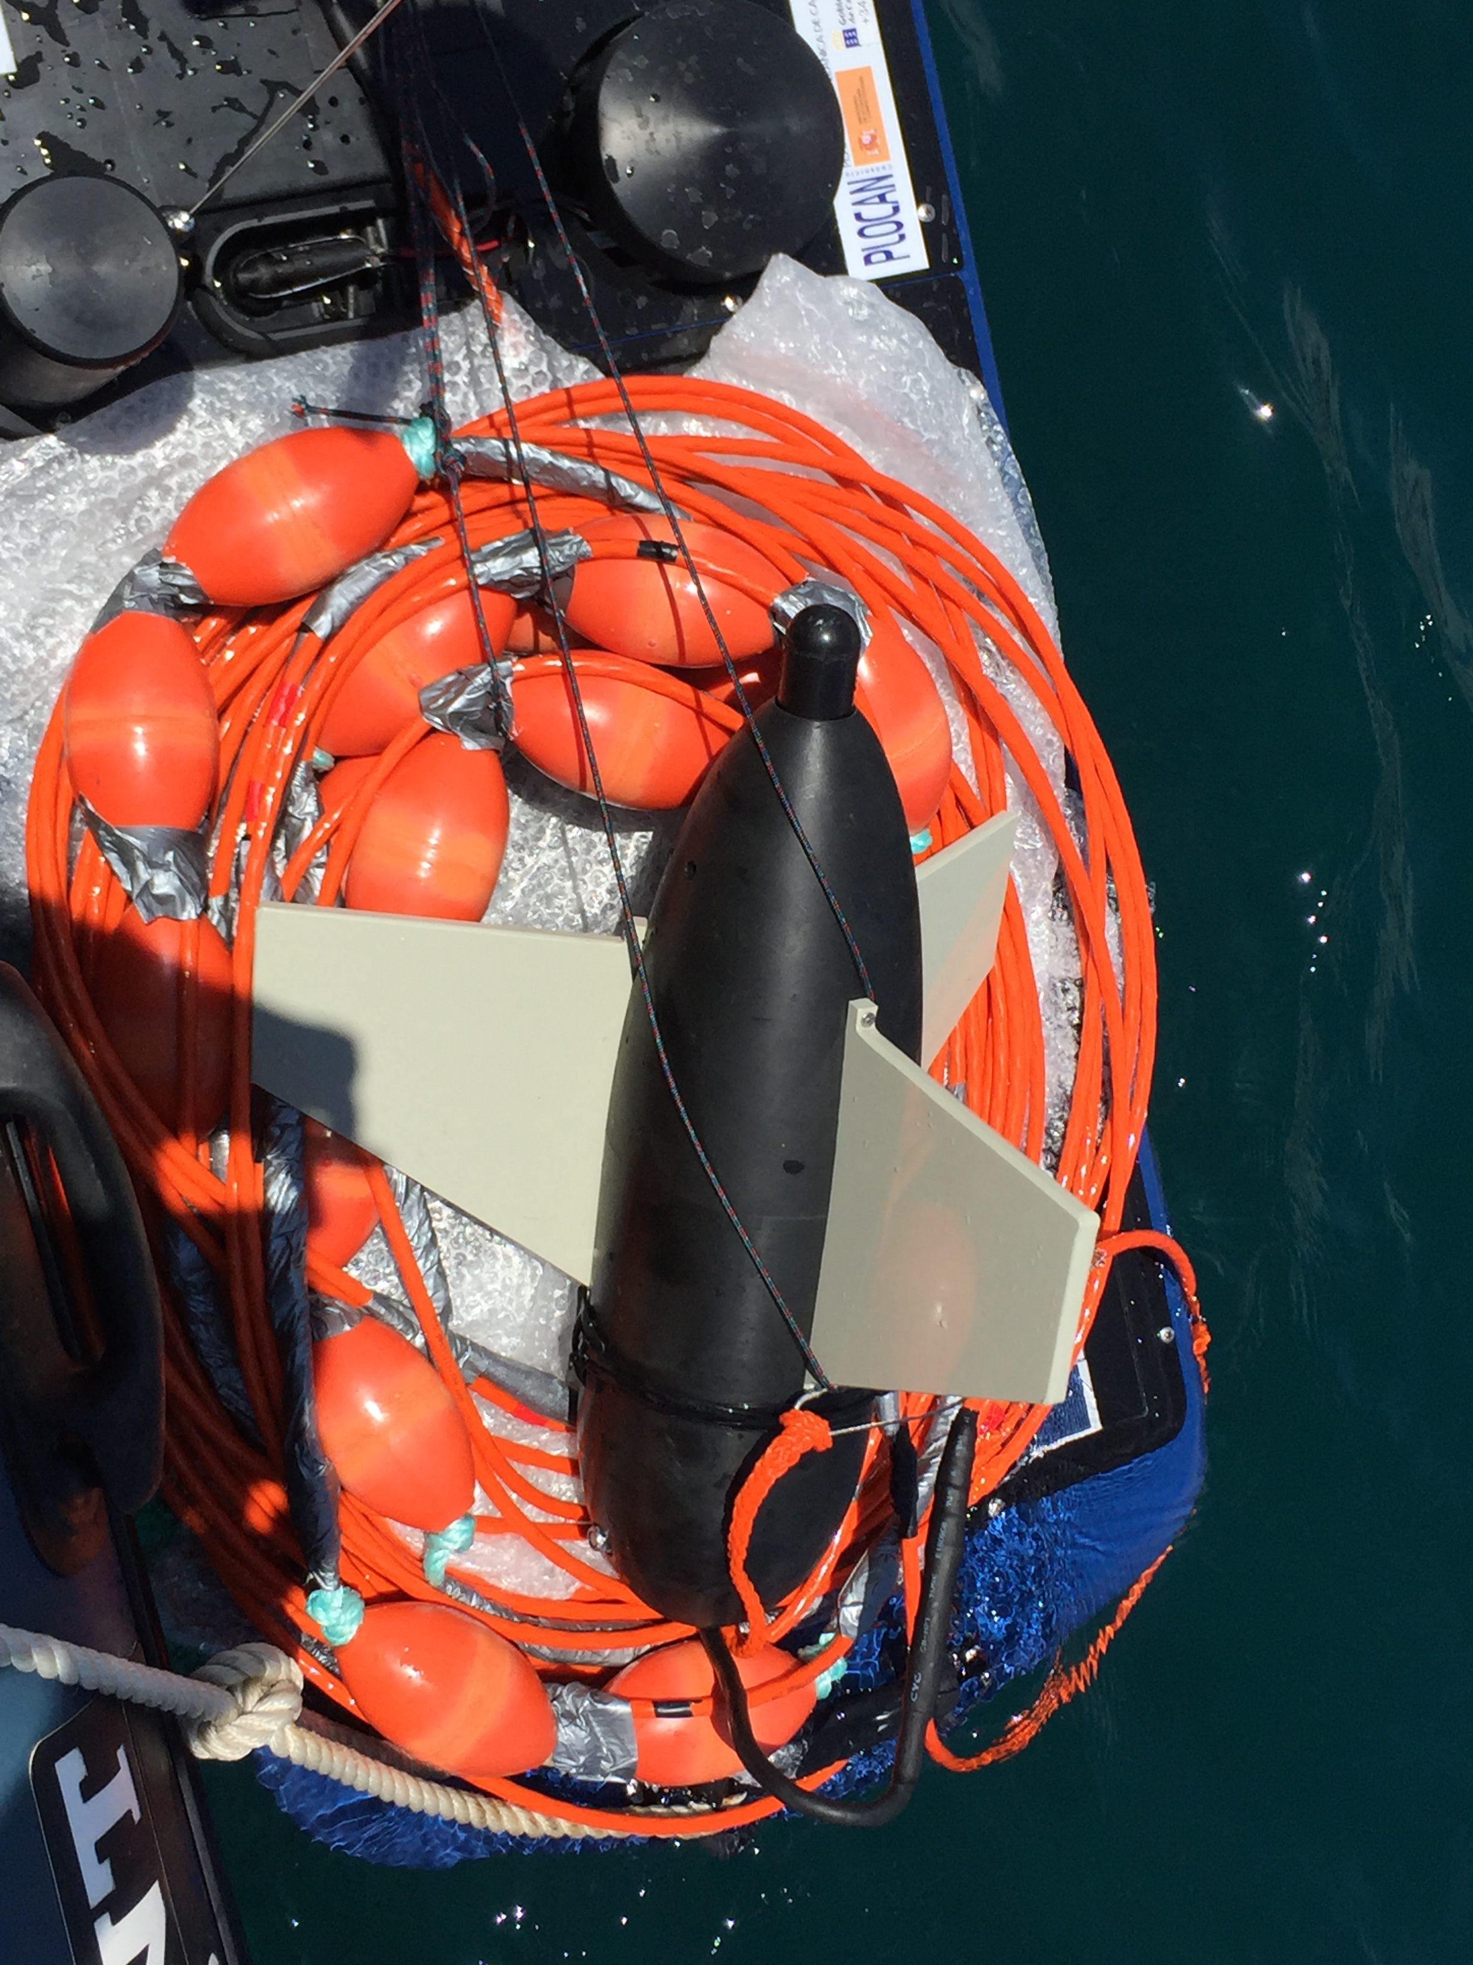
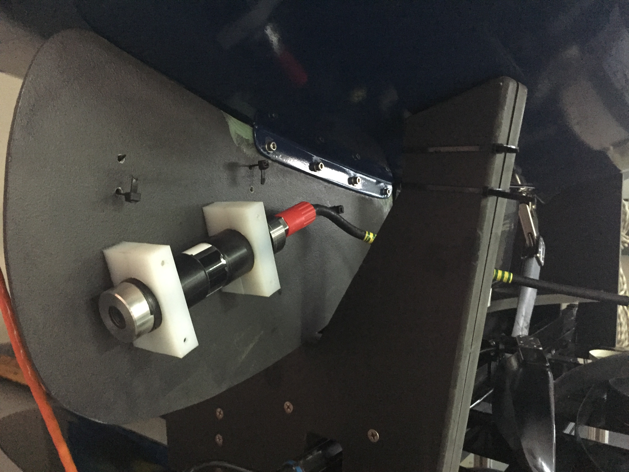
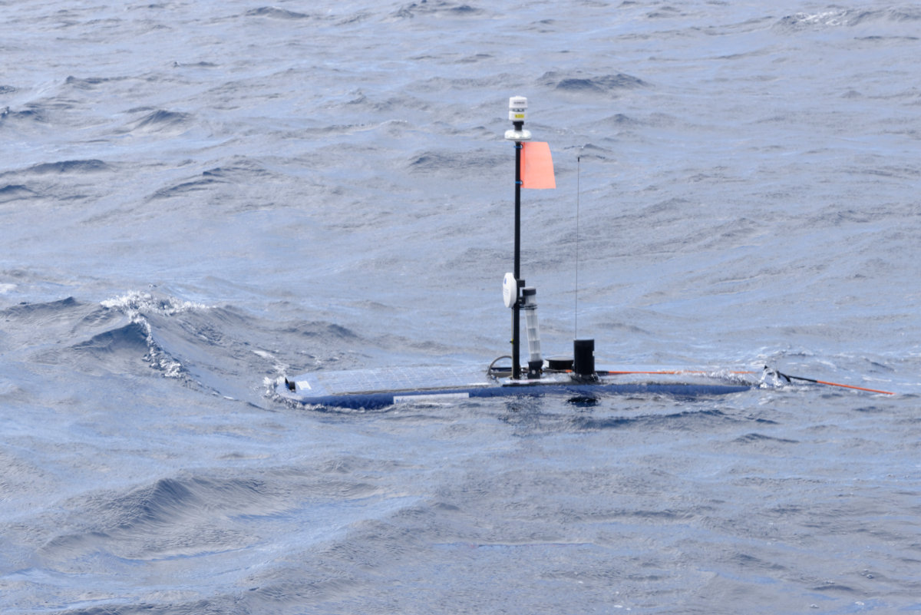
PLOCAN Wave glider with OGC-PUCK, SWE Bridge and NeXOS sensors

Slide 35
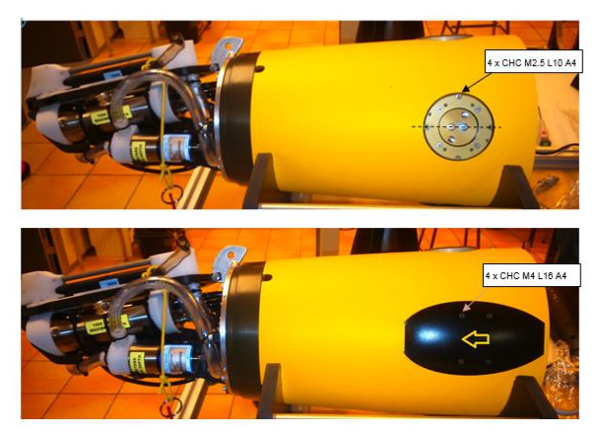
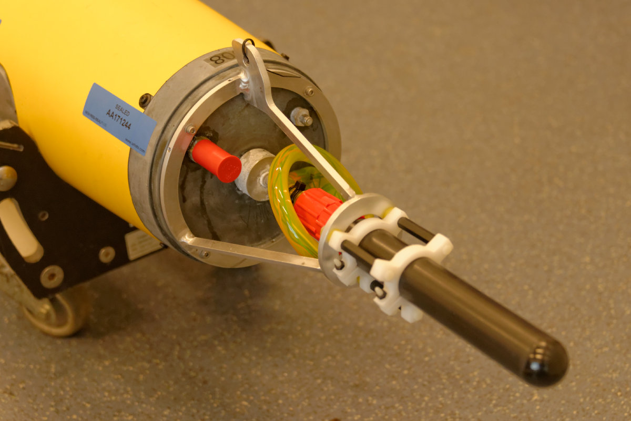
Argo float (Provor) with A1, Seaexplorer with A1 and O1 miniflu – OGC SWE & PUCK enabled

Slide 36
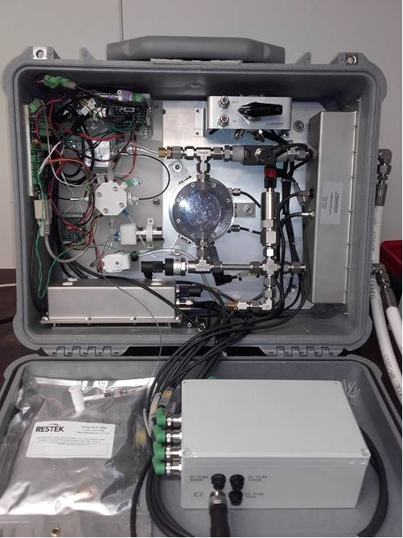
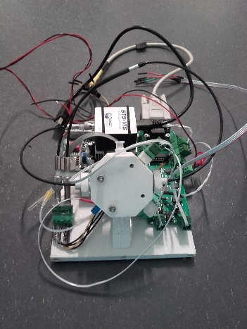
Ferrybox and sailbuoy with pCO2 and pH

Slide 37
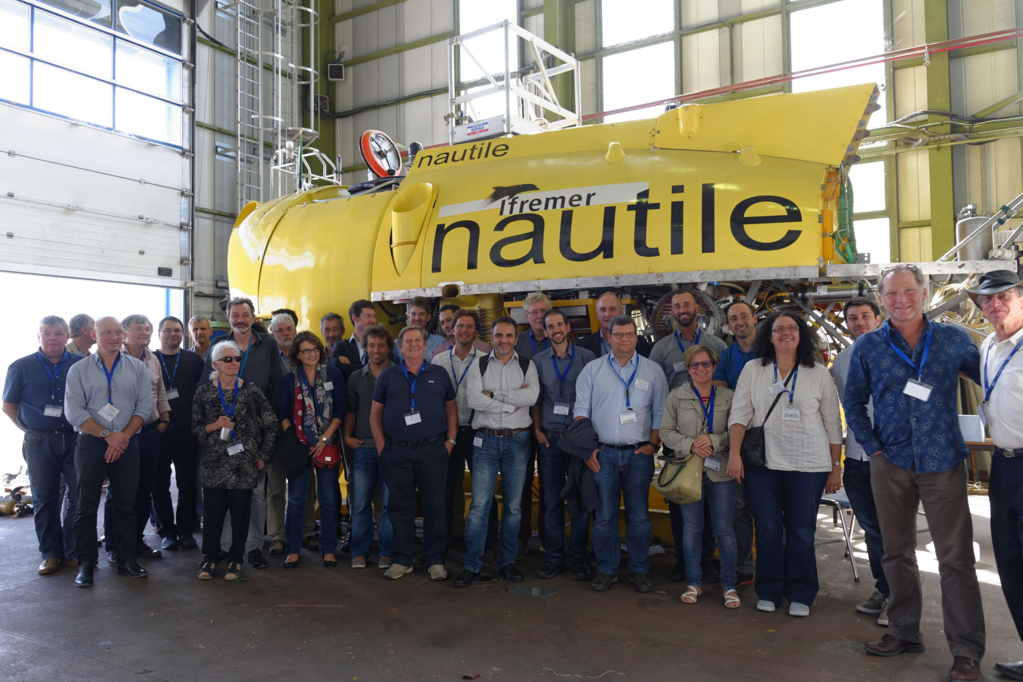
Thank you!
www.nexosproject.eu
eric.delory@plocan.eu
"
Work presented was funded by project NeXOS (Grant Agreement No. 614102)

Slide 38
Thank you!
www.nexosproject.eu
eric.delory@plocan.eu

