Slide 1



MENTOR
Blue Career Centre of Eastern Mediterranean and Black Sea
Blue Careers
Call for Proposals EASME/EMFF/2016/1.2.1.2:
"Blue Careers in Europe“
Proposal N° EASME/EMFF/2016/1.2.1.2/002
Zacharias Siokouros, Maritime Institute of Eastern Mediterranean
Expert Group on skills and career development in the blue economy, Brussels, 16-17 January 2018

Slide 2
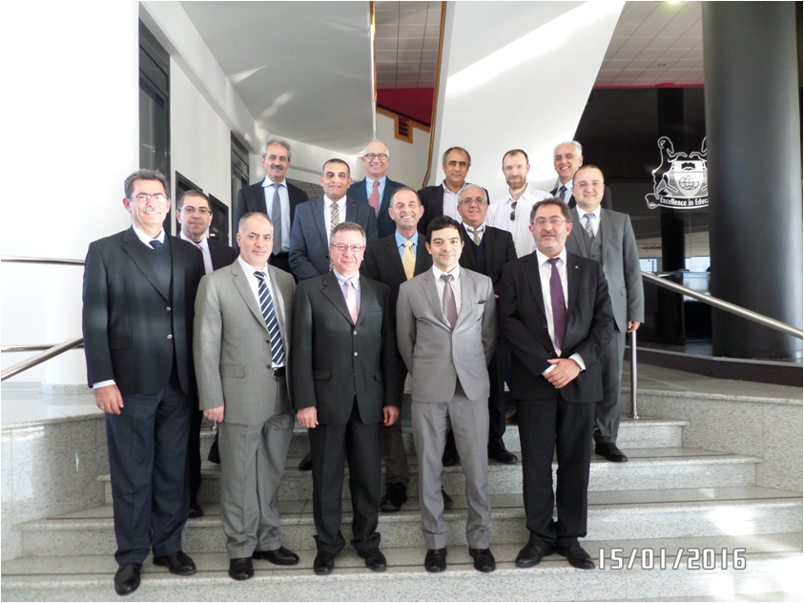







Focus Group Larnaka (Cyprus), Friday 15 January 2016
Integrated maritime education opportunities in the area of Maritime Technologies
Mar.In.E.M.
“Study supporting a possible network of maritime training academies and institutes in the Mediterranean sea basin” (EC)
Establish a Blue Career Center in the Eastern Mediterranean

Slide 3








MENTOR Partners
1. University of Cyprus (UCY) Cyprus
2. Maritime Institute of Easter Mediterranean (Mar.In.EM) Cyprus
3. Cyprus Chamber of Commerce and Industry (CCCI) Cyprus
4. National Technical University of Athens (NTUA) Greece
5. Agricultural University of Athens (AUA) Greece
6. Marine Cluster Bulgaria (MCB) Bulgaria
7. Constanta Maritime University (CMU) Romania

Slide 4
MENTOR Observers
Istanbul Technical University
Al-Manar University of Tripoli
Jordan Academy for Maritime Studies
Arab Academy for Science, Technology and Maritime Transport

Slide 5
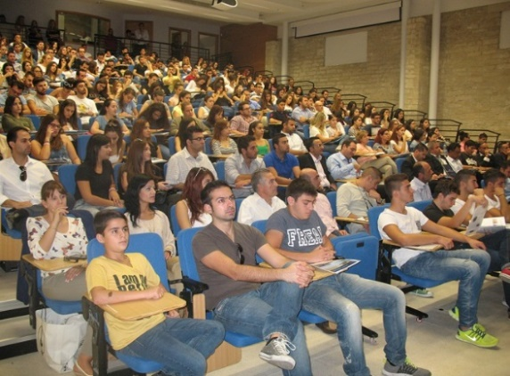

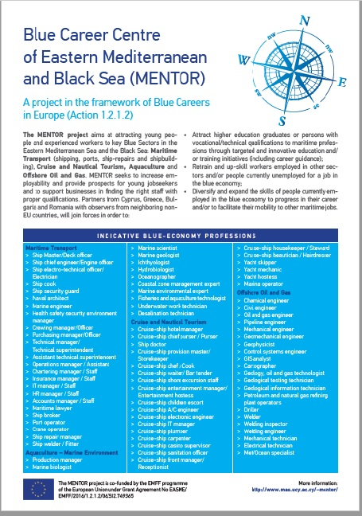
Blue Career Center - Motivation
Base: Cyprus
Representations: Greece, Bulgaria, Romania
Observers: Egypt, Jordan, Lebanon, Turkey
Aim:
- provide prospects for young jobseekers in blue economy
- support businesses in finding staff with proper qualifications
Objectives
Attract higher education graduates or persons with vocational/technical qualifications for maritime professions
Offer mentoring and career guidance to students (age 15-18) for Key Blue sectors of the region
Re-train and up-skill workers employed in other sectors and/or people currently unemployed for a job in the blue economy
Expand the skills of people currently employed in the blue economy and facilitate their mobility to other maritime jobs

Slide 6


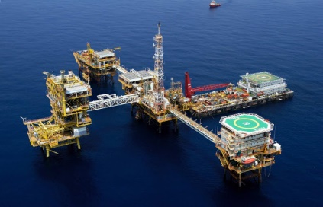

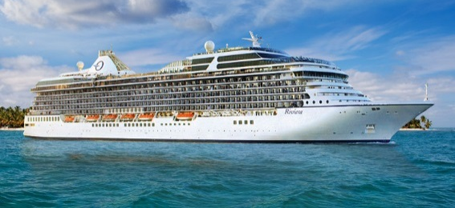

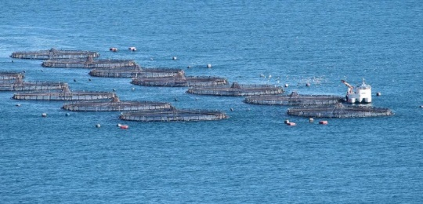


Important Blue Economy Sectors
  Maritime Transport (i.e. shipping, ports, shipbuilding and ship-repairs)
  2. Cruise Tourism
  3. Marine Aquaculture
  4. Offshore oil and gas

Slide 7





Expected Results
Establishment of the Blue Career Centre
Mapping of the provided maritime education and training centers
Development of re-training schemes for blue professionals
Mentoring and career guidance to students
Re-train blue professionals
Establish introductory e-learning courses

Slide 8
Expected Results
Sharing and pooling of resources
Organise Blue Career Fairs
Promote the mobility of students and staff
Balance the demand and supply of maritime, aquaculture, cruise tourism and offshore oil and gas professionals
11. Promote the harmonisation of Maritime Education and Training

Slide 9
D2.1. Career Guidance Framework: Mapping the needs of the selected MEAs and specifications for the construction of the personalized profile for blue professionals
MEA Country | Cruise | Marine Aquaculture | Maritime Transport | Offshore Oil & Gas | Total
Bulgaria | 5 | 2 | 15 | 2 | 24
Cyprus | 3 | 2 | 23 | 6 | 34
Greece | 6 | 8 | 10 | 7 | 31
Romania | 8 | 4 | 16 | 2 | 30
Total | 22 | 16 | 64 | 17 | 119

Slide 10
D2.1. Career Guidance Framework: Mapping the needs of the selected MEAs and specifications for the construction of the personalized profile for blue professionals
QA1. Which are currently the 3 most in demand jobs in your sector?
QA2. Which are currently the 3 most in demand tertiary-education degrees in your sector?
QA3. Which are currently the 3 most important – in your opinion - technical skills required for someone entering your sector? Please refer to List 1 for examples of Technical Skills
QA4. Which technical skills do you think are still missing from people entering your sector?
QA5. Which are currently the 3 most important – in your opinion - behavioral competencies for someone entering your sector? Please choose from List 2 of Behavioral Competencies.
QA6. Which behavioral competencies do you think are still missing from people entering your sector?
QB6. Which are the top 3 new technological and/or operational trends in your sector in the next 10 years in relation to future job opportunities? (Indicatively, automation, digitization, robotics, augmented reality, big data, etc.)

Slide 11
Technical skills
Auditing Management Systems | Driving specialized vehicles | Hydraulics / Pneumatics | Operating Systems | Sensors
Big Data Analytics | Electrical & Control | Hygiene / Sanitation | Project Management | Social Media
Communications | Electronics | Languages (specify) | Rigging | Technical Design
Customer Care | Energy Management | Machinery Damage & Repair | Risk Assessment | Technical Writing & Reporting
Diagnostic Engineering | First Aid / Medical Care | Management Systems (ISO) | Safety / Survival / Firefighting (STCW / OPITO) | Testing, Inspection and Verification
Diving | Hardware / Computer /IT | Navigating specialized crafts | Seamanship | Training (others)
Drilling | Hatchery | Occupational Health & Safety | Security | Welding / Materials & NDE

Slide 12
Behavioral competencies
Behavioural Competencies
1. | Leading
2. | Persuasive
3. | Deciding
4. | Planning & Organizing
5. | Business awareness
6. | Analysing/Problem solving
7. | Customer Orientation
8. | Communication Orally
9. | Communication in writing
10. | Networking
11. | Teamwork/Collaboration
12. | Interpersonal sensitivity
13. | Flexibility/Adaptability
14. | Resilience
15. | Personal Motivation
16. | Adherence to principles and values

Slide 13
Technological trends
 | List of technological trends that may occur in the next 10 years
1. | Automation
2. | Innovative engineering applications
3. | Robotics
4. | Big Data
5. | Performance Management
6. | Alternative Energy
7. | Digitization
8. | Autonomous Ships
9. | Diagnostic Engineering
10. | Environmental Technology
11. | Marketing
12. | Augmented Reality
13. | Logistics organization and coordination
14. | Deep Sea Drilling
15. | New materials/3D printing
16. | Genetic improvement of major aquatic species used in aquaculture
17. | Improvements in health management of cultured organisms
18. | Larviculture nutrition

Slide 14
Which are currently the 3 most in demand jobs in your sector?
 | Cruise
 | Bulgaria | Cyprus | Greece | Romania
1 | Food & Beverage Personnel 53% | Engineers 33% | Engineers 45% | E/R Officers 19%
2 | Housekeeping Personnel 20% | HR Personnel/ Hotel Administration Personnel/ Bridge Officers/ E/R Officers/ Housekeeping Personnel/ Operation Personnel 11% | HR personnel 18 | Leisure Activity 15%
3 | Lower Ranking E/R Crew/ Engineers/ Hotel Administration Personnel/ E/R Officers 7% | - | E/R Officers/ Consultants 9% | Bridge Officers/ Personal Care 12%
Notes:
Which are currently the 3 most in demand jobs in your sector?) – Cruise
Table 5.2. Highest ranking variables of QA1 for Cruise

Slide 15
Which do you expect to be the 3 most in demand jobs in your sector in the next 10 years?
 | Cruise
 | Bulgaria | Cyprus | Greece | Romania
1 | Food and Beverage Personnel 53% | Engineers 43% | Engineers 47% | Lower ranking E/R crew 28%
2 | Housekeeping personnel 18% | Marketing/PR Personnel Technicians 14% | E/R Officers 26% | Engineers E/R Officers Personal Care and Shipboard Medical Personnel 12%
3 | Bridge Officers E/R Officers 12% | - | Office personnel Bridge Officers Manager Marketing/PR Personnel Onshore officers 5% | -
Notes:
Which do you expect to be the 3 most in demand jobs in your sector in the next 10 years? - Cruise

Slide 16
Which are currently the 3 most in demand jobs in your sector?
 | Marine Aquaculture
 | Bulgaria | Cyprus | Greece | Romania
1 | Aquaculture low level personnel 75% | Aquaculture low level personnel 67% | Aquaculture scientific personnel 37% | Aquaculture scientific personnel 75%
2 | Aquaculture scientific personnel 25% | Aquaculture scientific personnel Technicians 17% | Aquaculture low level personnel 33% | Engineers 17%
3 | --- | --- | Aquaculture manager 22% | Aquaculture Technicians 8%
Notes:
Which are currently the 3 most in demand jobs in your sector?) – Marine Aquaculture

Slide 17
Which do you expect to be the 3 most in demand jobs in your sector in the next 10 years?
 | Marine Aquaculture
 | Bulgaria | Cyprus | Greece | Romania
1 | Aquaculture low level personnel 40% | Aquaculture low level personnel 50% | Aquaculture scientific personnel 37% | Aquaculture scientific personnel 42%
2 | Engineers 20% | Aquaculture manager 33% | Aquaculture low level personnel 17% | Engineers 25%
3 | - | Aquaculture scientific personnel 17% | Office personnel Engineers 13% | Manager 17%
Notes:
Which do you expect to be the 3 most in demand jobs in your sector in the next 10 years?) – Marine Aquaculture
Table 5.5. Highest ranking variables of QB1 for Marine Aquaculture

Slide 18
Which are currently the 3 most in demand jobs in your sector?
 | Maritime Transport
 | Bulgaria | Cyprus | Greece | Romania
1 | Engineers 20% | Engineers 25% | Engineers 45% | E/R Officers 18%
2 | Port Operation Personnel 13% | Onshore Officers 15% | Onshore Officers 16% | Engineers/ Bridge Officers 14%
3 | Lower Ranking E/R Crew/ Operation Personnel/ Technicians 11% | E/R Officers 10% | Manager 10% | -
Notes:
Which are currently the 3 most in demand jobs in your sector?) – Maritime Transport

Slide 19
Which do you expect to be the 3 most in demand jobs in your sector in the next 10 years?
 | Maritime Transport
 | Bulgaria | Cyprus | Greece | Romania
1 | Engineers 19% | Technicians 36% | Engineers 64% | E/R Officers 16%
2 | Lower ranking deck crew 15% | E/R Officers 13% | Onshore officers 18% | Bridge Officers Manager 14%
3 | Technicians 13% | Bridge Officers 12% | Bridge Officers E/R Officers 6% | -
Notes:
Which do you expect to be the 3 most in demand jobs in your sector in the next 10 years?) – Maritime Transport

Slide 20
Which are currently the 3 most in demand jobs in your sector?
 | Offshore Oil & Gas
 | Bulgaria | Cyprus | Greece | Romania
1 | Engineers 83% | Office Personnel Mid level offshore personnel 18% | Mid level offshore personnel 16% | Bridge Officers 33%
2 | Technicians 17% | Engineers/ Logistic Personnel/ High level offshore personnel 12% | Engineers High level offshore personnel 12% | Food & Beverage Personnel Engineers Housekeeping Onshore Officers 17%
Notes:
Which are currently the 3 most in demand jobs in your sector?) – Offshore Oil & Gas
Table 5.8. Highest ranking variables of QA1 for Offshore Oil & Gas

Slide 21
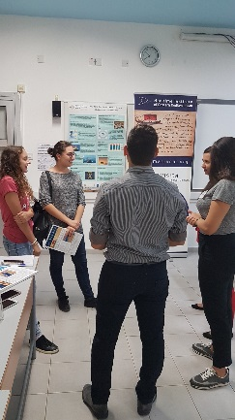
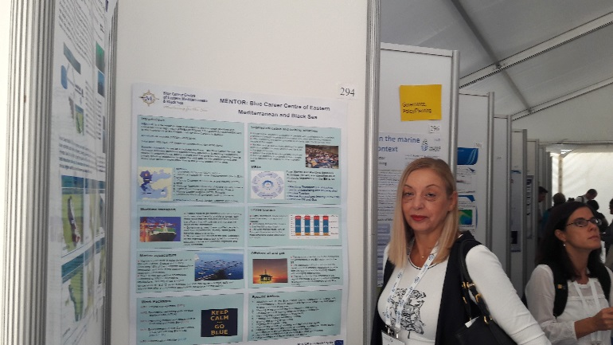
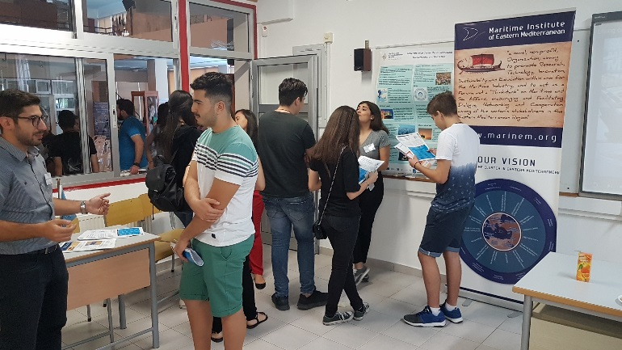
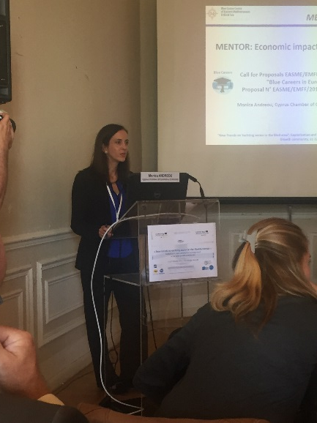
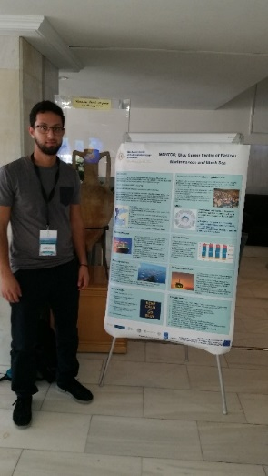
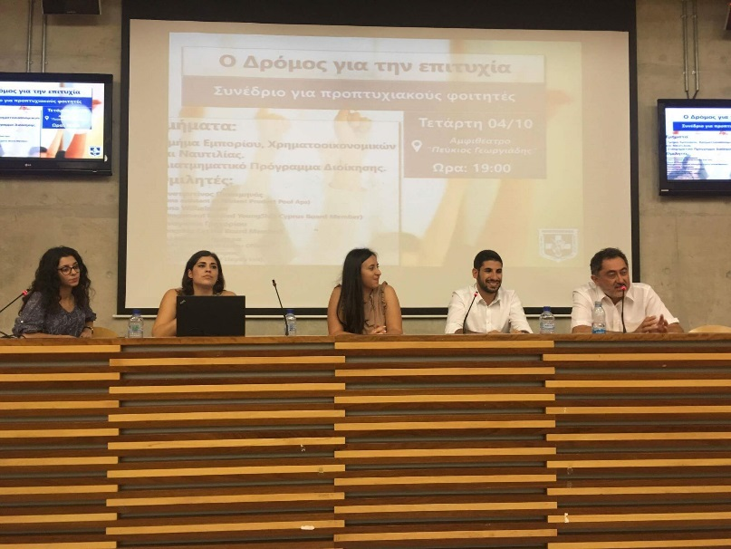
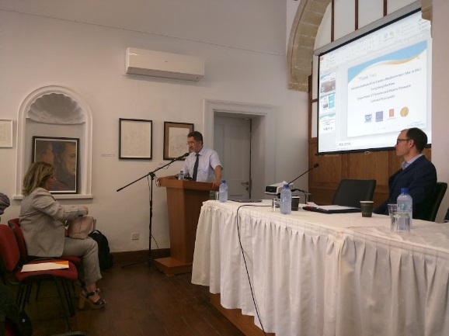
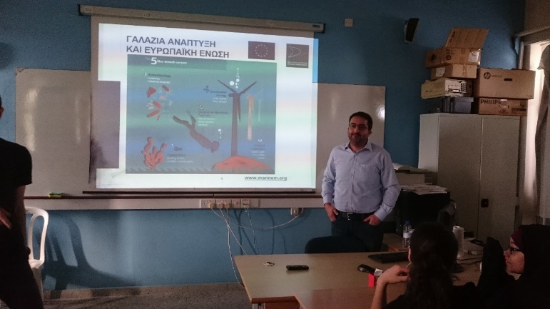
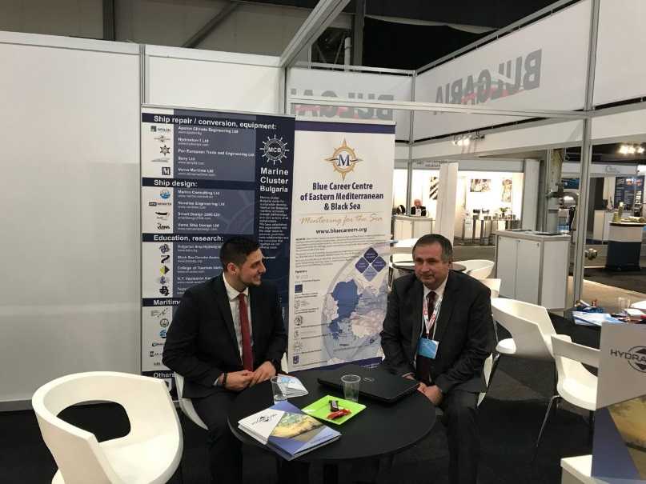
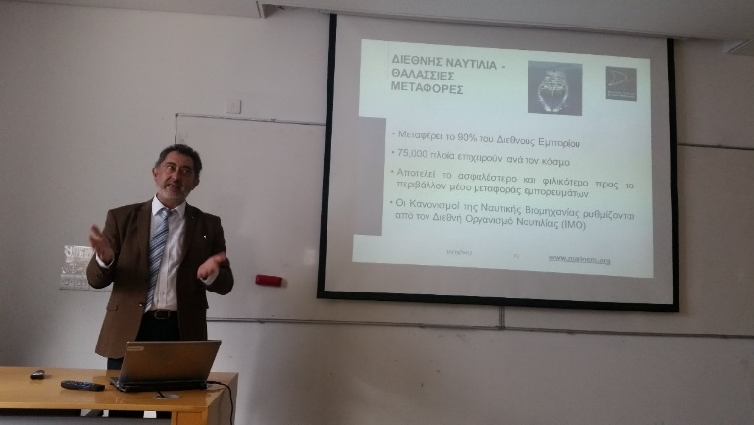
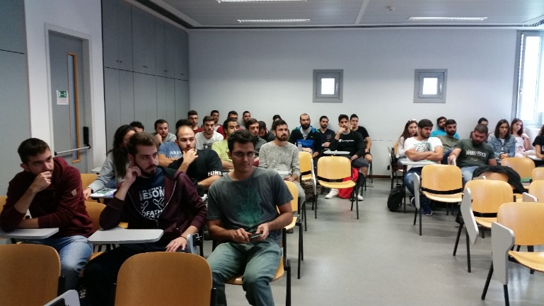
Visits to Schools - Conferences

Slide 22
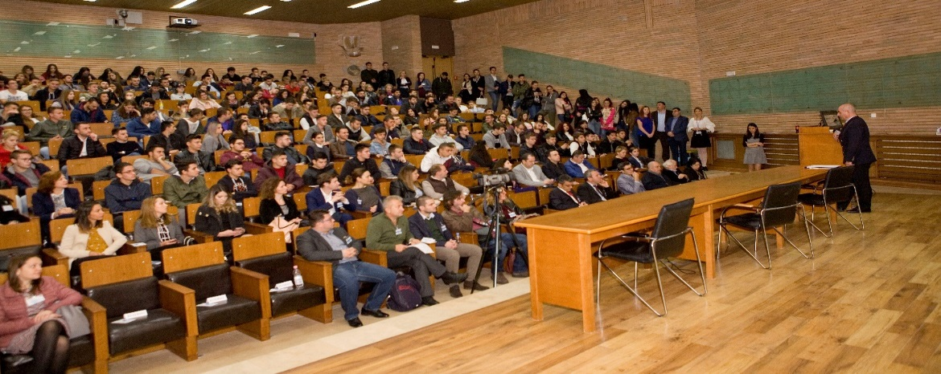
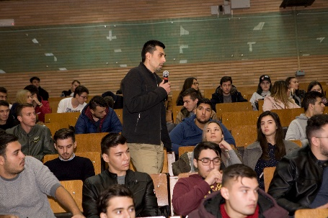
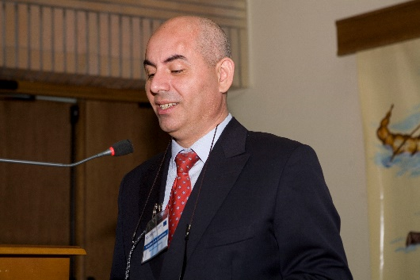
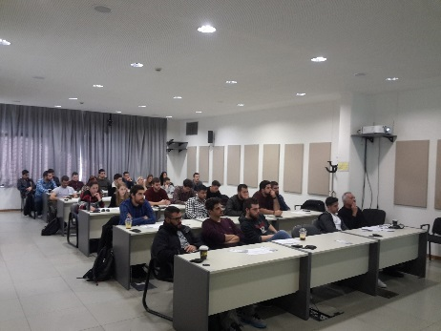
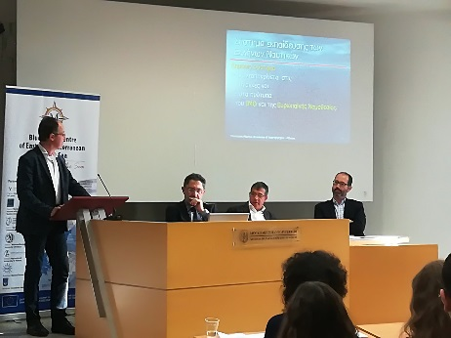

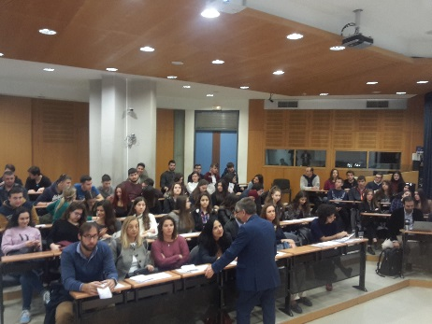
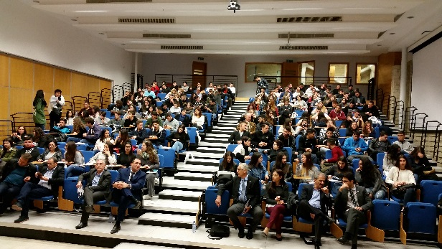
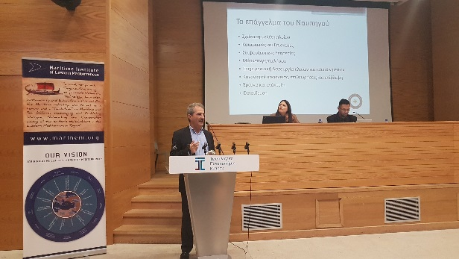
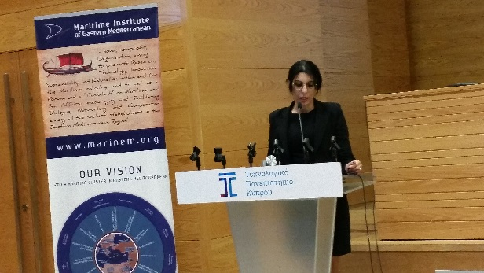
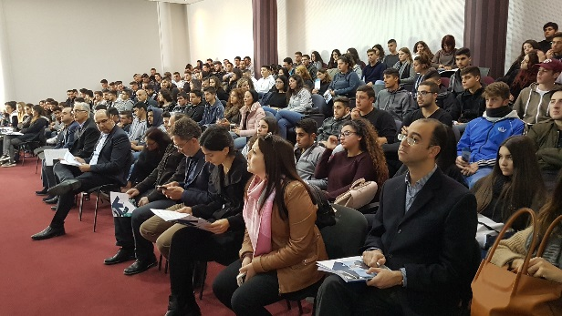
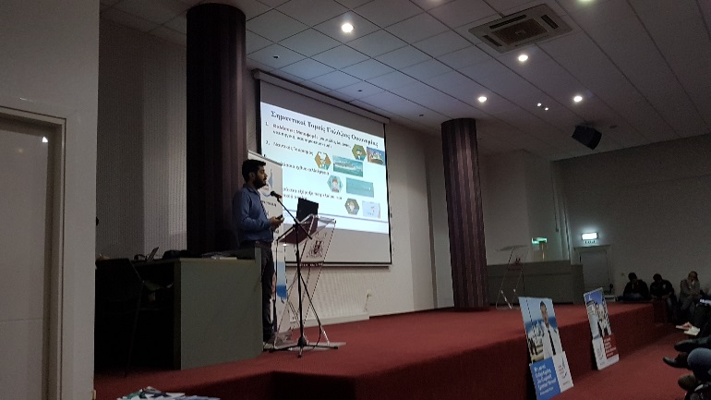
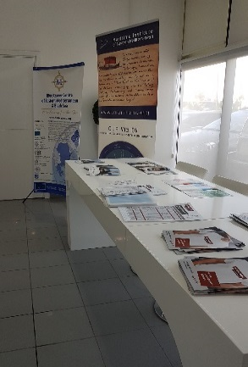
Blue Career Fairs
Blue Career Fair, Constanta, 27.10.2017
Blue Career Fair, Athens, 27.10.2017
Blue Career Fair, Limassol, 8.12.2017
Blue Career Fair, LarnaKa, 11.12.2017

Slide 23

More info and Updates
www.bluecareers.org
admin@marinem.org
Thank you very much for your attention!
MENTOR is co-funded by the
European Maritime and Fisheries Fund

