Slide 1
Study to Support a Sustainable Algae Industry
ROHELINE VIHMAVARI OÜ
CINEA/2023/OP/0006/SI2.906327
online
07th June 2024

Slide 2
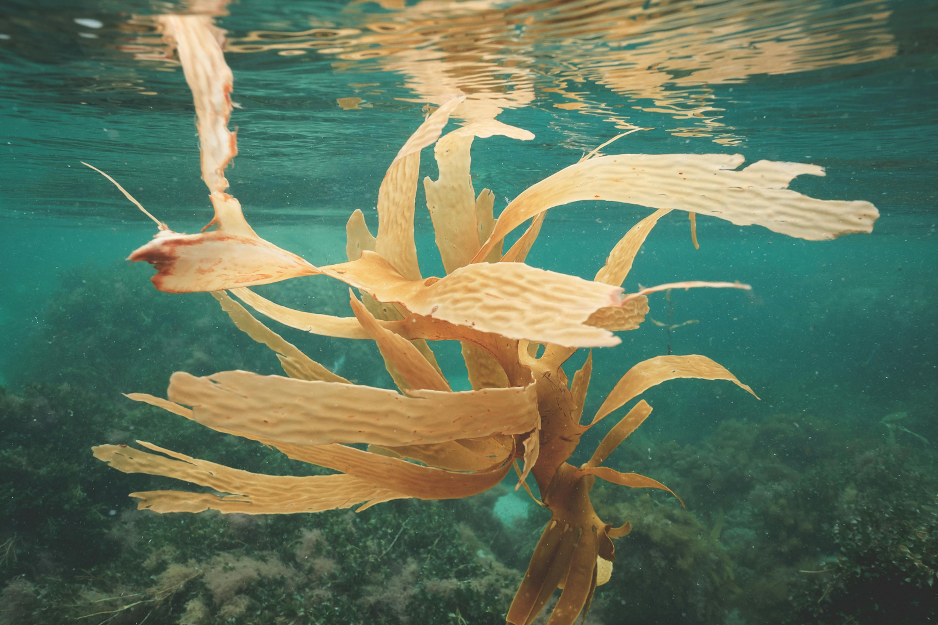
Study Objectives
Algae as key pathway to addressing: food security, climate change mitigation, employment and waste-related issues
Project: understand the potential, risks, challenges to the development of a sustainable EU algae sector
6 distinct topics (work packages) > comprehensive picture of whether/how algae can support the objectives of the EU Green Deal
Picture: Seaweed growing on bottom of sea

Slide 3
Work Plan
Year |  | 2024 |  |  |  |  |  |  |  |  |  |  | 2025
Calendar | 14.1. | 14.2. | 14.3. | 14.4. | 14.5 | 14.6. | 14.7 | 14.8. | 14.9 | 14.10. | 14.11 | 14.12. | 14.1. | 14.2. | 14.3. | 14.4. | 14.5. | 14.6.
Month | 1 | 2 | 3 | 4 | 5 | 6 | 7 | 8 | 9 | 10 | 11 | 12 | 13 | 14 | 15 | 16 | 17 | 18
Work Packages 1-6
literature research and data collection
stakeholder consultations (interviews, surveys)
analysis and synthesis of findings
validation (stakeholder workshops)
development of final reports
The final reports will seek to create new knowledge and concrete recommendations on how to move forward towards a sustainable algae industry in the EU.

Slide 4
Work Package 1 Investigating the use of algae-based feed as a replacement of fish-based feed in EU aquaculture

Slide 5
Objectives
Conduct a comprehensive investigation into the use of algae feed in the EU
Explore different approaches and methodologies for substituting fish-based feed with algae-based feed ingredients in aquaculture
Perform a forecast analysis for the potential replacement of fish-based feed with algae-based feed in the EU

Slide 6
EU Algae Initiative
Project Work Package | EU Algae Communication Action from the European Commission
WP 1 on algae-based feed as replacement of fish-based feed in aquaculture | Action 7 - based on the good practices, feed indicators, and other relevant information: develop specific guidance to promote replacing fish-based feed with algae-based feed
Notes:
- EU Agae Initiative promised 23 actions regarding algae (will be completed 2030)
Many of the listed actions will be fulfilled by ALIS
- ALIS plays a core role in the EU Algae Initiative

Slide 7
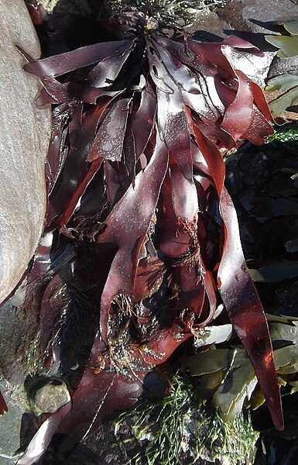
Which Algae will we focus on?
MACRO ALGAE MICRO ALGAE
Saccharina - Chlorella
Ulva - Nannochloropsis
Palmaria palmata - Schizochytrium sp.
Primary fish species utilized for fish feed (EU):
- European anchovy - European sardine - Atlantic herring
Picture: Palmaria palmata

Slide 8
Methodology
Output | Planned Content
1. Recommendations for replacing fish-based feed with algae-based alternatives | 1 - Current use & acceptance of algae based feed in aquaculture 2 - Analysis of different fish feed ingredients and mixtures (MCA) 3 - Recommendations processing and inclusion levels of algae
2. Assessment of methods and methodologies for replacing fish-based feed | 1 - EU & national regulations relevant to algae as feed 2 - Operational criteria for industry standards 3 - EU forage fish dependency ratio (FFDR) 4 - Recommendations Minimum blend-in targets EPA + DHA 5 - Recommendations high potential algae ingredients candidates 6 – Recommendations ALARA (as low as reasonably achievable) contaminants 7- Sustainable Finance Taxonomy
3. Forecast analysis for the replacement of fish-based feed by algae-based feed | 1 - Current total usage of fish-based feed ingredients in EU aquaculture 2 - Ratios of fish feed which could be replaced with algal-based feed 3 - Potential of algal-based feed to be used in current EU aquaculture
Output | Planned Content
1. Recommendations for replacing fish-based feed with algae-based alternatives | 1 - Current use & acceptance of algae-based feed in aquaculture 2 - Analysis of different fish feed ingredients and mixtures (MCA) 3 - Recommendations processing and inclusion levels of algae
2. Assessment of methods and methodologies for replacing fish-based feed | 1 - EU & national regulations relevant to algae as feed 2 - Operational criteria for industry standards 3 - EU forage fish dependency ratio (FFDR) 4 - Recommendations ALARA (as low as reasonabliy achivable) contaminats 5 - Recommendations Minimum blend-in targets EPA + DHA 6 – Recommendations high potential algae ingredients candidates 7- Sustainable Finance Taxonomy
3. Forecast analysis for the replacement of fish-based feed by algae-based feed | 1 - Current total usage of fish-based feed ingredients in EU aquaculture 2 - Ratios of fish feed which could be replaced with algal-based feed 3 - Potential of algal-based feed to be used in current EU aquaculture
Notes:
All about algae feed itself & compare it to different feed (fish/plant/... based) -> nutritional composition + economic + environmental. + processing/inclusion levels
2.1 - Regulatory aspects -> mapping of regulations to give overview
2.2 - Recom. on operational criteria/industry standards
2.3 FFDR: (evolution from FIFO -> focus: utilization of wild fish in feeds due to ecological concerns)
-> Nutritional requirements & optimal dietary composition for key European fish species. Recommendations for its adjustment. Assessment of the environmental impacts linked to the current FFDR in aquaculture.
- …

Slide 9
Methodology
Output | Planned Content
1. Recommendations for replacing fish-based feed with algae-based alternatives | 1 - Current use & acceptance of algae-based feed in aquaculture 2 - Analysis of different fish feed ingredients and mixtures (MCA) 3 - Recommendations processing and inclusion levels of algae
2. Assessment of methods and methodologies for replacing fish-based feed | 1 - EU & national regulations relevant to algae as feed 2 - Operational criteria for industry standards 3 - EU forage fish dependency ratio (FFDR) 4 - Recommendations ALARA (as low as reasonabliy achivable) contaminats 5 - Recommendations Minimum blend-in targets EPA + DHA 6 – Recommendations high potential algae ingredients candidates 7- Sustainable Finance Taxonomy
3. Forecast analysis for the replacement of fish-based feed by algae-based feed | 1 - Current total usage of fish-based feed ingredients in EU aquaculture 2 - Ratios of fish feed which could be replaced with algal-based feed 3 - Potential of algal-based feed to be used in current EU aquaculture
GET INVOLVED!
​ ​
tms@sustainable-projects.eu
Notes:
We will follow data protection notice DPN of the European Commission - data will be anonymised (except for if you don’t if you want that)
If you want to get involved, we are happy to discuss the details

Slide 10
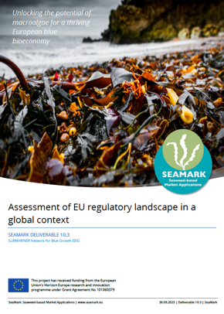
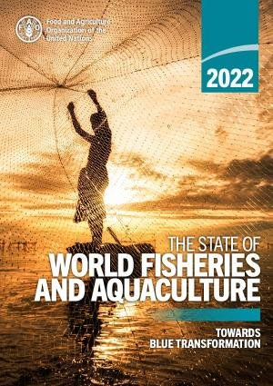
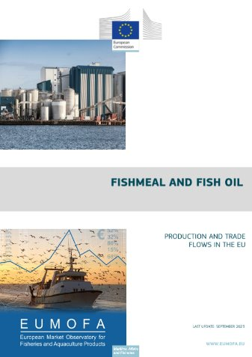
Projects & Studies
Let us know, if you have more relevant studies/projects/papers to share!
​ ​
tms@sustainable-projects.eu

Slide 11
How can I get Involved?
We need YOUR help!
NOW:
Information, Studies, Projects
You could help guiding us as a member of the task force
​ ​
tms@sustainable-projects.eu

Slide 12
How can I get Involved?
Planned activities:
10 Interviews - with industry and associations (fish & fish feed producers)
August/September 2024
Surveys (on FFDR assessment, incl. consumer safety, and blend-in targets)
Autumn 2024
Workshop - with WG4 to validate results and develop recommendations
December 2024
​ ​
tms@sustainable-projects.eu

Slide 13
Slido Survey
Scan QR-Code with your phone
OR
Join at slido.com and enter #2912726
​ ​
tms@sustainable-projects.eu

Slide 14
Thank you!
ROHELINE VIHMAVARI OÜ

