Slide 1
Hot tuna! Fukushima radioactivity and Pacific biota
Nicholas Fisher
School of Marine and Atmospheric Sciences
State University of New York at Stony Brook

Slide 2
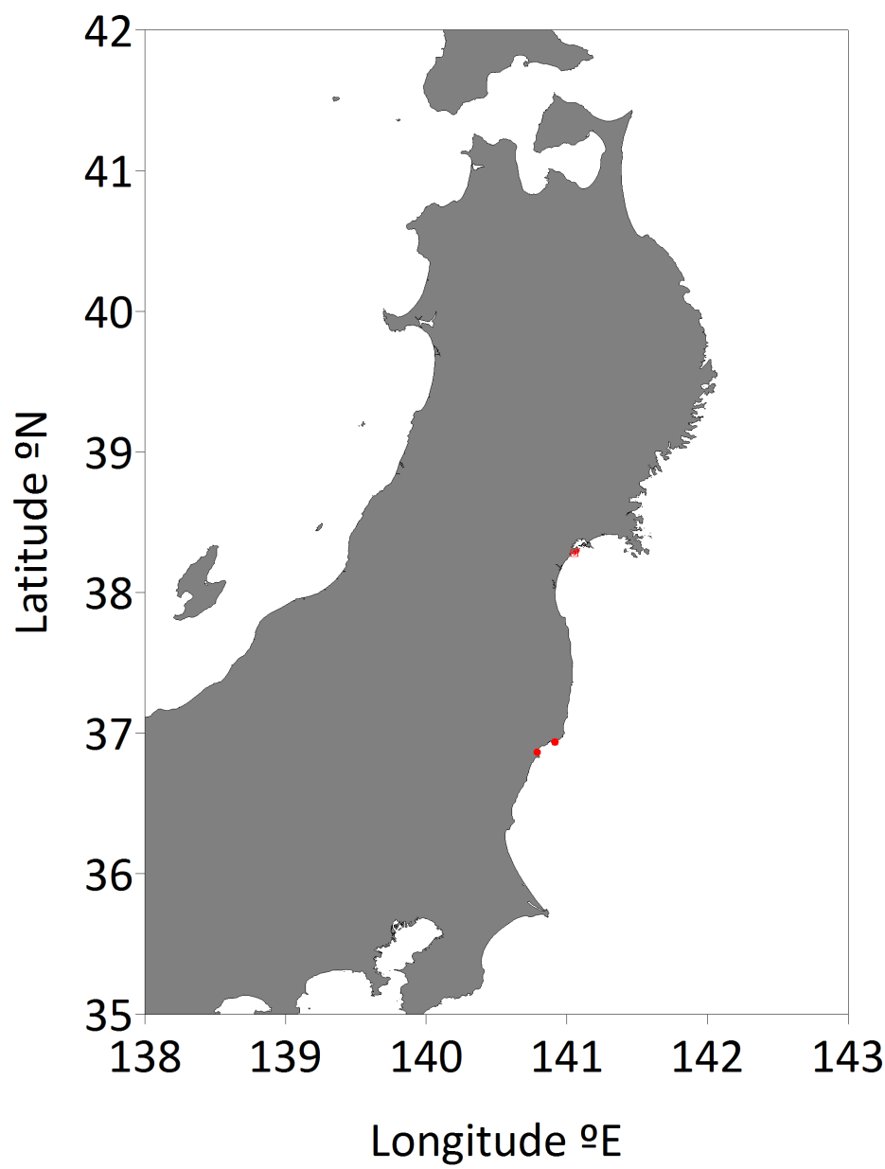
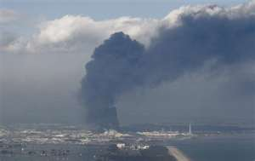
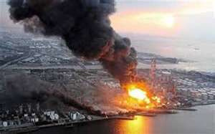
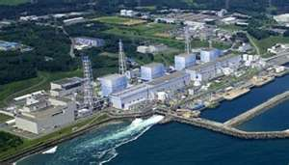
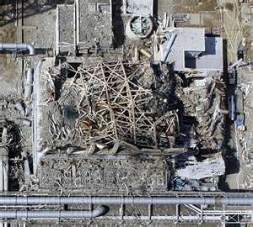

Fukushima Daiichi Nuclear power plant
March 11, 2011

Slide 3
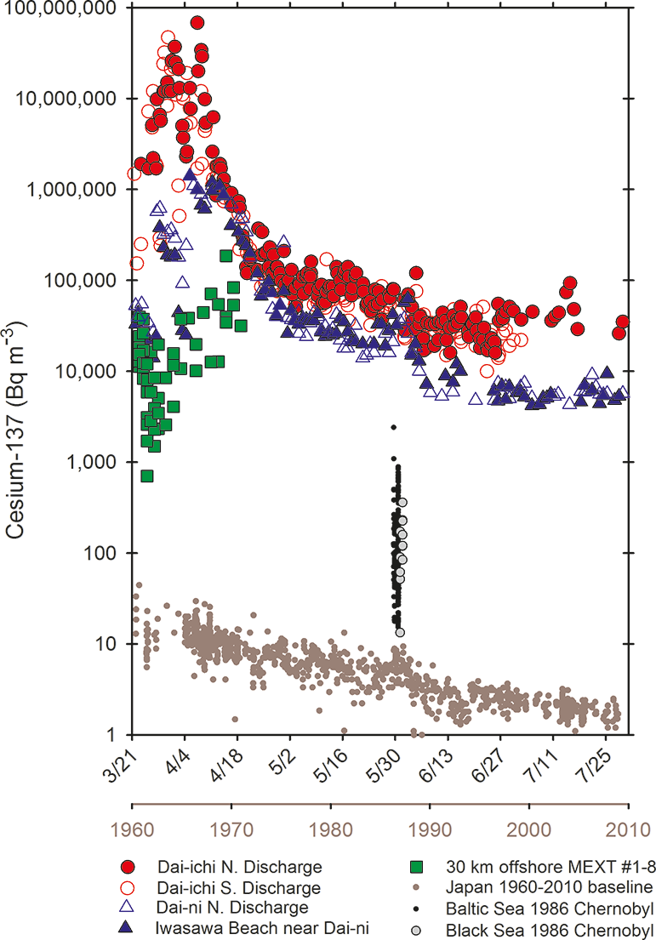
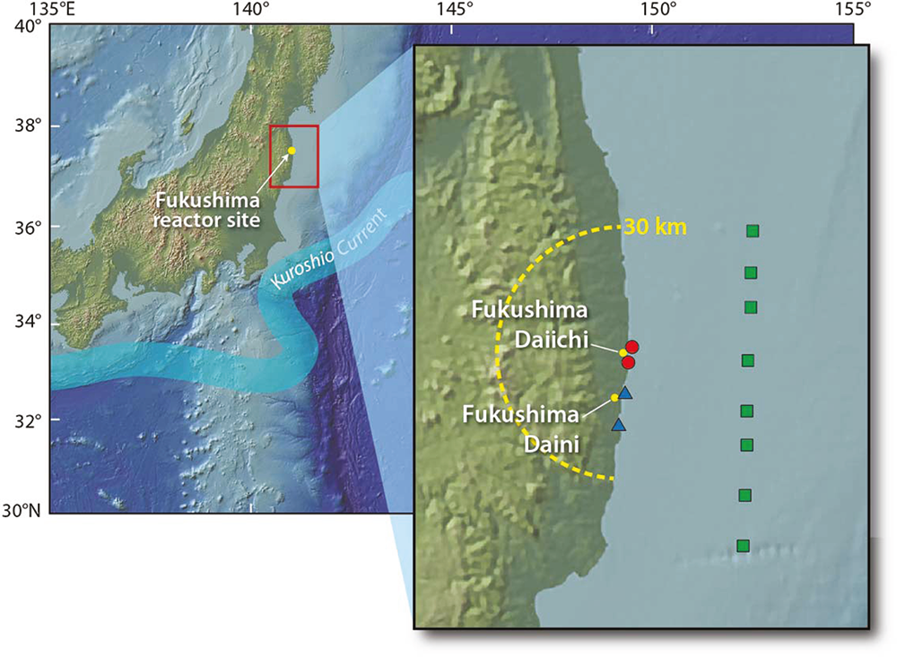
Earthquake, Tsunami …and a failed Nuclear Power Plant
Surface ocean concentrations from March 21 to July 31, 2011
Buesseler et al. 2011. ES&T
Notes:
Honshu

Slide 4
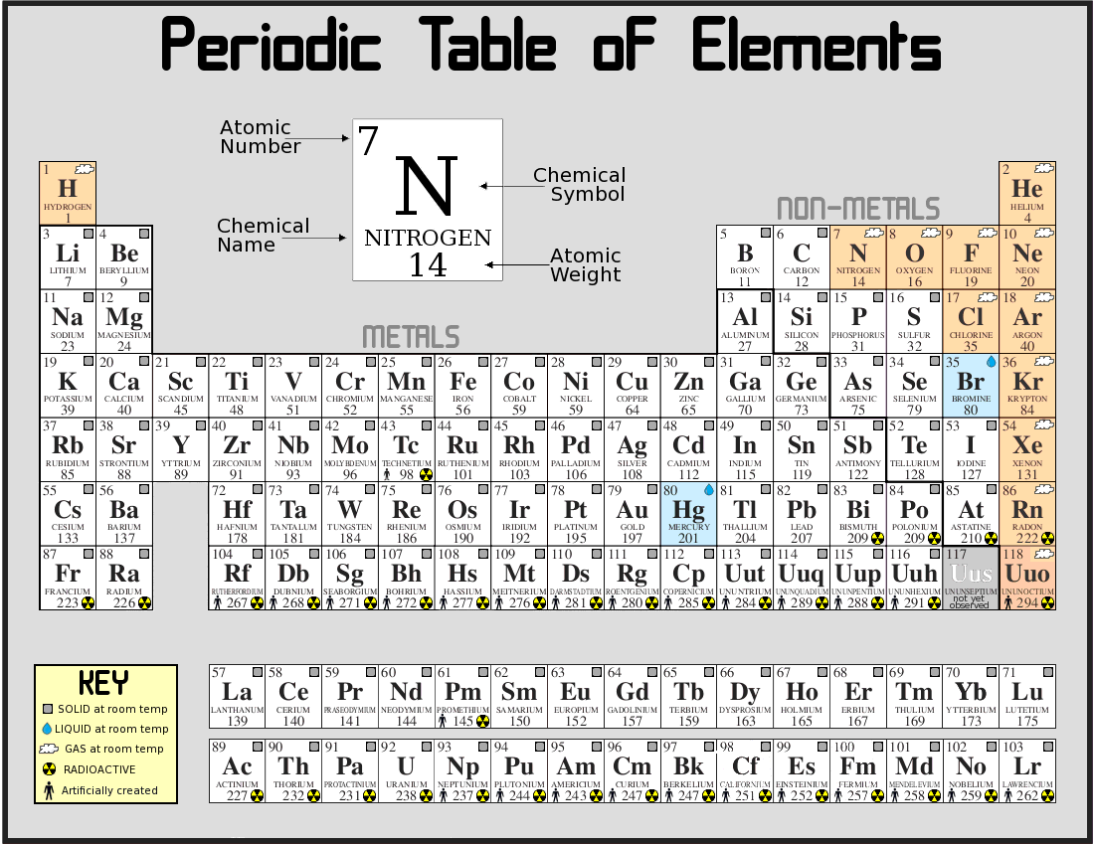
Notes:
First show periodic table; then show table with I highlighted; then show table with only Cs highlighted

Slide 5
Background information on radioactive iodine
¹³¹I: 8-day half-life; after 70 days only 0.1% remaining; after 1 year 0.000000000002% remaining
¹²⁷I: stable, present at concentrations of ~ 400 nM in seawater
I bioconcentrated about 10,000 times out of seawater by brown macroalgae (active uptake), but relatively little bioaccumulation in most other marine organisms
Notes:
All text slides with ocean background, please

Slide 6
Background information on radioactive cesium
¹³⁷Cs: 30-year half-life; still detectable in Pacific seawater and trace levels in biota as remnants from nuclear weapons testing in the Pacific, which peaked in the 1960s (fission product)
¹³⁴Cs: 2.1-year half-life: undetectable in Pacific waters and biota (neutron activation product) prior to Fukushima accident
¹³³Cs: stable, present at concentrations of ~40 nM in seawater

Slide 7
Cesium
non-essential for all organisms, generally follows K uptake pathways and tissue distributions
shows low uptake in marine phytoplankton (Kds < 100) but much higher in freshwater where there are orders of magnitude lower K, Na concentrations (Kds ~10,000)
modest biomagnification in marine food chains (much less than methylmercury)—high assimilation efficiencies (~70%) in fish and daily loss rates of ~2% from excretion; ~2/3 of Cs from diet
concentrates in muscle tissue (e.g., filet of fish)

Slide 8
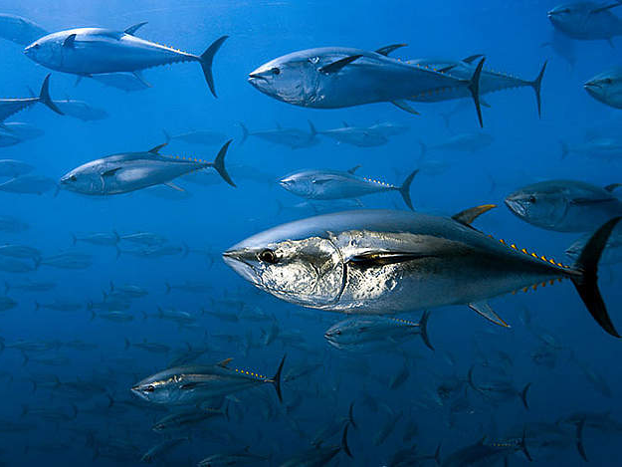

Slide 9
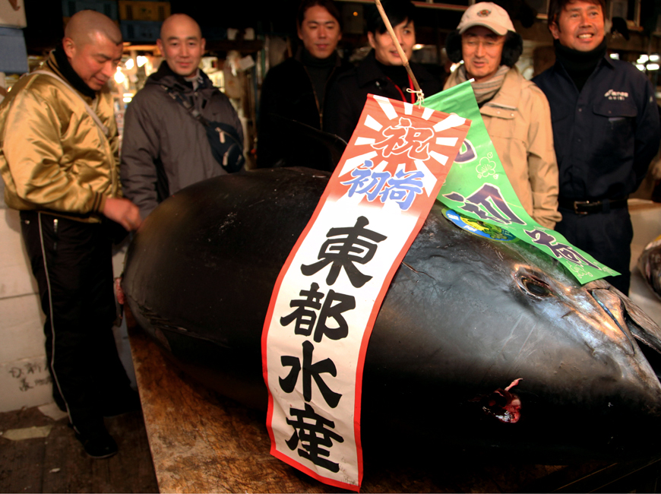

Slide 10
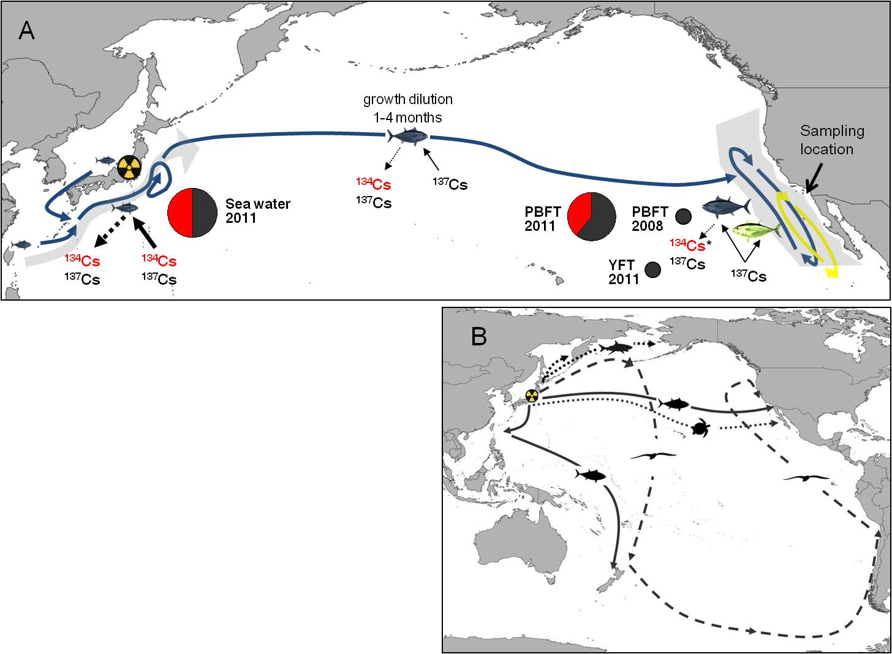
Simplified movement patterns for juvenile Pacific bluefin tuna (blue arrows) from Japan to the California and juvenile yellowfin tuna (yellow arrows)

Slide 11
Measured ¹³⁴Cs, ¹³⁷Cs, and the natural⁴⁰K for post-Fukushima bluefin (PBFT 2011), pre-Fukushima bluefin (PBFT 2008), and post-Fukushima yellowfin tuna (YFT 2011)
 |  |  |  |  | Radionuclide concentrations Bq kg⁻¹ dry mass
 |  | SL | Body mass | Age | ¹³⁴Cs |  | ¹³⁷Cs | ⁴⁰K | ¹³⁴Cs:¹³⁷Cs | ¹³⁴⁺¹³⁷Cs
 |  | cm | kg dry | years | Bq kg⁻¹ Bq kg⁻¹
PBFT 2011 n=15 | Median | 66.5 | 1.5 | 1.5 | 4.3 | 6.0 |  | 367 | 0.66 | 10.3
 | Mean | 66.2 | 1.5 | 1.5 | 4.0 | 6.3 |  | 347 | 0.62 | 10.3
 | SD | 3.6 | 0.2 | 0.1 | 1.4 | 1.5 |  | 49 | 0.14 | 2.9
PBFT 2008 n=5 | Median | 66.3 | 1.5 | 1.4 | 0 | 1.4 |  | 266 | 0 | 1.4
 | Mean | 66.2 | 1.5 | 1.4 | 0 | 1.4 |  | 258 | 0 | 1.4
 | SD | 1.2 | 0.09 | 0.05 | 0 | 0.2 |  | 43 | 0 | 0.6
YFT 2011 n=5 | Median | 72.3 | 1.9 | 1.2 | 0 | 1.2 |  | 342 | 0 | 1.2
 | Mean | 72.3 | 1.9 | 1.2 | 0 | 1.1 |  | 333 | 0 | 1.1
 | SD | 2.5 | 0.2 | 0.01 | 0 | 0.4 |  | 78 | 0 | 0.3

Slide 12
Simplified movement patterns for juvenile Pacific bluefin tuna (blue arrows) from Japan to the California and juvenile yellowfin tuna (yellow arrows)

Slide 13
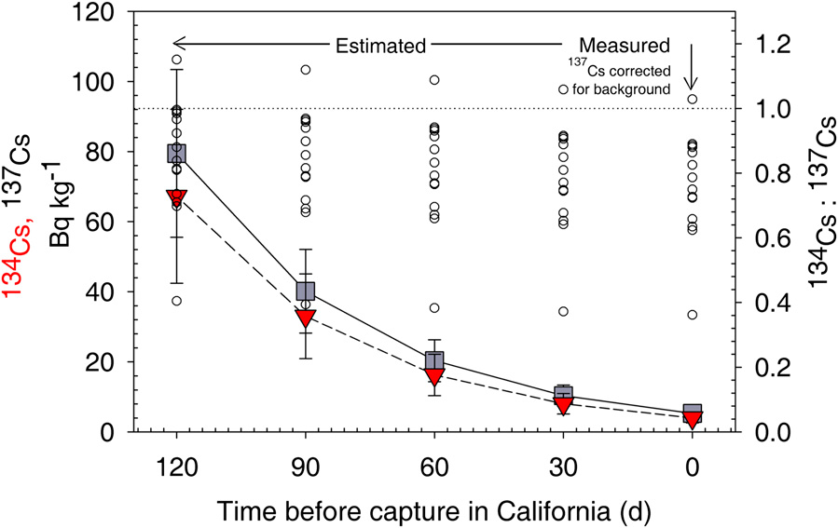
Cesium concentrations in post-Fukushima bluefin tuna
¹³⁴Cs:¹³⁷Cs in myctophid fish off Japan = 0.9; in plankton = 1.1; in water = 1.0
Japan safety limit: 100 Bq kg⁻¹ wet wt (~410 Bq kg⁻¹ dry wt)

Slide 14
Concentrations of ¹³⁴Cs, ¹³⁷Cs, and the naturally occurring radionuclide ⁴⁰K for pre-Fukushima bluefin (PBFT 2008) and post-Fukushima yellowfin tuna (YFT 2011)
 | Individual fish | SL | Body mass | Age | ¹³⁷Cs | ¹³⁴Cs | ⁴⁰K
 |  | cm | dry kg | years | Bq kg⁻¹
PBFT 2008 | 1 | 67.5 | 1.6 | 1.5 | <0.8 | 0 | 298
 | 2 | 65 | 1.4 | 1.4 | 1.61 | 0 | 266
 | 3 | 66.5 | 1.5 | 1.4 | 1.38 | 0 | 298
 | 4 | 64.5 | 1.4 | 1.3 | 1.37 | 0 | 225
 | 5 | 66 | 1.5 | 1.4 | 1.18 | 0 | 202
 | Median | 66 | 1.5 | 1.4 | 1.4 | 0 | 266
 | Mean | 65.9 | 1.5 | 1.4 | 1.4 | 0 | 258
 | SD | 1.2 | 0.1 | 0.05 | 0.2 | 0 | 43
YFT 2011 | 1 | 69 | 1.6 | 1.2 | 1.21 | 0 | 412
 | 2 | 72.3 | 1.9 | 1.2 | 0.49 | 0 | 406
 | 3 | 74.7 | 2.1 | 1.2 | 1.40 | 0 | 342
 | 4 | 70.9 | 1.8 | 1.2 | 1.17 | 0 | 247
 | 5 | 74.7 | 2.1 | 1.2 | 1.22 | 0 | 260
 | Median | 72.3 | 1.9 | 1.2 | 1.2 | 0 | 342
 | Mean | 72.3 | 2.1 | 1.2 | 1.1 | 0 | 333
 | SD | 2.5 | 0.2 | 0.01 | 0.4 | 0 | 78

Slide 15
NO significant relationship between cesium and fish length

Slide 16
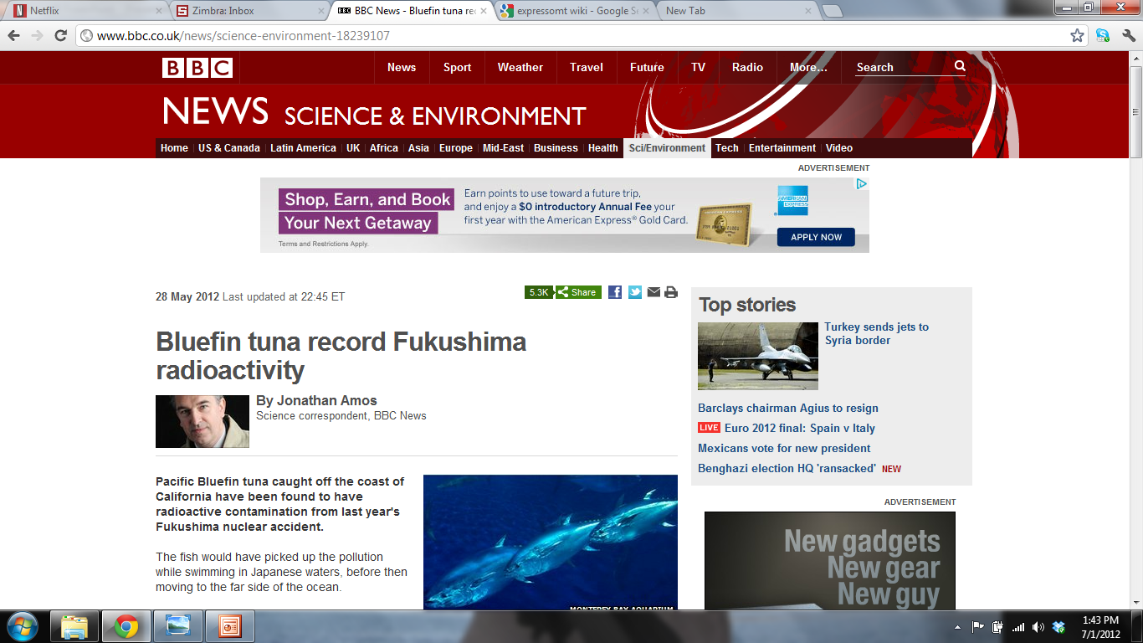
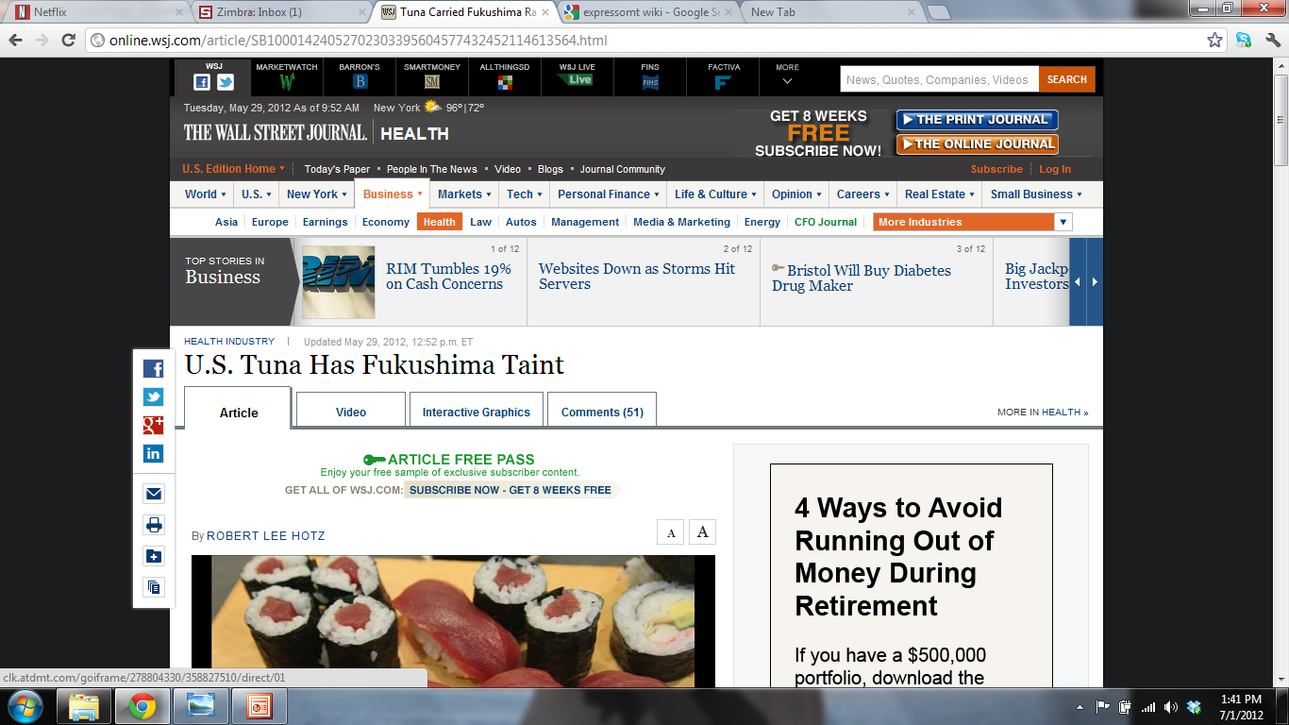
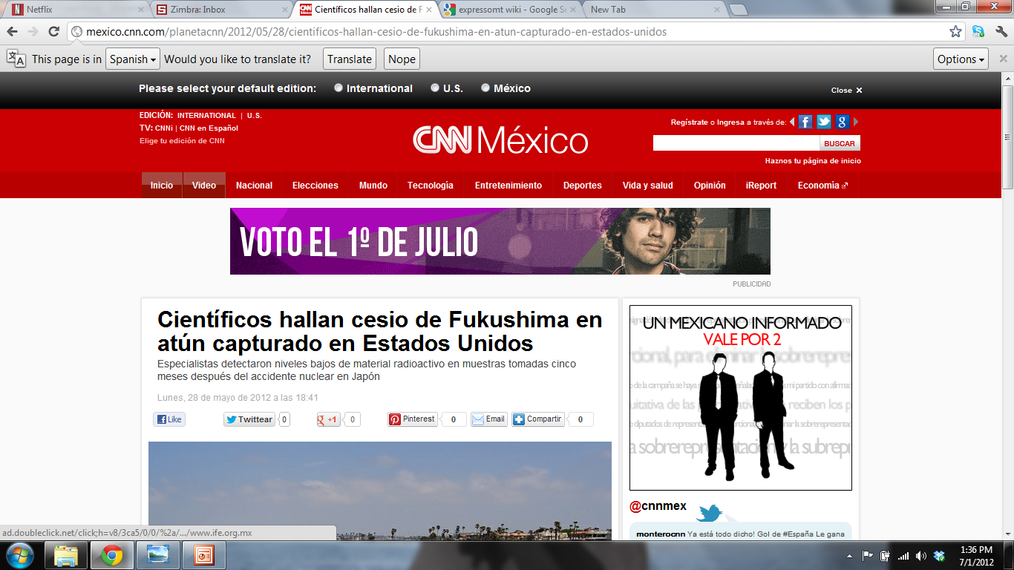
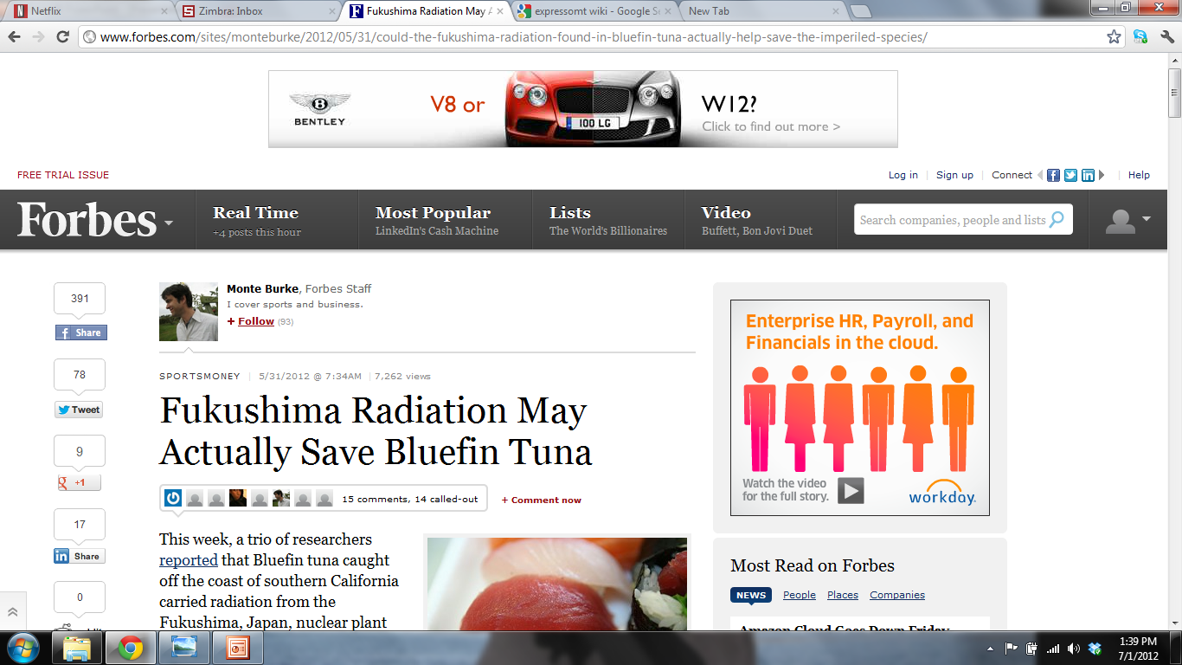
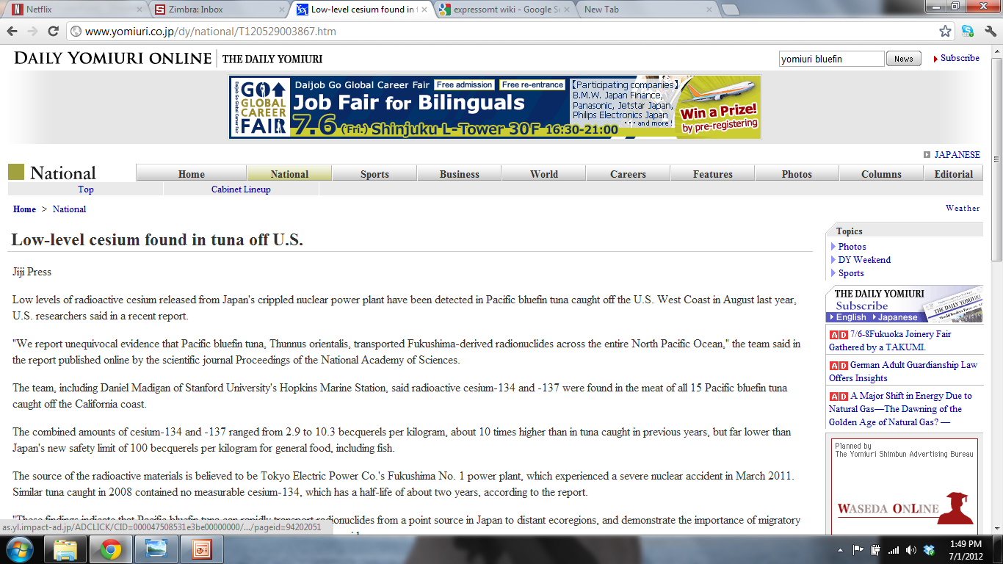
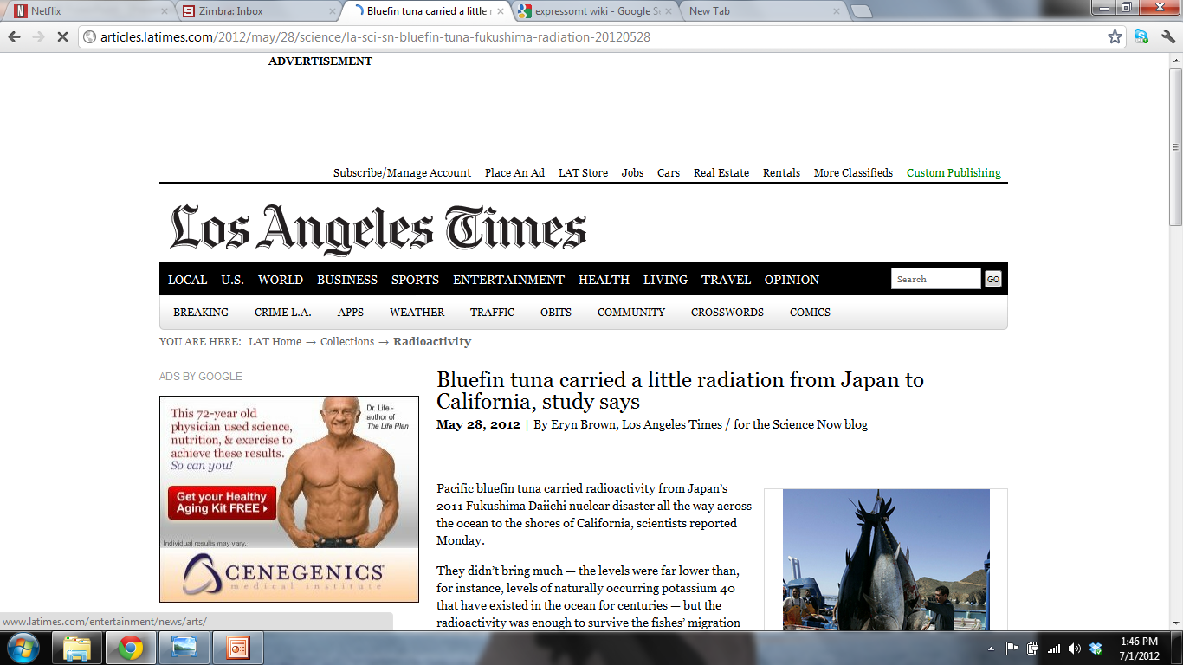
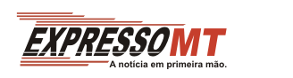
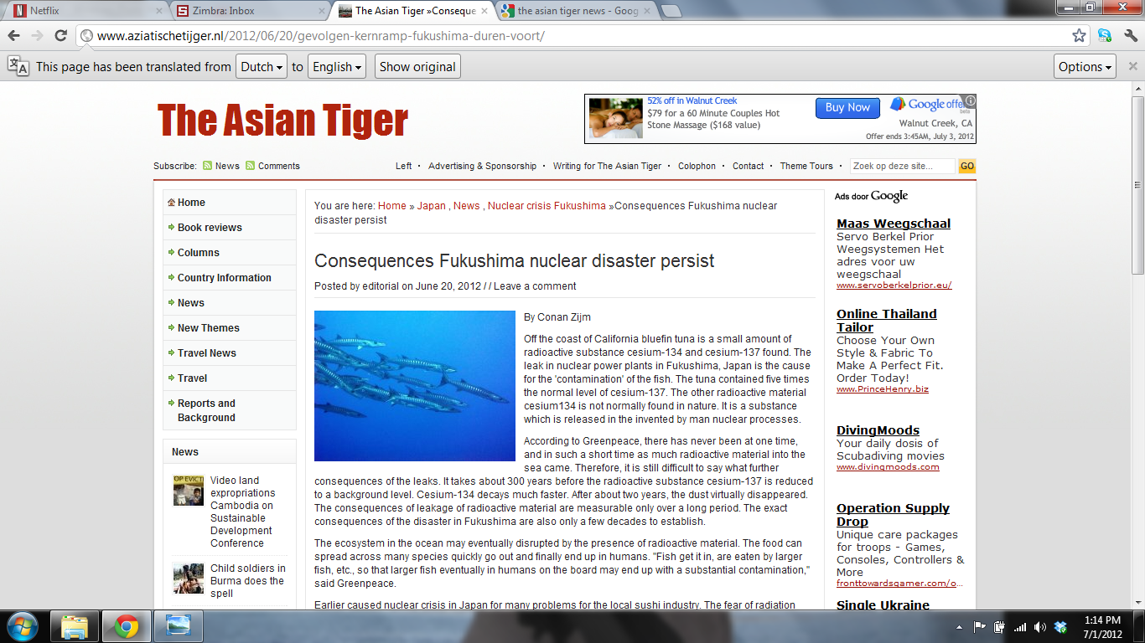


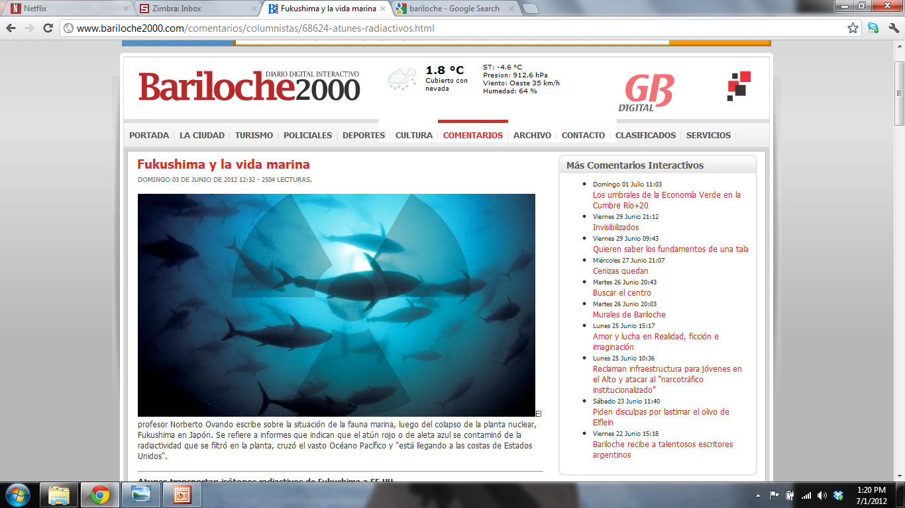


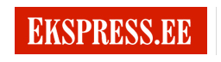
U.S.
U.K.
Japan
Portugal
East Asia
Argentina
Washington DC
Estonia

Slide 17


Slide 18
Doses to human consumers
(1 Sv = 100 rem = 1 joule kg⁻¹)
 | Tuna: from ¹³⁴⁺¹³⁷Cs | Tuna: from ⁴⁰K | Banana: from ⁴⁰K | Dental x-ray | 1 flight NY to LA (cosmic rays)
Consumption of: | 1 kg | 1 kg | 1 banana
Dose (µSv) | 0.038 | 0.5 | 0.1 | 5 | 40
Top 5% of fish eaters in the US (µSv y⁻¹) | 4.7 | 61.8 | = 47 bananas , or 0.13 bananas/d

Slide 19
Doses to zooplankton and bluefin tuna (nGy h⁻¹)
(1 Gy = 100 rads = 1 joule kg⁻¹ of tissue)
 | ^{110m}Ag | ¹³⁴Cs | ¹³⁷Cs | ²¹⁰Po | ⁴⁰K | Natural : anthropogenic
Zooplankton (near Japan) | 0.76 | 1.50 | 1.80 | 1700 | 110 | 424
Tuna (in California) | n.a. | 0.62 | 1.10 | 600 | 1.3 | 350
Tuna (near Japan) | n.a. | 9.3 | 16.5 | 600 | 1.3 | 23

Slide 20
Simplified migration patterns of some highly migratory species in the Pacific

Slide 21


What is the Cesium load of PBFT in 2012 and 2013?
Our 2011 data are from fish that spent ~1 month in contaminated waters
Buesseler et al. 2011
This year’s cohort spent their first year in contaminated waters
Values may be higher
Takashi et al. 2004

Slide 22
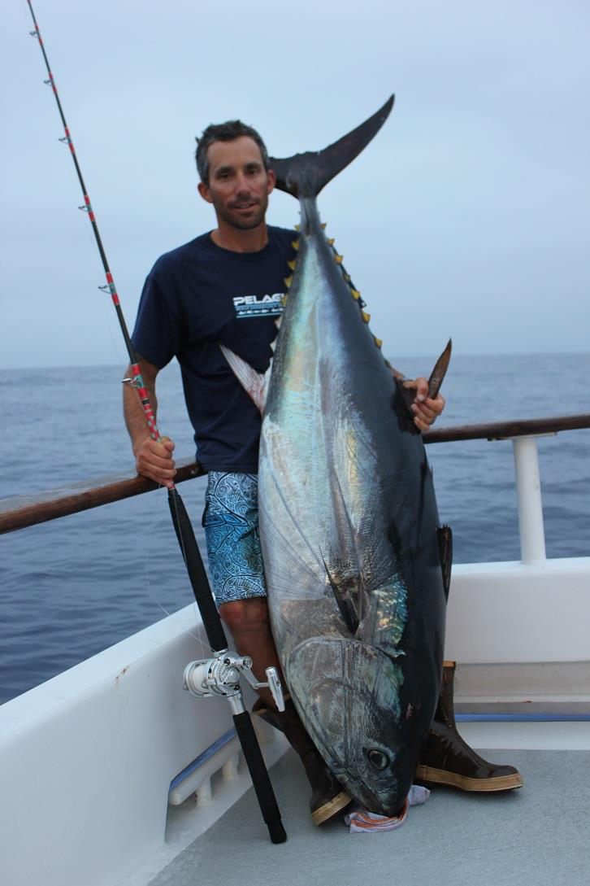
Still a work in progress—stay tuned….
Conclusions so far:
¹³⁴Cs and ¹³⁷Cs accumulate in bluefin tuna in waters off Japan and are retained by tuna during their migration across the Pacific;
Yellowfin tuna which are residential species show no evidence of Fukushima radioactivity;
Radioactivity clearly detectable in tuna in California coastal waters, but at low concentrations compared to natural radioactivity, and doses to marine biota and to human consumers are low;
Cs isotopes may be useful in tracing migration of some fish, mammals, turtles, birds.

Slide 24
Pacific bluefin Thunnus orientalis catch data in the Eastern Pacific Ocean and total harvested muscle biomass in the EPO
Year | Catch (×10³ mt) | Muscle biomass (×10⁶ kg)
2000 | 4.2 | 3.0
2001 | 1.7 | 1.2
2002 | 2.5 | 1.8
2003 | 3.7 | 2.6
2004 | 9.0 | 6.4
2005 | 4.8 | 3.4
2006 | 9.9 | 7.0
2007 | 4.2 | 3.0
2008 | 4.5 | 3.2
2009 | 3.6 | 2.6
2010 | 7.9 | 5.6
Median | 4.2 | 3.0
Mean | 5.1 | 3.6
SD | 2.6 | 1.9
Yields mean of 3.6 million Bq (= 1 mCi) of ¹³⁴⁺¹³⁷Cs in harvested tuna per year

Slide 25
Sampling method | Station | Sample composition |  | % abundance of dominant species | ¹³⁷Cs | ¹³⁴Cs | ¹³⁷Cs | ¹³⁴Cs | ^{110m}Ag | ⁴⁰K | ¹³⁴Cs : ¹³⁷Cs | ¹³⁴Cs : ^{110m}Ag | anthropogenic : natural radioactivity ratio
 |  |  |  |  | Bq kg⁻¹ |  | CF |  | Bq kg⁻¹
Bongo nets (300 µm) | 2 | zooplankton mixed | copepods | 50 | 0.3 | bd | 134 | bd | 1.9 | 217 | bd | bd | 0.01
 | 3 |  |  | 70 | 6.4 | 6.2 | * | bd | 1.3 | 229 | 1.0 | 4.7 | 0.06
 | 8 |  |  | 80 | 14.3 | 15.1 | 98 | 105 | 18.3 | 321 | 1.1 | 0.8 | 0.07
 | 9 |  |  | 92 | 1.2 | 1.2 | 16 | 17 | 3.3 | 156 | 1.0 | 0.4 | 0.04
 | 10 |  |  | 71 | 4.7 | 4.6 | 27 | 26 | 6.5 | 147 | 1.0 | 0.7 | 0.11
 | 11 |  |  | 61 | 3.1 | 3.9 | 29 | 36 | 5.3 | 126 | 1.3 | 0.7 | 0.10
 | 12 |  |  | 72 | 7.2 | 8.8 | 77 | 98 | 8.7 | 148 | 1.2 | 1.0 | 0.17
 | 14 |  |  | 65 | 56.4 | 45.5 | * | * | 0.0 | 188 | 0.8 | bd | 0.54
 | 17 |  |  | 47 | 0.9 | bd | 255 | bd | 0.5 | 195 | bd | bd | 0.01
 | 19 |  |  | 65 | 12.8 | 15.0 | 53 | 59 | 12.0 | 232 | 1.2 | 1.2 | 0.17
 | 21 |  |  | 52 | 17.3 | 20.7 | 78 | 88 | 11.1 | 225 | 1.2 | 1.9 | 0.22
 | 22 |  |  | 79 | 4.5 | 4.2 | 20 | 19 | 5.1 | 129 | 0.9 | 0.8 | 0.11
 | 23 |  |  | 58 | 29.1 | 31.4 | 34 | 36 | 21.5 | 181 | 1.1 | 1.5 | 0.45
 | 24 |  |  | 65 | 12.8 | 15.5 | 285 | 351 | 14.0 | 197 | 1.2 | 1.1 | 0.21
 | 25 |  |  | 51 | 26.2 | 29.4 | 44 | 49 | 6.3 | 272 | 1.1 | 4.7 | 0.23
 | 27 |  |  | 84 | 19.9 | 25.4 | 27 | 33 | 12.4 | 194 | 1.3 | 2.0 | 0.30
 | 29 |  |  | 76 | 34.2 | 38.0 | 10 | 10 | 14.4 | 230 | 1.1 | 2.6 | 0.38
 |  |  |  | median | 12.8 | 15.1 | 44 | 36 | 6.5 | 195
 |  |  |  | mean | 14.8 | 17.7 | 79 | 71 | 8.4 | 199
 |  |  |  | sd | 14.9 | 13.7 | 85 | 90 | 6.4 | 51
Methot net (4 mm) | 25 | scyphomedusan | Chrysaora sp. | 100 | 11.1 | 11.9 | 19 | 20 | 3.4 | 197 | 1.1 | 3.5 | 0.13
 | 19 | euphausiids | Euphausia pacifica | 88 | 2.3 | 4.5 | 9 | 18 | 20.6 | 196 | 2.0 | 0.2 | 0.14
 | 25 |  |  | 100 | 23.4 | 27.2 | 39 | 45 | 15.7 | 214 | 1.2 | 1.7 | 0.31
 | 29 | euphausiids | Nematoscelis difficilis | 86 | 15.1 | 16.3 | 4 | 4 | 11.5 | 182 | 1.1 | 1.4 | 0.24
 | 32 | fish, shrimps, euphausiids, pyrosomatids mixed | nd | nd | 3.1 | 6.8 | 9 | 20 | 23.6 | 278 | 2.2 | 0.3 | 0.12
 |  |  |  | median† | 9.1 | 11.6 | 9 | 19 | 18.2 | 205
 |  |  |  | mean† | 11.0 | 13.7 | 16 | 22 | 17.9 | 217
 |  |  |  | sd† | 10.1 | 10.3 | 16 | 17 | 5.3 | 42
 | 19 | fish | Stenobrachius leucopsarus | 50 | 4.9 | 3.3 | 20 | 13 | bd | 144 | 0.7 | bd | 0.06
 | 27 | fish | Cyclothone pseudopallida, Sigmops gracile | 40, 40 | 11.4 | 11.9 | 16 | 15 | bd | 232 | 1.0 | bd | 0.10
 | 29 | fish | S. gracile | 63 | 15.8 | 14.8 | 4 | 4 | bd | 129 | 0.9 | bd | 0.24
 |  |  |  | median | 11.4 | 11.9 | 16 | 13 | bd | 144
 |  |  |  | mean | 10.7 | 10.0 | 13 | 11 | bd | 168
 |  |  |  | sd | 5.5 | 6.0 | 8 | 6 | bd | 55
Notes:
Enlarge numbers?

Slide 26
Measured concentrations of naturally occurring radionuclides ⁷Be, ²¹¹Bi, and ²¹²Pb and for n=15 post-Fukushima Pacific bluefin tuna (PBFT 2011)
PBFT 2011 | SL (cm) | Body mass (kg dry) | Age (years) | ⁷Be | ²¹¹Bi | ²¹²Pb |  | Total
 |  |  |  | mBq kg⁻¹ |  |  |  | mBq kg⁻¹
1 | 72.4 | 2.0 | 1.7 | 0.5 | nd | 2.5 |  | nd
2 | 64.0 | 1.3 | 1.4 | 0.4 | 54.2 | 1.4 |  | 56.0
3 | 60.6 | 1.1 | 1.3 | <0.12 | 35.6 | 0.8 |  | 36.4
4 | 68.0 | 1.6 | 1.6 | <0.12 | 40.0 | 0.8 |  | 40.8
5 | 69.0 | 1.7 | 1.6 | <0.12 | 54.7 | 0.2 |  | 54.9
6 | 69.0 | 1.7 | 1.6 | <0.12 | 42.4 | 0.9 |  | 43.3
7 | 69.5 | 1.7 | 1.6 | <0.12 | 49.3 | 1.6 |  | 50.9
8 | 66.5 | 1.5 | 1.5 | <0.12 | 38.5 | 0.9 |  | 39.4
9 | 58.6 | 1.0 | 1.2 | <0.12 | 43.2 | 1.5 |  | 44.7
10 | 66.0 | 1.5 | 1.5 | 1.1 | 49.3 | 0.9 |  | 51.3
11 | 67.5 | 1.6 | 1.5 | 0.2 | 41.8 | 1.2 |  | 43.2
12 | 68.5 | 1.6 | 1.6 | 14.2 | 53.0 | 1.1 |  | 68.3
13 | 65.5 | 1.4 | 1.5 | 2.9 | 58.0 | 0.4 |  | 61.3
14 | 63.1 | 1.3 | 1.4 | <0.12 | 65.4 | 1.4 |  | 66.8
15 | 65.5 | 1.4 | 1.5 | 1.5 | 59.8 | 1.4 |  | 62.7
Median | 66.5 | 1.5 | 1.5 | 1.1 | 49.3 | 1.1 |  | 51.1
Mean | 66.2 | 1.5 | 1.5 | 3.0 | 48.9 | 1.1 |  | 51.4
SD | 3.6 | 0.2 | 0.1 | 5.0 | 9.0 | 0.5 |  | 10.5

Slide 27
Mean concentrations (Bq kg⁻¹ dry) in biota
 | ¹³⁷Cs | ¹³⁴Cs | ^{110m}Ag | ⁴⁰K
Copepods n = 17 | 14.8 CF = 79 | 17.7 CF = 71 | 8.4 | 199
Large zooplankton (euphausiids, gelatinous) n = 4 | 11.1 CF = 16 | 13.7 CF = 22 | 17.9 | 217
Fish n = 3 | 10.7 CF = 16 | 10.0 CF = 13 | bd | 168

Slide 28
Ranges of radioisotopes in biota
Natural Anthropogenic
Data from Buesseler et al. 2012 PNAS
Ratio of mean natural : anthropogenic = 6 : 1
Pre-Fukushima [¹³⁷Cs] = 37 - 80 x 10⁻³ Bq dry kg⁻¹
Kaeriyama et al., 2008
Notes:
Y axis: change radioactivity to 137Cs

Slide 29
Cesium isotopic ratios in biota ~1
1:1
Data from Buesseler et al. 2012 PNAS

Slide 30
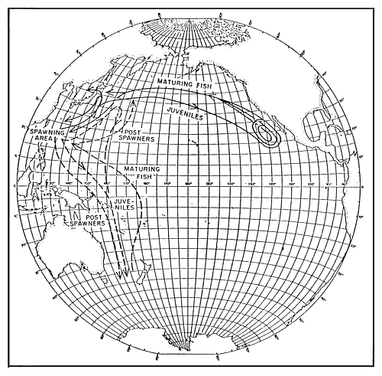


2. What proportion of older, larger fish are CCS residents and what proportion are Japan migrants?
To what extent does the EPO fishery depend on Japan stocks (versus its own smaller year classes) for its larger fish?
EPO may be fishing out older year classes
Bayliff 1980

