Slide 1
EU4Algae WG4 meeting
Replacing fish-based feed with algae-based feed
7. June 2024

Slide 2
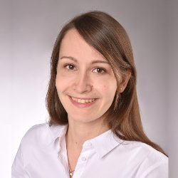
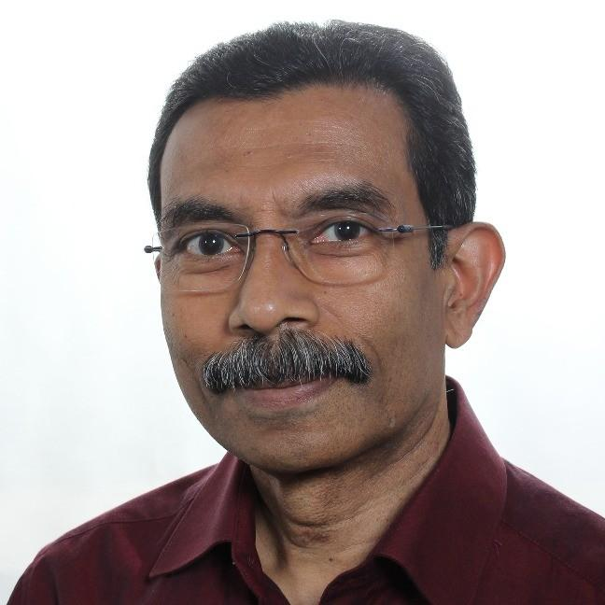
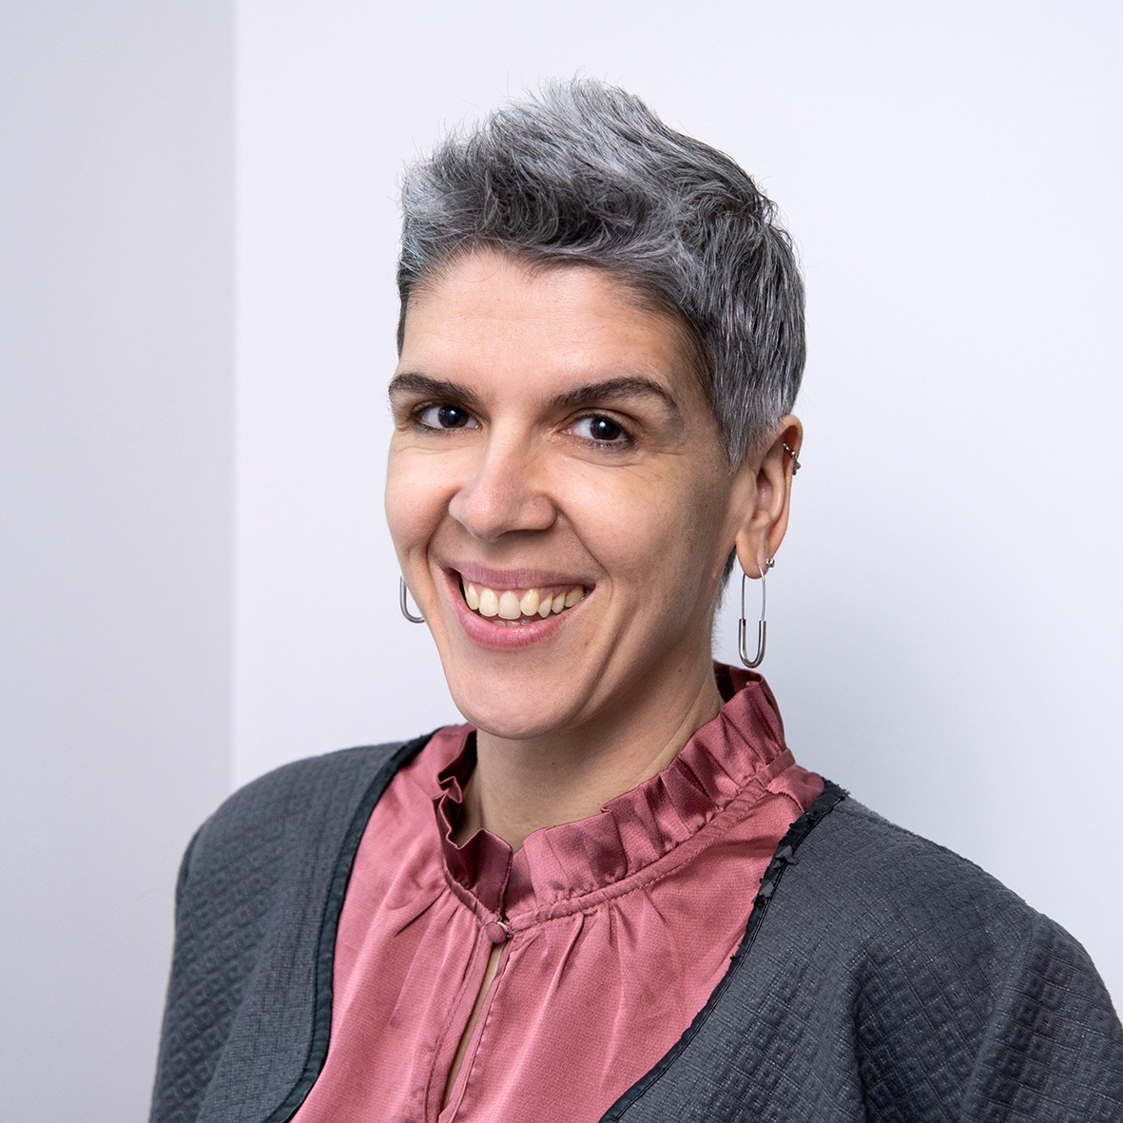
New faces!
Efthalia Arvaniti,
s.Pro sustainable projects GmbH
- Copenhagen-based
Tina Maria Seligmann
s.Pro sustainable projects GmbH, Berlin
- WG4 facilitator
Professor
Kiron Viswanath Nord University,
Bodø, Norway
- New WG4 Chair
​

Slide 3
Agenda
Time(CET) | Item | Lead
10:00 | Welcome & Introductions | Efthalia Arvaniti / Tina Seligmann, EU4Algae
10:05 | News: Recap on WG4 since last year | Efthalia, EU4Algae
10:10 | The potential of algae as aqua feed | Kiron Viswanath, NORD University
10:25 | A study to support a sustainable Algae Industry: Investigating the use of algae-based feed as a replacement of fish-based feed in EU aquaculture | Tina Seligmann, s.Pro – sustainable projects GmbH
10:40 | Role of algae in sustainable food and feed systems | Maria Kottari, Technopolis
10:55 | The SEAMARK project report on the regulatory assessment of macroalgae cultivation and applications in EU | Maya Miltell, SUBMARINER Network
11:10 | Algae fermentation and sustainable feed ingredients | Saskia Kliphuis, Corbion
11:25 | Any Other Business, Wrap-Up and Next Steps | Efthalia & Tina
11:30 | END OF MEETING

Slide 4
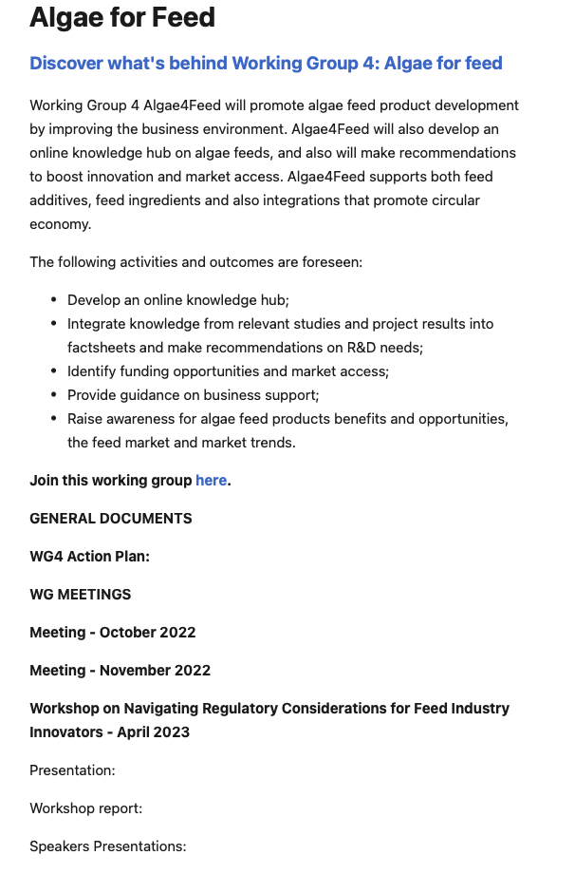
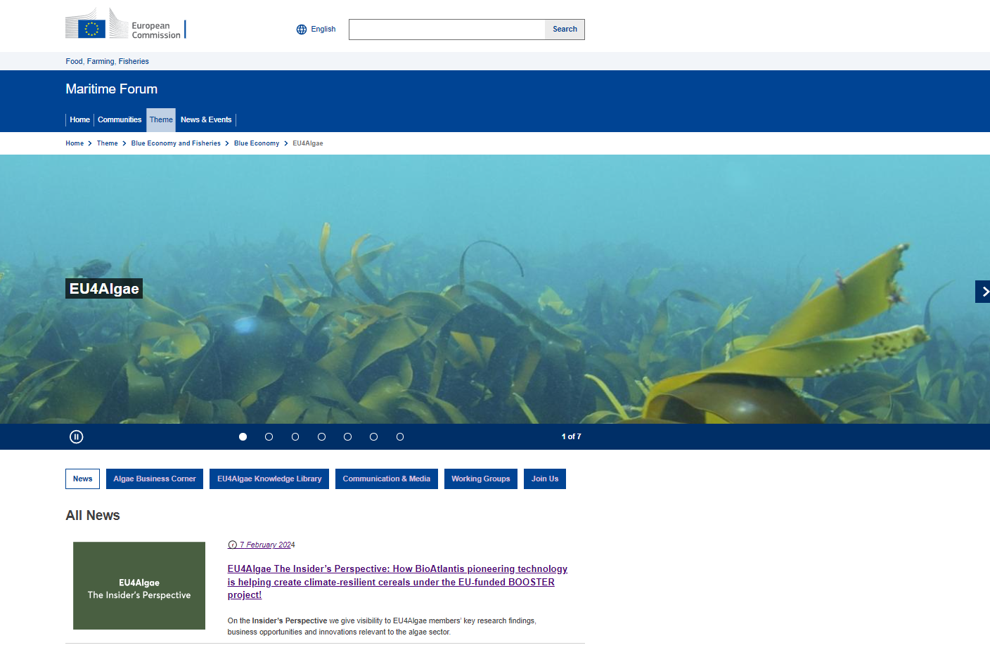
Check the new EU4Algae website
EU4Algae
https://maritime-forum.ec.europa.eu/contents/algae-feed_en
EU4Algae is hosted under the Maritime Forum

Slide 5
Upcoming EU4Algae events
Add in safe list!!
ec-maritime-forum-no-reply@nomail.ec.europa.eu
Online EU4Algae event – 8 July 2024

Slide 6
Thank you
© European Union 2023
Unless otherwise noted the reuse of this presentation is authorised under the CC BY 4.0 license. For any use or reproduction of elements that are not owned by the EU, permission may need to be sought directly from the respective right holders.
Slide xx: element concerned, source: e.g. Fotolia.com; Slide xx: element concerned, source: e.g. iStock.com
Notes:
Update/add/delete parts of the copy right notice where appropriate.
More information: https://myintracomm.ec.europa.eu/corp/intellectual-property/Documents/2019_Reuse-guidelines%28CC-BY%29.pdf

