Slide 1




Development of Tools and Techniques to
Survey, Assess, Stabilise, Monitor and Preserve
Underwater Archaeological Sites
FP 7, Cooperation, Theme 6, Environment (including climate change)
SME-targeted Collaborative Project
David Gregory (Coordinator)
The National Museum of Denmark
EU-UNESCO Information Meeting on Underwater Cultural Heritage, European Parliament, Brussels , 01.10.2015
Notes:
Thank you Ricardo for your kind introduction and inviting me to give a short presentation on the SASMAP project
SASMAP, or Development of Tools and Techniques to Survey Assess Stabilise Monitor and Preserve underwater archaeological sites.
The project ran from 2012 until 2015 and is an FP7 European Commission funded project under the Cooperation directive, Environment theme and is a Small Medium Enterprise targeted project.
I have been the coordinator of the project and want to give to give a very brief overview of the aims and results of the project

Slide 2
Protection of underwater cultural heritage
Valetta Treaty (1992) – European law
ICOMOS Charter (1996)
UNESCO Convention (2001)
”The preservation of underwater cultural heritage in situ should be considered as a first option.”
”Non- destructive techniques, non-intrusive survey and sampling should be encouraged in preference to excavation.”
Develop methods to locate & assess sites
Develop “proof of concept” equipment for non destructive / intrusive investigation
Produce Guidelines for informed management of underwater cultural heritage
Notes:
The project in essence addresses current trends for protection, or management, of the underwater cultural heritage. Certainly in light of sub sea development whereby a developer wanting to place a pipe line, wind farm or cable has to take the underwater cultural heritage into consideration and pay for archaeological investigation .
These treaties and conventions, all state that
”The preservation of underwater cultural heritage in situ should be considered as a first option.”
”Non- destructive techniques, non-intrusive survey and sampling should be encouraged in preference to excavation.”

Slide 3
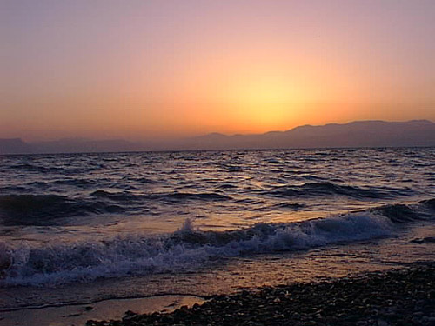
Archaeological Site Management:
Underwater Cultural Heritage
What is there?
Where is it?
State of preservation of sites / materials?
How can we best preserve it (excavation vs in situ)?
Monitoring of sites preserved in situ
Notes:
In order to do this there are several key points which need to be bourne in mind:
What is there under the waves?
Where actually is it?
Once we have located and identified a site what is the state of preservation of the site and the materials contained within it?
Knowing this how can we best preserve a site or materials? Is in situ preservation feasible or should the site ideally be excavated?
If the site is preserved in situ there should subsequent monitoring of the site and environment so as to ensure the site is not lost

Slide 4
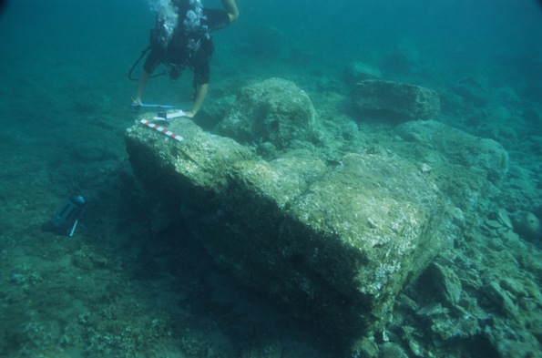
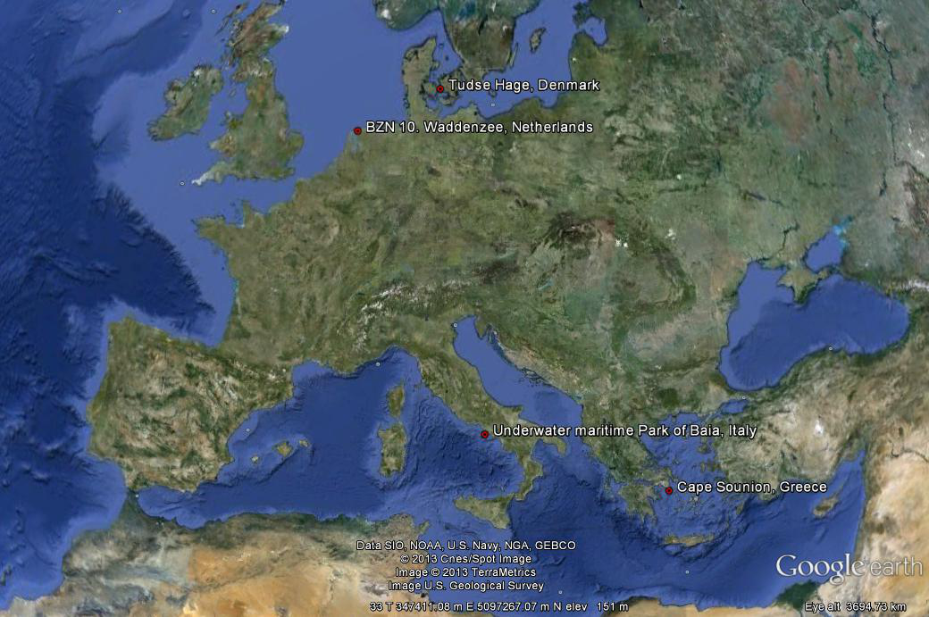
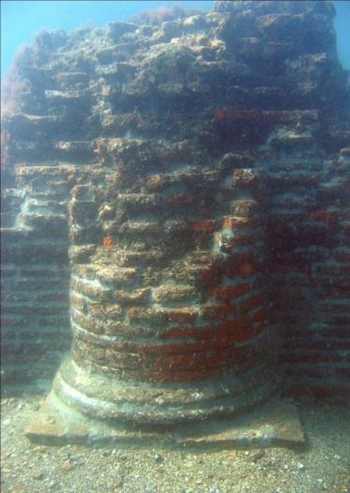
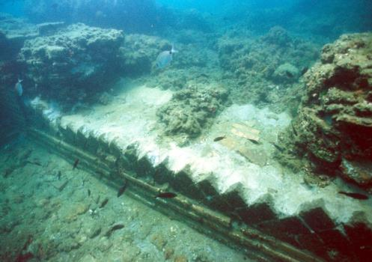
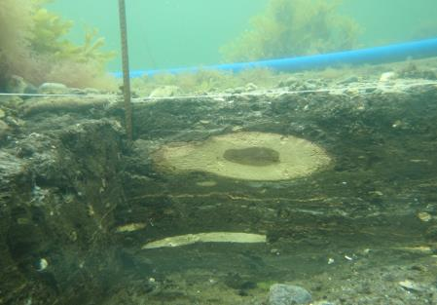
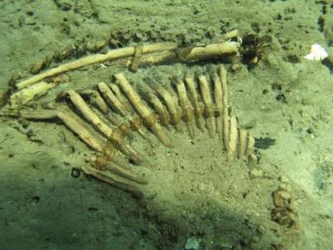
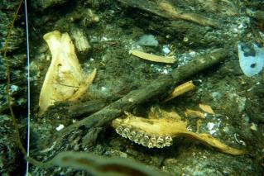
Case study areas: Shallow coastal sites
Notes:
Tudse Hage/DK Mesolithic 5000 BC
Underwater Archaeolgical park of Baiae, Naples, Italy
Cape Sounion,/Greece. Remains of the settlement from the 5th c. BC are lying today half submerged to a maximum depth of 3.5-4m
Different tests will undergo for different sites, depending on the type of artefacts to be preserved.

Slide 5
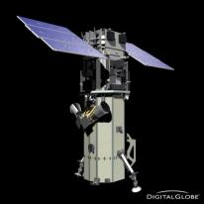
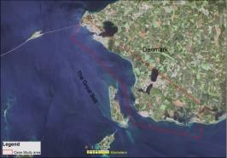
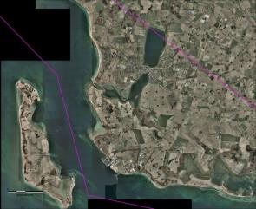

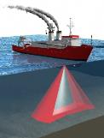
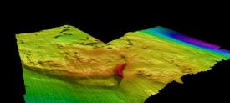
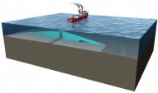
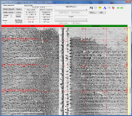
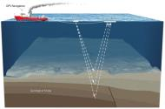

What is there?
Downscaling concept
Regional Scale

Slide 6
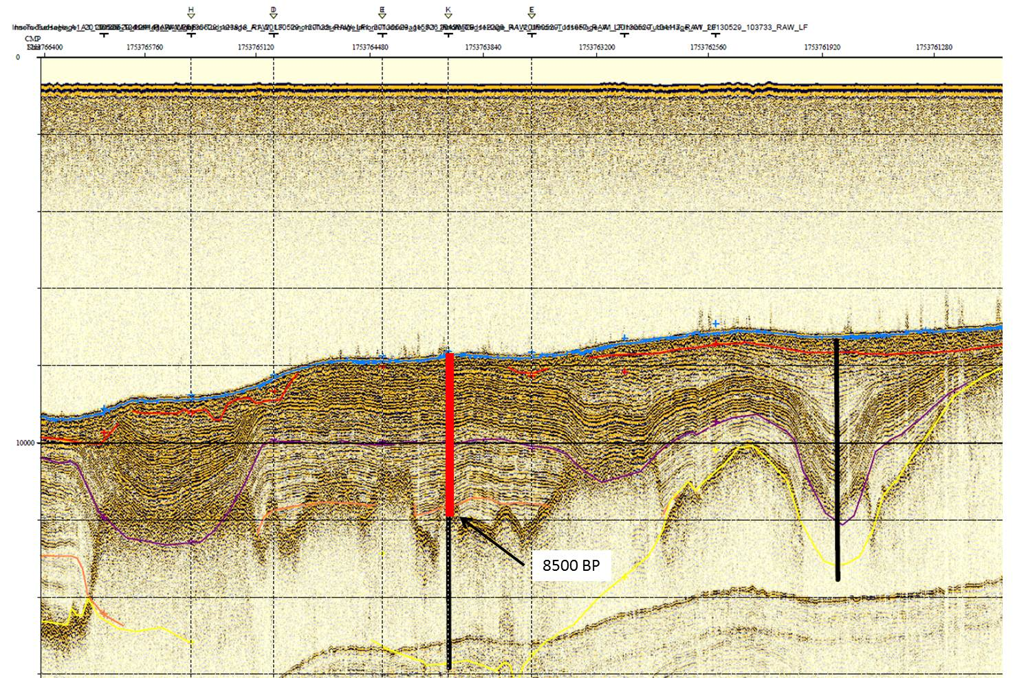


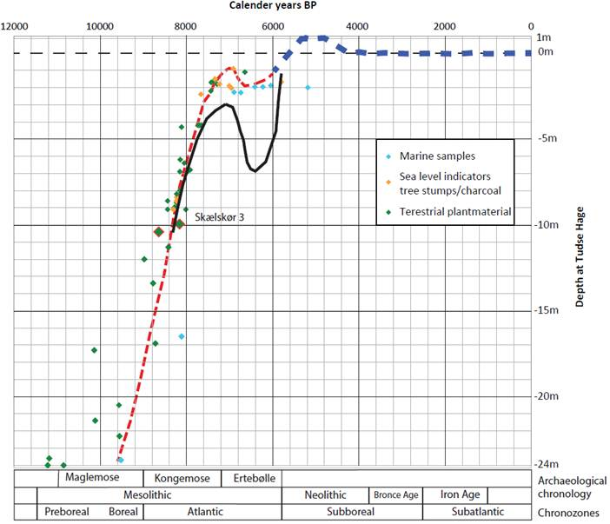
Stripping back layers of history: Geological models
Geological Survey of
Denmark & Greenland
University of Patras
(Greece)
Use of sub bottom profiling to ”strip back”
geological layers to see events that took place.
In combination with coring and C14 dating
enables reconstruction of sealevel curves, revealing
Transgression and regresssion history of the sea
Notes:
You can replace slide15 by “ Stripping back layers in history to produce geological model” , you can use the seismic line attached, where you mention that we use this technique of downscaling to strip the geological layers and see the events that took place through the past geological history, and with coring and C14 dating we construct the sea-level curve which reviles the behaviour of the transgression / regression history of the sea. Then you put in the same slide the sea level curve attached which, together with other geological/hydro info shows the most suitable places for ancient settlements.

Slide 7
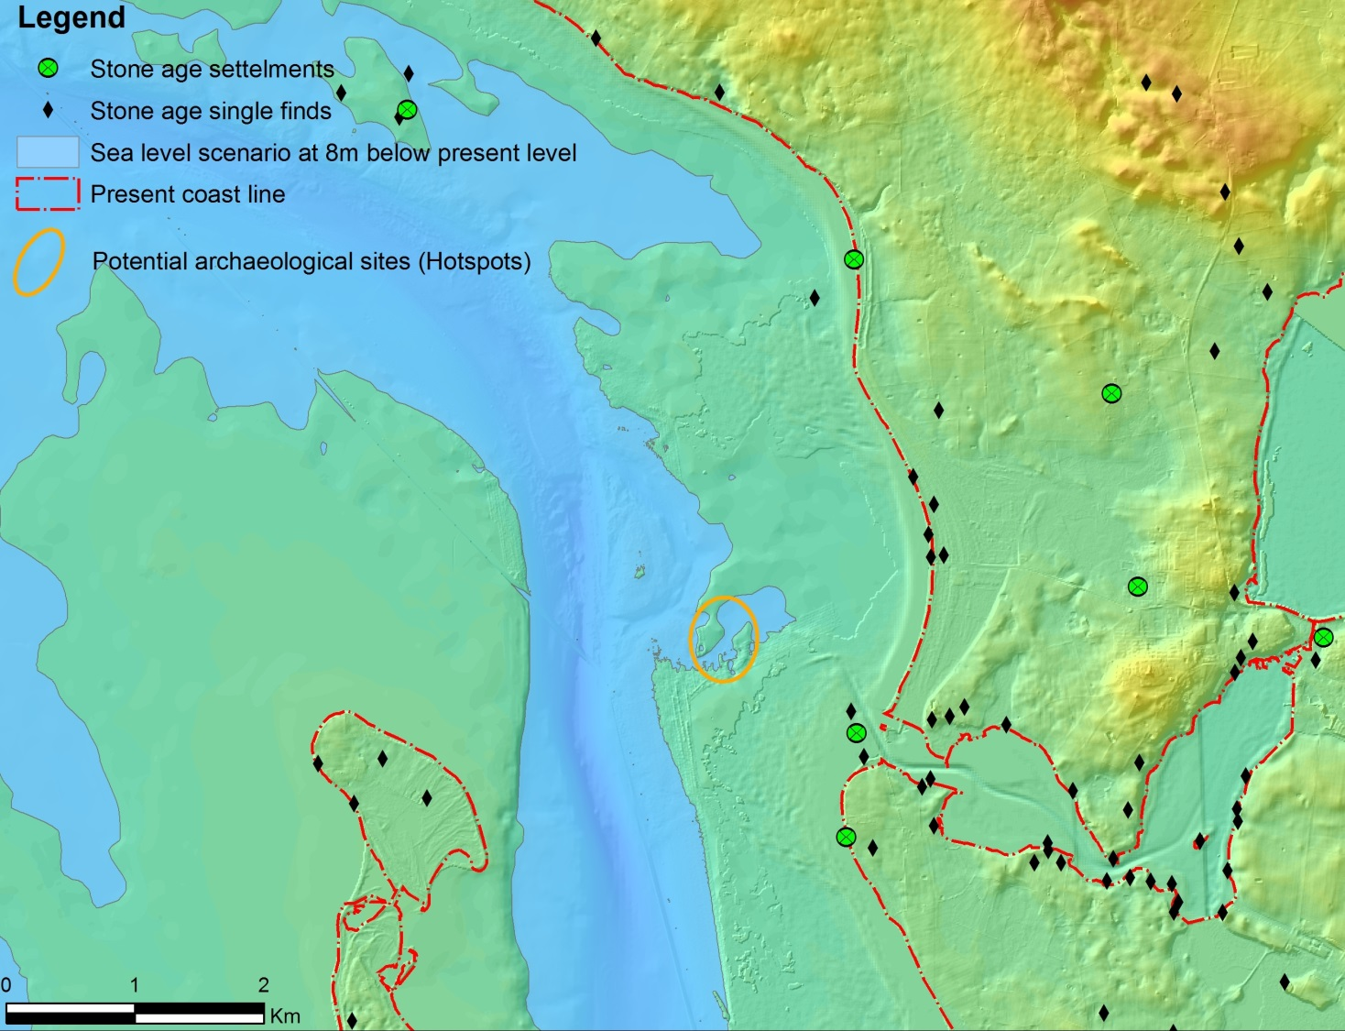
6,000 BC Sealevel 8m lower than present
Output: Enables reconstruction of palaeo coastlines through time

Slide 8

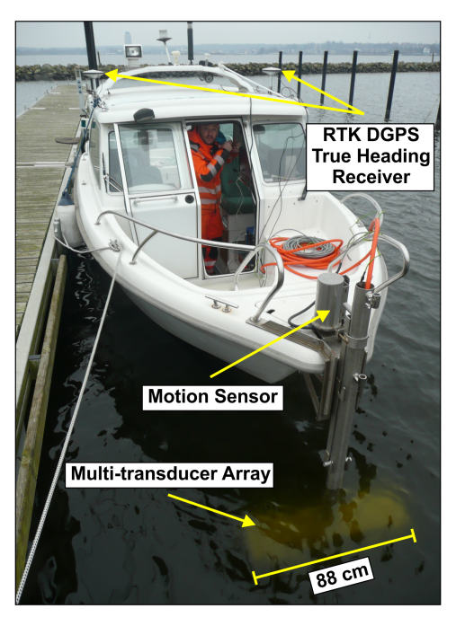
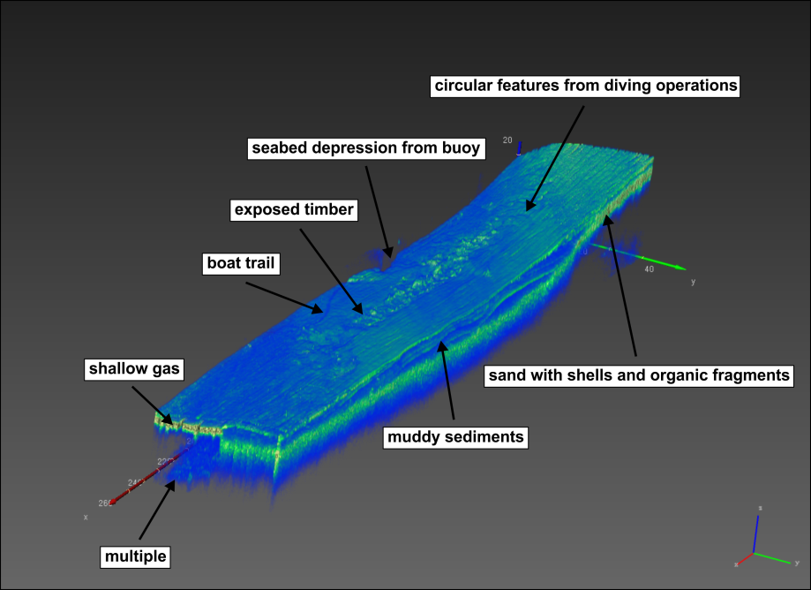
Output: Proof of concept of 3D Sub bottom profiler
Notes:
8
One of the outputs of the project will be they trialling and validating the proof oc concept of a 3D sub bottom profiler which can look at what is within the sea bed in 3 dimensions.
Founded in 1997 in Rostock (Germany)
Main product: parametric sub-bottom profilers SES-2000
Development and test of a new 3D sub-bottom profiler based on an existing experimental system
Working Depth~ 2km
Penetration Depth~ 70m depending on sediment type and frequency.
Range resolution up to 5cm.
HRP compensation.
Primary freq. 94-110kHz.
Secondary freq, 4,5,6,8,10,12,15kHz.

Slide 9
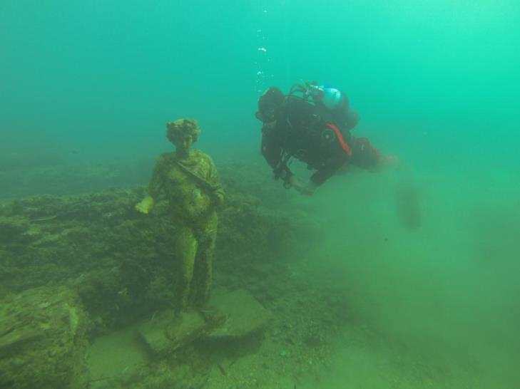
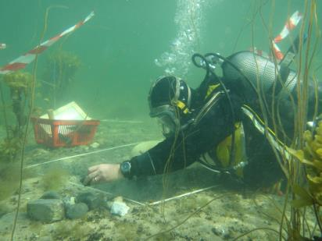
Up scaling: Site specific
Pictures, National Museum of Denmark, Viking Ship Museum/DK
Notes:
And we ground truth the site.
OK, up til now we have identified an archaeological site.
Next we need to assess this site..

Slide 10
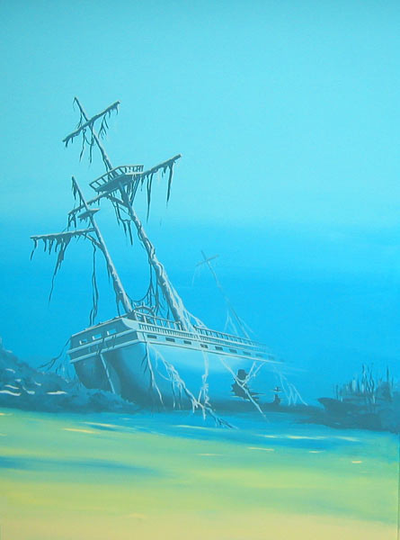
Upscaling: Groundtruthing & Assessing Potential threats
Open Seawater
Physical
Scour due to effects of currents
Biological
Activity of wood borers
Open seawater
Seabed
Seabed
Biological
Anaerobic microbial decay of materials

Slide 11
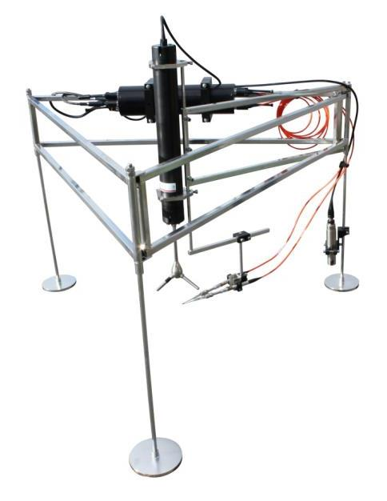
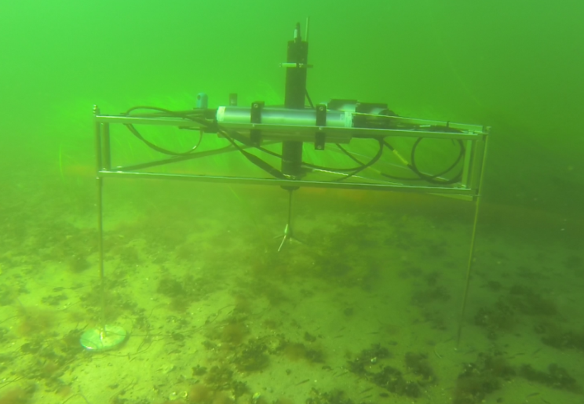

Open Water Datalogger
Conductivity (salinity)
Temperature
Dissolved oxygen
Water current data (Scour)
Notes:
Slide 10:
The Danish company Unisense develop sensors and equipment to characterise the marine environment. One of their main areas of expertise is what are called lander technologies where they can place equipment onto the seabed to measure what is going on in the open water and sediments. An open water data logger was deve,loped to measure Conductivity (salinity), Temperature, Dissolved oxygen, depth and a new device to measure the water current at the seabed so we can look at the chances of seabed erosion or scour.

Slide 12
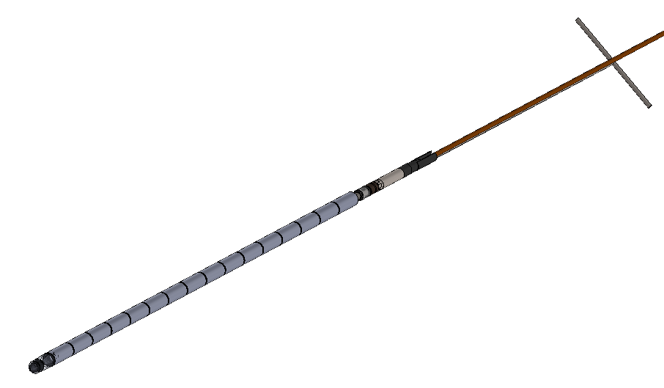
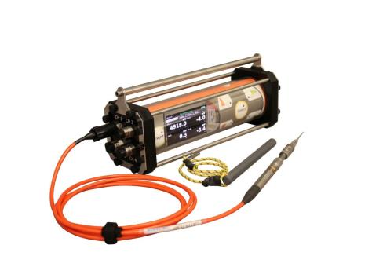
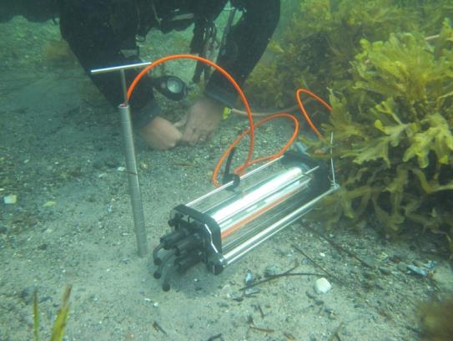
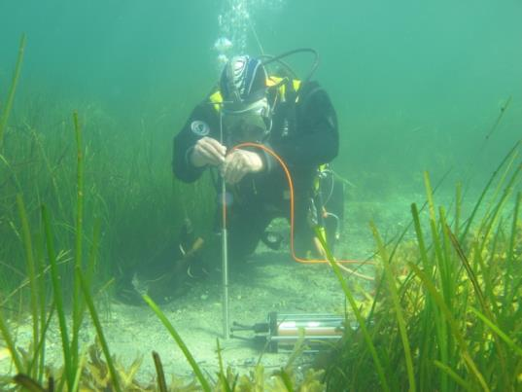
Sediment In situ profiler
Logging of dissolved oxygen, pH, sulphide, redox potential and temperature down to 50cm

Slide 13
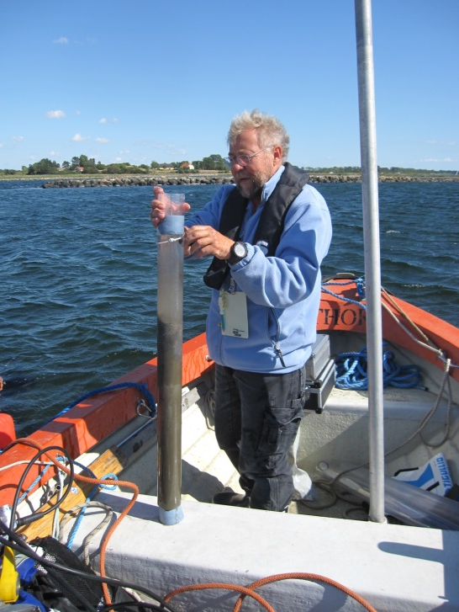
Sediment coring: Vibracorer
Sediment sampling with corer – so far succesful in range of sediment types to 2m depth
Notes:
Derefter blev det testet i Tudsehage sammen med de andre metoder i denne WP. Selve vibratoren og røret bliver holdt oppe af hævesække, på lavt vand som her blev det lidt mere kompliceret at bruge disse sække. Efter prøven er udtaget blev den taget med tilbage og der blev målt redoxpotentialet, pH og sulfid indholdet.

Slide 14
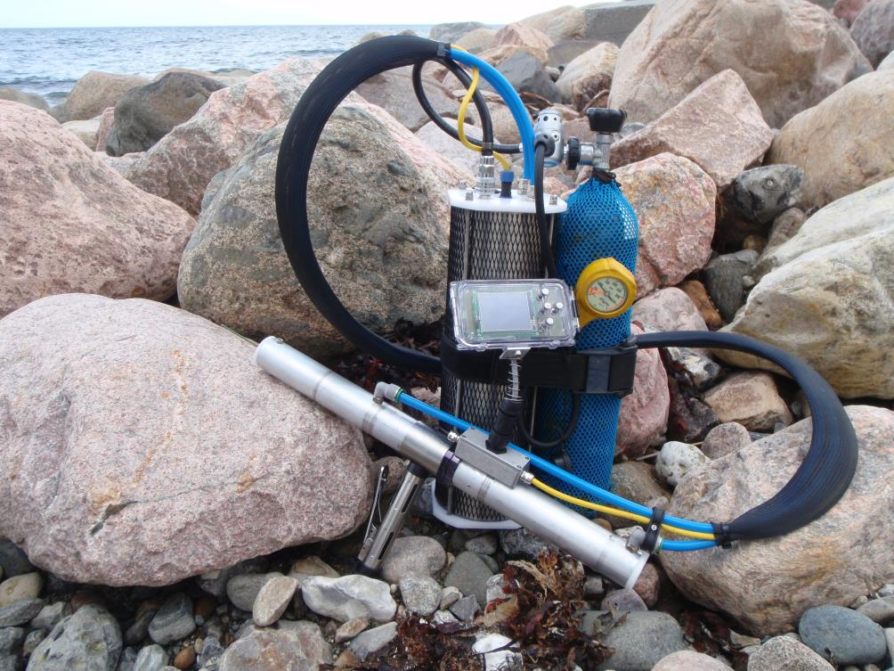

Assessment of the state of preservation of waterlogged archaeological wood in situ (WP4)
Output: Proof of concept of device for the non destructive testing of wood
Notes:
Further to this AKUT will also be developing non destructive techniques to assess the state of preservation of wood in situ – it is important to know in terms of whether a site or the wood in it is strong enough to be raised or preserved in situ.

Slide 15
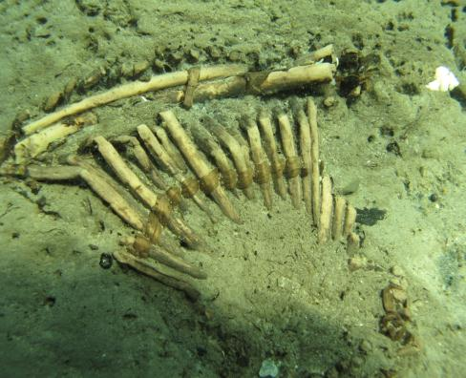
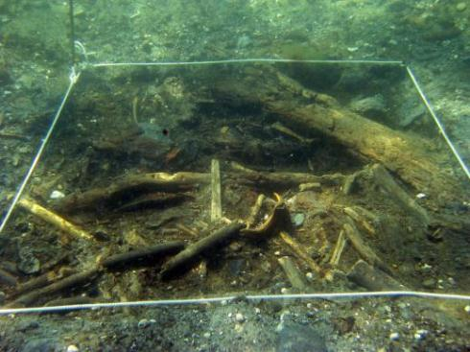
How can we best preserve sites
(excavation vs in situ)?
Tools and techniques to raise waterlogged organic archaeological artefacts (WP5)
Often encounter complex and fragile degraded artefacts underwater
Notes:
The final two themes look at how best to preserve sites. Are they stable enough to be left in situ or should they ideally be excavated in order to safeguard their future?
In this light we will be loking at developing technqies to better support and raise wooden artefacts, which although from an archaeological perspective may appear well preserved are in fact extremely degraded so we will be looking at ways of consolidating sediments and block lifting artefacts and also ways to better support artefacts when raising them

Slide 16


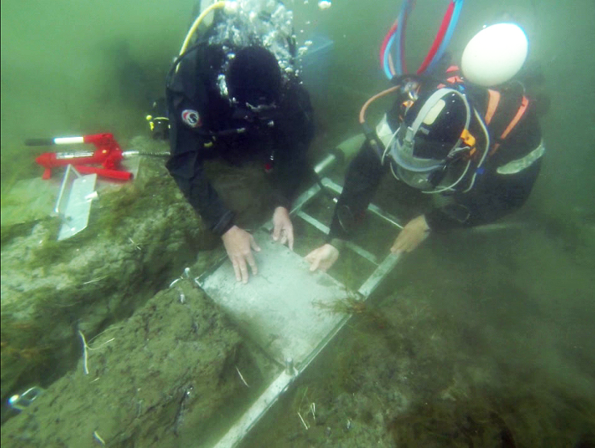
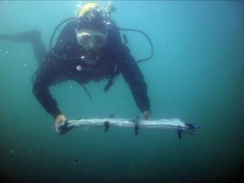
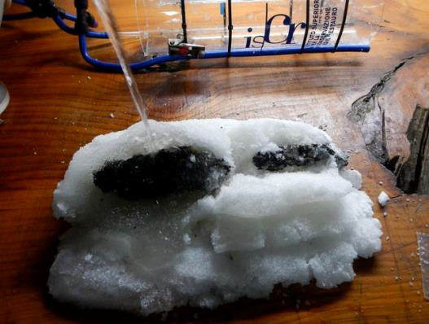
Block lifting
Supporting techniques
Consolidating artefacts in sediments

Slide 17

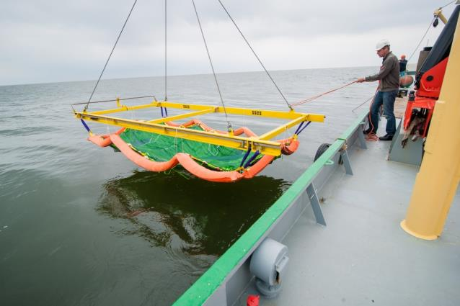
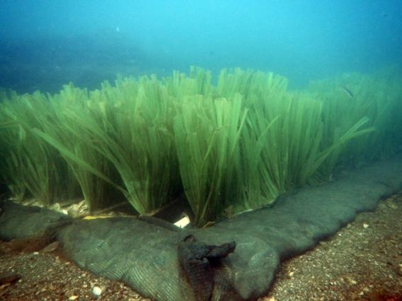
How can we best preserve sites
(excavation vs in situ)?
In situ stabilisation of underwater archaeological sites
Edge weighted Mats
Sand bag (Low profile) weighted mats
Artificial seagrass to prevent sediment erosion
(The project has also looked at deterioration of plastics in the marine environment)
Notes:
Finally, if it is deemed better to preserve the site in situ we must be sure that the site is stable. The final SME in the project, Sea Bed Scour Control Systems produce an artificial seagrass, the fronds of which trap sediments in waters where there is sediment transport and stabilise the seabed preventing further erosion. Their proprietary system and newly developed systems for working in shallow waters and more suitable archaeological sites have been developed and are being trialled to assess their effectiveness for archaeological purposes

Slide 18
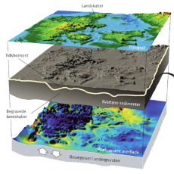

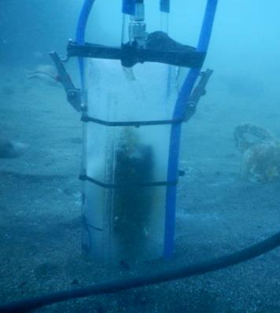
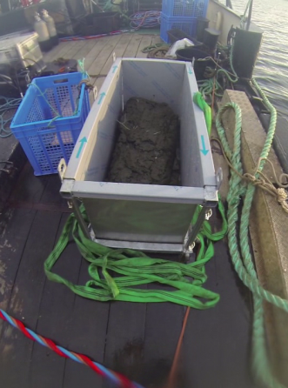
Outputs of project
Proof of concept of tools & methods
What is there & where is it?
State of preservation of sites / materials
Excavation (Lifting)
In situ protection
Notes:
The out puts of the project in the long term will be:
Proof of concept of tools and methods
And Guidelines for:
Best practice for assessing the potential of archaeological finds
Characterising, stabilising and monitoring archaeological sites preserved in situ

Slide 19
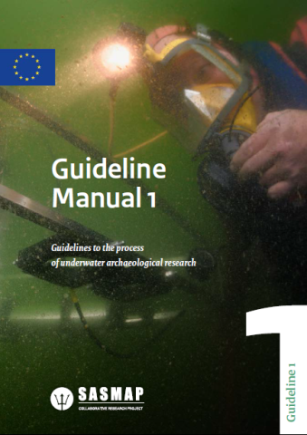
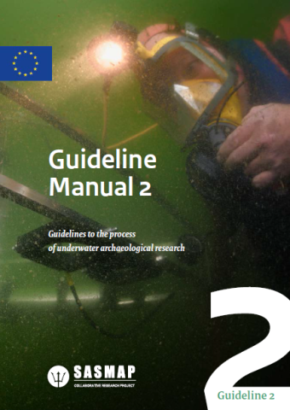
Guidelines:
Management Process
Overview of Methods

Slide 20






Consortium : Partners in the project
Archaeologists, geologists, conservators, GIS, geophysicists, wood scientists
Aimed at SMEs >30% of total budget (4 in project)
National Museum of Denmark
The Viking Ship Museum
(Denmark)
Geological Survey of
Denmark & Greenland
University of Patras
(Greece)
Superior Institute for
Conservation & Restoration (Italy)
(Sweden)
Dutch Cultural Heritage Agency
(The Netherlands)
Seabed Scour Control
Systems (UK)
Unisense (Denmark)
AKUT (Denmark)
Innomar (Germany))
Notes:
We are eleven partners in total, including 4 SMEs and we represent Archaeologists, geologists, conservators, GIS, geophysicists and wood scientists

Slide 21
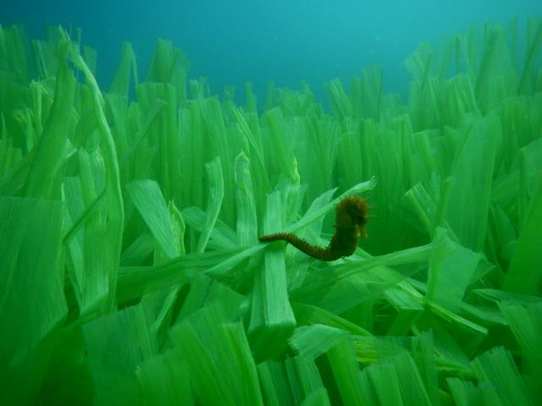
Thank you for your attention
The project is supported by EU grant 38340 under FP7.
Thanks to the project officers
Attilio Gambardella & Emanuela De Menna.
www.sasmap.eu

