Slide 1

Progress
8 February 2018, Dina Eparkhina, Glenn Nolan, EuroGOOS
info@eoos-ocean.eu

Slide 2
EOOS is a coordinating framework designed to:
align and integrate Europe’s ocean observing capacity;
promote a systematic and collaborative approach to collecting information on the state and variability of our seas;
underpin sustainable management of the marine environment and its resources

Slide 3

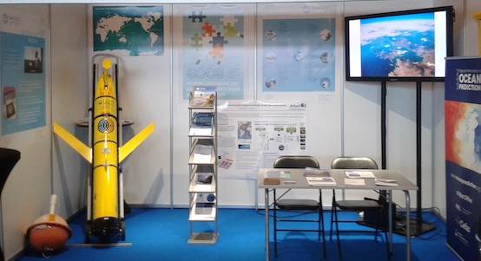
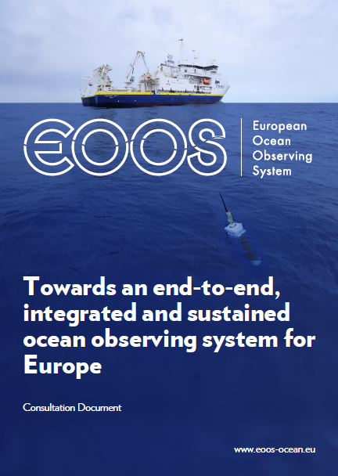
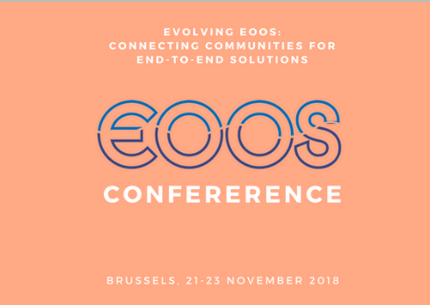



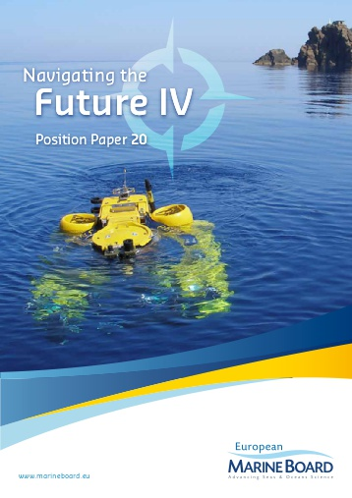



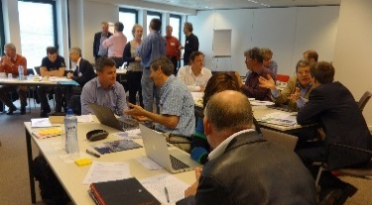
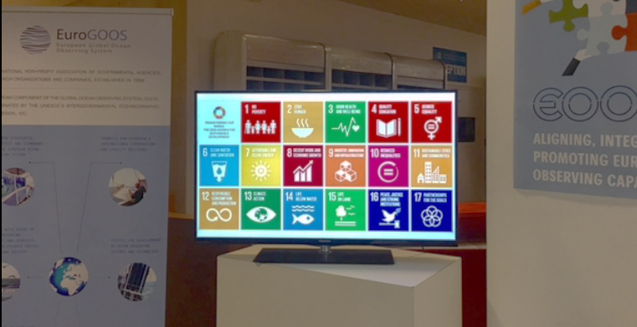
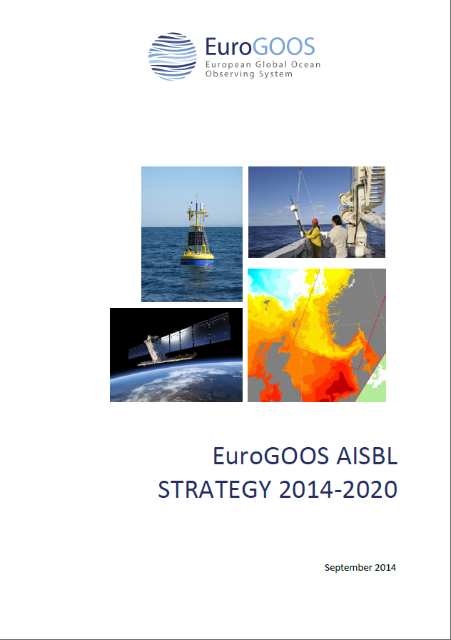

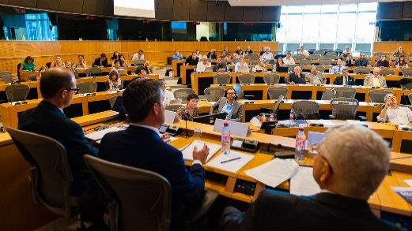
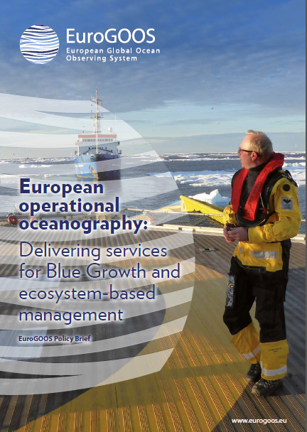
2007-2008: Integrated Maritime Policy; EuroGOOS and EMB deliver a vision document on an end-to-end, integrated and inter-operable network of ocean observing systems in Europe
2010-2014: EOOS in various strategy and policy documents
2015: EMB-EuroGOOS EOOS brainstroming workshop – 20 experts in personal capacity
2016: Setting up of EOOS steering group; EOOS consultation document; European Parliament event; logo; website; materials
2015-2017: Active EOOS promotion at events, conferences, exhibitions
Dec. 2016 – Jan. 2017: Open stakeholder survey based on the consultation document
2018: EOOS strategy and implementation plan; EOOS forum and EOOS conference in Brussels
2018
2017
2007
EOOS steering group to collect feedback on strategy and implementation plan at two events
2015
2016
Strategy-policy declation: EOOS a priority
Strategy-policy declation: EOOS a priority
www.eoos-ocean.eu
EOOS profiled in various exhibitions and events among others GEO, IOC, EMD
Visual identity and website
Integrated Maritime Policy
Strategy and policy documents feature EOOS
EOOS steering group launches open consultation
EMB-EuroGOOS Vision Document
Expert brainstorming
EOOS a key priority in EuroGOOS policy brief
EOOS event at European Parl.
www.eoos-ocean.eu
Dina Eparkhina, EuroGOOS

Slide 4
EOOS Stakeholder Consultation
Six weeks, 12 Dec to 22 Jan on www.eoos-ocean.eu
Aim: (i) Collect feedback on Cons. Doc and suggested early actions;
(ii) Gather new ideas; (iii) Demonstrate open and inclusive process
Disseminated by EuroGOOS and EMB – approx. 800 addresses (mailing, Twitter, website, hard copy dissemination, announcements at meetings)
High rate of responses through direct contacts
155 responses from 31 countries, 50% institutional (item 2)
Overwhelming support – we need an EOOS

Slide 5

EOOS Stakeholder Consultation – Cont’d
Help with funding support:
Identify funding priorities (EC, MS), investment planning, develop
multi-sectoral support to ocean obs, how to adapt to funding oscillations?
Support obs across all regions (poor regions, oversea terr, etc)
Reach out to ‘non-traditional’ stakeholders, new ways to support obs
Help reduce RI costs (use, re-use, joint use)
Help with science and policy support:
Have answers to sci and policy needs (requirement setting)
Gap analysis – what elements are missing
Coordinate infrastructures (with ESFRI) & technologies
Help data
integration, management, etc, incl. EOSC, big data
modelling
Help to build capacity, knowledge transfer, education and training
Help promote – why do obs, why fund obs
EC and MS (identify who to speak to)
One voice & Community forum
Open data
Ocean services & Ocean technologies
Local meetings, not only at EU level
Help link at all scales/ecosystems:
Deep sea, open ocean, coastal, rivers,
atmosphere, …
Ocean governance, resource exploitation
Link to users through existing networks + industry
(EMOD, Copernicus, ICES, GEOSS, JPIs, ERICs,
INSPIRE, Conventions, National networks, etc)
How to govern EOOS:
Mainly bottom-up/community with SG
Sustained, creative, purposeful community
Secretariat, perhaps delegated to existing bodies
Involving MS
Supervised by SG, perhaps with tech. advisory
committees/expert groups
Involve users as advisors (not in core gov.)
Need authority

Slide 6
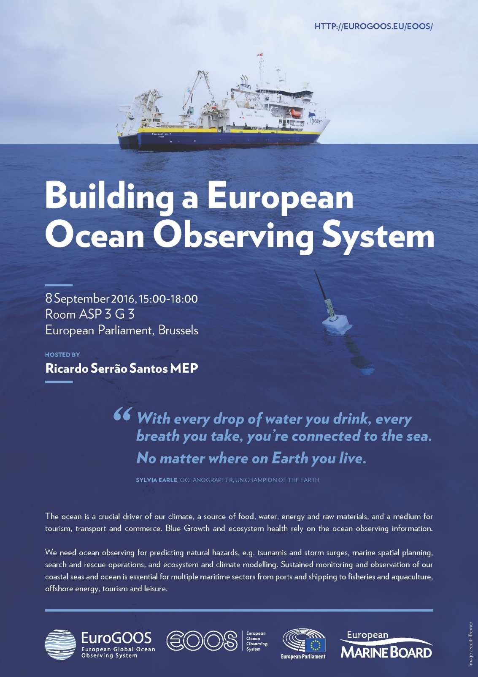
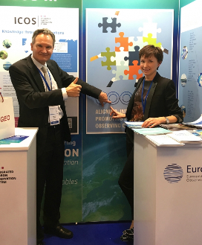
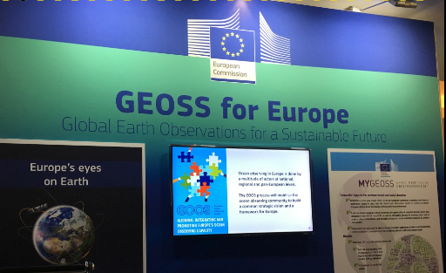
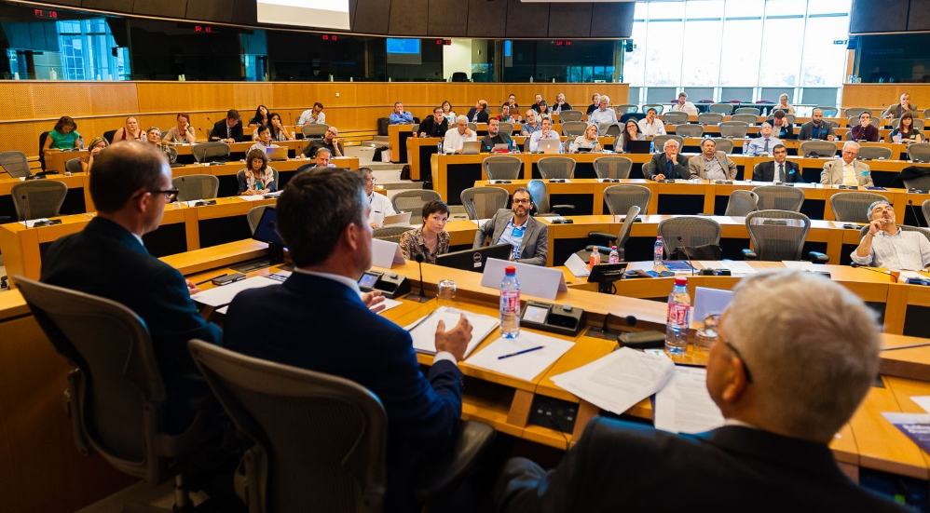
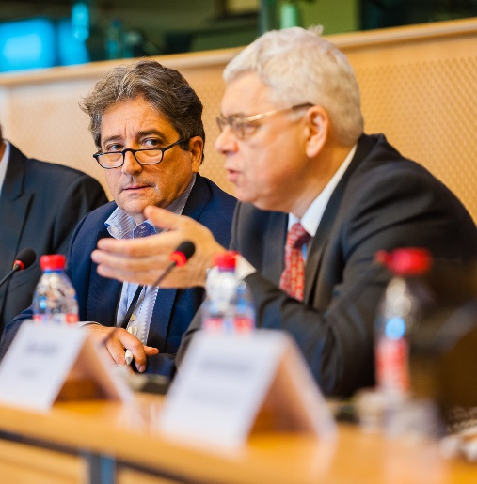

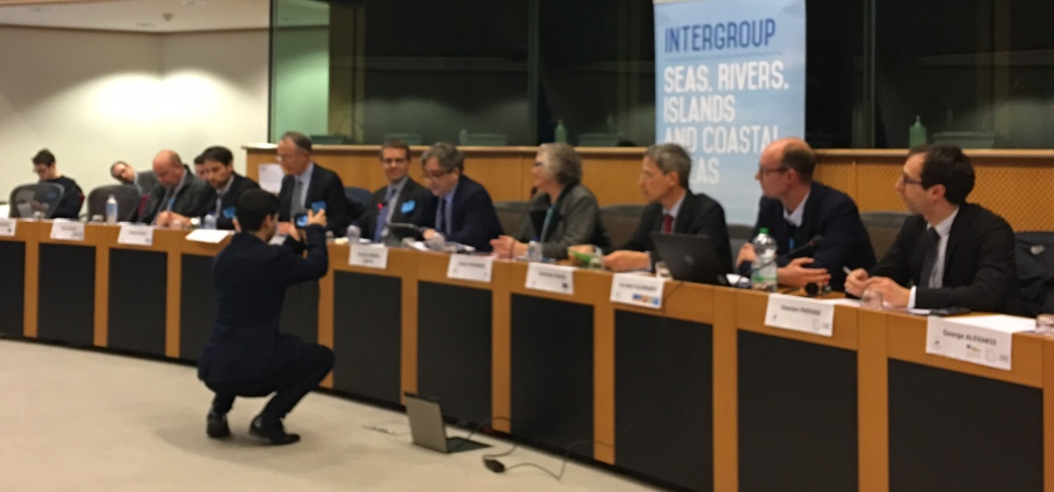
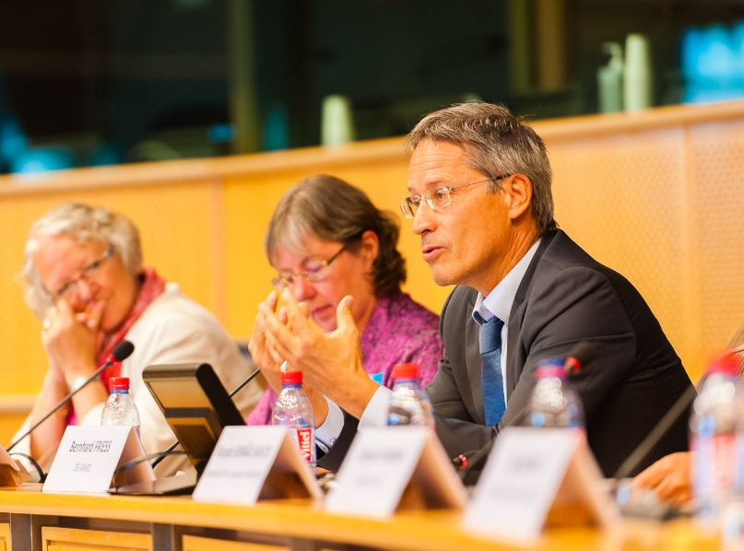
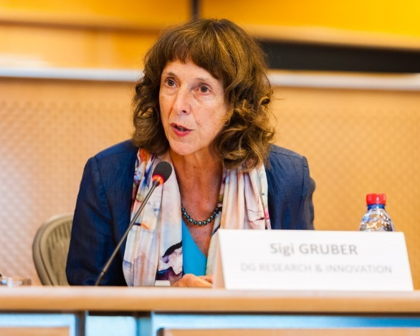
GOOS Regional Alliances Forum
GEO: Board, Projects Conference
Meetings with Commissioner Vella
Galway: Seabed Mapping WG
EOOS event at the European Parliament
CIESM Congress
COLUMBUS Conference
MRI meetings: Jerico, AtlantOS, Euro-Argo, FixO3, GAIC, ENVRI+
Exhibitions: EMD, UNESCO IOC World Oceans Day, EGU, AGU, IMDIS
EC Science and Business Forum
GEO-XIII Plenary
International MSP Conference, UNESCO
…

Slide 7
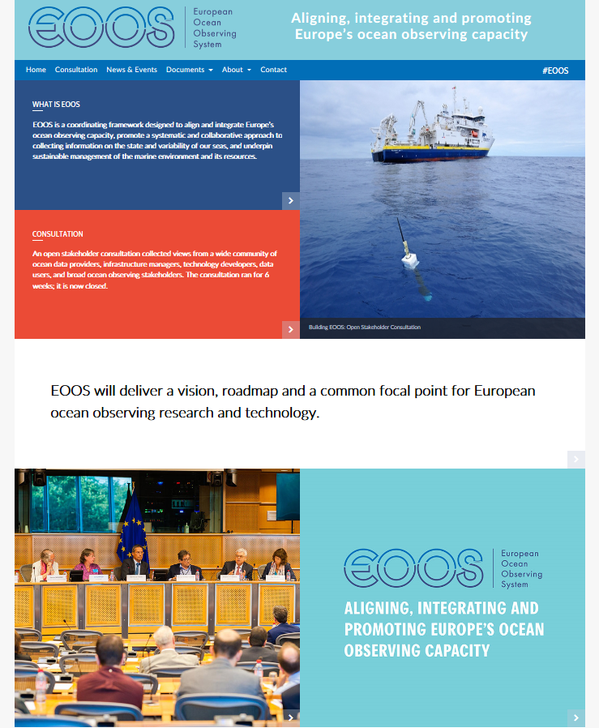

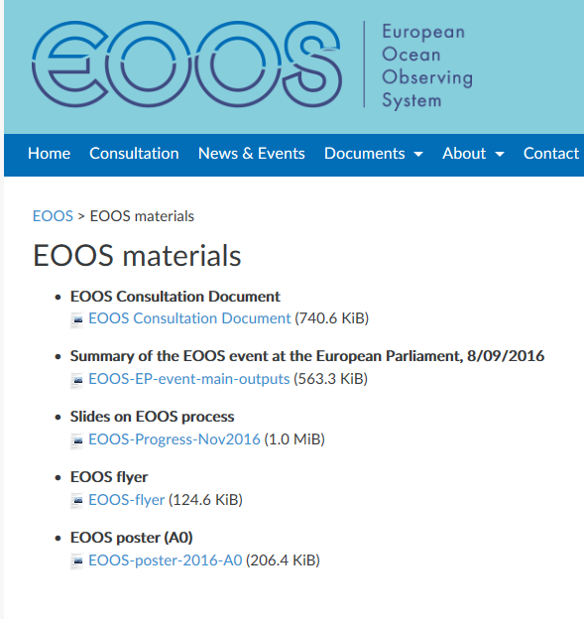


+
Relevant Materials
About: What is EOOS, Why, EOOS Progress
EOOS
www.eoos-ocean.eu

Slide 8

EOOS: proposed implementation activity
Fora
Conferences
OceanObs 19 White paper
Strategy and impl. Plan
Requirements gathering
Sustainability studies
System design tools
Foresight and global context
Stakeholder engagement
Foresight (EMB and others)
EC and member state project outcomes
Tracking policy context
Funding activity
Member state Statements of intent
Research infrastructure planning
Joint programming
EC support for EOOS
Influencing Member State funders
Implementation
6

Slide 9
EOOS: proposed implementation activity
Communications
Governance
Communications plan
EOOS web presence
Social media activity
Citizen science ??
Hosting of Steering Group
EOOS Advisory Group
Evolution of governance (sub-group of SG)
6

Slide 10
Sustainability
Future plans to apply to all platforms

Slide 11
EOOS events 2018
EOOS Forum (March 8th)
OceanObs Whitepaper submission (March-September 2018) pending abstract acceptance
EuroGOOS Sustainability Workshop (May 8th and 9th)
Blue Planet Symposium (July 4th to 6th, Toulouse)
EOOS Conference (November 21st to 23rd)
EMB Working Group activities
EuroGOOS Coastal working Group (membership call imminent)
Others we should include??
Notes:
a common vision on achieving an ecosystem approach to the management of Europe’s marine resources as a fundamental requirement for sustainable Blue Growth.

Slide 12


Forum
8 March 2018
The Royal Belgian Academy of Sciences
Brussels
Conference
November 2018
TBD
www.eoos-ocean.eu

