Slide 1
The Marine Research Opportunity
Professor Edward Hill
Executive Director
National Oceanography Centre, UK
Meeting with Commissioner Vella, 2nd March 2016

Slide 2
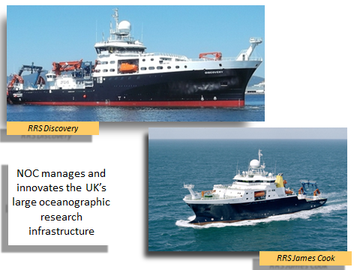
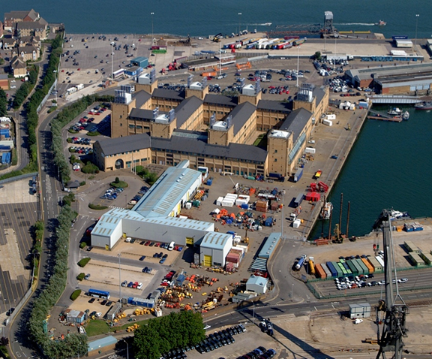
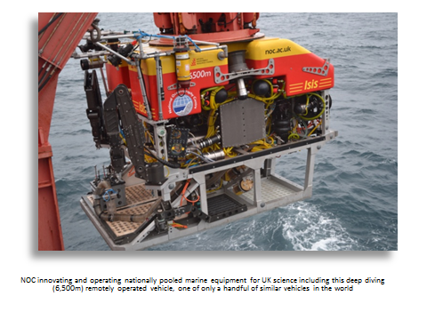
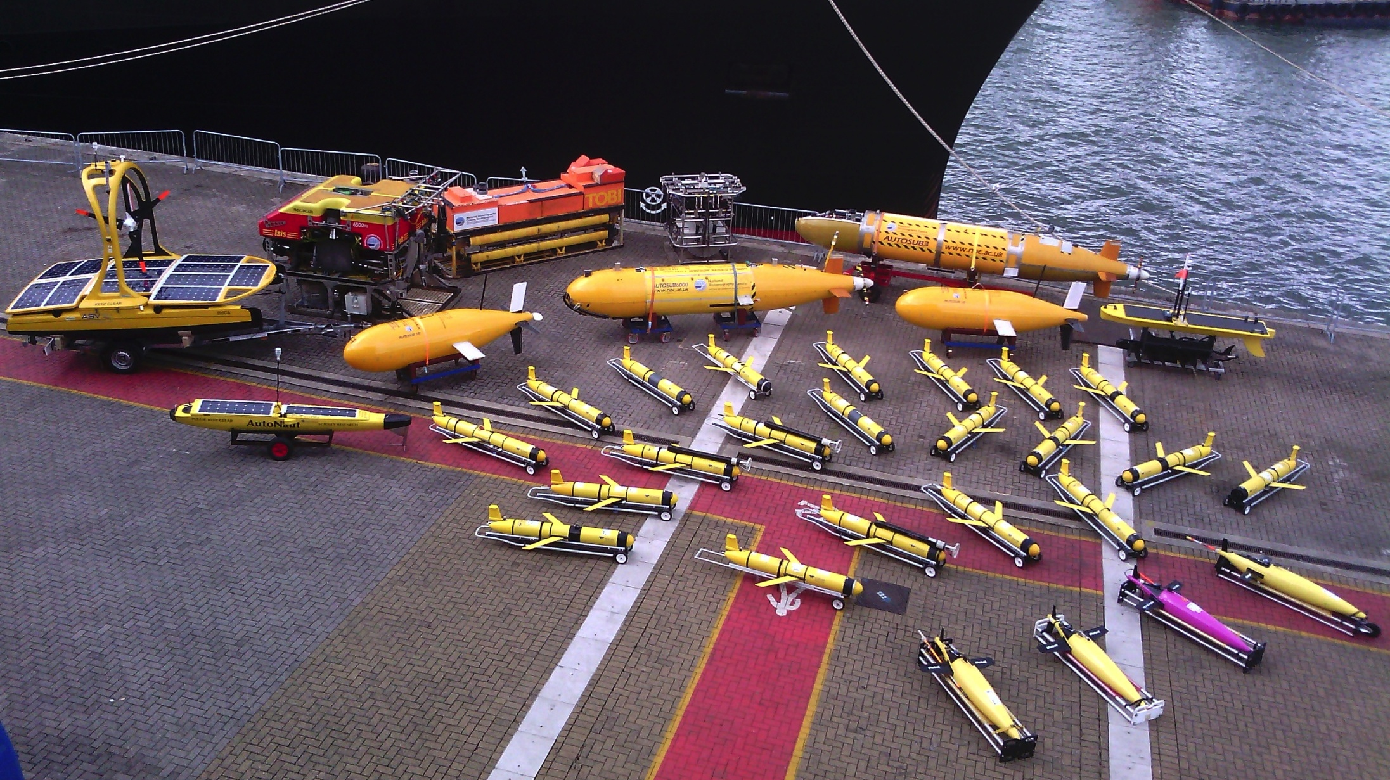
National Oceanography Centre, UK

Slide 3
Attention is urgently turning to the ocean
9 billion people by 2050……
….most living in low-lying coastal plains and
coastal mega-cities
secure natural resources
Continual
observations and data
increase
resilience to disasters
make sense of global change & variability
protect ocean future productive capacity
support
better ocean governance
Notes:
These key drivers require us to capture vast amounts of data to allow us to develop a fundamental understanding of the rapidly changing environment that is the ocean
Marine Autonomy provides a cost effective way of getting the right the right sensor to the right location to capture the data we need, without the need for the human in the loop

Slide 4
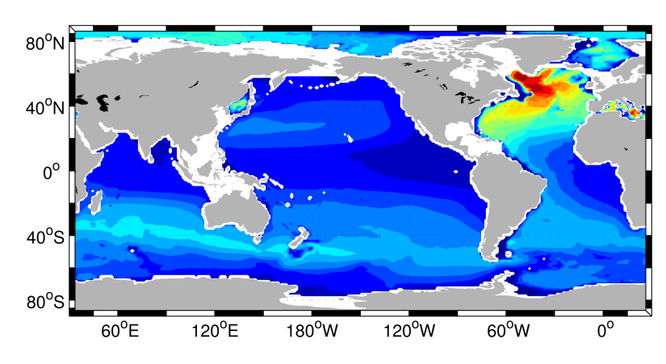
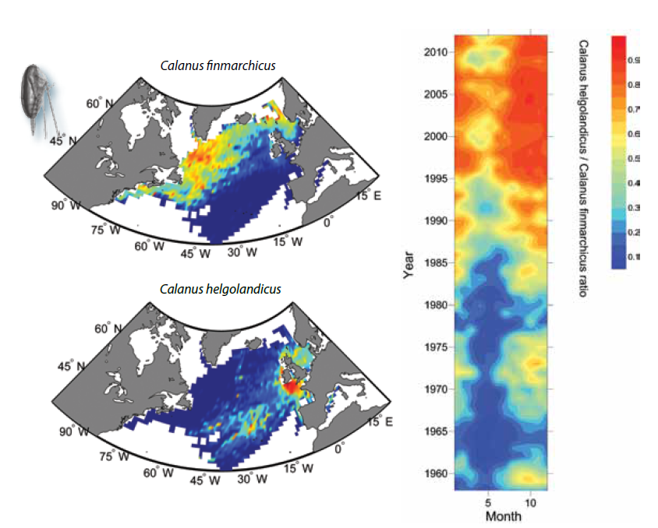
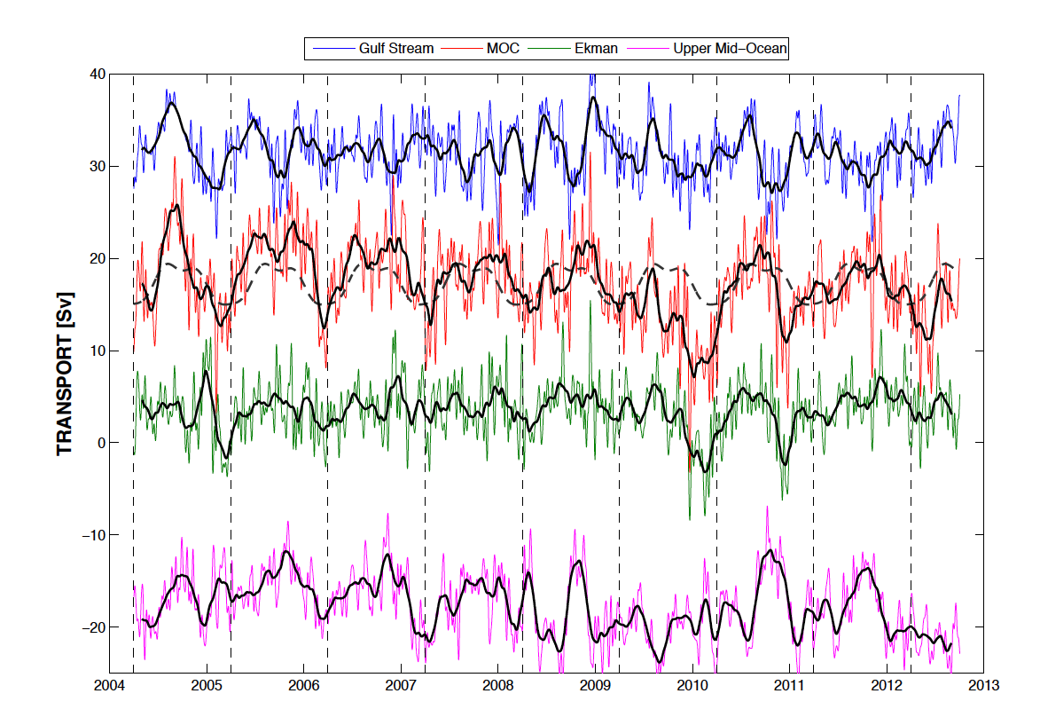
Making sense of change - a question of scale
Anthropogenic carbon storage
Sea surface temperature anomaly
10 years
50 years
Basin-decadal scale matters to people
- a lot!
Surface plankton
Atlantic Overturning Circulation

Slide 5
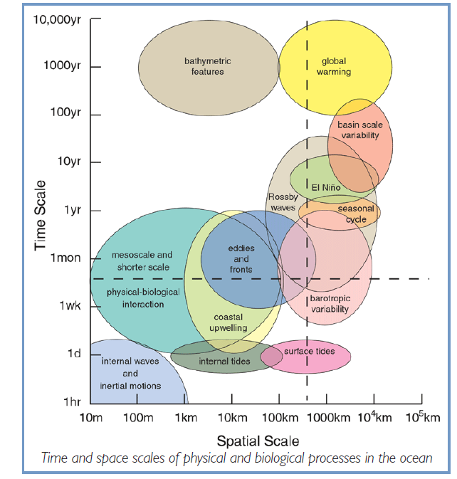
The basin-decadal scale is crucial
Physical and biological change
- climate
- chemical cycles
- ecosystems
- tipping points
Human time-scales
Important natural variability
Includes regional seas
(if viewed holistically)
-
Ocean is variable at all scales

Slide 6
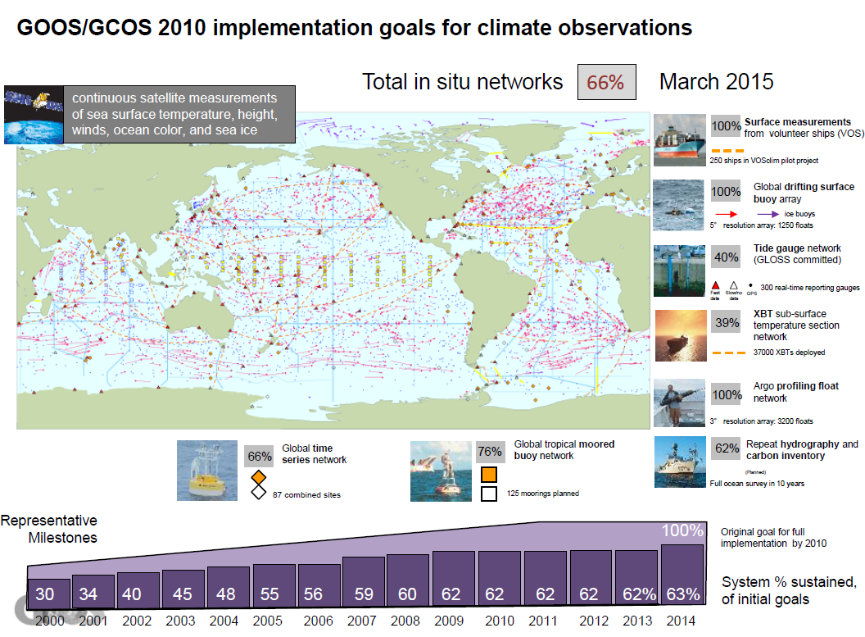
Needs a special measurement platform
Global Ocean Observing System (“The CERN of the Ocean” )
Satellite AND “in-water” systems
Today it is incomplete and mostly physical properties (climate), upper 2km, research funded

Slide 7
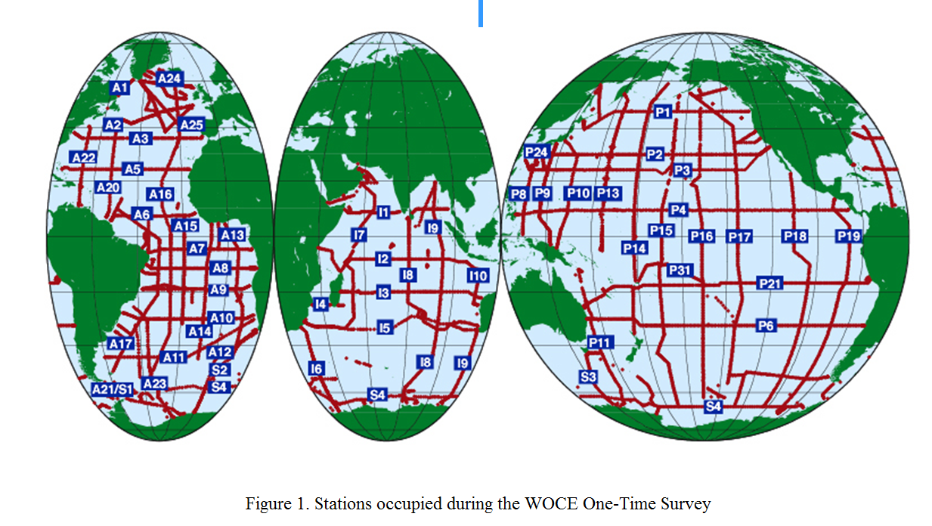
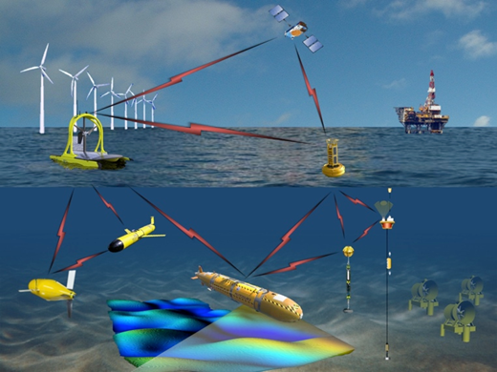
At the cusp of a revolution:
Disruptive technologies set to transform ocean observations
The World Ocean Circulation Experiment 1990-2000 “all day, every day” plus biology
autonomous platforms
biogeochemical sensors
big data
Notes:
Our journey of supporting marine autonomy businesses’ started with the first SBRI competition
This led to the development of 2 platforms created by local businesses that are now competing on the global stage

Slide 8
Priorities
Scientific and Technical
Biogeochemistry & ecosystem parameters
Depth below 2km
Continual presence
Political
Suitable international framework (e.g. GEO)
Sustained funding mechanisms (for “in water” system)
Political impetus (G7, SDG14, EC)
Suggested enabling action
Technical and Economic Assessment of the benefits of the Global Ocean Observing System

