Slide 1
EUROPEAN OPEN SCIENCE CLOUD Thematics 2017-2020
Presentation for RTD.F4 – BLUE CLOUD Brussels, 28.03.2017
P.O. Mihaela MERESI RTD.A.A6.EOSC-Team European Commission
DG RTD
Notes:
1. The European Open Science Cloud is the key component of the European Cloud Initiative, launched by the Commission on 19 April 2016, as part of the Digital Single Market Strategy
The EOSC will offer 1.7 million European researchers and 70 million professionals in Science and Technology a trusted environment to store, manage, analyse and re-use scientific data across disciplines and borders

Slide 2
CONTENTS
In the beginning …
Why and How?
What now?
What next?
DG RTD

Slide 3
COM 2016/178 - European Cloud Initiative : 3 pillars (19 April 2016)
https://ec.europa.eu/digital-single-market/en/news/communication-european-cloud-initiative-building-competitive-data-and-knowledge-economy-europe
1. European Open Science Cloud (EOSC)
Integration and consolidation of e-infrastructures
Federation of existing research infrastructures and scientific clouds
Development of cloud-based services for Open Science
Connection of ESFRIs to the EOSC
2. European Data Infrastructure (EDI)
Development and deployment of large-scale European HPC, data and network infrastructure
3. Widening access and building trust
eGovernment (EU eGovernment Action Plan 2016-2020 – accelerating the digital transformation of government) SMEs, industry, citizens.
DG RTD

Slide 4
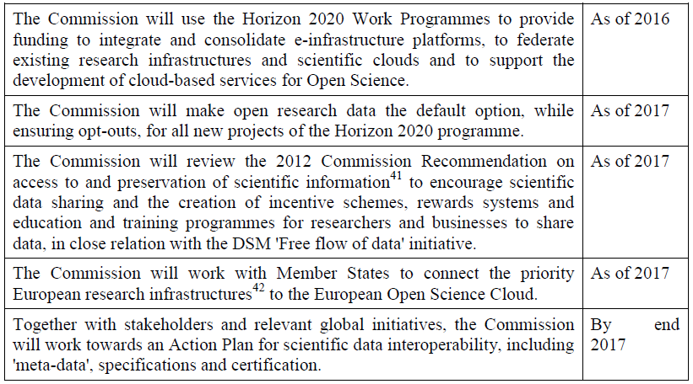
Vision & Action
European Open Science Cloud (EOSC)
OECD, RDA, G7
WP2018-20
01.01.2017
EG on Rewards & EG on Skills
FAIR Action Plan
DG RTD

Slide 5
Our Mission in DG RTD:
We have to deliver the European Open Science Cloud (1st stage implementation)
by 2020
DG RTD

Slide 6
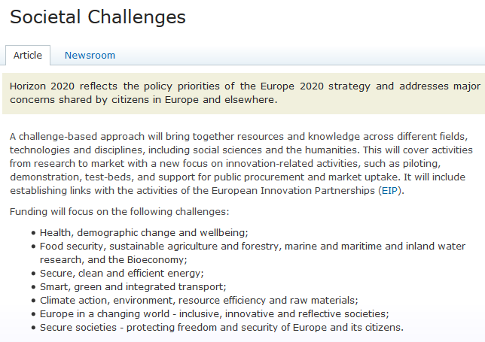
Thematic clouds
WP 2018-20
DG RTD
Notes:
Thematic clouds, as we call them, are the research results and data sets generated by the European wealth of H2020 projects (and also previous FPs, sometimes as far as FP3, in the case of Blue Cloud). These projects were designed to answer Societal Challenges and these research data must converge, more and more, towards the European Open Science Cloud, to ensure long term sustainability. At the moment, a huge amount if research data is lost, after the life of the funding grant. These thematic clouds benefit already from the support of their scientific communities and other relevant stakeholders, therefore the bottom up approach to integration/federation of resources is highly needed.
Defragmentation of (thematic) research infrastructures, reducing duplication of costs and increasing efficiency and long term sustainability of these infrastructures, including e-infrastructures, are amongst the objectives of the EOSC. In addition, defragmentation process of governance and funding models will progress towards a single governance structure and an innovative co-funding mechanism, both nourished bottom up, by the user communities (European researchers).
https://ec.europa.eu/programmes/horizon2020/en/h2020-section/societal-challenges

Slide 7
Work in progress in DG RTD
What now?
EOSC from concept to implementation: EOSC App (one stop shop for science)
Governance (interim EOSC governance board to be launched in 2017)
adequate level of representativeness (different fields of science, different countries);
group that brings together a critical mass of data infrastructures, take stock of what already exists, oversee the development of Science Cloud and its services, seek consensus on standards, and be a source of advice for the Commission (including for preparing the WP)
EOSC (co)funding model: an urgent task.
DG RTD

Slide 8
What now?
EOSC Pilot project outputs expected – 2017-2018
To support the EC in the first stage implementation of the EOSC
Focus on:
Governance and Policy
Science Demonstrators and Services
Interoperability
Skills
Stakeholder Engagement
http://cordis.europa.eu/project/rcn/207500_en.html
http://www.eoscpilot.eu/
DG RTD

Slide 9
What next?
Setting up EOSC first stage implementation
EOSC Summit on 12 June 2017 (endorsing statements)
Declaration of intent & Coalition of the Willing - end of summer 2017
Funding decision on EOSC in WP 2018-20 – Oct2017
Roadmap for governance and funding – Nov 2017
Interim EOSC governance board – winter 2017
EOSC Web App - spring 2018
FAIR Action Plan - summer 2018
CAB REQUEST H2020 (WP 2018-20) to support
Open Data & EOSC (3 O's Strategy)
Independent expert studies are being launched by the EC, in March-April 2017, expecting results before the end of 2017, (alternative models of governance and co-funding of the EOSC).
The H2020-funded projects EOSCpilot (DG RTD) and elnfraCentral (DG CNECT), both launched in January 2017, and the project resulting from the Call EINFRA-12-2017 (DG CNECT) will provide key building blocks in 2018, of the future shaping of the EOSC.
The first Report and Recommendations provided by the HLEG-EOSC in 2016
DG RTD

Slide 10
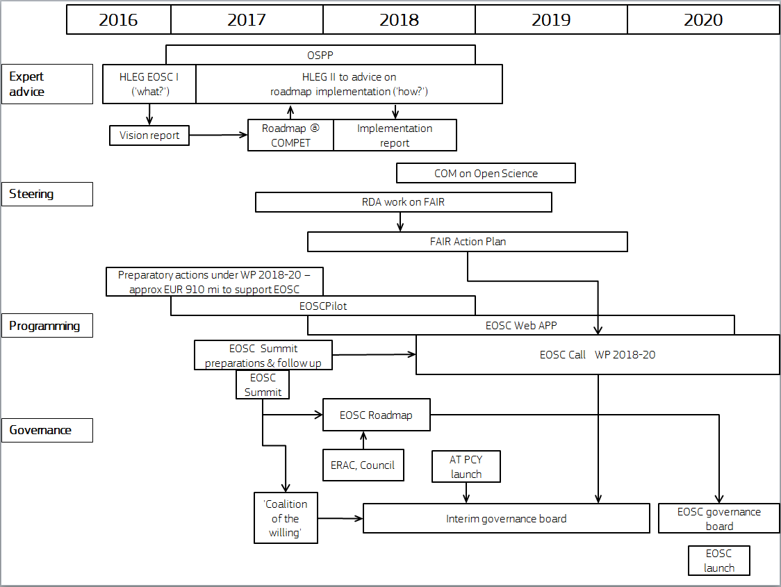
What next?
DG RTD

Slide 11
General orientation
Focus points in thematic workshops & policy debates:
How to create a culture of data stewardship in your thematic community and the role of funding agencies;
Mapping the types of data and Data Management Plans (DMPs);
FAIR principles in thematic communities and across disciplines and other borders; (European open research data circulated within the EOSC will be findable, accessible, interoperable and reusable)
Research data infrastructures and services for European scientists (projects, ESFRIs / ERICs , national nodes, clusters; how they work together/ decision flows, funding models etc.);
Thematic cloud/s architectures, functionalities, funding mechanisms and governance models already in place, existing federations, assessing potential of interdisciplinarity (e.g. Blue and Food, Blue and Health, Blue and Citizens/SSH etc.);
Needs assessment / mapping the needs of your scientific community/ scientific discipline and proposing next steps/ action plans
DG RTD

Slide 12
Website
http://ec.europa.eu/research/openscience/eosc
E-mail RTD-EOSC@ec.europa.eu Mihaela.MERESI@ec.europa.eu
DG RTD

