Slide 1
CISE
TESTA Introduction
November 2015

Slide 2
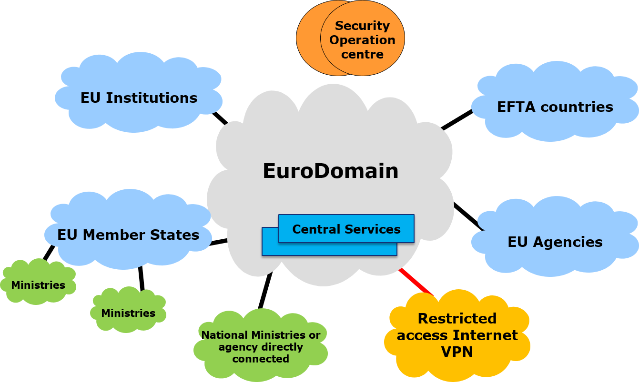

Introduction
TESTA
Mission
Facilitate cooperation between public administrations in various policy areas by consolidating exisiting networks and by providing a secure, reliable and flexible communication service layer.
TESTA – Trans European Services for Telematics between Administrations – is a data communication network service provided by the European Commission. It provides garantueed performance, high levels of security and has connections with EU institutions and agencies and national networks of EU Member States.
The EuroDomain provides the common telecommunications infrastructure for the trans-European network. This network interconnects the Local Domains, which are national, regional or local administrative networks.
2

Slide 3
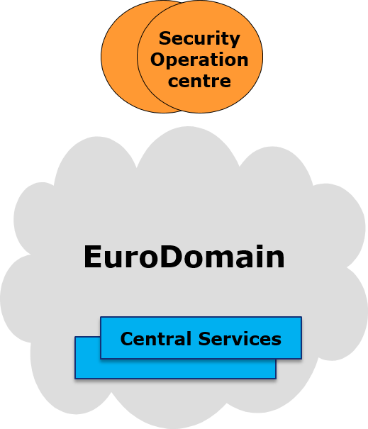
Introduction
TESTA services
TESTA has a Support and Operations Centre (SOC). The SOC is responsible for providing operations and support for the EuroDomain and its services. Support is provided 24/7.
TESTA also provides a set of supporting services, including:
Mail relay
DNS services
Network Time Protocol
Secured FTP
Secured email
Web collaboration tool
Dedicated secured complimentary services (e.g. private cloud services hosted in dedicated data centres)
3

Slide 4
Introduction
TESTA objectives
TESTA focusses on six objectives to provide an optimal quality of service
TESTA Objectives
1 Connectivity
4 Support
  TESTA provides a highly available, extendable, flexible and secure communication infrastructure to interconnect public administrations in Europe. This to tackle both current and future needs for inter-administration communication.
  TESTA provides a Single Point of Contact for all its support functions to be offered to the different sectors and administrations, alert management and reporting.
2 Consolidation
5 Management
  TESTA consolidates existing data networks currently spread over different contracts and independently managed by different public administrations in Europe.
  To ensure successful operations of TESTA in the future, the European Commission is carefully managing the future stages of the project, including service management and administrative management activities of the TESTA networking services.
3 Security
6 Monitoring
  TESTA provides a secure network infrastructure which is RESTREINT.
  TESTA ensures dedicated monitoring and audit of the operational networking services

Slide 5

Questions

