Slide 1
Status and Trends of
Chinese Marine Spatial Planning
Lu Wenhai Zhao Rui
Brussels, Belgium
2 June 2017

Slide 2
Contents
Chinese Context of MSP
Chinese MSP System
Trends of Chinese MSP
Suggestions on international Cooperation

Slide 3
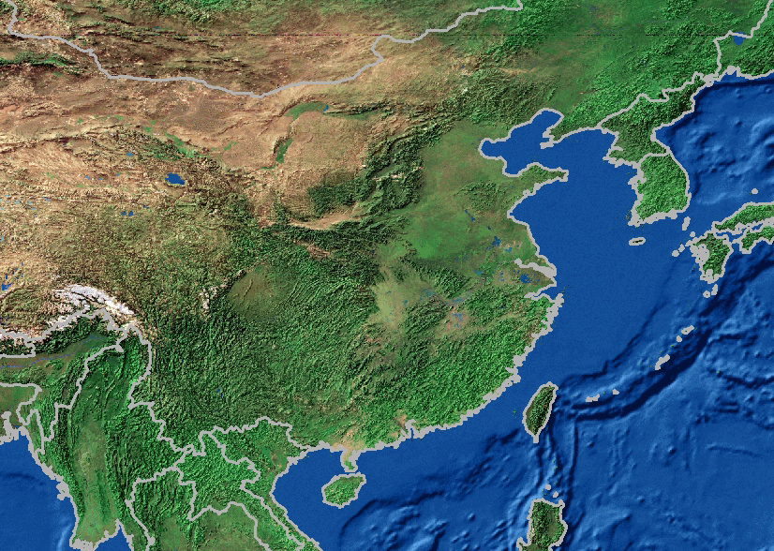
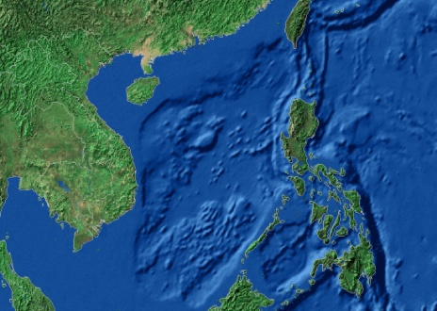
Chinese Context of MSP
General Ocean and Coastal Information
18,000Km coastline
Ocean economy 10% of national GDP
7300 islands (over 500 square meters)
34 National Natural Reserves (19400 square KM)
11 Coastal Provinces with 9% of the world Population

Slide 4
Chinese Context of MSP
National Economic and Social Development Planning
comprehensive Planning
Space Utilization Planning
Land
Environmental Protection Planning
Regional Planning
Ocean
Cities and Towns
Specialized Planning
industry
agriculture
forestry
energy
water conservancy
transport
Marine major function-oriented zone planning
marine functional zoning
Chinese National
Planning System
Land
Ocean
marine environmental protection planning

Slide 5
Contents
Chinese Context of MSP
Chinese MSP System
Trends of Chinese MSP
Suggestions on international Cooperation

Slide 6
Chinese MSP System
Strategic MSP
Marine Major Function-Oriented Zone planning
Basic unit: the whole ocean area under the administration of the county-level government
Hierarchy of MMFOZ planning: National, Provincial
foundation
and basis
Specific
MSP
Marine Functional Zoning
Basic unit: relatively integrated geographic unit
Hierarchy of MMFOZ planning: National, Provincial, city and county
Other MSP
Redline for the protection of ecological regions
Island protecting plan
Notes:
Marine Major Function-Oriented Zone Planning（MMFOZ Planning）is an important attempt in Chinese Marine Spatial Planning Since the beginning of the new century, and it has been raised to the national strategic level in the field of ocean development.

Slide 7
Chinese MSP System
Marine Major Function-Oriented Zone Planning (MMFOZ Planning)
Goal of MMFOZ planning
Chinese MMFOZ Planning is an comprehensive marine spatial planning, based on resource and environmental carrying capacity, current development state and future development potential of different ocean areas, aiming at realizing sustainable development of maritime space.

Slide 8
Chinese MSP System
Marine Major Function-Oriented Zone Planning (MMFOZ Planning)
Law and policy basis
Marine Environmental Protection Law
National Major Function-Oriented Zone Plan
Mission of MMFOZ planning
identify ocean functions
carry out division of major function-oriented zones
define the orientation of each major function-oriented zone

Slide 9
Chinese MSP System
Marine Major Function-Oriented Zone Planning (MMFOZ Planning)
Types of MMFOZ
Development-optimized area. Optimization is carried out at two levels. One is the optimization of marine spatial structure. Enlargement of ocean exploitation scale will be controlled in this type of areas, the focus of future development should be increasing the yield of per ocean unit. The other is the optimization of development mode, aiming at developing new green industries with high technology and added value.
Development-prioritized area. This kind of zone has the priority to enlarge the industrial sea use appropriately and establish modern industrial system.

Slide 10
Chinese MSP System
Marine Major Function-Oriented Zone Planning (MMFOZ Planning)
Types of MMFOZ
Development-restricted area. This type of areas are divided into the fishery industry-related area and ecology-related area. The orientation of the fishery industry-related area is to ensure the food security of the country or region. They can also develop industries in a way suitable for local conditions. For the ecology-related areas, the primary mission is to restore the ecosystem, protect the environment, and provide ecological products.
Development-prohibited area. This type of areas specifically refers to natural reserves and islands with territorial sea base point. They should be mandatorily conserved according to laws, regulations and relevant plans.

Slide 11
Chinese MSP System
Index system of major function orientation identification
index | index | Development-optimized area | Development-prioritized area. | Development-restricted area
Resource and environmental carrying capacity | Utilizable ocean spacial resources | ※ | ※※ | ※※※
 | Environmental quality | ※ | ※※ | ※※※
 | Vulnerability of ecosystem | ※ | ※ | ※※※
 | Ecological importance | ※ | ※ | ※※※
 | Danger of natural disaster | - | - | -
Current development state | Degree of sea use aggregation | ※※※※ | ※※※ | ※※
 | Ocean economic development level | ※※※※ | ※※※ | ※※
 | Regional economic development level | ※※※※ | ※※※ | ※※
Future development potential | Transport superiority | ※※※※ | ※※※ | ※※
 | Ability of marine science and technology innovation | ※※※※ | ※※※ | ※※
 | Ability to manage pollutants from land | ※※※※ | ※※※ | ※※
※ represents the unit value of evaluation result

Slide 12
Chinese MSP System
Index system of major function orientation identification
Based on the index system, 3 types of MMFOZ are identified at the county level through a series of appropriate technical processes. Each coastal county is confirmed as a development-optimized area, development-prohibited area or development -restricted area.
Development-prohibited area is directly recognized by its definition.

Slide 13
Chinese MSP System
Development-prohibited area of Guangdong Province

Slide 14
Chinese MSP System
Evaluation of resource and environmental carrying capacity
Utilizable ocean spacial resources
Environmental quality
Vulnerability of ecosystem
Ecological importance
Danger of natural disaster

Slide 15
Chinese MSP System
Evaluation of current development status
Evaluation of future development potential
Transport superiority
Ability of marine science and technology innovation
Ability to manage pollutants from land

Slide 16
Chinese MSP System
MMFOZ of Guangdong Province

Slide 17
Chinese MSP System
Marine Major Function-Oriented Zone Planning (MMFOZ Planning)
Based on the requirements for each functional zone, in the 13th five-year, we will:
improve differentiated policies related to finance, industry, investment, sea use, and environmental protection while also implementing differentiated performance evaluation methods.
put into effect industry negative lists in key ecosystem service areas.
increase transfer payments to major fishery industry-related areas and key ecosystem service areas.
establish sound mechanisms for trans-regional compensation for ecological conservation efforts.

Slide 18
Chinese MSP System
MMFOZ and MFZ
coastal counties will make its MFZ(Marine functional zoning) based on the MMFOZ type, and its major functional orientation
SOA is working on the technical standard

Slide 19
Chinese MSP System
Marine Functional Zoning(MFZ )
MFZ, is a process to divide the sea into different functional zones with different environment quality requires in order to control and guide the direction of the sea use, aiming at making it clear that which kind of sea use are suitable, prohibited for the specific sea area.

Slide 20
Classification of MFZ
Chinese MSP System
Harbor and Channel Zone | Harbour area
 | Channel area
 | Anchor ground area
Fishery Resources Utilization and Conservation Zone | Fishing port and Fishery facilities basic building area
 | Breed area：Harbour area、Shoal area，Shallow sea area
 | Proliferate area
 | Fishing area
 | Important Fishery breed protected area
Mineral Resources Utilization Zone | Oil gas area
 | Solid mineral area
Tourist Zone | Scenery tourist area
 | Travel resort area
Seawater Resources Utilization Zone | Salina area
 | Peculiar industrial water area
 | General industrial water area
Ocean Energies Utilization Zone | Tidal energy area
 | Tidal current energy area
 | Wave energy area
 | Temperature difference energy area
Sea Area for Engineering Use | Submerged pipeline area
 | Petroleum platform District
 | Make area around the sea
 | Coast protected project area
 | Bridge area across the sea
 | other protective sea use area
Marine Protected Area | Marine nature reserve
 | Special protection area of ocean
Special Use Zone | Experimental area of science and study
 | Military affairs area
 | Drain contamination area
 | Dump area
Reserved Zone
MFZ can be divided into 10 types
And 10 types are composed by 32 subtypes.

Slide 21
Five basic principles of MFZ
Chinese MSP System
Scientifically defining the functions of the sea areas in light of such natural attributes as their geographical location, natural resources and natural environment;
Making overall arrangements for the use of sea areas among various related sectors according to the needs of economic and social development;
Protecting and improving the ecological environment, ensuring the sustainable utilization of the sea areas and promoting the development of the marine economy;
Ensuring the maritime traffic safety;
Safeguarding the security of national defense and guaranteeing the needs in the military use of the sea areas.

Slide 22
Contents
Chinese Context of MSP
Chinese MSP System
Trends of Chinese MSP
Suggestions on international Cooperation

Slide 23
Trends of Chinese MSP
Land-ocean integrating MSP
SOA is currently working on Protecting and Developing Plan of Chinese Coastal area. This plan is going to be the first land-ocean integrating MSP in China.
Sea and land of coastal areas are considered as a whole;
Implement ecosystem-based integrated management
Further optimizing the urban spatial distribution and industrial layout

Slide 24
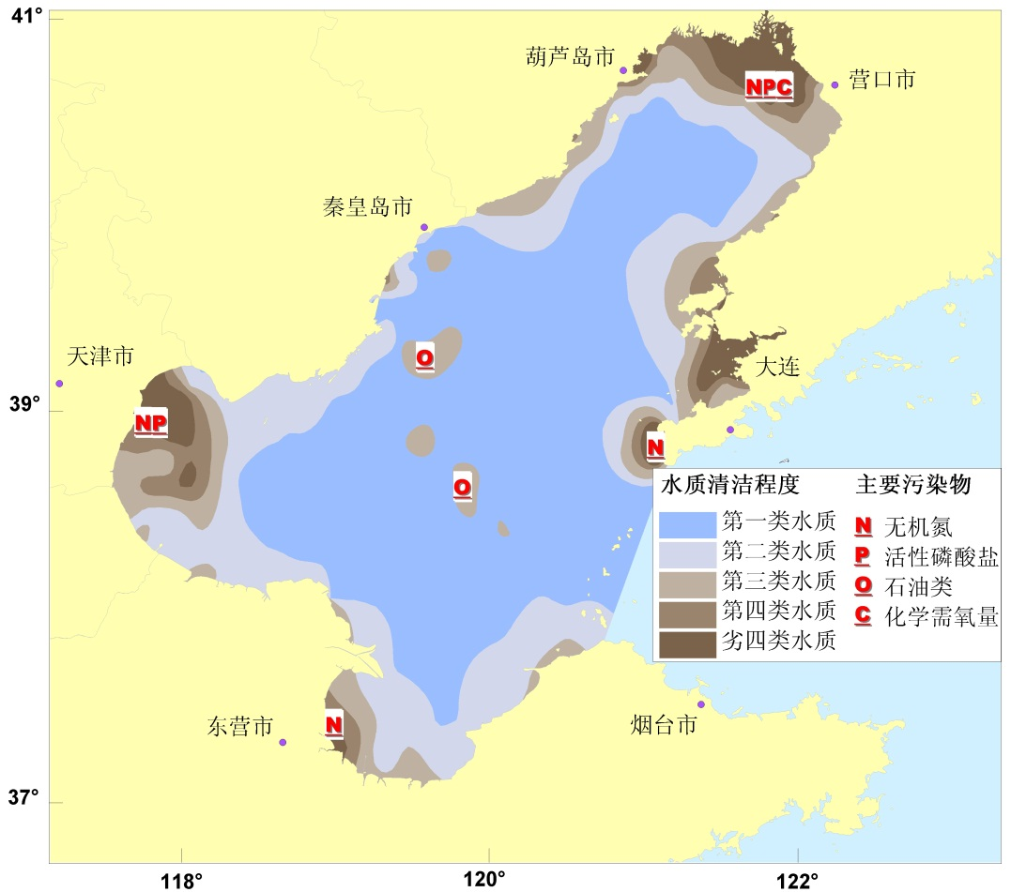
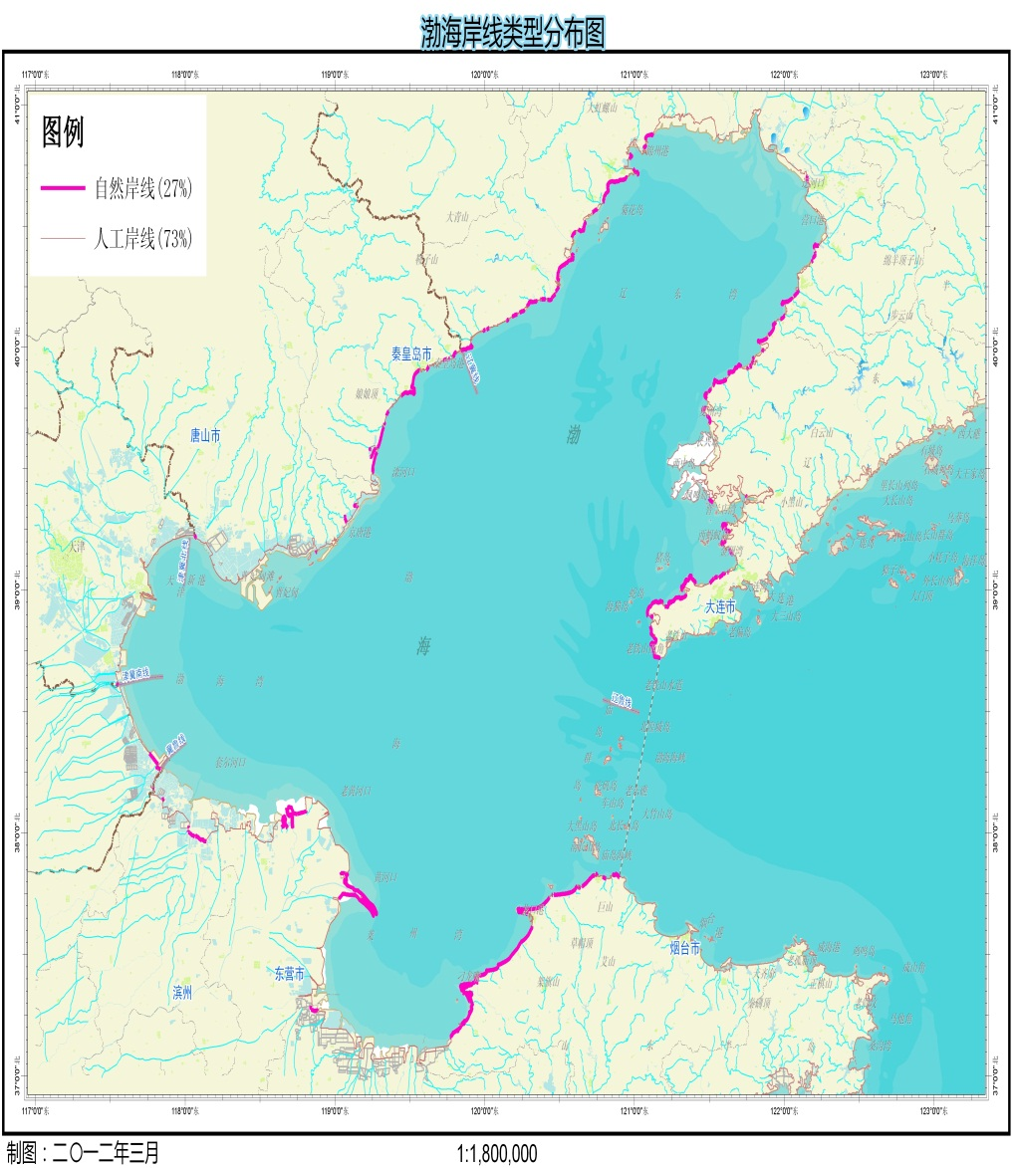
Trends of Chinese MSP
Strictest reclamation management.The boundary of reclamation prohibited area will be made clear through MSP. SOA has released an policy on the environmental protecting of Bohai sea, by this policy no reclamation will be approved in the coming years.
Water quality and main pollutants in the Bohai Sea Shorelines distribution in the Bohai Sea

Slide 25
Contents
Chinese Context of MSP
Chinese MSP System
Trends of Chinese MSP
Suggestions on international Cooperation

Slide 26
Suggestions on international Cooperation
We propose that EU and China cooperate in the following areas:
Improving the theory of MSP. Although about 60 countries have their own MSP initiatives, MSP is still in its infancy stage, so it should be a great idea for China and EU countries to cooperate on improving the theory of MSP and establishing standard for the MSP process.

Slide 27
Suggestions on international Cooperation
Since the definition of stakeholder engagement is widely variable across countries, and its scope and effectiveness is difficult to validate, we would love to start cooperation with researchers of EU countries on how to get stakeholders involved in MSP.

Slide 28
Suggestions on international Cooperation
We are also interested in collaborating with EU countries on:
monitoring and evaluation of MSP plans
Trans-boundary MSP
MSP in the Arctic Ocean
MSP in the High Seas

Slide 29
Thanks for your attention!

