Slide 1
Towards European Integrated ocean Observation Commission expert group on marine observation infrastructures
IMP – Member States' expert group meeting 11 December 2012 – Brussels
Waddah Saab – European Commission – RTD.H.2

Slide 2
Work and Objectives of the expert group
Composition and work of the group:
Framework ←→ EU strategy for marine and maritime research
18 experts covering main fields of expertise in ocean observation and all sea basins;
Met 9 times between March 2012 and Sept 2012 – report finalised in November 2012;
Mandate:
Value of and funding opportunities for MRIs;
Gaps and needs in marine research infrastructures (MRIs) for ocean observation;
Governance of EU marine research infrastructures ←→ long term sustainability and synergy at European level.

Slide 3
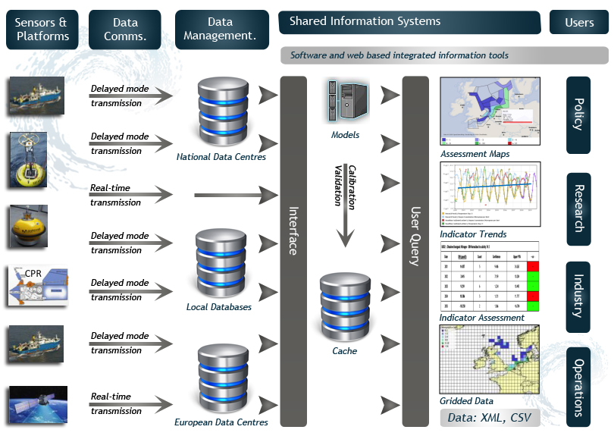
MRIs for ocean observation – What are they?

Slide 4
Ocean observation technologies
A data processing chain:
Sensors (physical, chemical, biological, geological, acoustic, optical…)
Fixed or moving platforms
Data transmission technologies
Digital models →end products and visualisation tools
Ocean observation is inter-disciplinary (engineering, ICT, biomaterials & nanotechnologies, environmental science – biology…)
It underpins all marine / maritime activities
It is in itself a growing and highly innovative sector

Slide 5
European distributed MRIs
Categories of MRIs | Marine Research Centre 1 – MRC1 in country A | MRC2 in country B | … | MRCn in country X | … | MRCp in country Y | Distributed European Scale MRIs or projects for European governance of MRIs | European data management Initiatives | Integrated European Marine Observation Initiatives
Drifting floats |  |  |  | X |  |  | EURO-ARGO | SeaDataNet EMODNET ELIXIR | GMES
Seabed observatories | X |  |  |  |  | X | EMSO
Buoys / Moorings | X |  |  |  |  | X | EURO-SITES (project)
Oceanographic vessels |  | X |  | X |  | X | EUROFLEETS (project)
Gliders | X |  |  | X |  |  | GROOM (project)
… |  |  |  |  |  |  |  |  | EuroGOOS
Marine biodiversity databases |  | X |  | X |  |  | EUR-OBIS |  | JERICO Project - Joint European Research Infrastructure network for Coastal Observatories
Model organisms / genet. databases |  | X |  |  |  | X | EMBRC
Plankton databases |  | X
Ferryboxes |  | X |  | X
Fish captures |  | X |  |  |  |  | EU Fisheries Data Collection Framework
Satellite Remote Sensing

Slide 6
Investing in MRIs – Value
Impact and value in 4 main areas:
Support the maritime economy (Blue Growth)
Marine environment stewardship (MSFD - GES)
Prediction and mitigation of climate change impact
Marine safety - hazards
→Framework for socioeconomic impact assessment of MRIs
Value of coordinating MRIs investments at European level
Ocean challenges (Blue Growth, MSP, GES, Climate impact) also have a regional or European scale ←→ coordinated investments
Giving access to marine data across sectors at European level (EMODnet) is a source of immense value

Slide 7
MRIs: starting with the needs
Policy / Societal needs e.g.
Global Environment change - MSFD | 1. Biodiversity, alien species, fish stocks, food webs, seabed integrity / habitats 2. Eutrophication 3. Hydrographical conditions 4. Contaminants 5. Litter – 6. Noise / Energy
Ocean / Climate interactions | 1. Ocean circulation system, ocean / atmosphere interactions 2. Impact of climate change on marine environment 3. Impact of climate ch. on coastal areas
Socio-economic needs | Marine Energy / Transport… Biological / mineral resources MSP / ICZM - Marine safety - hazards Weather -climate-seasonal forecasting
Key parameters | Existing Infrast./proj.
Fisheries Plankton Chloro-phyl … ??? | EU Fish data collect CPR Ferryboxes Satellite EMBRC
T, salinity Pressure CO2, pH … | ARGO EMSO EUROSITES TENATSO Rapid-Array SIOS…
Bathym. Geology Sismic data wind, wave Ecosystems | EMSO EMBRC Vessels / multibeam sonars…
Full and
Open
Exchange
Of
Data
Across
Initiatives &
Projects
E
M
O
D
N
E
T
Science
Needs
-
Major
User of
Data

Slide 8
Key recommendations – 1
Investing in MRIs-funding
Structural funds are a potential source of funding for MRIs (~ € 330 billion in (2014-2020), > 25% of which for R&I)
Bridge the gap between the regional rationale of SF and the European rationale of large distributed MRIs
Explore opportunities for PPPs
Give access to marine data
EMODnet must become operational, building upon SeaDataNet
Stewardship of data (NODC) at national level is crucial
Cooperation with Member States in JPI Oceans could be useful

Slide 9
Key recommendations - 2
Move towards European Ocean observation capacity
EMODnet is part of a broader picture including MRIs, GMES, WISE-Marine…
We need a European vision for ocean observation to provide convergence and coherence between all initiatives ←→ Marine Knowledge
Boosting innovation and filling gaps in ocean observation
We need innovation to fill gaps (e.g. biochemistry) & develop promising technologies (e.g. marine genomic and acoustic observation), which can make major breakthroughs in relation to e.g. ocean resources or pressures on biodiversity
We need innovation to reduce costs of data collection
We need to fill geographical gaps, particularly in shared seas / third countries ←→ coordinate MS and Commission marine scientific cooperations for capacity building

