Slide 1
Integrated Sea Information System for
Offshore Wind
John Shaw, CIO Mainstream Renewable Power
08 June 2011

Slide 2

Introduction
By 2050 there will be a transition to large-scale Offshore Wind Farms in the North Sea.
The Supergrid will enable efficient distribution of this new energy resource
An Integrated Sea information System is needed to accelerate this transition: ISIS.
To create ISIS, new policies, new standards, greater cooperation and innovative Information and Communication Technologies are needed.

Slide 3
Open Integrated Seabed Information System
Mainstream Renewable Power
Offshore Wind in Europe
Offshore Wind Developers’ needs
Supergrid’s needs
Data Management initiatives
Integrated Sea Information System
Next Steps

Slide 4
Open Integrated Seabed Information System
Mainstream Renewable Power
Offshore Wind in Europe
Offshore Wind Developers’ needs
Supergrid’s needs
Data Management initiatives
Integrated Sea Information System
Next Steps

Slide 5
Vision
Mainstream Renewable Power was founded by Dr. Eddie O’Connor in February 2008.
“ Our vision
is of thriving economies and communities
liberated from the restrictions of fossil fuels,
using
renewable energy
as their
mainstream source of power. “
The world is experiencing a once-off historical transition to sustainable fuels: Each one of our 195 countries must go through it.
4 fundamental issues drive this transition ;
    Climate change
    Ever-increasing Demand for Energy
    Rising Fossil Fuel Prices
    Energy Security
This Vision demands a strong Business Model

Slide 6
Mainstream’s Business Model
Sustainability as a business is what we do at Mainstream : wind & solar.
Mainstream’s business model spans 4 key areas ;
Government Policy
Project Development
Recycle
Cash
For New
Projects
Project Construction
Asset Operation & Maintenance
3 Revenue Streams =
Profit
from sale
Long-term
O&M contract
Asset out-performance fee
A sustainable pipeline of Renewable Energy projects secured

Slide 7
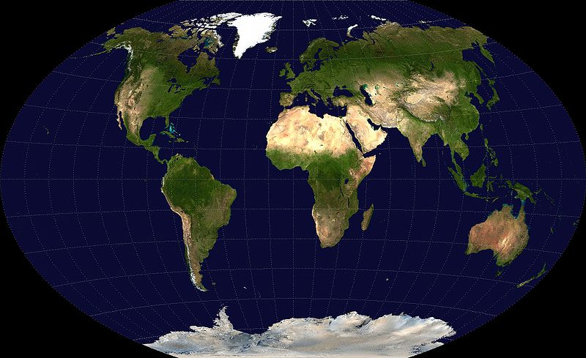
Mainstream’s 14,000+ MW Projects’ Pipeline
420 MW : Scotland
1,000 MW : Germany
845 MW : Canada
6,000 MW : England
947 MW : USA
994 MW :Chile
4,086 MW : South Africa
Offices
Offshore
8 offices, 4 continents, 120 colleagues, growing fast
Onshore

Slide 8
Open Integrated Seabed Information System
Mainstream Renewable Power
Offshore Wind in Europe
Offshore Wind Developers’ needs
Supergrid’s needs
Data Management initiatives
Integrated Sea Information System
Next Steps

Slide 9
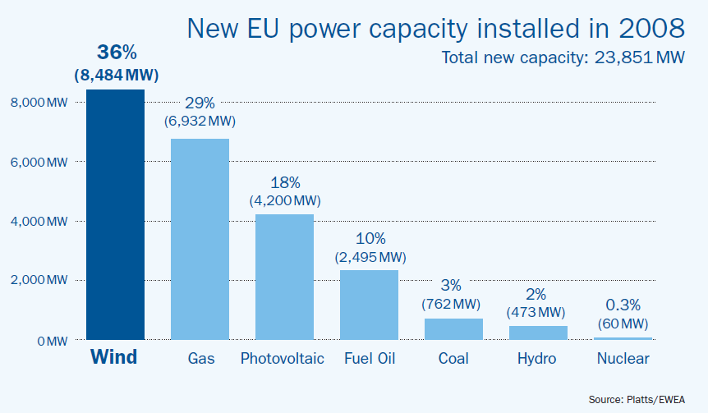
EU Energy Perspective : Current Investment Mix
> 50 % of new Generation Capacity from Wind & PV

Slide 10
EU Energy Perspective : Where is the Wind Resource?
1,800,000 MW of installed Wind Power needed by 2050
        Based on projected 2050 energy requirements
200,000 MW from Onshore Wind : the limit
        The limit because Europe is the world’s most crowded Continent
1,600,000 MW from Offshore Wind
        Plenty of space to grow beyond this target
        Achievable at €3,600,000.00 per MW installed
Equates to :
€5.8 Trillion investment in Offshore Wind Turbines by 2050.
€0.6 Trillion investment in associated Offshore transmission and distribution .
European Offshore Wind is a €6.4 Trillion Investment opportunity

Slide 11

EU Energy Perspective : 2050 Mix
Energy Demand
Offshore Winds farms are needed for Europe to meet Green House Gas Targets
Interconnection across EU member states is needed to enable Offshore Wind
Interconnection, or Supergrid is vital for delivery of any 2050 scenario
2020 offshore grid connections must be Supergrid-compliant
> 80 % of Generation Capacity will be from Wind & PV

Slide 12
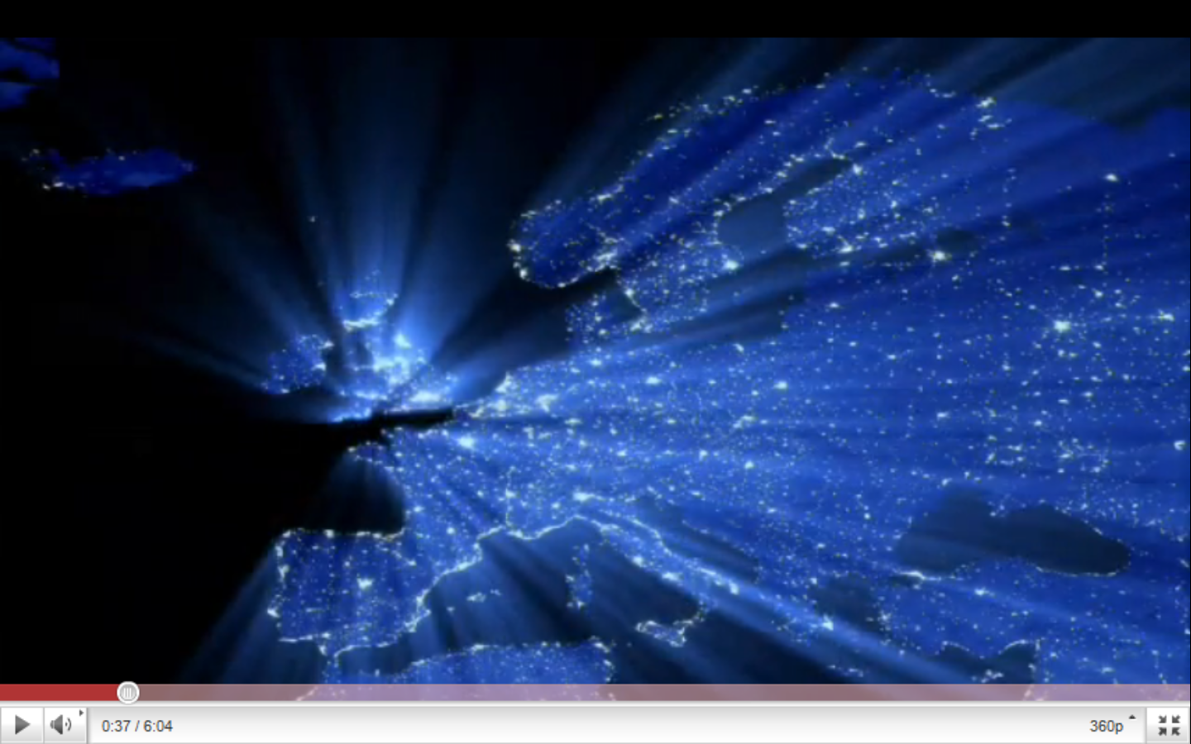
Video : 2050 Challenge
Click Here

Slide 13
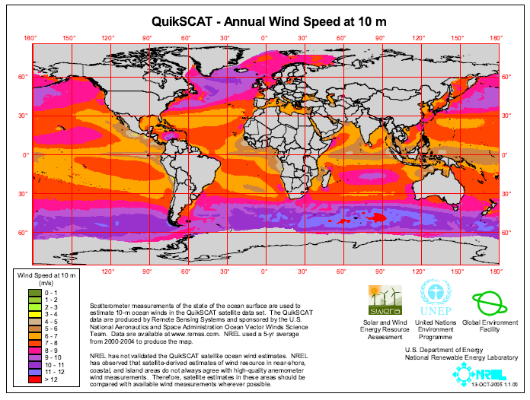
Offshore Wind Resource
Offshore Wind in the North Sea represents Europe’s best option

Slide 14
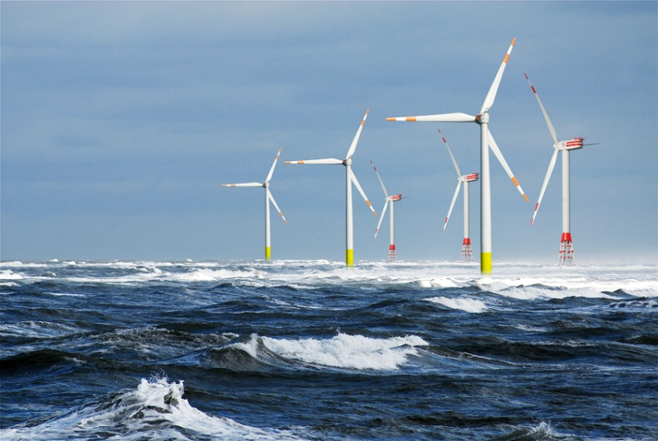
Europe’s Electricity Demand
Europe’s Power Demand
EU27 Demand (2008): 3,200 TWh
Offshore Wind Power Available
Area considered with 5MW/Km²
North Sea: 35,700,000 MW
Mediterranean Sea: 12,500,000 MW
Total 48,200,000 MW
Equates to: 161,000 TWh
Conclusion :
Demand 3,200 TWh
Supply 161,000 TWh
Supply v Demand x 50
Mr Brian Hurley, Wind Site Evaluation Ltd.
Offshore Wind Resources in Europe
Marseilles, March 2009
Offshore Wind in the North Sea can meet Europe’s need, 50 fold

Slide 15
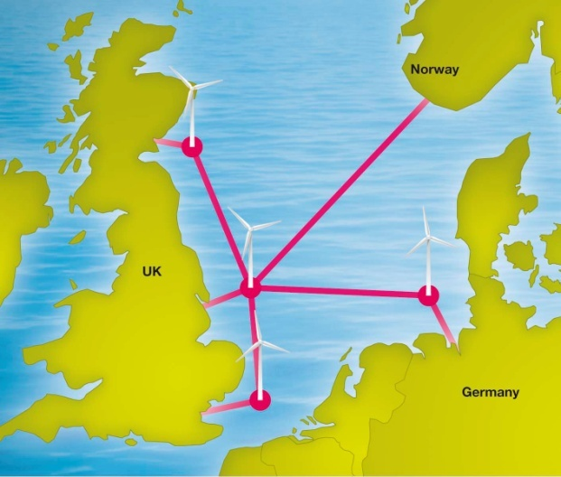
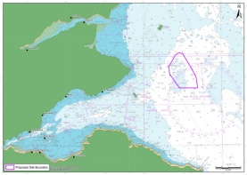
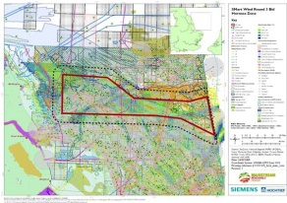
Mainstream’s Projects in the North Sea
Key Features
Excellent wind resource
Convenient location for major energy consumers
10 countries are now focused & organised to developing this resource
Mainstream has 3 projects in the North Sea:
  Germany
  Scotland
  England
33,000 MW of Offshore Wind Round 3 Development licences issued by Crown Estate in UK waters
420 MW
NEART NA GAOITHE
6,000 MW
1,000 MW
HORNSEA R3
HORIZONT
Offshore Wind Farms in the North Sea will deliver the EU Energy Strategy

Slide 16
Open Integrated Seabed Information System
Mainstream Renewable Power
Offshore Wind in Europe
Offshore Wind Developers’ needs
Supergrid’s needs
Data Management initiatives
Integrated Sea Information System
Next Steps

Slide 17
What Offshore Wind Developers Need
Mainstream’s fundamental belief is that marine data is a Public Good.
  It should be collected once and used many times.
Key needs ;
  Accessibility and Management:
    Clear policy of ownership, licensing & access for all publicly funded data collection
    Single point of access to marine data and information
    Discourage cost-recovery pricing from public bodies
  Data Standards and Quality control:
    Common standards across jurisdictions and disciplines
    Ensure the above is addressed in publicly funded data collection contracts
  International Coordination:
    Harmonised approach across the EU in relation to all of the above:
    Links provided and maintained to EU/global databases and initiatives
Benefits of improved data management ;
  Measurable reductions in costs to find, access and retrieve data
  Wider and more reliable data and information upon which to base assessments
  Mechanisms to share results and data with stakeholders
Offshore Wind Energy Developers want to reduce Project Risk

Slide 18
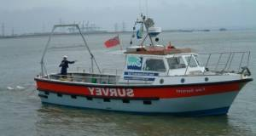
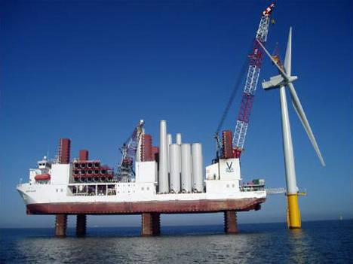
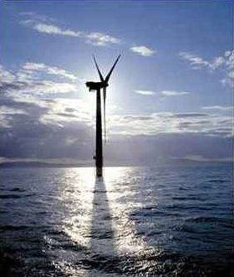
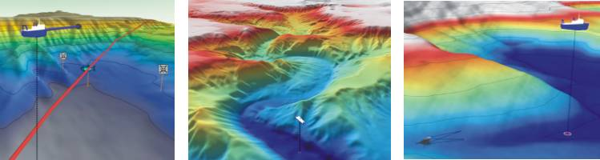
Offshore Business Process
5 % of the € 6.4 Trillion investment will be for ICT
Equates to € 320 Billion ICT investment
Survey
Construct
Operate
Business needs to...
Identify & Mitigate Risks
Accelerate Surveying
Accelerate Construction
Connect & Distribute Power
Information needed :
Surveying
Modelling
Turbine Control Systems
Wireless Communication
Power Distribution Management
Project & Document Management
Risk Management
Reducing Risk is all about Data

Slide 19
Open Integrated Seabed Information System
Mainstream Renewable Power
Offshore Wind in Europe
Offshore Wind Developers’ needs
Supergrid’s needs
Data Management initiatives
Integrated Sea Information System
Next Steps

Slide 20

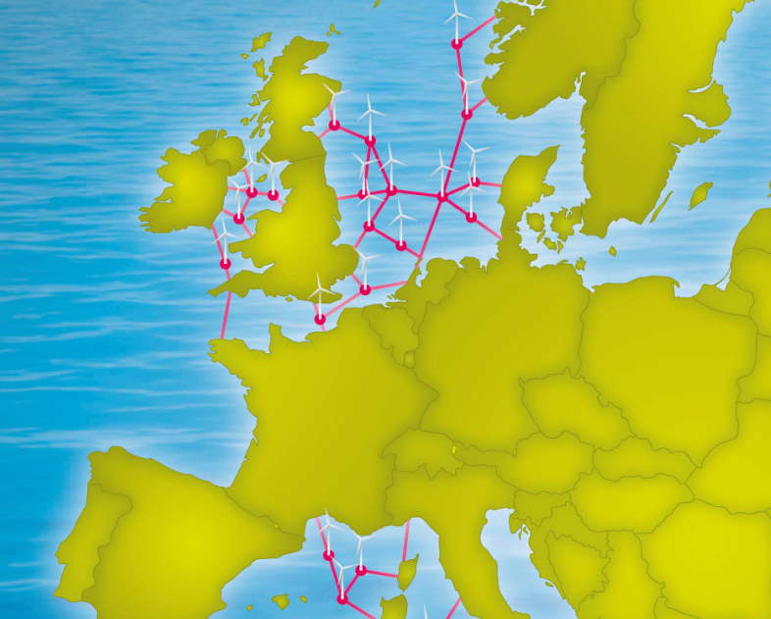
An electricity transmission system, mainly based on direct current, designed to facilitate large scale sustainable power generation in remote areas for transmission to centres of consumption, one of whose fundamental attributes will be the enhancement of the market in electricity.
Supergrid
Key Features
A new transmission backbone for Europe’s decarbonised power sector
Enables distribution of energy from 1,600,000 MW Offshore Wind Farms
A transformational approach to electricity generation and distribution
Captures clean energy generation and delivers firm renewable power across Europe
Goes beyond existing point-to-point interconnectors
Innovative technology needed to deliver HVDC Supernode technology
Requires a strategic partnership across the Supply Chain
Cost to build Europe’s Supergrid;
€0.6 Trillion Offshore Supergrid
€0.6 Trillion Onshore Supergrid
The wind is always blowing somewhere; Supergrid creates portfolio effect

Slide 21
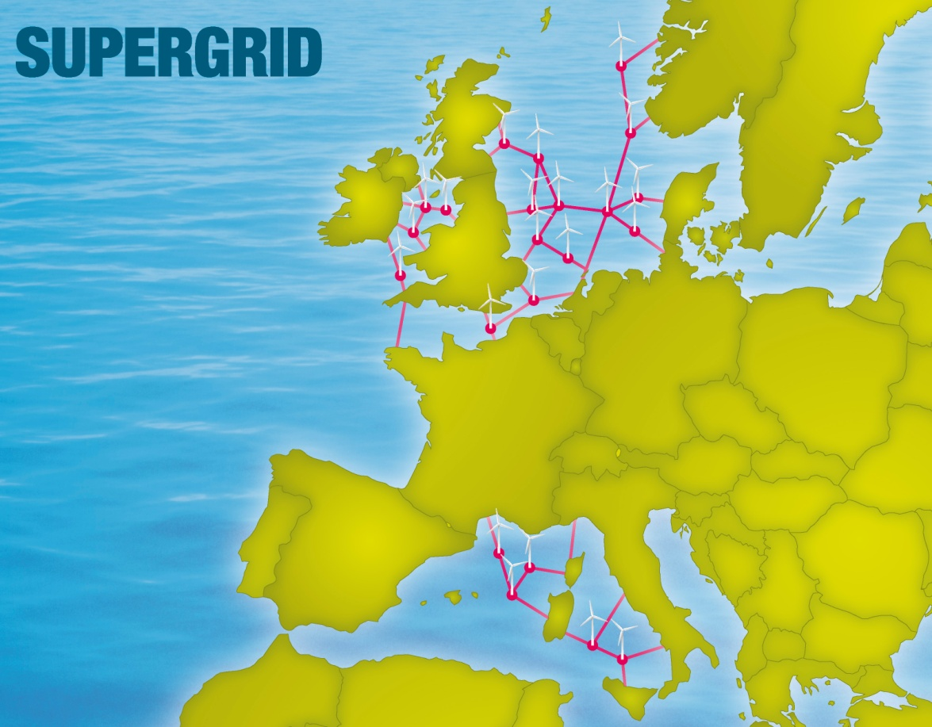















Supergrid Consortium
The consortium represents companies and organisations with a mutual interest in promoting the policy agenda for a European Supergrid.
CEO Ana Aguado run the Consortium which exists to accelerate the Supergrid via a 5 point strategy:
  Develop Standards
  Create Offshore Transmission Operator
  Establish EU Regulations
  Create Single Electricity Market
  Establish legal basis for trading
The Consortium has 20 members so far

Slide 22
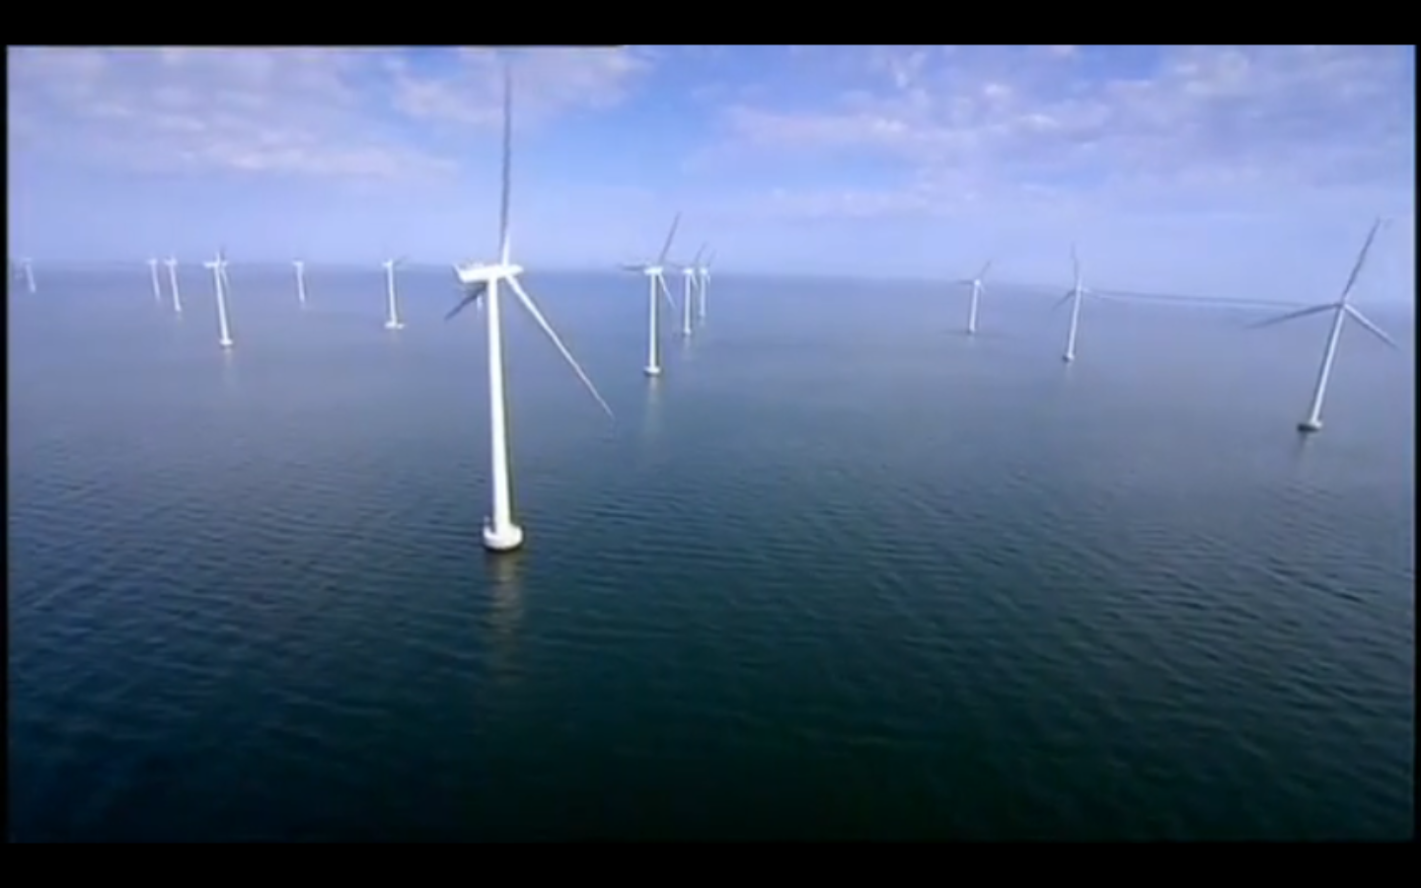
Video : 2050 Supergrid
Click Here

Slide 23
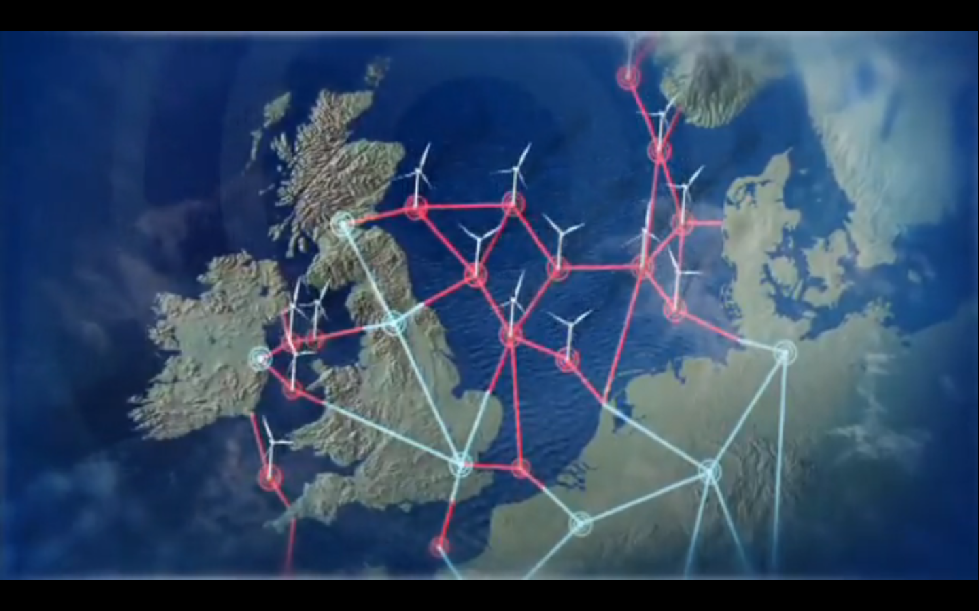
Europe’s Supergrid in 2050
7 Innovation Trajectories are needed;
Bigger Wind Turbines
HVDC Transmission Cables
Supernode
Next-Generation Civil Engineering
Bigger Construction Vessels
Bigger Ports
Better ICT
Dr Eddie O’Connor, Mainstream Renewable Power
Supergrid Launch
London, March 2010
An inevitable transition to Sustainability with 7 Innovation Trajectories

Slide 24
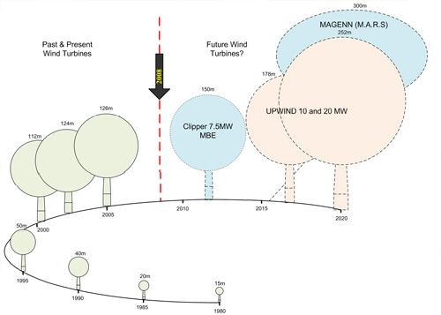
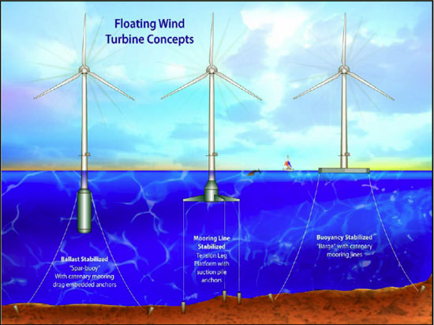
Innovation # 1 : Bigger Wind Turbines
Turbines will get bigger : 20 MW
Floating Turbines will be viable
Source: Garrad Hassan
Dr Eddie O’Connor, Mainstream Renewable Power
C & F Offshore Summit
London, April 2009
Bigger, better turbines are needed

Slide 25
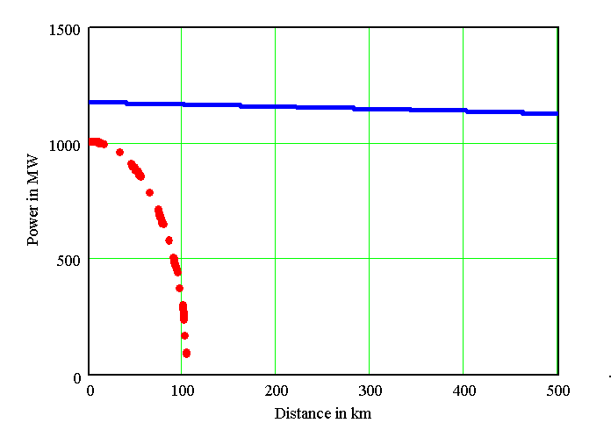
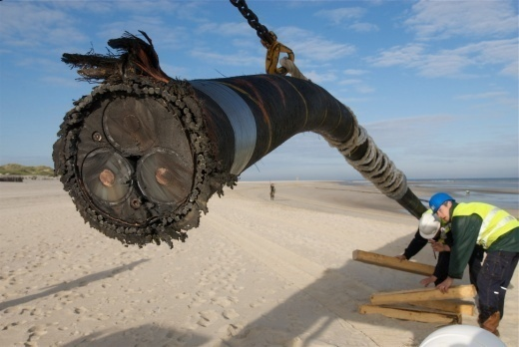
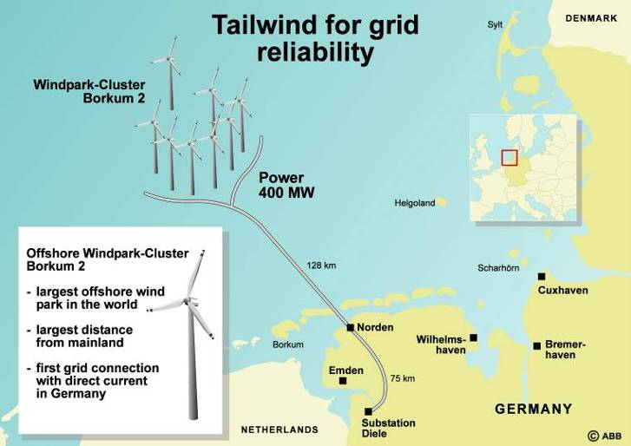
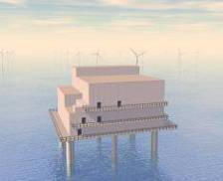

Innovation # 2 : HVDC Transmission Cables
Overhead Cables
Sea Cables
400 kV
AC line
Three 400 kV
AC cables
320 kV
DC line
Two 320 kV
DC cables
400 MW offshore
converter
128 km sea cable
75 km land cable
400 MW converter
E.ON Netz, Borkum 2, 400 MW HVDC Light
Mr Gunnar Asplund, ABB
HVDC Supergrid - Technology and Costs
Marseilles, March 2009
HVDC uses proven technology

Slide 26
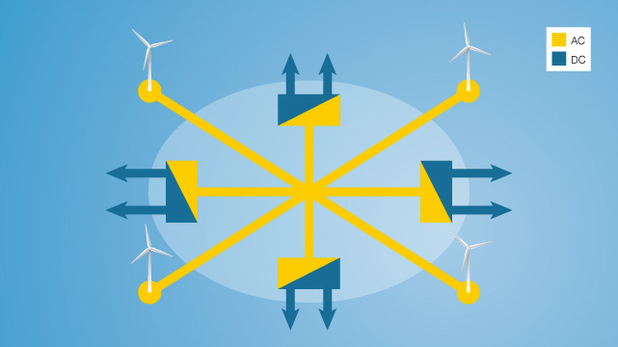
Innovation # 3 : Supernode
SUPERNODE CONCEPT
2 x 500MW
2.4GW
2 x 500MW
400kV
2.4GW
±320kV
Converter Station
±320kV
2.4GW
2.4GW
2 x 500MW
2 x 500MW
Mr Joe Corbett, Mainstream
Detailed design of the Supernode
Marseilles, March 2009
Supernode is a proven concept

Slide 27
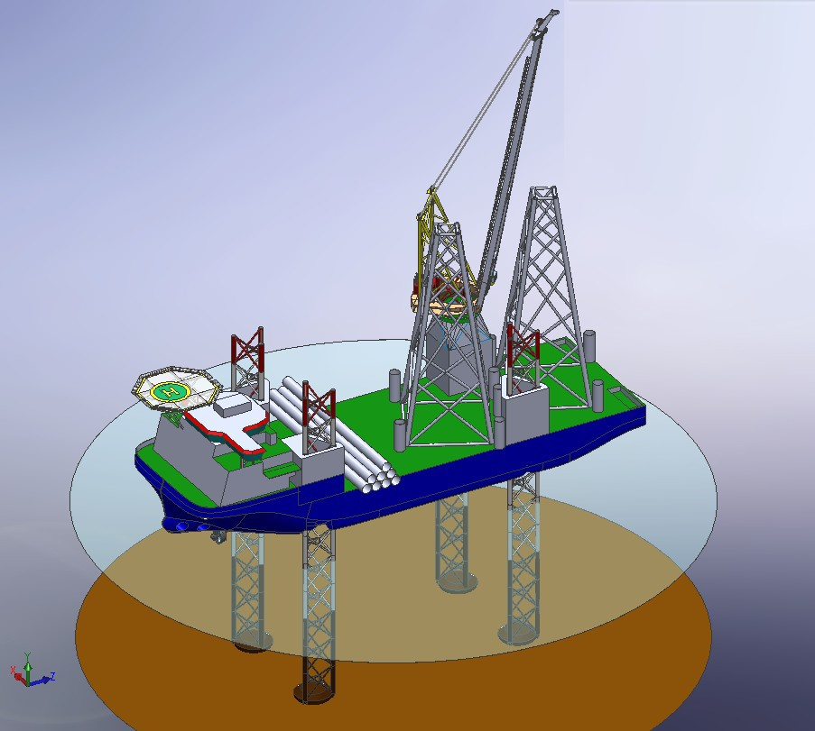
Innovation # 4 : Next Generation Civil Engineering
Offshore wind Jack-up
Crane Capacity
1 000 tonnes
Project Load
7000 – 10 000 tonnes
Mr Fenno Leeuwerke, Hochtief Construction
Building at Sea and 3rd Generation of Ships
Marseilles, March 2009
Bigger, stronger Jack-up Technology

Slide 28
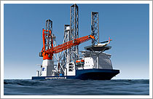
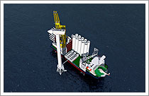
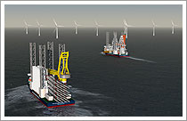
Innovation # 5 : Bigger Construction Vessels
Mr Fenno Leeuwerke, Hochtief Construction
Building at Sea and 3rd Generation of Ships
Marseilles, March 2009
Bigger Ships for bigger loads

Slide 29
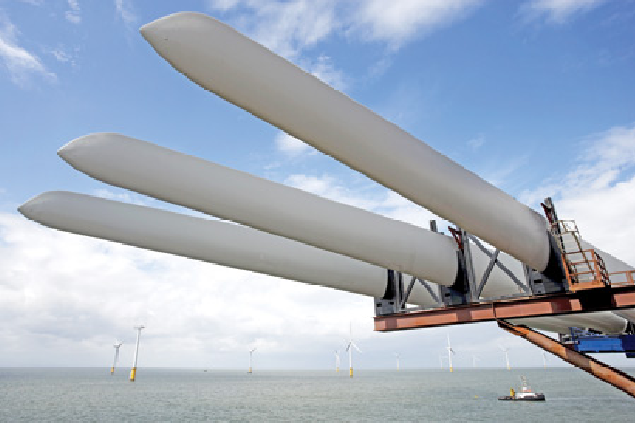
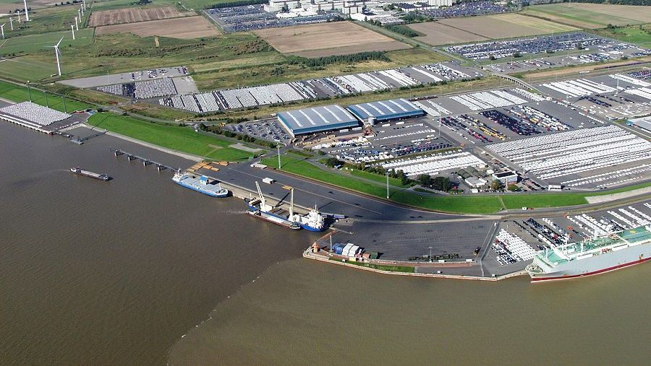
Innovation # 6 : Bigger Ports & Better Logistics
Requirements for UK’s Offshore Plans;
Develop two completely new ports
One on either coast of the UK
More than transport nodes
Focal point for regional development
Centres of excellence for R + D
Training centres for technologists/technicians
New manufacturing centres
Dr Eddie O’Connor, Mainstream Renewable Power
C & F Offshore Summit
London, April 2009
An entirely new approach to Logistics is needed

Slide 30

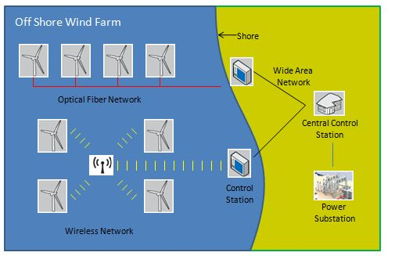
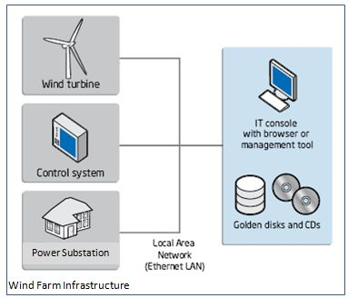
Innovation # 7 : Better Information Technology
Power Distribution Management
Supernode Power Controls
Hi-Speed Wireless Communication
Monitoring & Controlling Risk
Wind Turbine Control Systems
John Shaw, Mainstream Renewable Power
ICT Strategy for Offshore Wind
Surveying & Modelling the Sea
Better ICT will add value throughout the business process

Slide 31

Video : 2050 Forward
Click Here
Better ICT will add value throughout the business process

Slide 32
Open Integrated Seabed Information System
Mainstream Renewable Power
Offshore Wind in Europe
Offshore Wind Developers’ needs
Supergrid’s needs
Data Management initiatives
Integrated Sea Information System
Next Steps

Slide 33

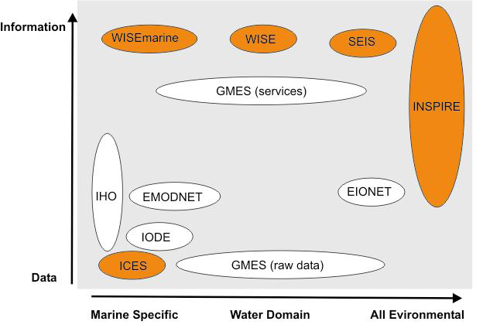
EU & Marine Data Management
4 EU Directives in particular impact industry:
  Marine Strategy Framework Directive – ‘establish and implement coordinated monitoring programmes for ongoing assessment of the environmental status of [member state] marine waters’
  INSPIRE Directive – ‘adopt measures for the sharing of data sets and services between public authorities for the purpose of public tasks and the Environmental Information Directive’
  Birds and Habitats Directive – ‘establish a network known as Natura 2000 (SPA, SACs)
  Data Collection Framework for Fisheries – ‘collect, manage and provide high quality fisheries data for the purpose of scientific advice, mainly for appropriate fisheries management decisions’
Shading = initiatives to manage data to satisfy EC Legislation
There are many directives and initiatives underway

Slide 34

Marine Knowledge 2020
Marine Knowledge 2020 :
Marine Data and Observation for Smart and Sustainable Growth
Launched 13 September 2010
Led by Iain Shephard
Key Objectives
This Initiative from the Commission will ensure the following are achieved ;
Data from the EU-supported research programmes are more available for re-use
Common standards and policies
Contribute towards an interoperable global marine knowledge system
Cost
€110.0 Million spent per year by EU on marine data collection
€ 18.5 Million additional allocation per year for EU’s Marine Knowledge 2020 initiative
Offshore Wind Developers need to contribute to Marine Knowledge 2020

Slide 35
Open Integrated Seabed Information System
Mainstream Renewable Power
Offshore Wind in Europe
Offshore Wind Developers’ needs
Supergrid’s needs
Data Management initiatives
Integrated Sea Information System
Next Steps

Slide 36
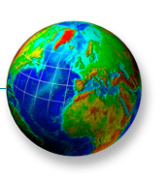
Convert Data into Wisdom
Offshore
Data Types
Depth
Bathymetry
Wrecks
Magnetometer
Seabed
Sidescan Sonar
Sub-Strata
Boomer
Mapping
ESA Satellites
Wind
MetMast,
Lidar
Foundations
Geotechnics
ISIS
Risk
Prediction & Mitigation
Waves &
Currents
Oceanography
Flora &
Fauna
Ecology
Collect Data
Store Data
Visualise Data
Identify Patterns
Run Scenarios
Regulatory
Reports
Consultancy
An Integrated Sea Information System ( ISIS ) is needed : doesn’t currently exist

Slide 37
Key Parameters
 |  |  |  |  |  |  |  |  | Wind Farm Phase
Parameter Column | Parameter Reference | Parameter | Parameter Value | Instrument Type | SI Units | Instrument Range | Instrument Resolution | Frequency of collection | Survey Phase | Construct Phase | Operate Phase
Air | PA01 | Wind Speed | Determine wind energy characteristics | Anemometer/ LIDAR | M / second | 0 - 50 M / second | 0.01 M / second | Continuous - 6 seconds | X | X | X
 | PA02 | Air Temperature | Determine operating conditions for Wind Turbines | Thermometer | o C | : - 10 o C to + 50 o C | 0.1 o C | Continuous - 60 seconds | X | X | X
Water | PW01 | Depth | Identify best postion for Wind Turbines ( < 40 M Depth ) | Sonar | M | 0 - 100 M | 0.01 M | Once-off Campaign | X
 | PW02 | Water Temperature | Determine operating conditions for Wind Turbines | Thermometer | o C | 0 o C to + 30 o C | 0.1 o C | Once-off Campaign | X | X | X
 | PW03 | Waves | Determine operating conditions for Wind Turbines | Bouys | M | 0 - 15 M | 0.01 M | Prolonged Campaign ( 6 months + ) | X | X | X
 | PW04 | Currents | Determine operating conditions for Wind Turbines | Bouys | M / second | 0 - 30 M / second | 0.01 M / second | Prolonged Campaign ( 6 months + ) | X
Seabed | PS01 | Seabed Macro- Topology | Identify exclusion areas | Satellite Mapping | M | Wide range | 10 M | Acquired GIS file information | X
 | PS02 | Seabed Topology | Identify best position for Wind Turbines ( < 40 M Depth ) | Sidescan Sonar | Hertz (Hz ) | 100 - 500 kHz | 1 kHz | Once-off Campaign | X | X | X
 | PS03 | Ship wrecks | Identify exclusion areas | Magnetometer | Tesla (T) | 0 - 100 mT | 1 uT | Once-off Campaign | X
 | PS04 | Sub-strata | Identify solid ground for Foundations | Boomer | Hertz (Hz ) | 100 - 500 kHz | 1 kHz | Once-off Campaign | X
 | PS05 | Sub-strata | Identify solid ground for Foundations | Extracted Sample | Kg, M | Various | Various | Once-off Campaign | X
Flora and Fauna | PF01 | Macro-Population | Identify exclusion areas | Physical count | Count | Trained Counter | Trained Counter | Acquired Ecology file information | X
 | PF02 | Mammal Fauna Count | Meet Ecological Regulatory requiremetns | Physical count | Count | Trained Counter | Trained Counter | Once-off Campaign | X | X | X
 | PF03 | Fish Count | Meet Ecological Regulatory requiremetns | Physical count | Count | Trained Counter | Trained Counter | Once-off Campaign | X | X | X
 | PF04 | Bird Count | Meet Ecological Regulatory requiremetns | Physical count | Count | Trained Counter | Trained Counter | Once-off Campaign | X | X | X
 | PF05 | Micro-Fauna Count | Meet Ecological Regulatory requiremetns | Extracted Sample | Count | Trained Counter | Trained Counter | Once-off Campaign | X | X | X

Slide 38
The 5 Layers of ISIS
 |  |  |  |  |  | Wind Farm Phase
ISIS Layer | Value | Technology Maturity | Specific Requirements | Reference Standard | Areas for improvement | Survey Phase | Construct Phase | Operate Phase
5. Risk Scenario | Identify Project Risk | Low | Vectorise parametric data and predict the future. Run various scenarios to identify best-fit result. | to be defined | Develop new technology | X | X | X
4. Visualisation | Allow accurate presentation of real world | Medium | Presentation of n dimensions over time, with colour shading to display parameters ( surfaces, currents, etc ) and exclusions ( sea-lanes, wrecks, etc) | to be defined | Develop new technology | X | X | X
3. Database | Provide a single source of validated reference data with time and GPS stamps | Medium | Data Historian for time-series data, linked to RDBMS for query/reports | ODBC compliant | Adoption of data historian technology | X | X | X
2. Communications | Provide a reliable mechanism to transfer data from Instruments to Database | High | Buffering, compression, Send-Receive confirmation, TCP/IP, CSV-ASCII file format, | Complies with EIA232 | Encryption. Wireless Communications | X | X | X
1. Instruments | Provide accurate measurement of key parameters | High | Ruggedised Instruments, Self-powered, Linear, meet range and resolution requirements, IP addressable | Complies with ANSI/ISA TR77.70.01.2010 Tracking & Reporting of Instrument and Control Data | Self calibrating instruments, suited to North Sea Environment | X | X | X

Slide 39
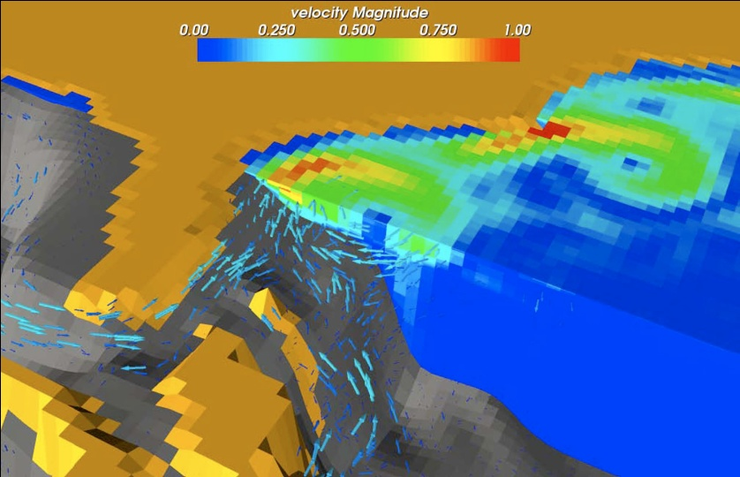
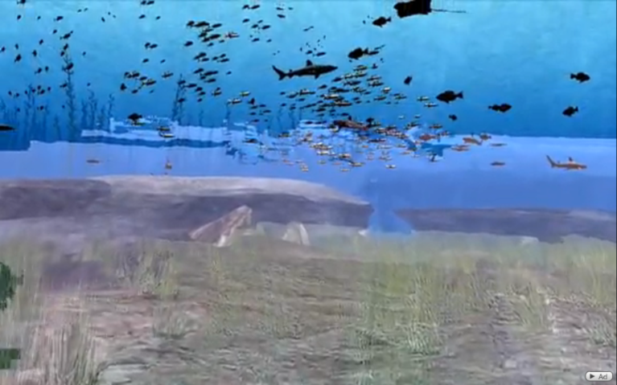
Precedent: 3D Data Visualisation
Pittsburgh Supercomputing Center ( PSC ) computational scientist consultants work closely with discipline scientists to provide tools for visualization and analysis on their Cray XT3.
“too much information.”: When it comes to a scientist’s desire to simulate physical phenomena in realistic detail, there is no such thing.
Realtime Ocean Visualisation
Lenfest Ocean Future Blender 2.48
3D visualisation of Atlantic Currents
University of Miami & PSC
http://www.youtube.com/watch?v=Z5Q1Pwrp8bw&feature=youtube_gdata_player
Basic Visualisation technology exists

Slide 40
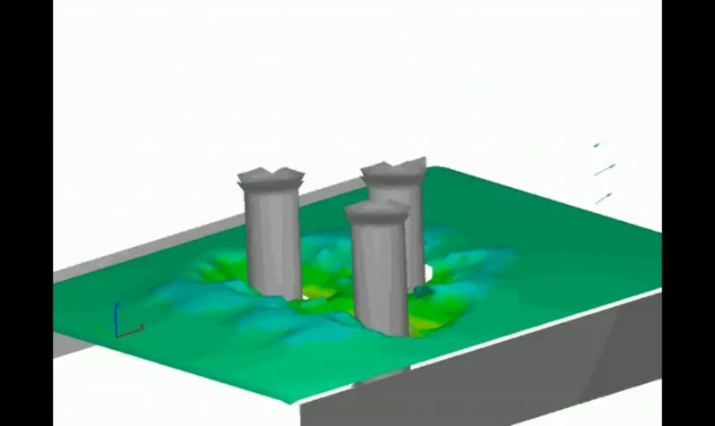
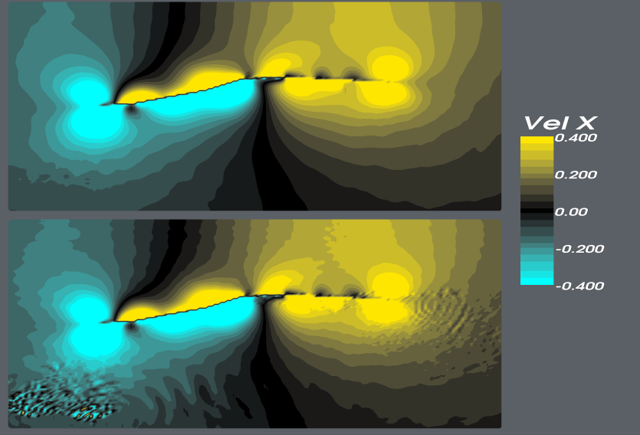
Precedent: Running What If Scenarios
Visualising data makes it easier to identify risk.
Simulating scenarios makes it easier to predict future risk.
Sediment Scour Simulation
Northwest Hydraulics Consultants. CUDA
3D visualisation of Soil Displacement
Carnegie Mellon University & PSC
http://www.youtube.com/watch?v=NlGzrlsIhQg&feature=youtube_gdata_player
Basic Modelling Technology exists

Slide 41
Open Integrated Seabed Information System
Mainstream Renewable Power
Offshore Wind in Europe
Offshore Wind Developers’ needs
Supergrid’s needs
Data Management initiatives
Integrated Sea Information System
Next Steps

Slide 42
Identity & Address ISIS Barriers
Innovation is inhibited by data licence issues:
  Data licence issue throughout European waters
  Over 400 legal entities have licensed ownership of data in Britain
  Need EU Data Ownership Policy
Innovation is inhibited by regional data strategy variation:
  National data archives are at different levels of maturity
  Low Interoperability of data and metadata across EU
  Need EU standard for data archives
Role for EU Commission:
  Build on existing progress made by data communities
  Provide sustainable funding for Innovation
  Provide framework for licensing and re-use of data
There is a compelling need for Standard Policy

Slide 43
Conclusion
Offshore Wind will meet Europe’s Energy objectives
The Supergrid is the key enabler for Offshore Wind
ISIS will accelerate Offshore Wind Energy Development
ISIS needs a consortium from across Industry, Commission, Academia to define policies, standards and specifications

Slide 44
Further information
Ana Aguado John Shaw Adam Bruce Joe Corbett
CEO Head of Information Services Head of Corporate Affairs Head of Technical Services
Friends of the Supergrid Mainstream Renewable Power Mainstream Renewable Power Mainstream Renewable Power
+32 2 546 7463 + 353 87 283 6499 + 44 207 189 8347 +353 87 237 3251
Ana.agudo@fosg.eu John.shaw@mainstreamrp.com adam.bruce@mainstreamrp.com joe.corbett@mainstreamrp.com

