Slide 1
Working Group 6
Gabriel Acien (EABA) (facien@ual.es)

Slide 2
Working Group 6
Aim
To promote emerging applications of algae related to Materials/Chemicals/Bioactives further than conventional uses by improving the business environment and cooperation across the algae sector
Identification of the most important research, development and innovation needs
Promotion of ongoing activities/projects
Collaborate in market/product development
Validating/ disseminating EU4Algae results
How to do it?
Objectives
Obstacles
Actions
Outcomes

Slide 3
Working Group 6
Workplan
Introducing the WGs to the stakeholders (20th June during the EU4Algae Online Event)
Defining the Actions and outcomes: WGs Meetings and activities (July to October)
Online working group meeting (1st week of October)
Discussions and Action Plan Refinement (October to November)
1st WG Annual Meeting during the EU4Algae Event (Rome 11/12/2022)
2nd Version of Action Plans (December 2022)
Draft of actions/outcomes (May 2023)

Slide 4
Working Group 6
Objectives
Obstacles/Issues
Stakeholders platform to share/collaborate
Boost innovative uses of algae based products
Identify and solve technical/busines problems
To promote social acceptance of algae based products
To promote education/training regarding algae chemicals
High production cost/low production capacity
Lack of standards and flaghship initiatives
Limited knowledge of markets/consumers
Limited knowledge of risks and impacts
Fragmented knowledge of technologies
Actions
Outcomes/Deliverables
Develop EU Algae Industry/connect with chemical industry
To promote demonstration processes
To gather knowledge on carbon, nutrients bioremediation
To improve education/training activities
To promote social acceptance of algae products
Database of algae related companies/technologies
Network of open pilot/demo facilities
Position paper about materials/chemicals/bioactive
Collaboration in education/training courses
Campaigns for social acceptance of algae products

Slide 5
Working Group 6
Defined topics (first round)
Identified Constraints, Obstacles, and Issues
Algae (seaweed and microalgae) biomass production capacity and cost must be improved. Guarantee biomass supply chain, quality and production capacity. Lack of information about real biomass production and main actors. Collaboration between processor/producers and formulators/end-users. To promote platforms for the exchange/development of new processes and case studies Avoid critical terms (biorefinery, waste biomass, contaminated biomass). Need for education and training courses for young people and entrepreneurs
Working Groups Actions
Develop EU Algae Industry/connect with the chemical industry To promote demonstration processes already working and successful. To promote social acceptance of algae products To promote algae-related applications from the industry. To improve education/training activities. To develop biorefinery approaches and to provide recommendations for that. To demonstrate the sustainability of algae-based solutions To promote the end-of-waste regulation to utilize algae biomass for non-food/feed applications. To develop specifications of biomass based on algae standards already defined. To perform a market analysis of biorefinery products. To develop a platform to facilitate the exchange of information between producers and buyers.
Specific Objectives
Collaborate in market/product development Promotion of ongoing activities/projects Identification of the most important research, development and innovation needs Defining expert and training courses
Outcomes
Database of algae-related companies/technologies Network of open pilot/demo facilities Position paper about materials/chemicals/bioactive Collaboration in education/training courses Campaigns for social acceptance of algae products

Slide 6
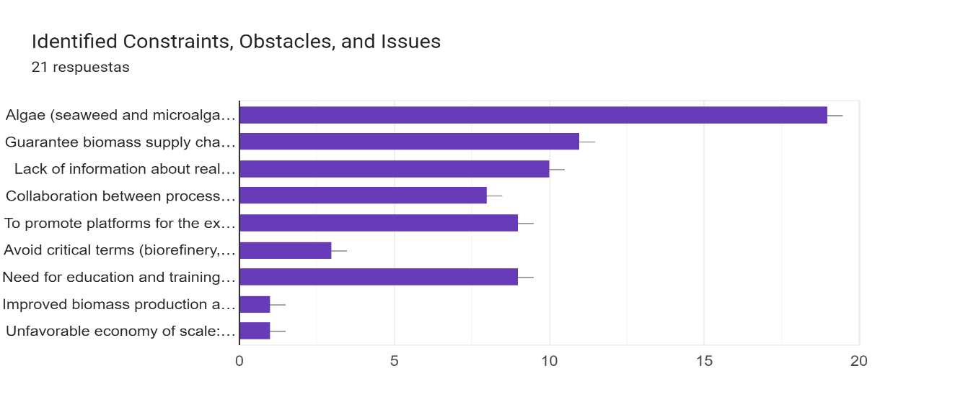
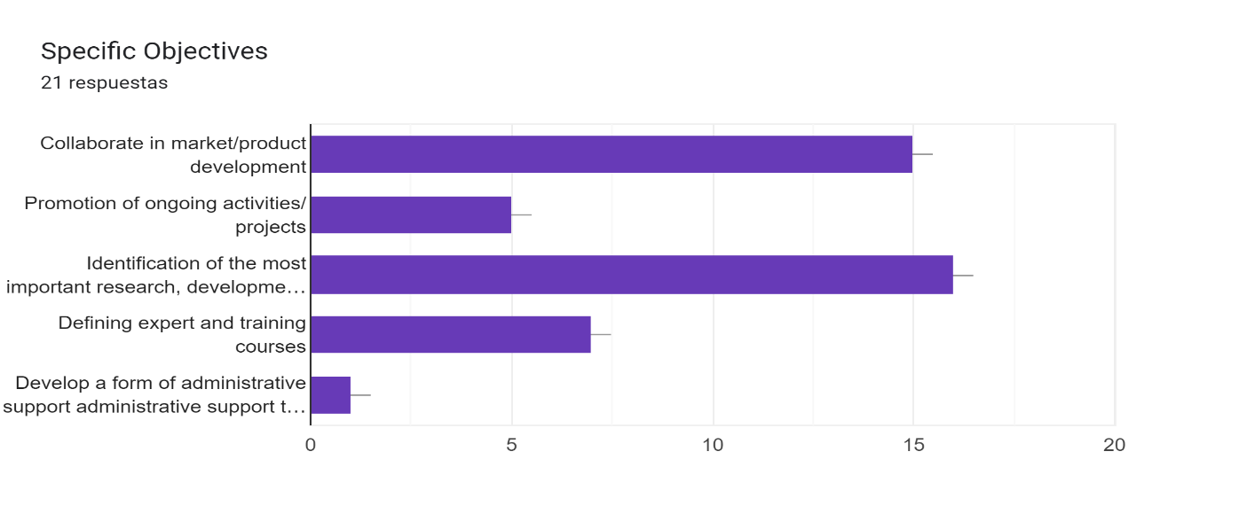
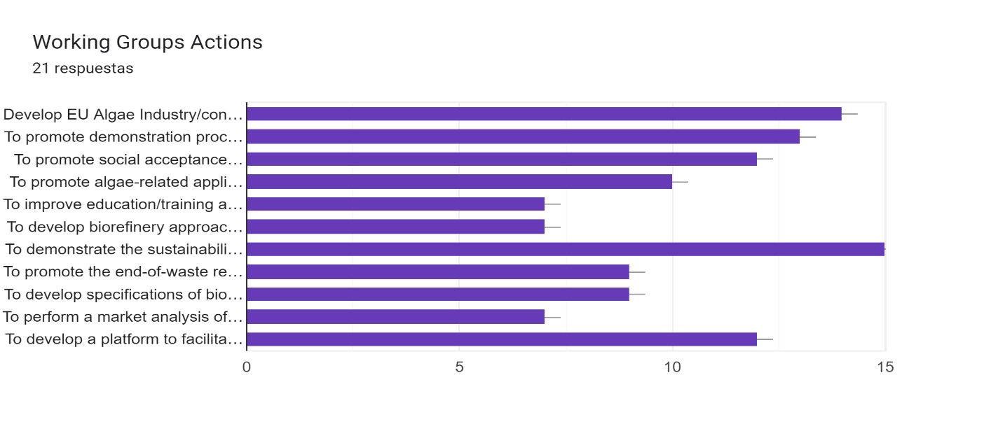
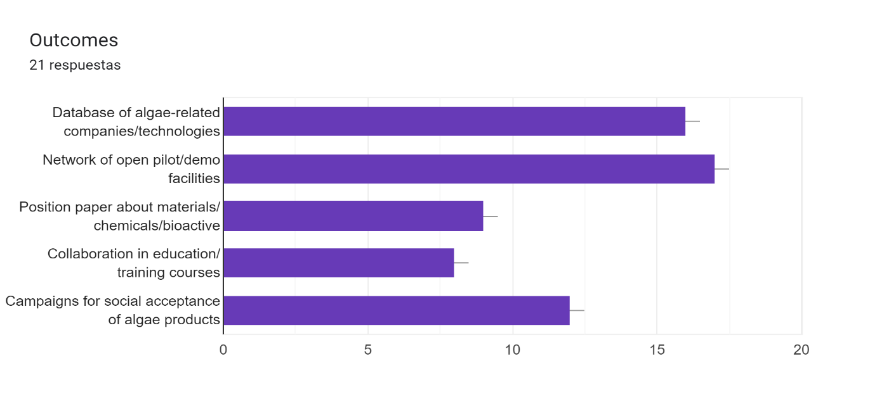
Working Group 6
Survey

Slide 7
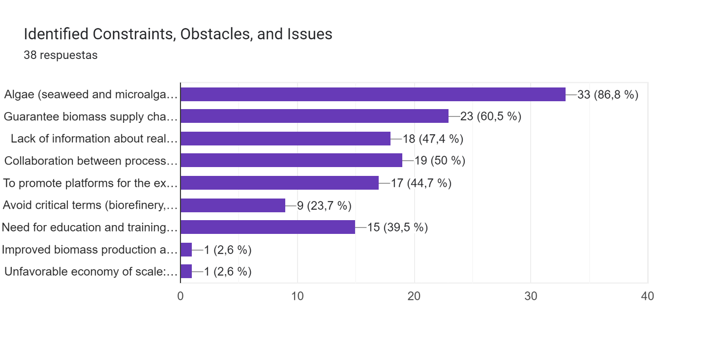
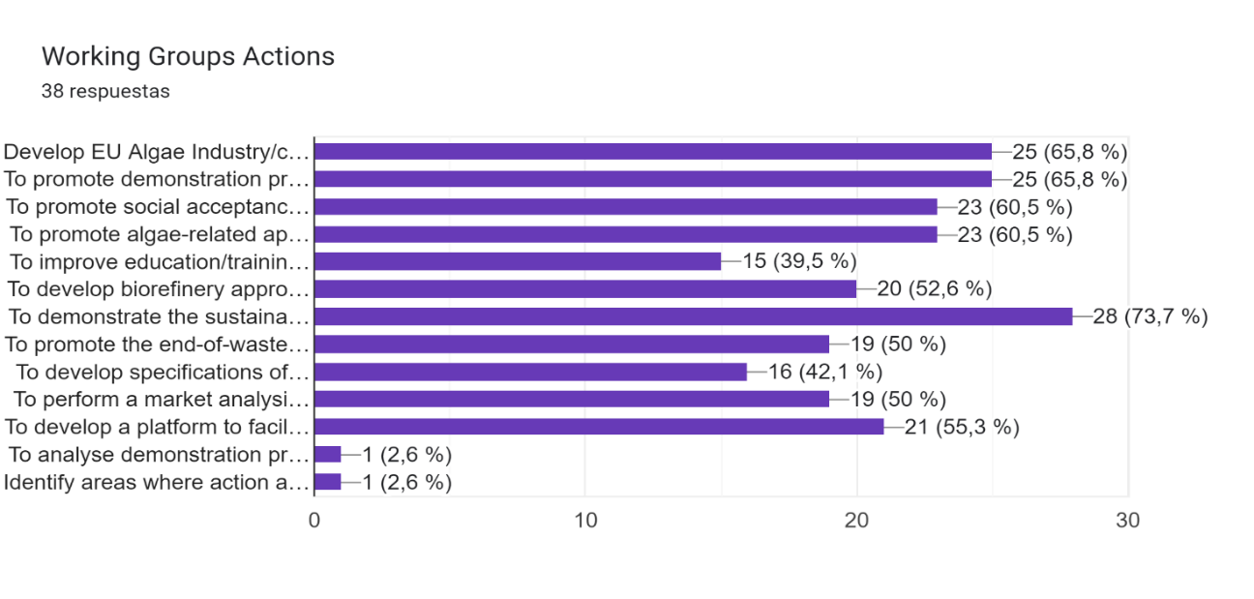
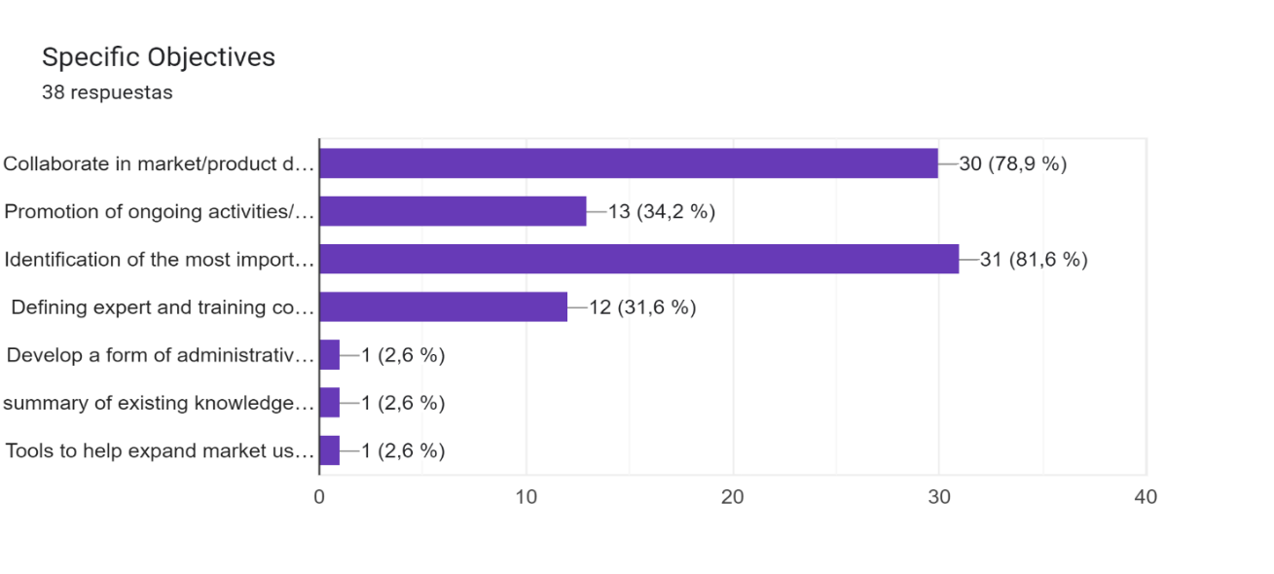
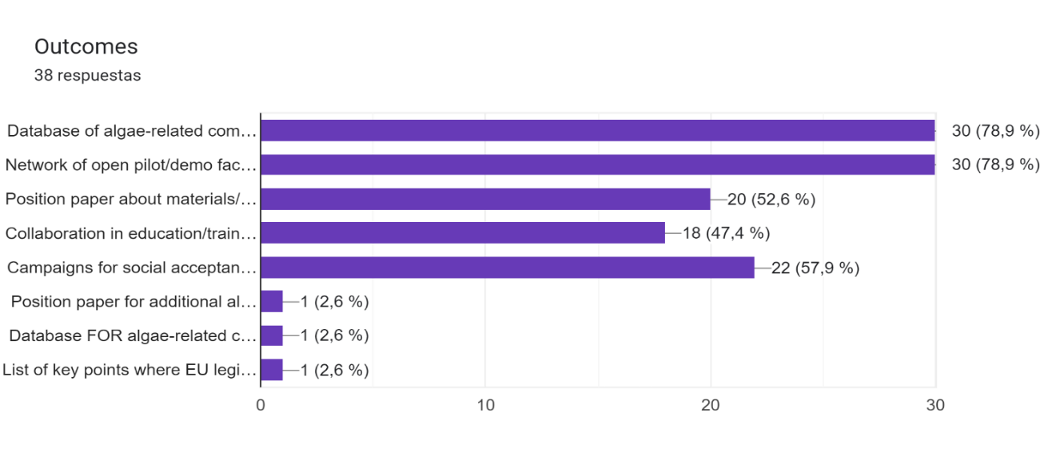
Working Group 6
Survey

Slide 8
Working Group 6
Objectives
Obstacles
Actions
Outcomes
Selected topics
Materials / Chemicals / Bioactives and Algae Biorefining
Specific Objectives
1. Identification of the most important research, development and innovation needs 2. Collaborate in market/product development 3. Promotion of ongoing activities/projects 4. Defining expert and training courses
Identified Constraints, Obstacles, and Issues
1. Algae (seaweed and microalgae) biomass production capacity and cost must be improved. 2. Guarantee biomass supply chain, quality and production capacity. 3. Collaboration between processor/producers and formulators/end-users. 4. Lack of information about real biomass production and main actors. 5. To promote platforms for the exchange/development of new processes and case studies 6. Need for education and training courses for young people and entrepreneurs
Working Groups Actions
1. To demonstrate the sustainability of algae-based solutions 2. Develop EU Algae Industry/connect with the chemical industry 3. To promote demonstration processes already working and successful. 4. To promote social acceptance of algae products 5. To promote algae-related applications from the industry. 6. To develop a platform to facilitate the exchange of information between producers and buyers.
Outcomes
1. Database of algae-related companies/technologies 2. Network of open pilot/demo facilities 3. Campaigns for social acceptance of algae products 4. Position paper about materials/chemicals/bioactive 5. Collaboration in education/training courses
How to connect

Slide 9
Working Group 6
Objectives
Obstacles
Actions
Outcomes
Selected topics
Materials / Chemicals / Bioactives and Algae Biorefining
Identified Constraints, Obstacles, and Issues | 1. Lack of information about industrial biomass processors, needs and main actors
Specific Objectives | Identification of relevant actors and innovation needs (financial, technology, markets)
Working Groups Actions | To identify processing companies, technologies and products, and major challenges
Outcomes | Interviews and surveys to identify algae processing-related companies and major needs.
Identified Constraints, Obstacles, and Issues | 2. Lack of collaboration between relevant actors such as producers, processors, formulators, academia, providers
Specific Objectives | Facilitate the collaboration between relevant actors to accelerate the development of knowledge and industry
Working Groups Actions | To develop a platform to facilitate the exchange of information between producers and buyers, to understand the needs of algae industry and demonstrate the sustainability of algae-based solutions.
Outcomes | Forum /platform, connected to EABA, for the exchange of information/knowledge between major actors. Position paper about algae biorefinery including potential, technology, products, markets, etc.
Identified Constraints, Obstacles, and Issues | 3. Lack of platforms for the development and demonstration of industrial processes
Specific Objectives | Promotion of new and ongoing activities/projects, to facilitate upscaling and demonstration of processes
Working Groups Actions | To promote demonstration processes and industrial applications to materials/chemicals/bioactives
Outcomes | Network of open pilot/demo facilities integrating industry and academia for demonstration of processes and products
Identified Constraints, Obstacles, and Issues | 4. Need for education and training courses for young people and entrepreneurs
Specific Objectives | Defining expert and training courses
Working Groups Actions | To promote dissemination and transference, including social acceptance of algae products.
Outcomes | Development of training courses and transference activities about potential and sustainability of algae products Campaigns for acceptance of algae products to general public and specific target sectors
Bottlenecks:
Connection/overlapping with other WGs
Industrial/Intellectual protection-common problems-CONFIDENTIALITY
Connect with EU Commission, how collect and manage the data- EU Regulation on data protection

Slide 10
Working Group 6
Objectives
Obstacles
Actions
Outcomes
Outcomes
Materials / Chemicals / Bioactives and Algae Biorefining
Identified Constraints, Obstacles, and Issues | Outcomes | Actions | Lead/Part.
1. Lack of information about industrial biomass processors, needs and main actors | Interviews and surveys to identify algae processing-related companies and major needs | A1.- Define the survey. Collect and process the results. Report summarizing results | Gabriel-Others
2. Lack of collaboration between relevant actors such as producers, processors, formulators, academia, providers | Forum /platform, connected to EABA, for the exchange of information/knowledge between major actors | A2.- Revise the database of EABA-Forum. Create a form for exchange of information. Integrate interested members on the platform | Stefan-Others
 | Position paper about algae biorefinery including potential, technology, products, markets, etc. | A3.- Publish a position paper integrating academia and industry, but also regulators and policy makers | Gabriel-Others
3. Lack of platforms for the development and demonstration of industrial processes | Network of open pilot/demo facilities integrating industry and academia for demonstration of processes and products | A4.- Collect data about available pilot/demo facilities. Create a database of available infrastructure. Integrate the database at part of EABA website | Claudio/Marcello-Others
4. Need for education and training courses for young people and entrepreneurs | Development of training courses and transference activities about potential and sustainability of algae products | A5.- Training courses for young researchers and entrepreneurs. Transference activities for specific stakeholders | Paul-Others
 | Campaigns for acceptance of algae products to general public and specific target sectors | A6.- Surveys about social acceptance. Identification of major bottlenecks and challenges | Antonio-Others

Slide 11
Working Group 6
Objectives
Obstacles
Actions
Outcomes
Outcomes
Materials / Chemicals / Bioactives and Algae Biorefining
Identified Constraints, Obstacles, and Issues | Outcomes | Actions | Lead/Part.
1. Lack of information about industrial biomass processors, needs and main actors | Interviews and surveys to identify algae processing-related companies and major needs | A1.- Define the survey. Collect and process the results. Report summarizing results | Gabriel-Others
2. Lack of collaboration between relevant actors such as producers, processors, formulators, academia, providers | Forum /platform, connected to EABA, for the exchange of information/knowledge between major actors | A2.- Revise the database of EABA-Forum. Create a form for exchange of information. Integrate interested members on the platform | Stefan-Others
 | Position paper about algae biorefinery including potential, technology, products, markets, etc. | A3.- Publish a position paper integrating academia and industry, but also regulators and policy makers | Gabriel-Others
3. Lack of platforms for the development and demonstration of industrial processes | Network of open pilot/demo facilities integrating industry and academia for demonstration of processes and products | A4.- Collect data about available pilot/demo facilities. Create a database of available infrastructure. Integrate the database at part of EABA website | Claudio/Marcello-Others
4. Need for education and training courses for young people and entrepreneurs | Development of training courses and transference activities about potential and sustainability of algae products | A5.- Training courses for young researchers and entrepreneurs. Transference activities for specific stakeholders | Paul-Others
 | Campaigns for acceptance of algae products to general public and specific target sectors | A6.- Surveys about social acceptance. Identification of major bottlenecks and challenges | Antonio-Others

Slide 12
Working Group 6
Meeting 16/02/2023
Map stakeholders on these fields: invite relevant stakeholders
Define the work plan to achieve major outcomes
Documents to be included in the knowledge library
EU4Algae tasks alignment with EU algae initiative
Split of WG6 in different topics: 1 Materials, 2 Chemicals, 3 Bioactives (non food), 4 Biorefining

Slide 13
Working Group 6
Meeting 17/03/2023
A1.- Define the survey. Collect and process the results. Report summarizing results
First draft available. Include questions about expectative and further developments. To be disseminated among EU4ALGAE participants. Further interviews with specific stakeholders to enlarge discussion.
A2.- Revise the database of EABA-Forum. Create a form for exchange of information. Integrate interested members on the platform
First draft available. Connect with the ongoing platform for food otherwise explore the use of ubuntoo or others. Remark the relevance of forum for exchange of information/contacts between stakeholders.
A3.- Publish a position paper integrating academia and industry, but also regulators and policy makers
Prepare the first draft version including academia, industry and regulators.
A4.- Collect data about available pilot/demo facilities. Create a database of available infrastructure. Integrate the database at part of EABA website
First draft version available. Include type of resources used.
A5.- Training courses for young researchers and entrepreneurs. Transference activities for specific stakeholders
Prepare list of formal training courses and programme for MOOC. Arrange a list of virtual workshops for specific topics including a short presentation plus round table.
A6.- Surveys about social acceptance. Identification of major bottlenecks and challenges
To prepare two surveys, one for industry out of EU4ALGAE and other for general public. First draft of Industrial survey available.

Slide 14
Working Group 6
A1.- Define the survey. Collect and process the results. Report summarizing results
Entity and contact details
Characteristics of the entity
Profile
Major activity
Market application
Biomass production/processing capacity
Turnover range
Strains being produced/processed
Main product being produced/processed
Identification of major challenges
Major technical needs or challenges
Most relevant non-technical needs or challenges
Most relevant activities to facilitate the development of algae related industry
Priorities in terms of knowledge and collaboration
Other comments
Envisage of further developments
Do you envisage further developments on the field? On which areas?
Are you planning to enlarge your activities on the field?
Which type of enlargement are you planning?
Are you planning to initiate new companies/activities on the field? On which areas?
Do you envisage further developments on the field? On which areas?
Link to the survey
https://forms.gle/9z3Fe71ytTjKUDsM8
Disseminate the survey among EU4ALGAE stakeholders
Process the results to identify algae processing-related companies and major needs
Select some of them for personal interview
Process the results and provide final discussion
CHALLENGE: Mapping of non food-feed uses of algae, current state, bottlenecks and further developments

Slide 15
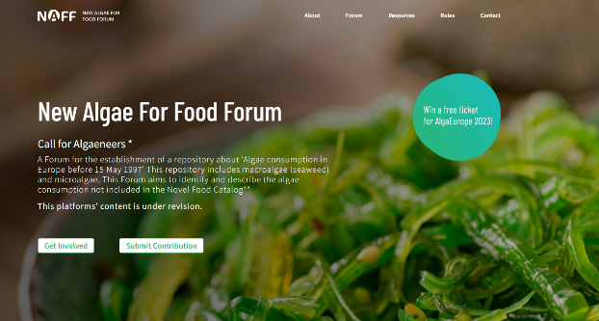
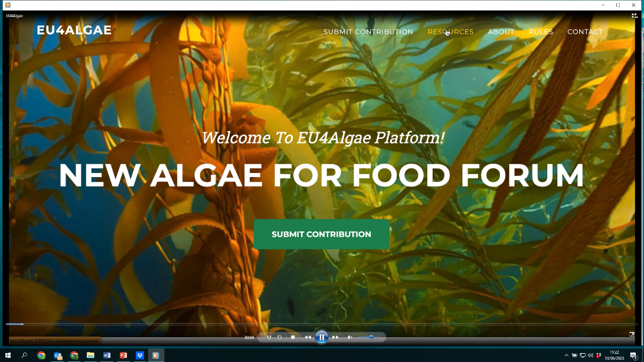
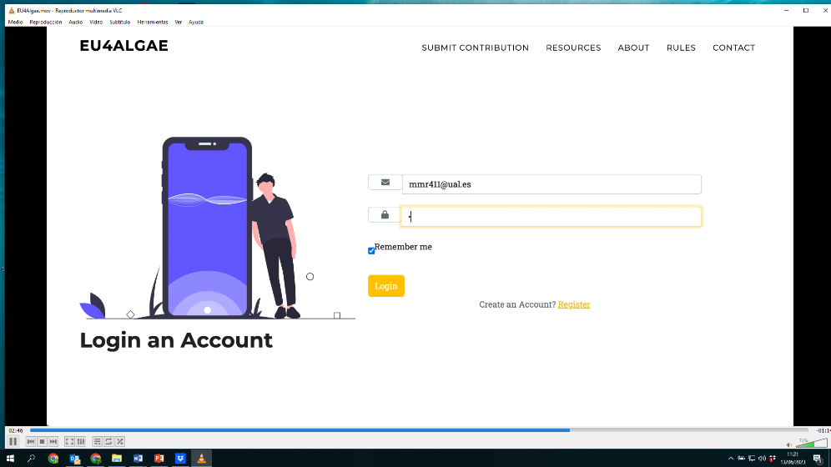
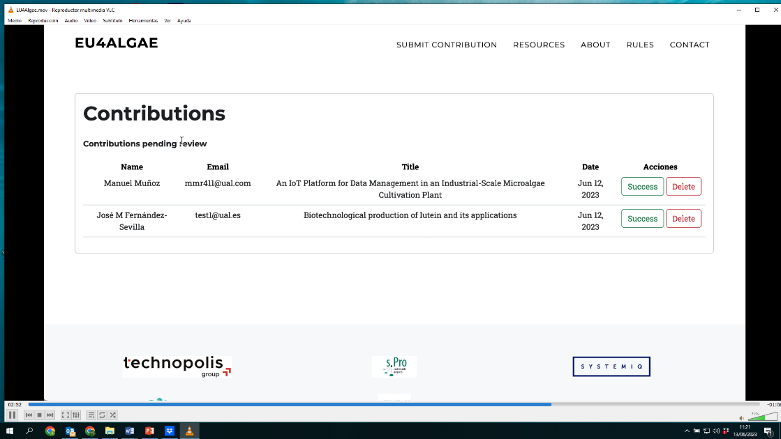
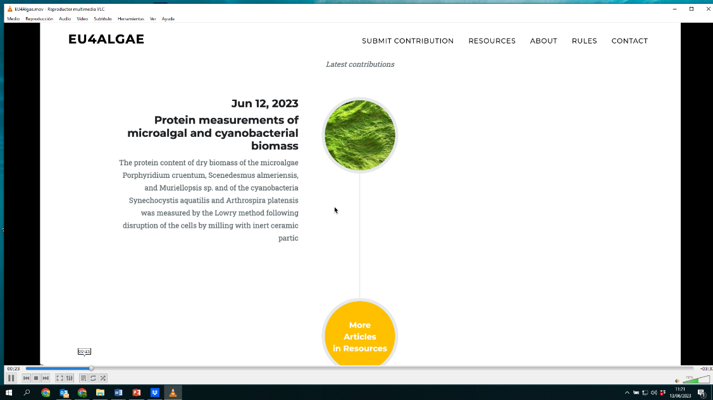
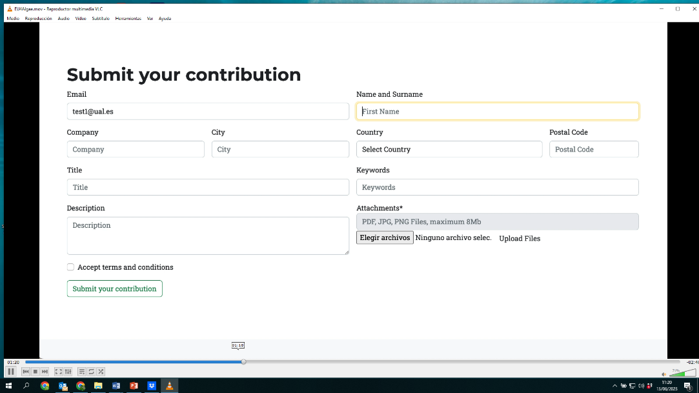
Working Group 6
A2.- Revise the database of EABA-Forum. Create a form for exchange of information. Integrate interested members on the platform
Video of the platform in progress
https://www.dropbox.com/s/08yztkzrrgpkyqk/EU4Algae.mov?dl=0
Platform for non food-feed uses of algae
Involve new members
Collect information about applications/technologies
Dissemination of public information
Exchange of contact details among interested members
CHALLENGE: Reliable tool for exchange of information about non food-feed uses of algae
A4.- Collect data about available pilot/demo facilities

Slide 16
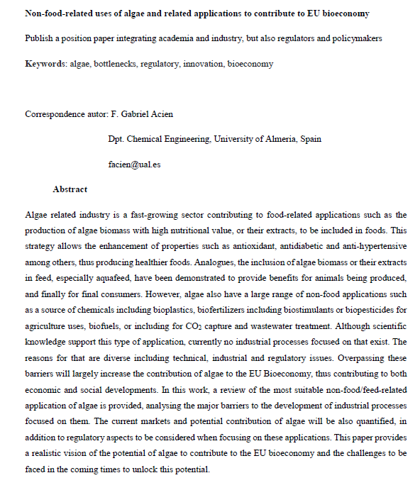
Working Group 6
A3.- Publish a position paper integrating academia and industry, but also regulators and policy makers
Non-food related uses of algae and related applications to contribute to EU bioeconomy
Publish a position paper integrating academia and industry, but also regulators and policy makers
1.Introduction
2.Scientific knowledge about non food/feed related applications of algae
2.1.Algae as a source of chemicals including bioplastics
2.2.Algae as a source of fertilizers including biostimulants and biopesticides
2.3.Algae as a source of biofuels
2.4.Algae for CO2 capture and wastewater treatment
3.Major challenges for the development of related industrial applications
3.1.Algae biomass production capacity and cost
3.2.Processing technologies for algae biomass
3.3.Algae biorefinery
4.Current and potential contribution to the EU bioeconomy
4.1.Current and potential markets
4.2.Regulatory barriers
4.3.Programmes supporting the algae sector
5.Conclusions
Draft of the paper available
https://docs.google.com/document/d/1ZAIwZjx387HbQolzffiVkFCiTXWI0vPZ/edit?usp=sharing&ouid=116414597601818970745&rtpof=true&sd=true
Maria Teresa Ferreira Cesário | teresa.cesario@tecnico.ulisboa.pt
Sónia Ventura | spventura@ua.pt
Gabriel Acien | facien@ual.es
Position paper for non food-feed uses of algae
Provide state of art on the field
Summarizes major challenges: scientific, industrial, etc..
Relevance of the sector
Policy and regulation
CHALLENGE: Reference document on the field

Slide 17
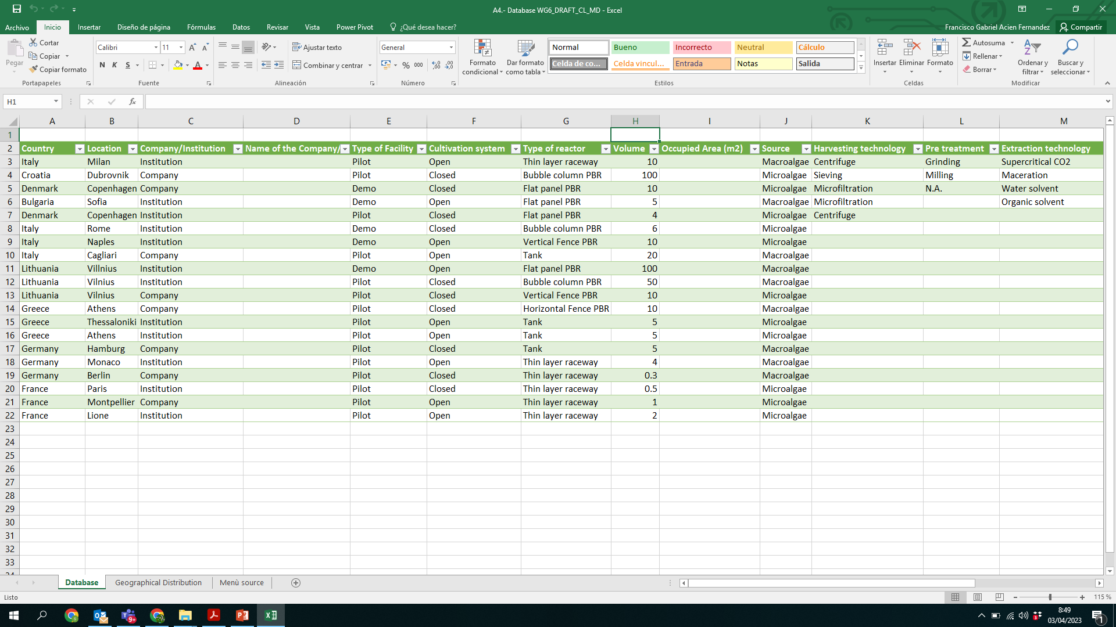
Working Group 6
A4.- Collect data about available pilot/demo facilities. Create a database of available infrastructure. Integrate the database at part of EABA website
Network of open pilot/demo facilities integrating industry and academia for demonstration of processes and products
A4.- Collect data about available pilot/demo facilities. Create a database of available infrastructure. Integrate the database at part of platform A2
Collect data about shareable facilities
Mapping shareable technologies/processes
Facilitate the collaboration between partners
Promote the development of new products/processes
CHALLENGE: Save efforts in the development of new processes/products
https://www.dropbox.com/s/vm370pchke0hm17/A4.-%20Database%20WG6_DRAFT_CL_MD.xlsx?dl=0

Slide 18
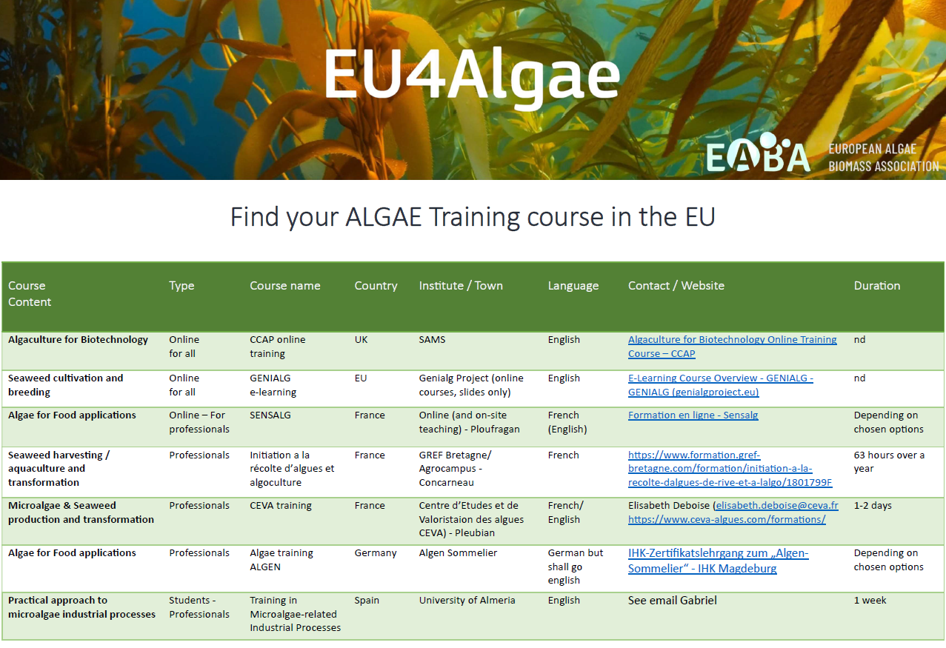
Working Group 6
A5a.- Training courses for young researchers and entrepreneurs. Transference activities for specific stakeholders
Training courses for young researchers and entrepreneurs
List of courses already available
Training course at University of Almeria (July)
Course at Wageningen University
Use this link to include information about other courses: https://forms.gle/tWd2a7SsMxQzTxD16
Development of a MOOC in cooperation between interested partners
Aim: to provide an introduction to (i) the fundamental of the processes, (ii) the state of the art, and (iii) potential and current production capacity. Each topic will be divided in three sessions according to these contents. Maximum 10 minutes each one.
Chemicals from algae
Materials from algae
Bioactive form algae
Wastewater treatment involving algae
Carbon capture processes involving algae
Biorefineries based on algae
https://www.dropbox.com/s/gzd1txflp7bzeey/A5.-%20Training%20courses%20for%20young%20researchers%20and%20entrepreneurs.%20Transference%20activities%20for%20specific%20stakeholders.docx?dl=0

Slide 19
Working Group 6
A5a.- Training courses for young researchers and entrepreneurs. Transference activities for specific stakeholders
Development of a MOOC in cooperation between interested partners
Aim: to provide an introduction to (i) the fundamental of the processes, (ii) the state of the art, and (iii) potential and current production capacity. Each topic will be divided in three sessions according to these contents. Maximum 10 minutes each one.
Chemicals from algae
Materials from algae
Bioactive form algae
Wastewater treatment involving algae
Carbon capture processes involving algae
Biorefineries based on algae
Using OBS (free software). Result: With some technical guidelines, the teacher simultaneously records his webcam with his presentation. It can be difficult for the user.
Use of Powerpoint 365. Result: the result is a video of the presentation along with the teacher's webcam in a tiny corner.
Use of Zoom. Result: the presentation and the teacher's webcam are recorded in the cloud. We take care of downloading it already synchronized. For this we would enable a Zoom virtual room for recordings. It is the most optimal, simple and homogeneous solution.
https://www.dropbox.com/s/gzd1txflp7bzeey/A5.-%20Training%20courses%20for%20young%20researchers%20and%20entrepreneurs.%20Transference%20activities%20for%20specific%20stakeholders.docx?dl=0

Slide 20
Working Group 6
A5b.- Training courses for young researchers and entrepreneurs. Transference activities for specific stakeholders
Training and transference activities
Facilitate the access to the courses
Identify gaps and promote new courses about that
Facilitate the exchange among stakeholders
Develop activities for specific applications
Integrate these activities as part of the platform
CHALLENGE: Update the knowledge on the field, both theoretical and practical
Transference activities for specific stakeholders
Workshop about materials/chemicals
Workshop about biostimulants/biopesticides
Workshop about biorefineries based on algae
Regulation + waste streams (collaborate with other WG7)
Conditions:
1 h max duration
One presentation + round table
Records + written down conclusions.
Minutes of the event…
https://www.dropbox.com/s/gzd1txflp7bzeey/A5.-%20Training%20courses%20for%20young%20researchers%20and%20entrepreneurs.%20Transference%20activities%20for%20specific%20stakeholders.docx?dl=0

Slide 21
Working Group 6
A6.- Surveys about acceptance. Identification of industrial and social challenges
A6a. Survey for non algae related industrial sector: Identify the interest of non algae-related industrial sector for this type of applications
Generic information: Name ; surname; position in the company:
Knowledge and perception of algae
Major interest:
Challenges for your companies:
Factors influencing acceptance
Advantages and limitations of algae related products
Perception of industrial (non algae) sector
Potential and major barriers
Perception of general public
Advantages/drawbacks of algae products
Integrate this knowledge as part of the platform
CHALLENGE: Overall perception of algae sector out of the algae sector to identify the requirements and potentialities
https://www.dropbox.com/s/whyrbfxoe8x0dfc/A61.-%20Survey%20about%20industrial%20acceptance.docx?dl=0
A6b. Survey for general public: Identify the major advantages and limitations of algae related products
Description
Previous knowledge of Algae
Bioplastics from Algae
Biostimulants/biopesticides from Algae
Animal feed from algae
Human nutrition
Biorefineries from Algae
https://www.dropbox.com/s/yfp77ng2c8eanax/A62.-%20Surveys%20about%20social%20acceptance.docx?dl=0

