Slide 1
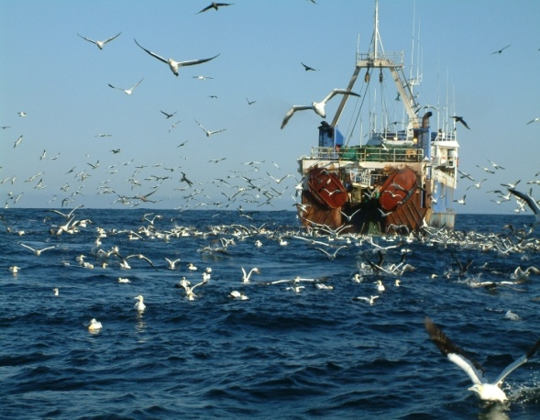
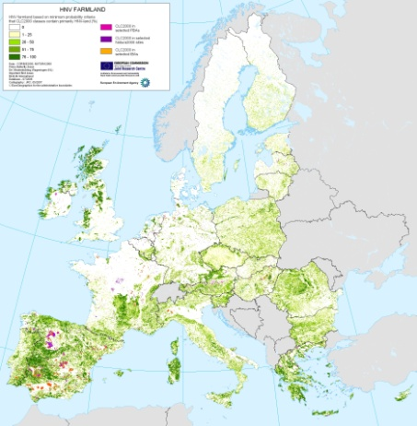
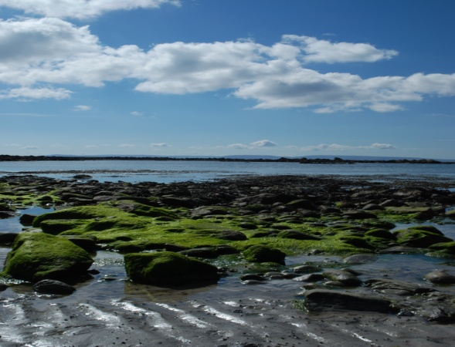
Approaches for Measuring Natural Capital
Stephen Hynes
EU-China Blue Year Brussels
2 June 2017

Slide 2
Overview
Natural Capital
Valuing Marine Ecosystem Services
Issues with data and measurement
Valuation techniques
Some market and non-market marine ecosystem service values for Ireland

Slide 3
Natural Capital Accounting
Need to align with the measurement approaches prescribed for national accounts (System of National Accounts; SNA)
Need to go beyond GDP for environmental economic accounts (System for Environmental Economic Accounts; SEEA).
Need to understanding of how ecosystem services, once quantified, can be incorporated in an accounting framework such as the SNA or the SEEA (the SEEA Experimental Ecosystem Accounting; SEEA EEA)
Valuation central to applying an Ecosystem Approach to management at strategic policy level

Slide 4
Natural Capital
Within natural capital, one can identify non-renewable resources such as oil and coal reserves, but also the asset value of ecosystems which depend in turn on the flow of ecosystem services over time (Barbier, 2011).
From a national accounting perspective, the value of an ecosystem asset is the sum of the net present
values of each ecosystem service generated by the asset under current management. (Obst et al. 2015)

Slide 5
Alternative definitions of NC
SNA: falls under non-financial non-producing assets; Natural capital is the extension of the economic notion of (produced) capital to the natural environment, i.e. the ‘stock’ of natural (eco-)systems that yields a flow of valuable (ecosystem) goods or services into the future.
UN Conference on Sustainable Development: Natural capital comprises Earth’s natural assets (soil, air, water, flora and fauna), and the ecosystem services resulting from them, which make human life possible.
SEEA Central Framework: Environmental assets are the naturally occurring living and non-living components of the Earth, together constituting the biophysical environment, which may provide benefits to humanity.

Slide 6
Multiple Lenses on the Blue Economy
Ecosystem Service Accounts
Environment & Ecosystem Accounts
National Income Accounts
Ocean Economy
Natural Capital
Accounts
Ecosystem Stocks and Flows
Provisional, Regulating, Cultural
Environmental
Expenditures
Blue Economy
Adapted from Colgan (2016)
Notes:
Environmental Service Expenditures
– Pollution control; Remediation; Conservation; Self-generated energy
• Resource Management; Internal Expenditures

Slide 7
Some Challenges
Need to distinguish benefits from services
Need for valuation methods that exclude consumer surplus [to use exchange values]
Measuring environmental degradation.
Difficulty in estimating expected actual flows of a basket of ecosystem services, which will depend on the expected management and pattern of use of the ecosystem
Standardised Estimates; e.g. UN CICIES framework

Slide 8
Data Requirements for the Ecosystem Accounting
Asset Accounts
- Physical models of resource stocks that can generate measures at regular intervals - Fisheries / Minerals
Price series
Production cost series (to identify resource values; e.g. in fisheries deduct harvesting costs from value of landed fish to get net unit price of the ecosystem service)
Environmental Services
Government sector expenditure statistics that identify resource management
Survey of environmental expenditures
Chain of custody for the ecosystem services in accounts

Slide 9
Other reasons to value marine services?
To support sustainable growth across marine industries and sea basin strategies need to consider all costs and benefits, both internal and external
Cost-benefit-analysis and environmental policy making
Aid in communicating importance of marine ecosystems
Legal claims and natural resource damage assessment
Setting a framework to establish market based instruments such as taxes, fees, subsidies, etc.
Guiding national and international strategies and directives
Valuation central to applying an Ecosystem Approach to management at strategic policy level

Slide 10
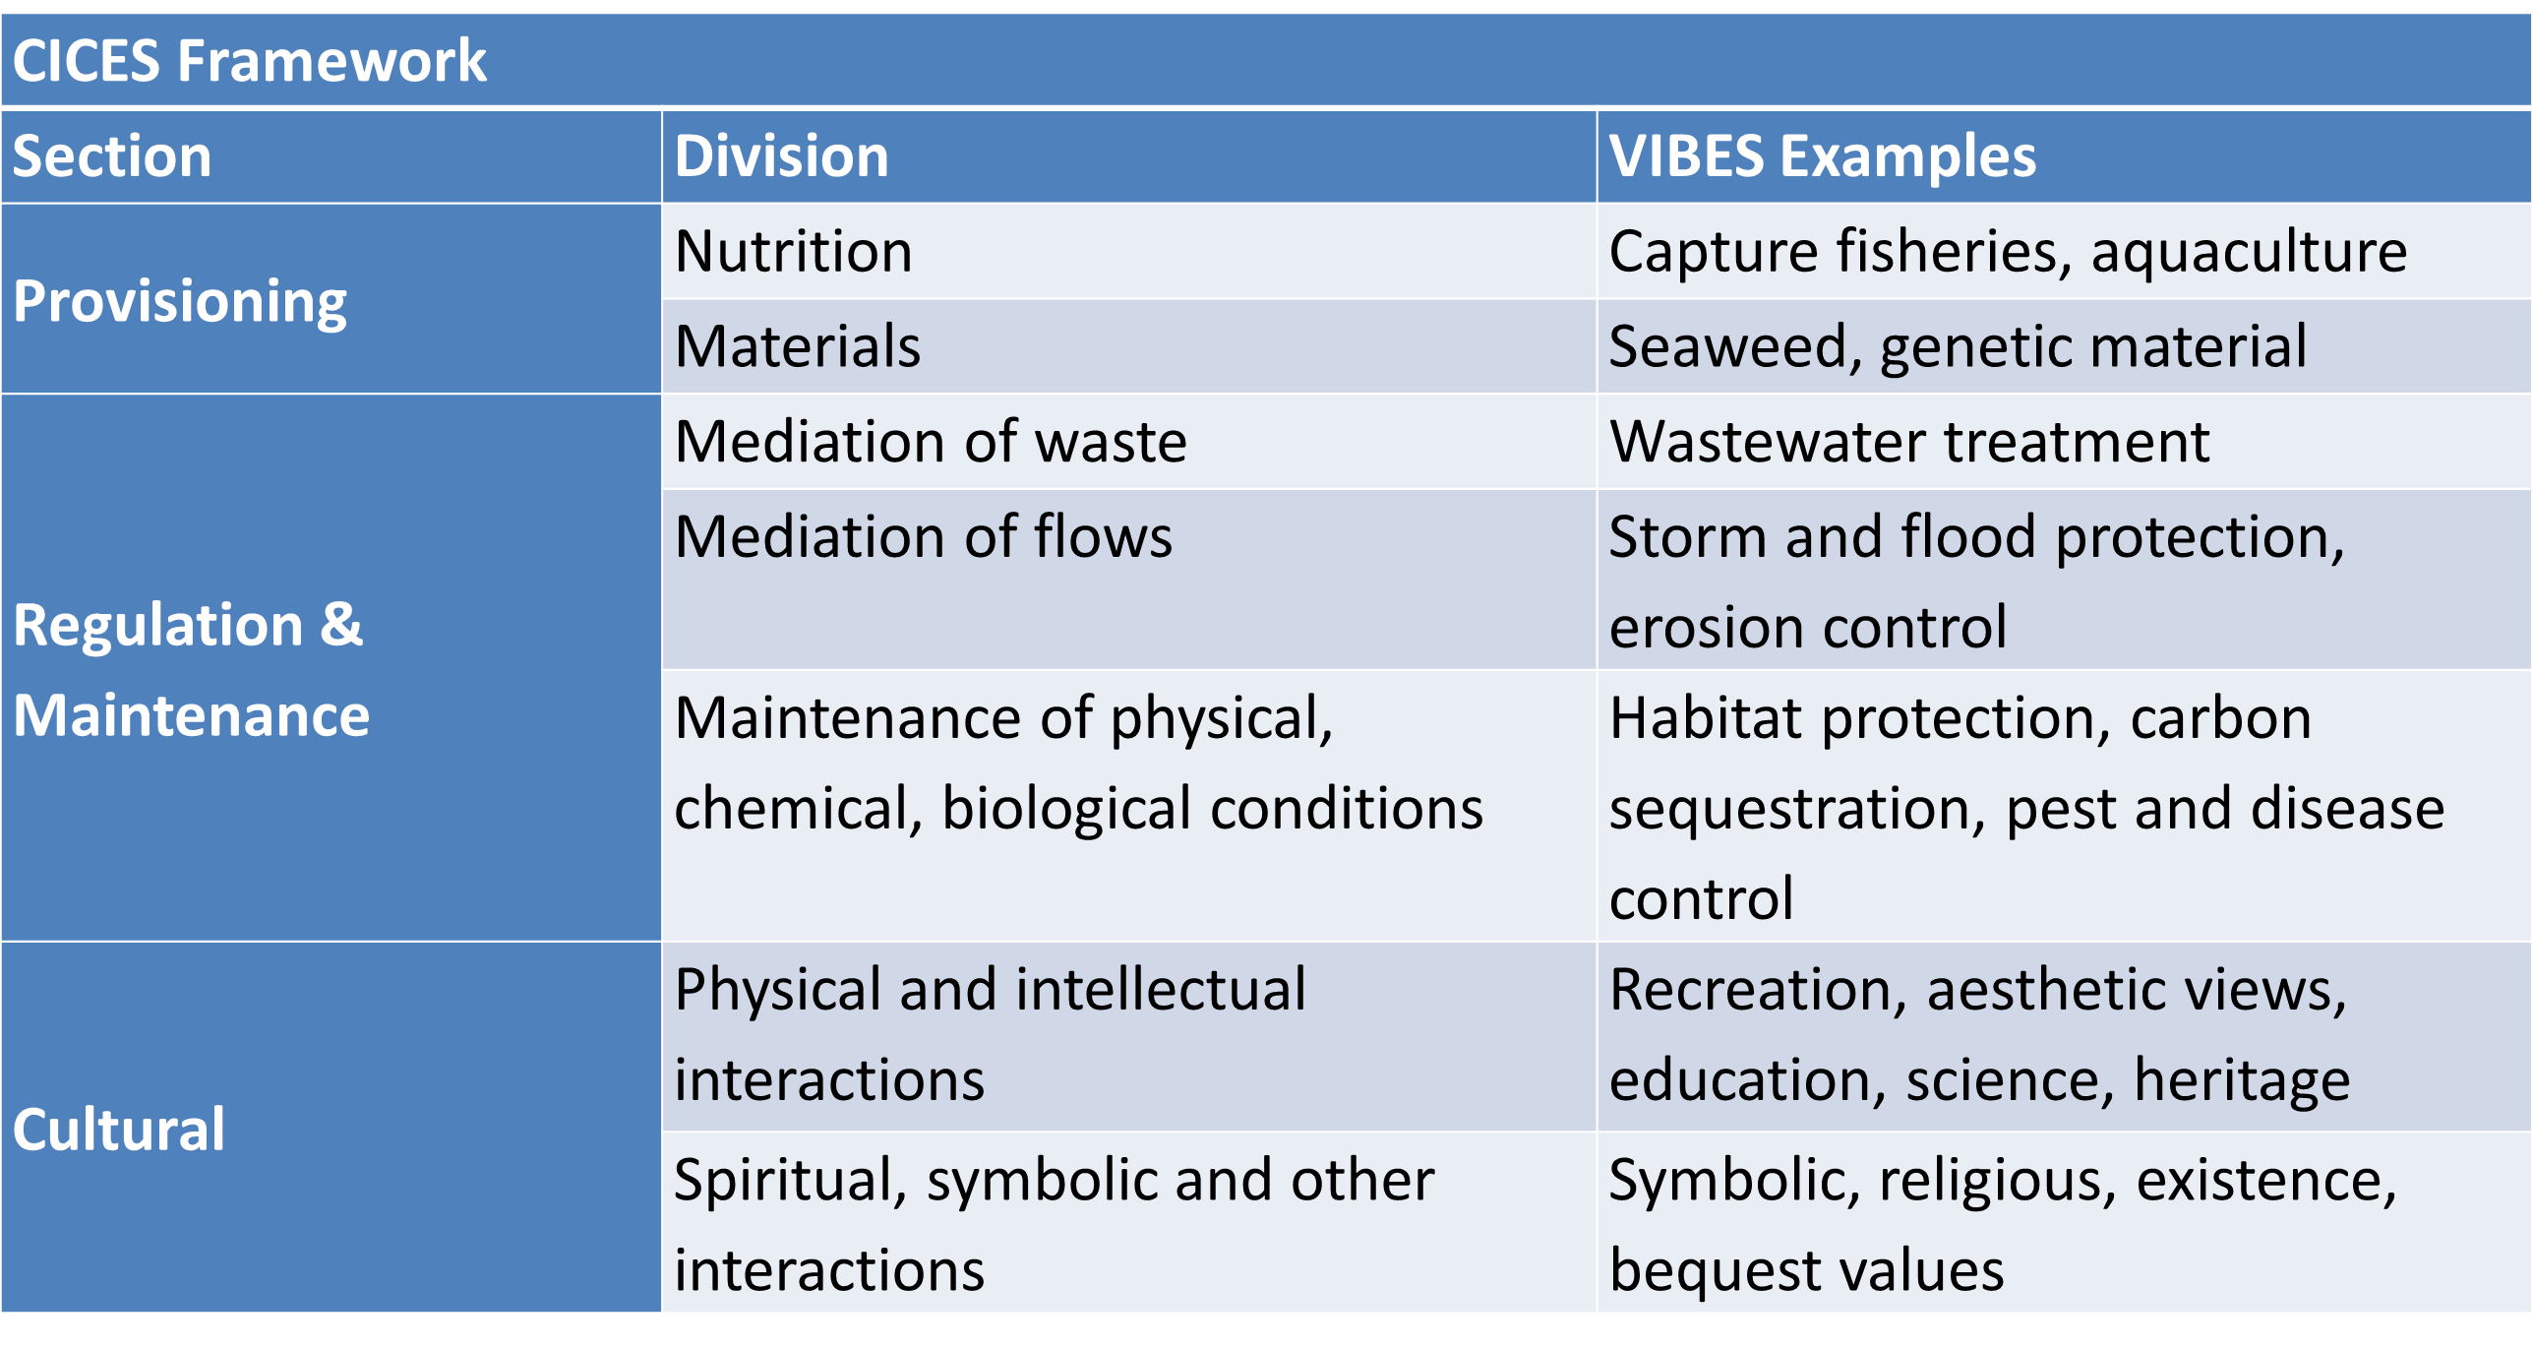
Common International Classification of Ecosystem Services (CICES) framework

Slide 11
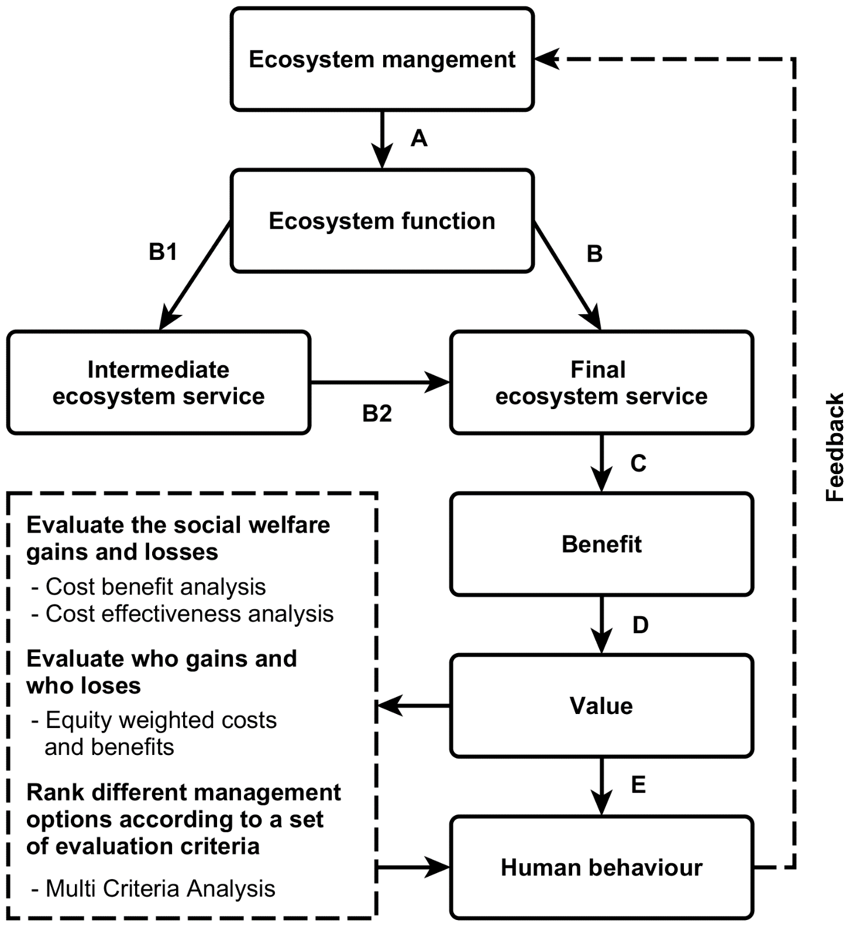
From ecosystem to welfare benefits.
Simple Conceptual Framework
(Hanley et al. 2016)

Slide 12
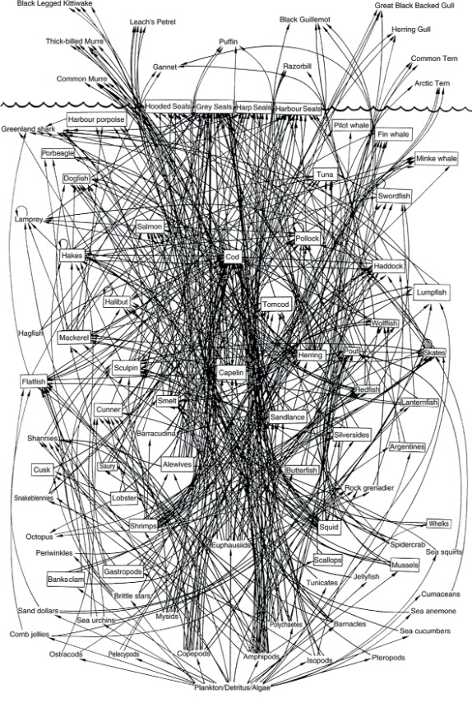
Most important problem(s)
The functioning of many marine ecosystems is still poorly understood.
This makes it difficult to
estimate impacts of existing policies
quantify impacts of measures
perform CBA in quantitative terms, let alone in monetary ones
Not to mention quantifying ecological targets (GES)
A simplified food web for the Northwest Atlantic (www.ifaw.org)

Slide 13
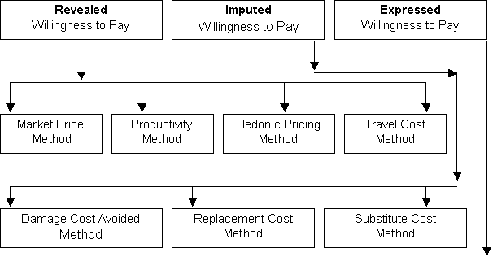
Valuation Methodologies
Contingent Valuation Method
Choice Experiments

Slide 14
Valuation Methodologies
Contingent Valuation Method
Choice Experiments

Slide 15
VIBES: Valuing Irish Blue Ecosystem Services
Ecosystem Service | CICES Classification |  | Quantity of ES | Value of ES
Off shore capture fisheries | Wild Animals |  | 449,848 tonnes | €405,991,000
Inshore capture fisheries | Wild Animals |  | 17,102 tonnes | €43,453,690
Aquaculture | Animals - Aquaculture |  | 35,627 tonnes | €128,711,470
Plants and algae | Plants & Algae from Aquaculture |  | 29,500 tonnes | €3,914,000
Water for non-drinking purposes | Surface water for non-drinking purposes |  | 1,019,692,399m³
Urban wastewater discharges | Mediation of waste |  | 14,465,519 kg organic waste | €983,655
 |  |  | 6,207,986 kg nitrogen | €191,268,048
 |  |  | 1,276,828 kg phosphorous | €119,102,515
Habitat protection | Lifecycle and habitat |  | 773,333 ha of CME inclusive SACs
Storm protection | Moderation of flows |  | c. 350km protected by saltmarsh
Carbon sequestration | Climate regulation |  | c. 47,000,000 tCO2 sequestered | €940,000,000

Slide 16
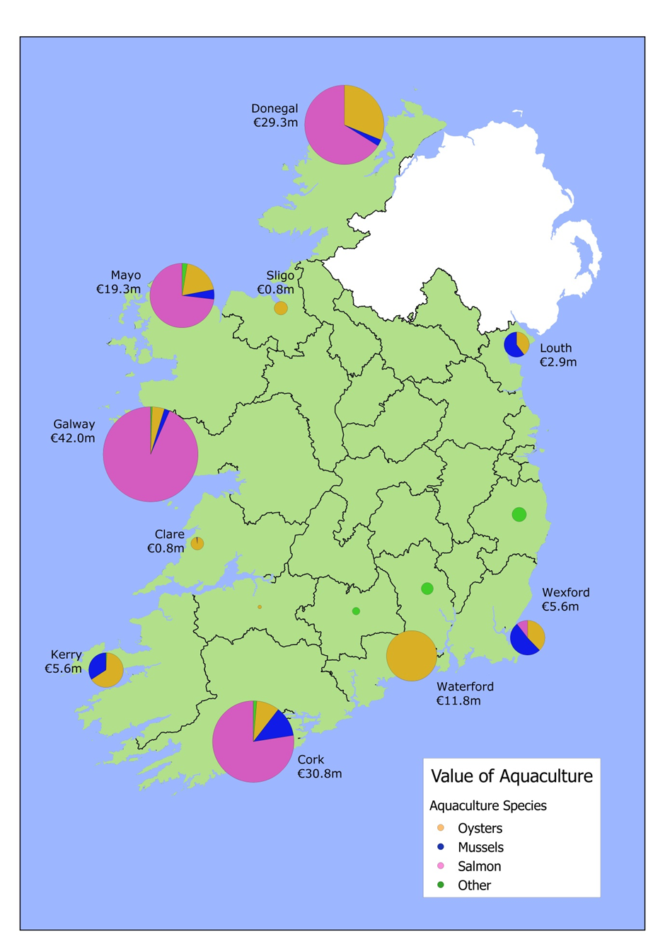
Provisioning Marine Ecosystem Services
Value of Irish aquaculture activity by county
Ecosystem Service | CICES Classification | Quantity | Value (€’000)
Off shore capture fisheries | Wild Animals | 469,735t | €472,542
Inshore capture fisheries | Wild Animals | 14,421 t | €42,113
Aquaculture | Animals - Aquaculture | 39,725 t | €148,769
Algae/ Seaweed harvesting | Wild Plants & Algae/ Plants | 29,500 t | €3,914
Water for non-drinking | Surface water non-drinking | 1,189,493,326 m³
Values based on market prices (sector turnover)

Slide 17
Regulating Marine Ecosystem Services
Waste Services: The shadow prices of Hernandez-Sancho et al. (2010) used as estimate of cost avoided by not having to bring the discharged water from water treatment services up to full re-use quality
Coastal Defence: Replacement cost approach
The value of the carbon dioxide removed is based on the Irish carbon tax of €20 per tonne of CO2 equivalent.
Ecosystem Service | CICES Classification | Quantity | Value (€’000)
Waste services | Mediation of waste, toxics and other nuisances | 9,350,642 kg organic waste | €316,767
 |  | 6,834,783 kg nitrogen
 |  | 1,118,739 kg phosphorous
Coastal defence | Mediation of flows | 179km of coastline protected by saltmarsh | €11,500
Lifecycle and habitat services | habitat protection | 773,333 ha protected through SAC’s
Climate regulation | Atmospheric composition | 42,743,000 tonnes CO2 absorbed | €854,700
Ecosystem | Irish area (ha) | Carbon absorption (tCO₂/ha)¹
Saltmarsh | 5,179 | 5.2 (2.4, 8.0)
Sand dunes | 12,013 | 2.2 (1.3, 3.1)
Estuaries | 80,680 | -20.8 (-0.9 - -32.4)
Coastal waters and bays | 1,314,374 | 0.4 (0.0 - 1.0)
Offshore waters | 87,685,626 | 0.5 (0.35 - 0.7)

Slide 18
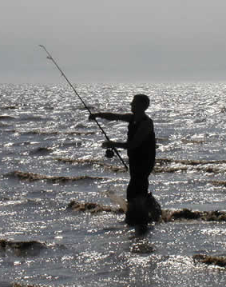
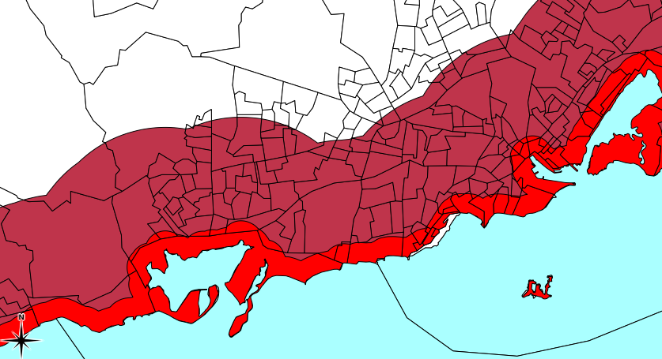
Cultural Marine Ecosystem Services
Ecosystem Service | CICES Classification | Quantity | Value (€’000)
Recreational services | Physical interactions | 96 million marine recreation trips per year | €1,683,590
Scientific and educational | Scientific & educational | Marine education and training fees | €11,500
Aesthetic services | Aesthetic | Flow value of coastal location of housing | €68,000
Recreation: Primary studies and Benefit transfer
Aesthetic: Hedonic Modelling

Slide 19
Conclusions
Factoring marine ecosystem service values into ocean economy account frameworks may help to ensure a more sustainable “blue economy”.
The application of ecosystem services assessment at a smaller spatial scale may help to improve knowledge in the planning process whether it be a local area plan or a one off development.
While valuation of ecosystem service values should not be the sole determinant of a decision, their inclusion in national accounts and impact assessments should contribute to a more explicit and transparent decision making process.

