Slide 1
Blue economy in the Black Sea Panel 2a: Save the sea
Jaroslav Slobodnik
EMBLAS-II Project Team Leader
15 September 2017, Batumi, Georgia

Slide 2
Project overview
Beneficiary countries: Georgia, Russian Federation, Ukraine
Observers: BG, RO, TK
Duration: April 2014 – May 2018 (42+8 months)
Budget: EUR 2,723,800 (EC 2,5 mil.; DG NEAR; In-kind support by EC JRC)
Implemented by: UNDP Istanbul Regional Hub (with UNDP COs)
Partners
GE – NEA, TSU
RF – SOI, SIO-RA, SRC
UA – UKRSCES, IMB, ONU
BSC PS
Target groups
GE – MENRP; RF – MNRE; UA - MENR

Slide 3
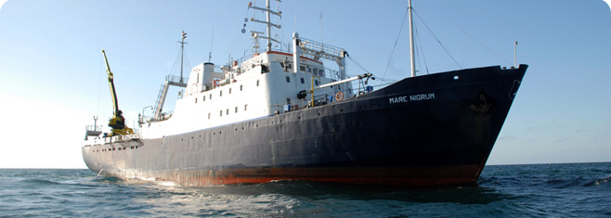
Project objectives
Overall objective:
To improve protection of the Black Sea environment
Specific objectives:
To improve availability and quality of Black Sea environmental data in line with the MSFD, WFD-coastal waters and Black Sea Strategic Action Plan (2009) needs
To improve partner countries’ ability to perform marine environmental monitoring along MSFD, WFD principles, taking into account the Black Sea Diagnostic Report II

Slide 4
Results http://emblasproject.org/
Large scale and national Black Sea surveys in 2016 and 2017
Harmonised sampling and reporting methodologies according to the MSFD and WFD
Delineation of coastal water bodies (WFD) as a basis for establishment of the national monitoring schemes
Hugely increased public awareness
Support to Initial Assessment by UA and GE – 8 out of 11 descriptors and BS SoE
For the first time in the region:
Development and testing of the environmental (MSFD), ecological and chemical (WFD) status classification schemes
Data collected in harmonised formats – Black Sea Water Quality Database
Systematic monitoring of marine litter
Bacterial DNA
eDNA (phytoplankton, zooplankton, macrozoobenthos, fish, macrophytes)
Microplastics
For the first time globally:
Holistic target (>2000) and non-target (>14000) screening of chemical pollutants in water, biota and sediment samples (support to REACH)

Slide 5
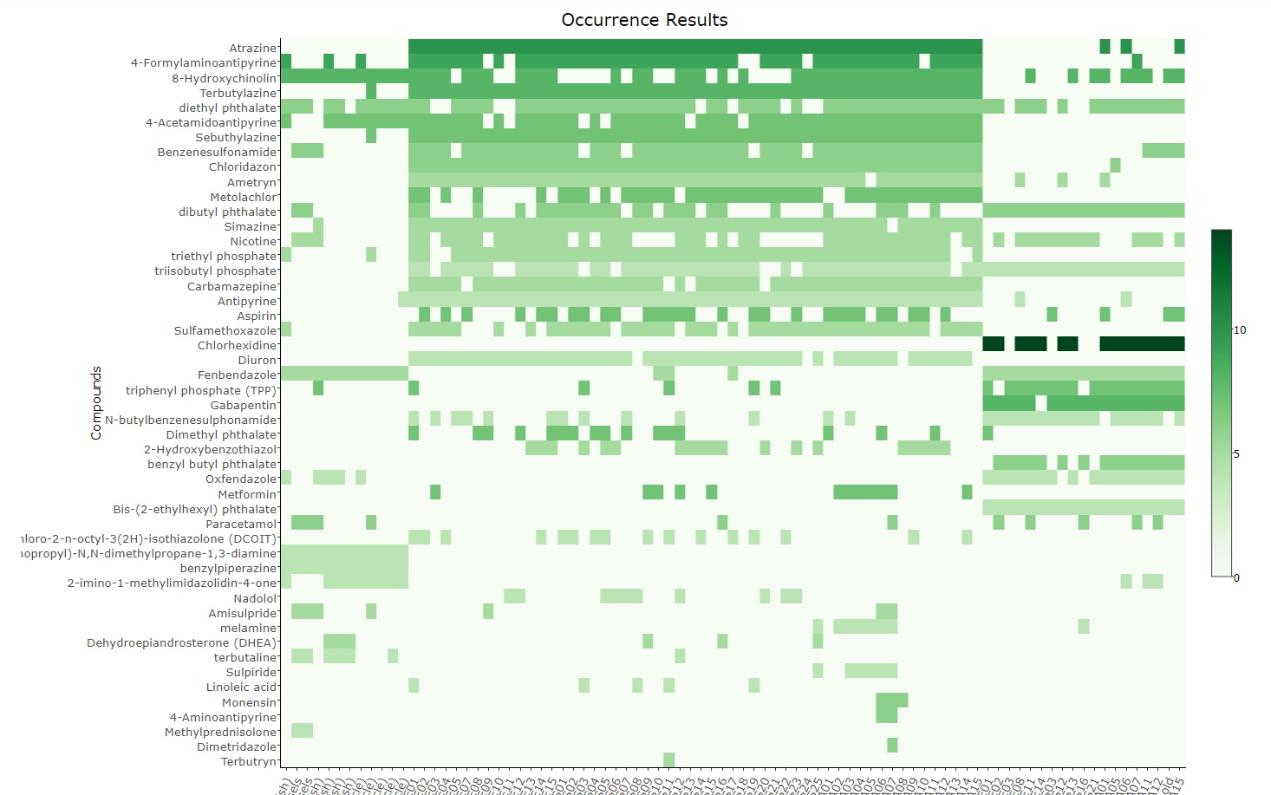
Screening of REACH compounds in samples from the Black Sea
Interactive heatmap available at http://norman-data.eu/NORMAN-REACH

Slide 6
Take home messages
Capacity building (sampling and laboratory analyses equipment, vessels, trainings) in GE, UA, RF (but also RO, BG) BADLY NEEDED
Regional scheme of sharing the data in harmonised formats and harmonised/sunchronised monitoring schemes coordinated by the BSC essential for any follow up decision making (Programme of Measures)
Establishment of regional BS status assessment schemes needed at the BSC level – impact on fact-based decision making and follow up investments

Slide 7
